Slide 1

Extractors for Samplable Distributions with Polynomially Small Min-Entropy
Ronen Shaltiel, University of Haifa.
In memory of Luca Trevisan (1971-2024).

Slide 2


Randomness extractors (motivation)
Daddy, how do computers get random bits?
Do we have to tell that same old story again.
“weak source of randomness”
coins may be biased and correlated
extractor
can be used to run randomized algorithms
“close to uniform output”
Notes:
This is the original joke.
I would say something like: “Any talk on extractors must start with a motivation on how computers get random bits”.
Flash the slide and move on (don’t explain it as it may ruin the joke)…

Slide 3
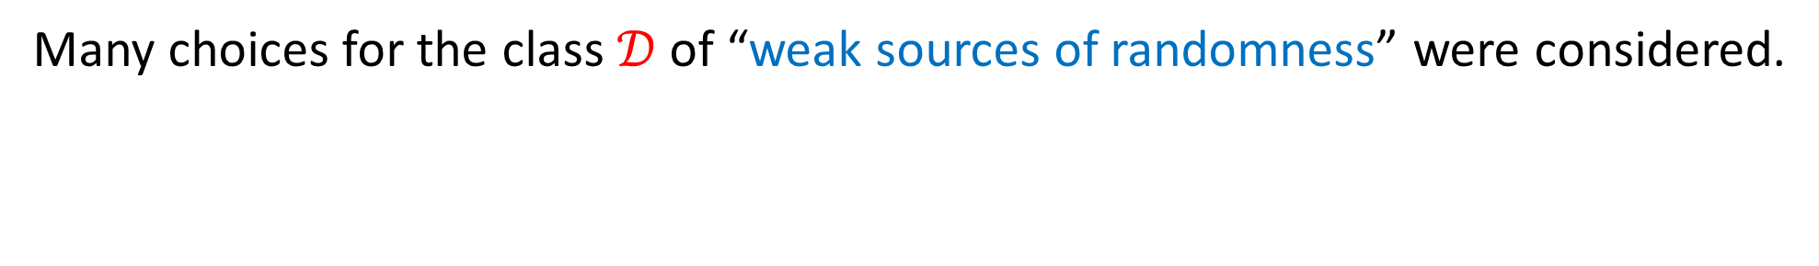
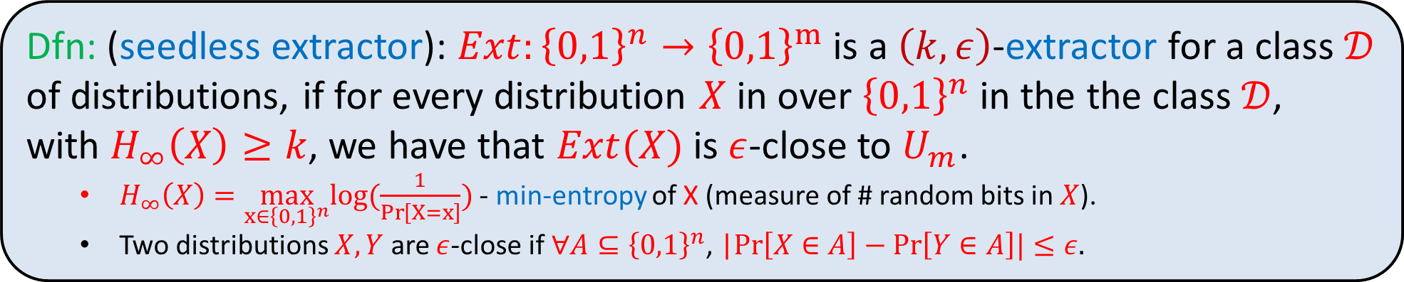
Seedless (Deterministic) Extractors
Dfn: (seedless extractor): $Ext:{\left\{0,1\right\}}^{n}→{\left\{0,1\right\}}^{m}$ is a $\left(k,ε\right)$-extractor for a class $𝒟$ of distributions, if for every distribution $X$ in over ${\left\{0,1\right\}}^{n}$ in the the class $𝒟$, with $H_{∞}\left(X\right)≥k$, we have that $Ext(X)$ is $ε$-close to $U_{m}$.
  $H_{∞}\left(X\right)=\max_{x∈{\left\{0,1\right\}}^{n}}log(\frac{1}{\operatorname{Pr}\left[X=x\right]})$ - min-entropy of X (measure of # random bits in $X$).
  Two distributions $X,Y$ are $ε$-close if $∀A⊆{\left\{0,1\right\}}^{n}$, |$Pr\left[X∈A\right]−Pr\left[Y∈A\right]|≤ε.$
“weak source of randomness”
seedless
extractor
“close to uniform output”
Many choices for the class $𝒟$ of “weak sources of randomness” were considered.

Slide 4
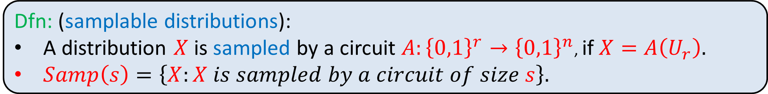
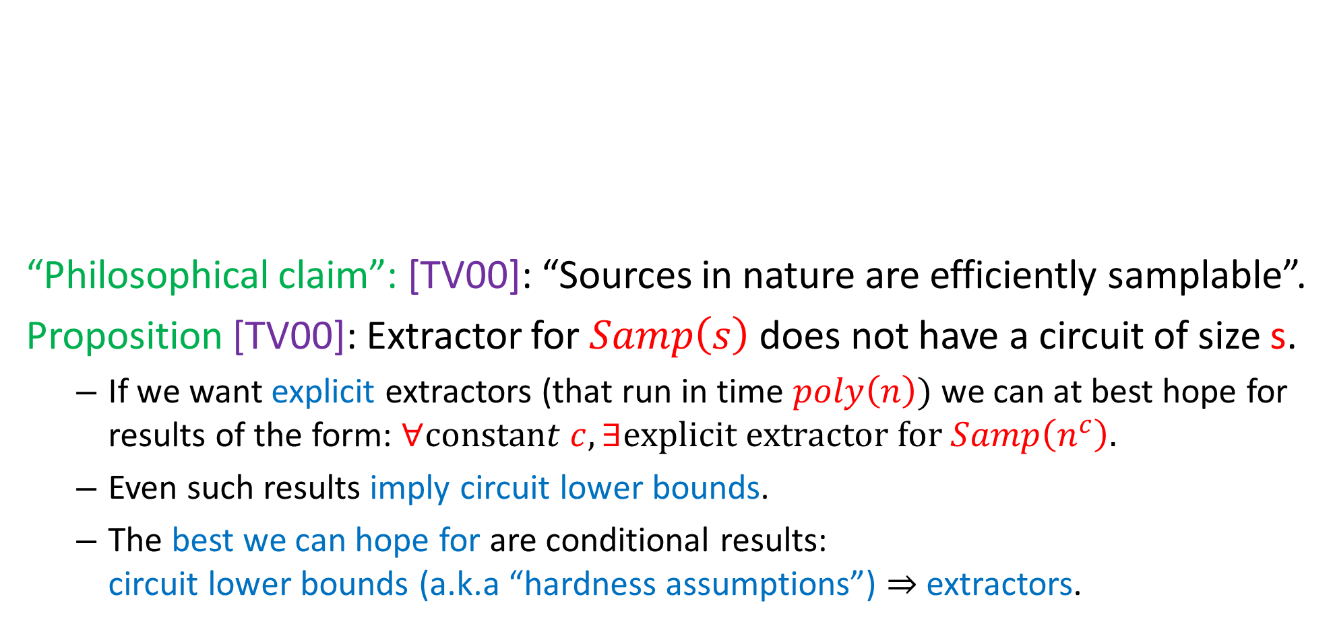
Extractors for Samplable Distributions [TV00]
“Philosophical claim”: [TV00]: “Sources in nature are efficiently samplable”.
Proposition [TV00]: Extractor for $Samp\left(s\right)$ does not have a circuit of size s.
  If we want explicit extractors (that run in time $poly\left(n\right))$ we can at best hope for results of the form: $∀constant c, ∃explicit extractor for Samp\left(n^{c}\right).$
  Even such results imply circuit lower bounds.
  The best we can hope for are conditional results: circuit lower bounds (a.k.a “hardness assumptions”) $⇒$extractors.
Dfn: (samplable distributions):
A distribution $X$ is sampled by a circuit $A:{\left\{0,1\right\}}^{r}→{\left\{0,1\right\}}^{n}$, if $X=A\left(U_{r}\right).$
$Samp\left(s\right)=\left\{X:X is sampled by a circuit of size s\right\}.$

Slide 5
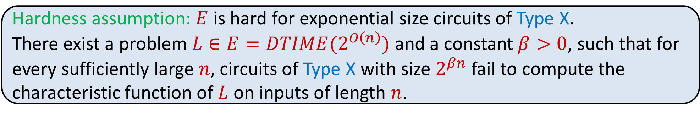
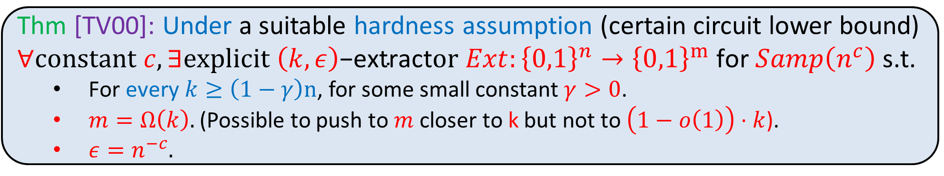
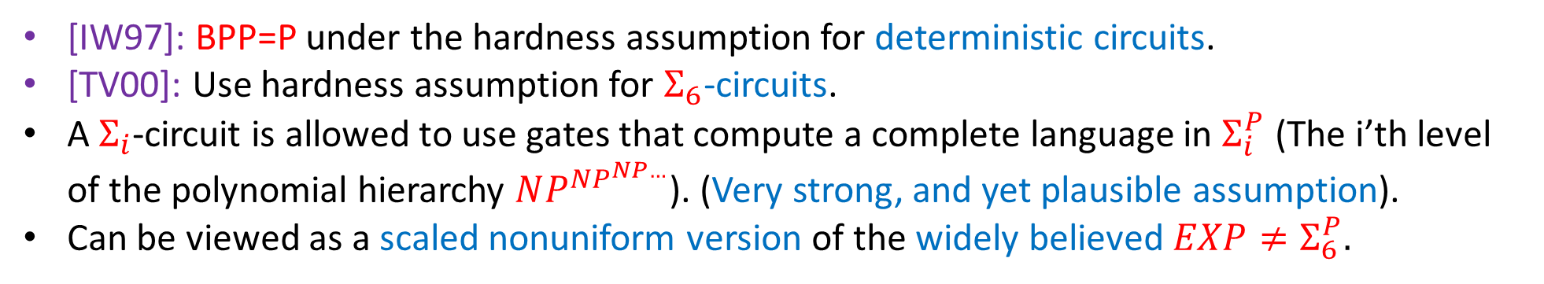
Extractors for Samplable Distributions [TV00]
Thm [TV00]: Under a suitable hardness assumption (certain circuit lower bound) $∀constant c, ∃explicit \left(k,ε\right)\text{−}\text{extract}or Ext:{\left\{0,1\right\}}^{n}→{\left\{0,1\right\}}^{m} \text{for} Samp\left(n^{c}\right)$ s.t.
  $\text{For} \text{every} k≥\left(1−γ\right)n$, for some small constant $γ>0$.
  $m=Ω\left(k\right).$(Possible to push to $m$ closer to k but not to $\left(1−o\left(1\right)\right)⋅k$).
  $ε=n^{−c}.$
Hardness assumption: $E$ is hard for exponential size circuits of Type X.
There exist a problem $L∈E=DTIME(2^{O\left(n\right)})$ and a constant $β>0$, such that for every sufficiently large $n$, circuits of Type X with size $2^{βn}$ fail to compute the characteristic function of $L$ on inputs of length $n$.
[IW97]: BPP=P under the hardness assumption for deterministic circuits.
[TV00]: Use hardness assumption for $Σ_{6}$-circuits.
A $Σ_{i}$-circuit is allowed to use gates that compute a complete language in $Σ_{i}^{P}$ (The i’th level of the polynomial hierarchy $NP^{NP^{NP…}}$). (Very strong, and yet plausible assumption).
Can be viewed as a scaled nonuniform version of the widely believed $EXP≠Σ_{6}^{P}.$

Slide 6
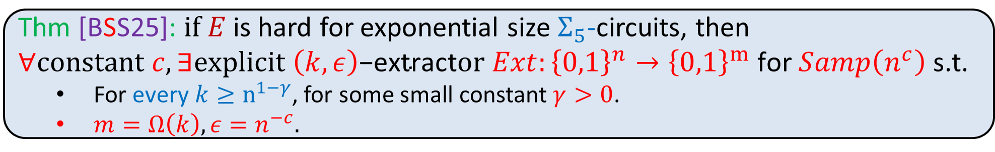
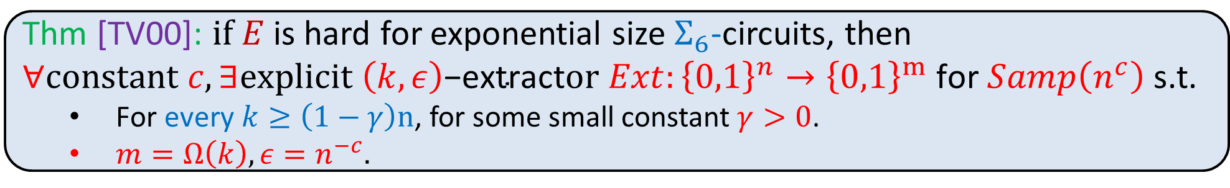
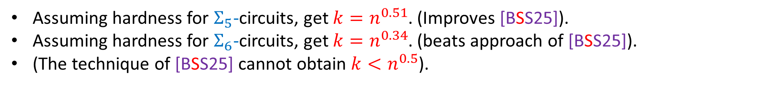
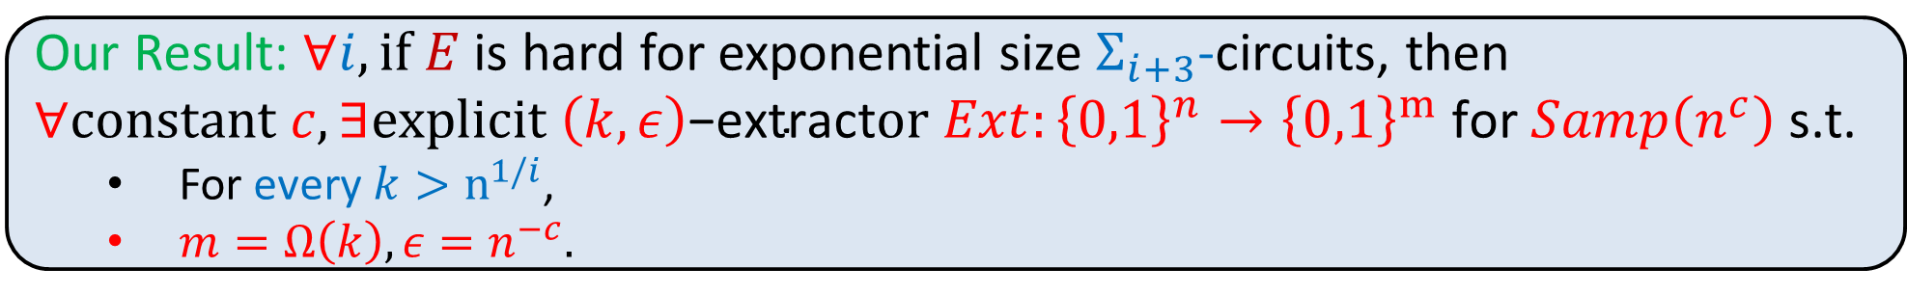
Extractors for samplable distributions with lower min-entropy
Thm [TV00]: $if E$ is hard for exponential size $Σ_{6}$-circuits, then $∀constant c, ∃explicit \left(k,ε\right)\text{−}\text{extract}or Ext:{\left\{0,1\right\}}^{n}→{\left\{0,1\right\}}^{m} \text{for} Samp\left(n^{c}\right)$ s.t.
  $\text{For} \text{every} k≥\left(1−γ\right)n$, for some small constant $γ>0$.
  $m=Ω\left(k\right), ε=n^{−c}.$
Thm [BSS25]: $if E$ is hard for exponential size $Σ_{5}$-circuits, then $∀constant c, ∃explicit \left(k,ε\right)\text{−}\text{extract}or Ext:{\left\{0,1\right\}}^{n}→{\left\{0,1\right\}}^{m} \text{for} Samp\left(n^{c}\right)$ s.t.
  For every $k≥n^{1−γ}$, for some small constant $γ>0$.
  $m=Ω\left(k\right), ε=n^{−c}.$
Our Result: $∀i, if E$ is hard for exponential size $Σ_{i+3}$-circuits, then $∀constant c, ∃explicit \left(k,ε\right)\text{−}\text{extract}or Ext:{\left\{0,1\right\}}^{n}→{\left\{0,1\right\}}^{m} \text{for} Samp\left(n^{c}\right)$ s.t.
  For every $k>n^{1/i}$,
  $m=Ω\left(k\right), ε=n^{−c}.$
Assuming hardness for $Σ_{5}$-circuits, get $k=n^{0.51}$. (Improves [BSS25]).
Assuming hardness for $Σ_{6}$-circuits, get $k=n^{0.34}$. (beats approach of [BSS25]).
(The technique of [BSS25] cannot obtain $k<n^{0.5}$).

Slide 7




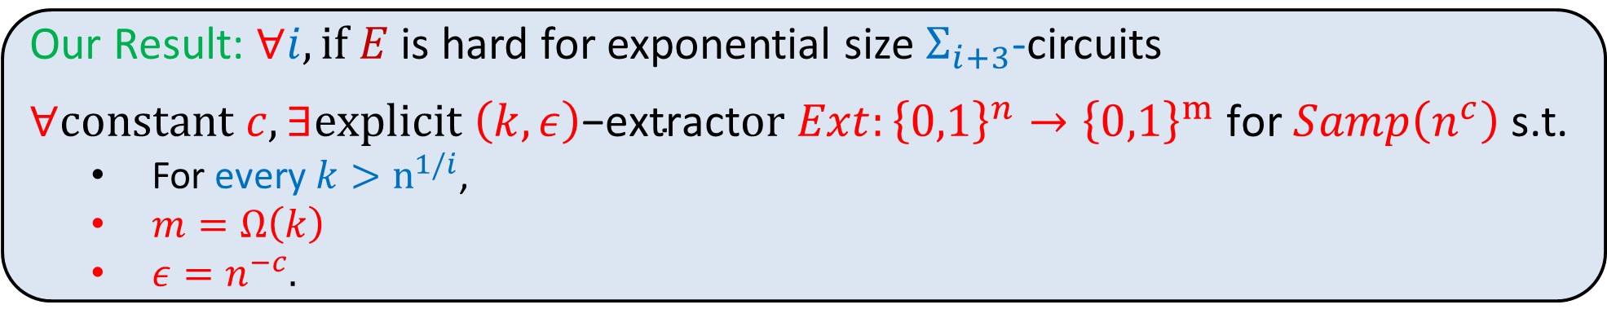
Multiplicative extractor for samplable distributions
[TV00] motivation: “selecting keys for crypto protocols”. Requires $ε=n^{−ω(1)}.$
[AASY15]: “Black-box proofs” cannot achieve explicit extractors with $ε=n^{−ω(1)}.$
[AASY15,S25]: Introduced “multiplicative extractors” to bypass this problem.
Suffices for application. Define $A=${Adversary steals honest party’s money}, Even for $ε=1$, we have: $\operatorname{Pr}\left[U_{m}∈A\right]=n^{−ω\left(1\right)}⇒\operatorname{Pr}\left[Z∈A\right]=n^{−ω\left(1\right)}$.
[AASY15]: Made [TV00] multiplicative. Not known for [BSS25].
Dfn [AASY15]: $Ext$ is multiplicative if output $Z=Ext\left(X\right)$ satisfies $∀z∈{\left\{0,1\right\}}^{m}$, $\operatorname{Pr}\left[Z=z\right]≤\left(1+ε\right)⋅2^{−m}⇒∀A⊆{\left\{0,1\right\}}^{m}$, $\operatorname{Pr}\left[Z∈A\right]≤\left(1+ε\right)⋅\operatorname{Pr}\left[U_{m}∈A\right]$
$\text{ , }\text{for}$e=O(1)
Our Result: $∀i, if E$ is hard for exponential size $Σ_{i+3}$-circuits
$∀constant c, ∃explicit \left(k,ε\right)\text{−}\text{extract}or Ext:{\left\{0,1\right\}}^{n}→{\left\{0,1\right\}}^{m} \text{for} Samp\left(n^{c}\right)$ s.t.
  For every $k>n^{1/i}$,
  $m=Ω\left(k\right)$
  $ε=n^{−c}.$
$$e$$
multiplicative
$k^{Ω(1)}$

Slide 8

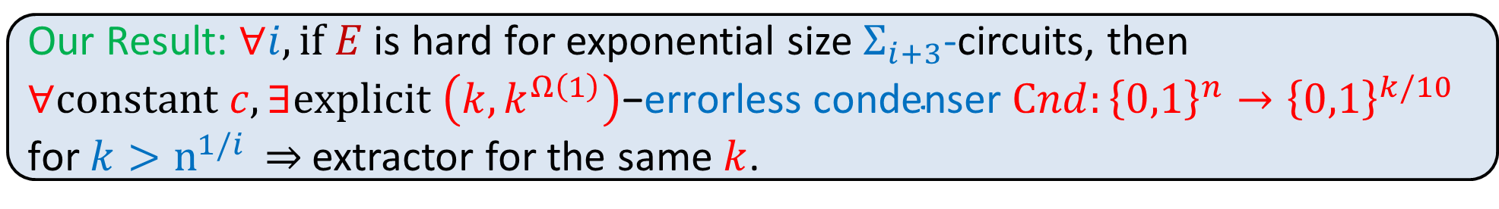
High level structure of proof
[BSS25]: Errorless Condensers $⇒$ Extractors
Idea: Don’t construct condensers by a separate argument (as done in BSS25]) use framework of [TV00,BSS25] (designed for extractors) to construct condensers.
Combine with win-win analysis and ideas from [SSZ95,T96,RSW01]. Adapted to the computational setting of samplable distributions.
Dfn: (errorless condenser): $Cnd:{\left\{0,1\right\}}^{n}→{\left\{0,1\right\}}^{n^{′}}$is a $\left(k,k′\right)$-errorless condenser if $∀X∈Samp(n^{c})$ over ${\left\{0,1\right\}}^{n}$ with $H_{∞}\left(X\right)≥k$, $H_{∞}\left(Cnd\left(X\right)\right)≥k′$
Thm: [BSS25] $∀k,$a $\left(k,k^{Ω(1)}\right)$ - errorless condenser $Cnd:{\left\{0,1\right\}}^{n}→{\left\{0,1\right\}}^{k/10}$ implies an extractor for the same $k$.
Our Result: $∀i, if E$ is hard for exponential size $Σ_{i+3}$-circuits, then $∀constant c, ∃explicit \left(k,k^{Ω\left(1\right)}\right)\text{−}\text{errorless} \text{condenser}$ $Cnd:{\left\{0,1\right\}}^{n}→{\left\{0,1\right\}}^{k/10}$
$\text{for} k>n^{1/i}$ $⇒$ extractor for the same $k$.

Slide 9
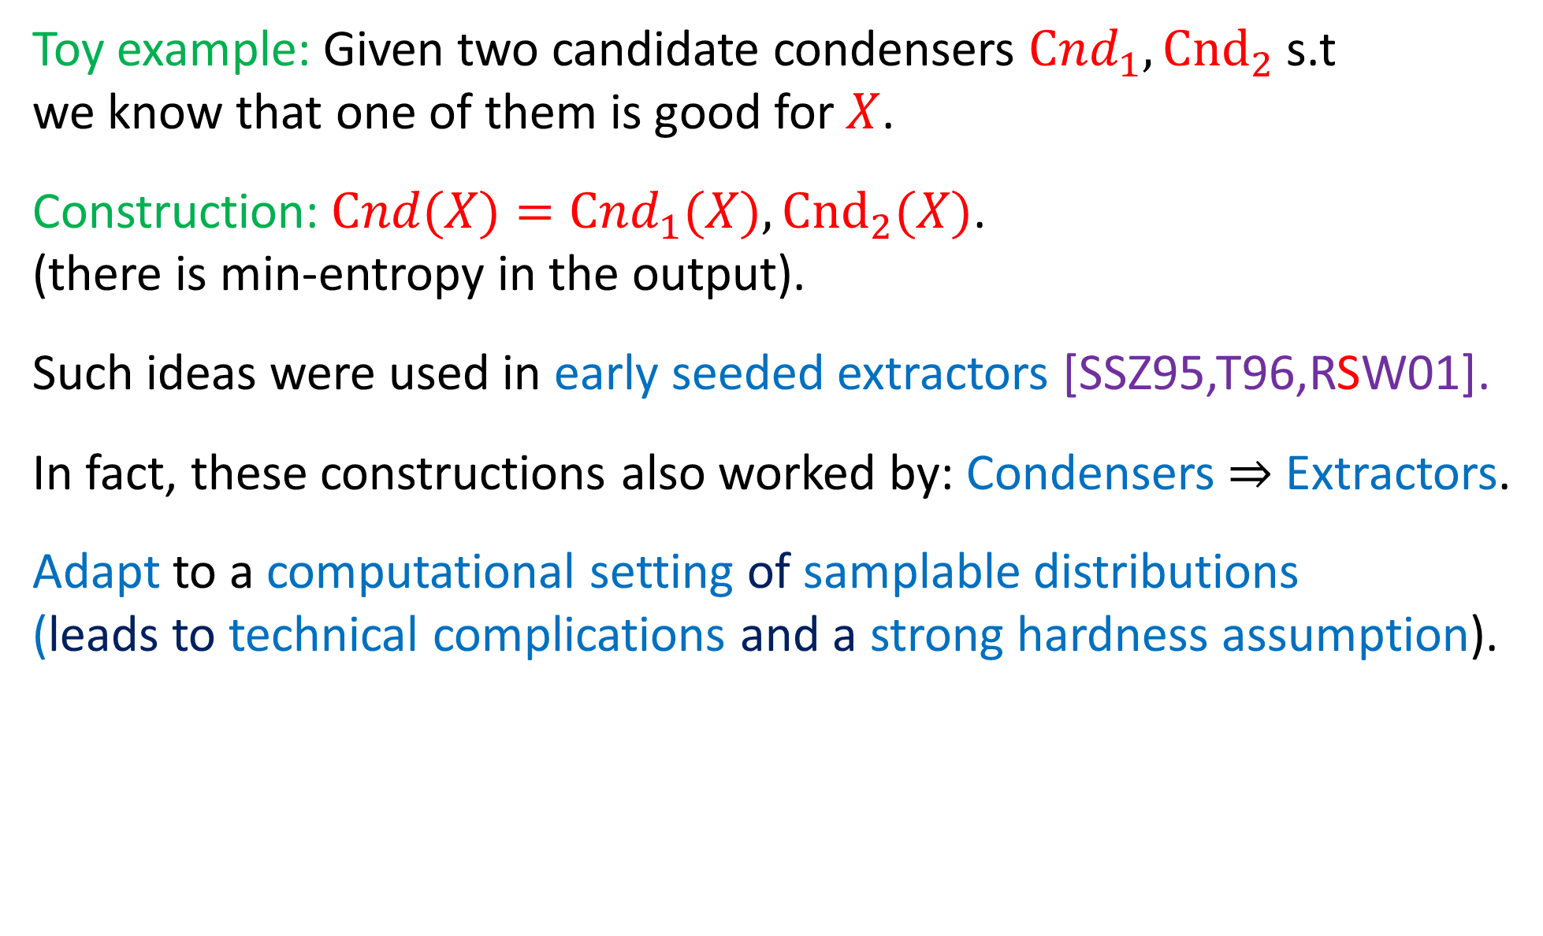
Win-win analysis a-la [SSZ95,T96,RSW01]
Toy example: Given two candidate condensers $Cnd_{1},{Cnd}_{2}$ s.t we know that one of them is good for $X$.
Construction:$Cnd(X)=Cnd_{1}(X),{Cnd}_{2}(X)$. (there is min-entropy in the output).
Such ideas were used in early seeded extractors [SSZ95,T96,RSW01].
In fact, these constructions also worked by: Condensers $⇒$ Extractors.
Adapt to a computational setting of samplable distributions (leads to technical complications and a strong hardness assumption).

Slide 10
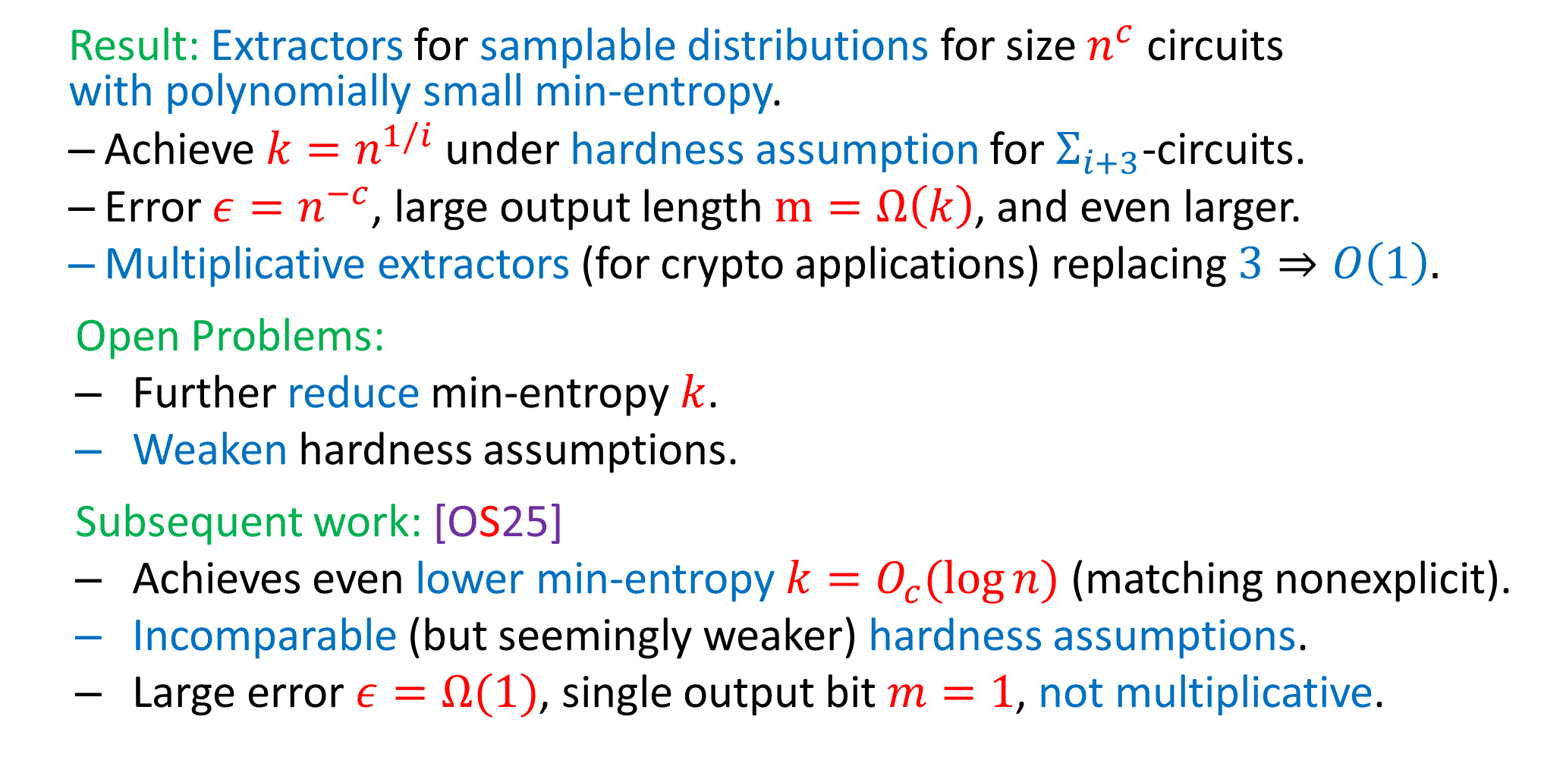
Conclusion and Open Problems
  Result: Extractors for samplable distributions for size $n^{c}$ circuits with polynomially small min-entropy.
  Achieve $k=n^{1/i}$ under hardness assumption for $Σ_{i+3}$-circuits.
  Error $ε=n^{−c}$, large output length $m=Ω\left(k\right)$, and even larger.
  Multiplicative extractors (for crypto applications) replacing $3⇒O\left(1\right).$
  Open Problems:
  Further reduce min-entropy $k$.
  Weaken hardness assumptions.
  Subsequent work: [OS25]
  Achieves even lower min-entropy $k=O_{c}(\log{n)}$(matching nonexplicit).
  Incomparable (but seemingly weaker) hardness assumptions.
  Large error $ε=Ω(1)$, single output bit $m=1$, not multiplicative.

Slide 11
That’s it…
Thank You…

