Slide 1

(Multiplicative) Extractors for Samplable Distributions
Ronen Shaltiel, University of Haifa.
In memory of Luca Trevisan (1971-2024).

Slide 2
Randomness extractors (motivation)
Daddy, how do computers get random bits?
Do we have to tell that same old story again.
Notes:
This is the original joke.
I would say something like: “Any talk on extractors must start with a motivation on how computers get random bits”.
Flash the slide and move on (don’t explain it as it may ruin the joke)…

Slide 3


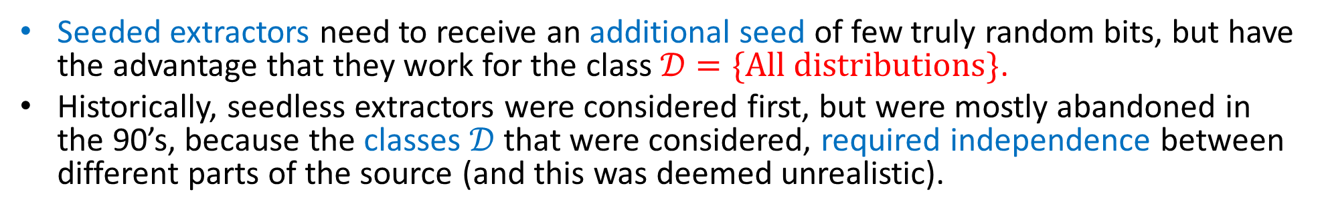
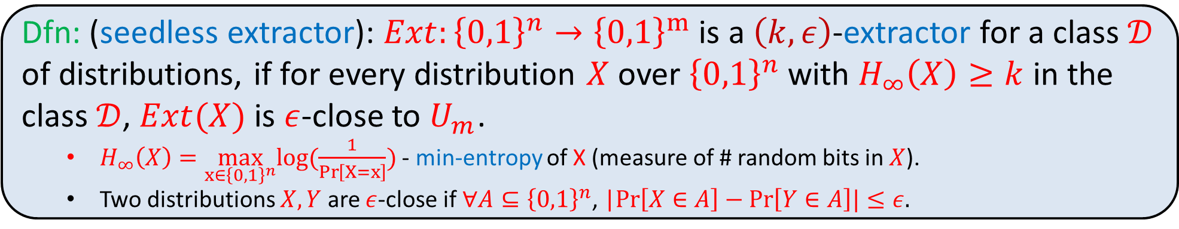
Seedless (Deterministic) Extractors
Dfn: (seedless extractor): $Ext:{\left\{0,1\right\}}^{n}→{\left\{0,1\right\}}^{m}$ is a $\left(k,ε\right)$-extractor for a class $𝒟$ of distributions, if for every distribution $X$ over ${\left\{0,1\right\}}^{n}$ with $H_{∞}\left(X\right)≥k$ in the class $𝒟$, $Ext(X)$ is $ε$-close to $U_{m}$.
$H_{∞}\left(X\right)=\max_{x∈{\left\{0,1\right\}}^{n}}log(\frac{1}{\operatorname{Pr}\left[X=x\right]})$ - min-entropy of X (measure of # random bits in $X$).
Two distributions $X,Y$ are $ε$-close if $∀A⊆{\left\{0,1\right\}}^{n}$, |$Pr\left[X∈A\right]−Pr\left[Y∈A\right]|≤ε.$
“weak source of randomness”
“weak source of randomness”
seedless
extractor
seeded
extractor
seed
“close to uniform output”
“close to uniform output”
Seeded extractors need to receive an additional seed of few truly random bits, but have the advantage that they work for the class $𝒟=\{All distributions\}$.
Historically, seedless extractors were considered first, but were mostly abandoned in the 90’s, because the classes $𝒟$ that were considered, required independence between different parts of the source (and this was deemed unrealistic).

Slide 4
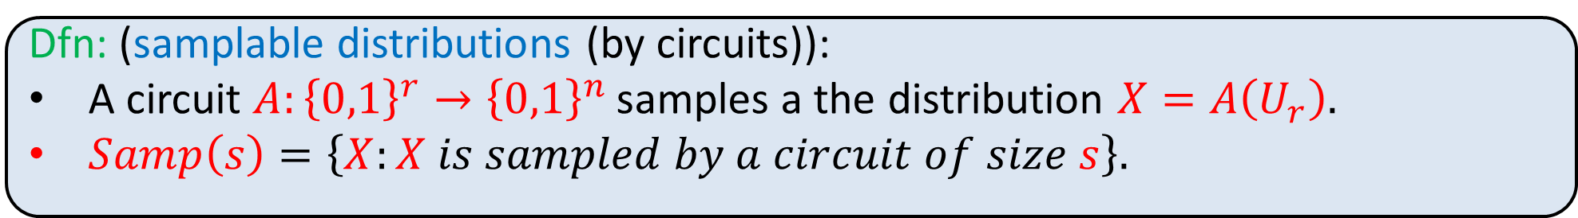
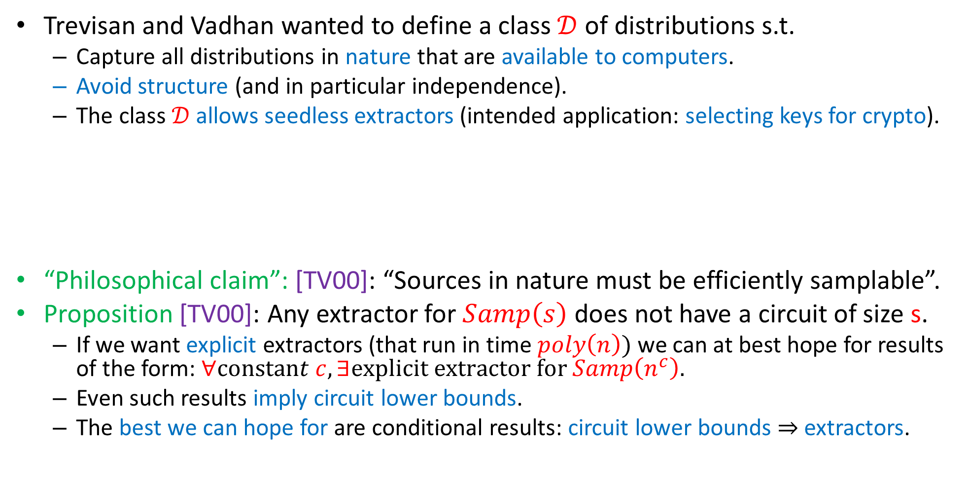
Extractors for Samplable Distributions [TV00]
Trevisan and Vadhan wanted to define a class $𝒟$ of distributions s.t.
Capture all distributions in nature that are available to computers.
Avoid structure (and in particular independence).
The class $𝒟$ allows seedless extractors (intended application: selecting keys for crypto).
“Philosophical claim”: [TV00]: “Sources in nature must be efficiently samplable”.
Proposition [TV00]: Any extractor for $Samp\left(s\right)$ does not have a circuit of size s.
If we want explicit extractors (that run in time $poly\left(n\right))$ we can at best hope for results of the form: $∀constant c, ∃explicit extractor for Samp\left(n^{c}\right).$
Even such results imply circuit lower bounds.
The best we can hope for are conditional results: circuit lower bounds $⇒$extractors.
Dfn: (samplable distributions (by circuits)):
A circuit $A:{\left\{0,1\right\}}^{r}→{\left\{0,1\right\}}^{n}$ samples a the distribution $X=A\left(U_{r}\right).$
$Samp\left(s\right)=\left\{X:X is sampled by a circuit of size s\right\}.$

Slide 5
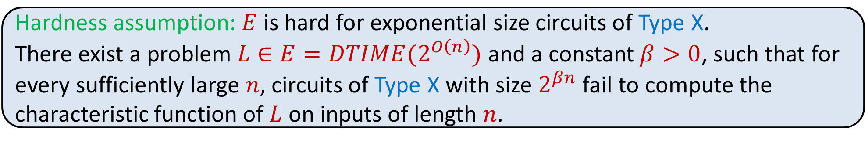
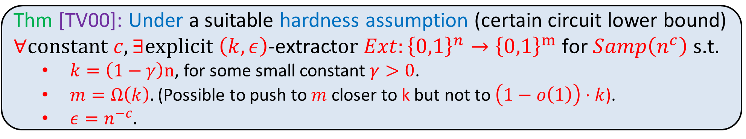
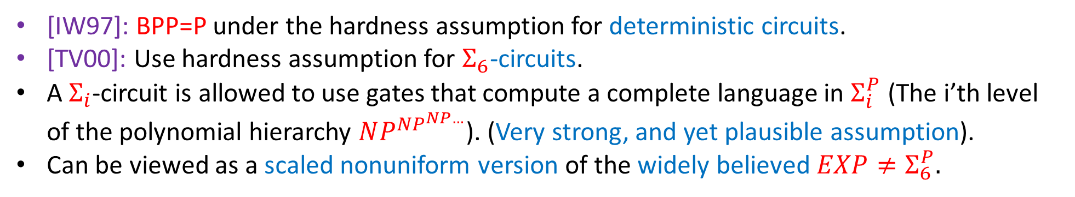
Extractors for Samplable Distributions [TV00]
Thm [TV00]: Under a suitable hardness assumption (certain circuit lower bound) $∀constant c, ∃explicit \left(k,ε\right)\text{−}\text{extract}or Ext:{\left\{0,1\right\}}^{n}→{\left\{0,1\right\}}^{m} \text{for} Samp\left(n^{c}\right)$ s.t.
$k=\left(1−γ\right)n$, for some small constant $γ>0$.
$m=Ω\left(k\right).$(Possible to push to $m$ closer to k but not to $\left(1−o\left(1\right)\right)⋅k$).
$ε=n^{−c}.$
Hardness assumption: $E$ is hard for exponential size circuits of Type X.
There exist a problem $L∈E=DTIME(2^{O\left(n\right)})$ and a constant $β>0$, such that for every sufficiently large $n$, circuits of Type X with size $2^{βn}$ fail to compute the characteristic function of $L$ on inputs of length $n$.
[IW97]: BPP=P under the hardness assumption for deterministic circuits.
[TV00]: Use hardness assumption for $Σ_{6}$-circuits.
A $Σ_{i}$-circuit is allowed to use gates that compute a complete language in $Σ_{i}^{P}$ (The i’th level of the polynomial hierarchy $NP^{NP^{NP…}}$). (Very strong, and yet plausible assumption).
Can be viewed as a scaled nonuniform version of the widely believed $EXP≠Σ_{6}^{P}.$

Slide 6
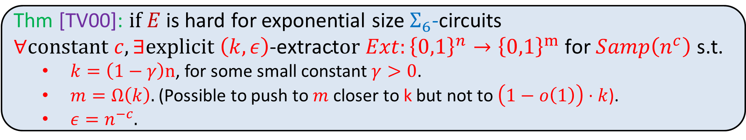
Extractors for Samplable Distributions [TV00]
Thm [TV00]: $if E$ is hard for exponential size $Σ_{6}$-circuits $∀constant c, ∃explicit \left(k,ε\right)\text{−}\text{extract}or Ext:{\left\{0,1\right\}}^{n}→{\left\{0,1\right\}}^{m} \text{for} Samp\left(n^{c}\right)$ s.t.
$k=\left(1−γ\right)n$, for some small constant $γ>0$.
$m=Ω\left(k\right).$(Possible to push to $m$ closer to k but not to $\left(1−o\left(1\right)\right)⋅k$).
$ε=n^{−c}.$
[BGDM23]: Same extractor; hardness assumption for nondeterministic circuits.
Same construction as [TV00], significantly more complicated proof.
Our Results:
A simpler proof of [BGDM23] (arguably simpler than [TV00]).
[BGDM23] also gets extractors for quantumly samplable distributions.
Partial justification for the necessity of hardness for nondeterministic circuits.
Our extractors are “multiplicative”.
Our extractor is a component in subsequent work [BSS25] which achieves lower min-entropy. (More on subsequent work at the end).
This hardness assumption was introduced in the framework of derandomizing AM, and is by now standard [AK02, KvM02, MV05, SU05, BOV07, GW02, GST03, SU06, SU09, Dru13, AASY15, BV17, AIKS16, HNY17, DMOZ22, BDL22, CT22, BGDM23, BSS24, SS24].

Slide 7



“Multiplicative Pseudorandomness” [AASY15,AIKS16]
Let $Z$ be a distribution over ${\left\{0,1\right\}}^{m}$.
Let $𝒞$ be a class of functions $C:{\left\{0,1\right\}}^{m}→\{0,1\}$, (e.g. All functions, $Size(m^{c})).$
$Z$ is $ε$-pseudorandom for $𝒞,$ if for every $C∈𝒞,$ the numbers:
$p_{1}=\operatorname{Pr}{[C\left(U_{m}\right)=1]}$, $p_{2}=Pr\left[C\left(Z\right)=1\right]$, satisfy the relation:
Additive: $p_{1}∼_{ε} p_{2} ⇔{ |p}_{2}−p_{1}|≤ε$
But (inspired by differential privacy) we can choose other relations:
Multiplicative: ${ p}_{1}∼_{ε} p_{2} ⇔ p_{2}≤e^{ε}{⋅p}_{1}$(think $e^{ε}≈1+ε$).
Weak-Multiplicative: ${ p}_{1}∼_{ε,δ}p_{2} ⇔{ p}_{2 }≤e^{ε}{⋅p}_{1}+δ$ (think $δ≪ε$).
Motivation (as in differential privacy): If it is impossible/expensive to get small $ε,$
we get a stronger pseudorandomness guarantee for large $ε$, as:
$$p_{2}≤e^{ε}⋅p_{1}≈\left(1+ε\right)⋅p_{1}≪p_{1}+ε.$$
Multiplicative extractor := extractor defined w.r.t the multiplicative relation.
$$p_{2}≤p_{1}+ε$$
If $p_{1}$ is small

Slide 8
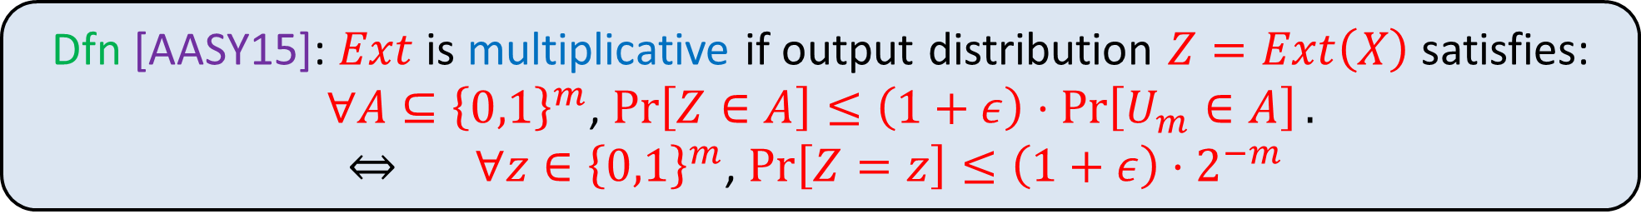
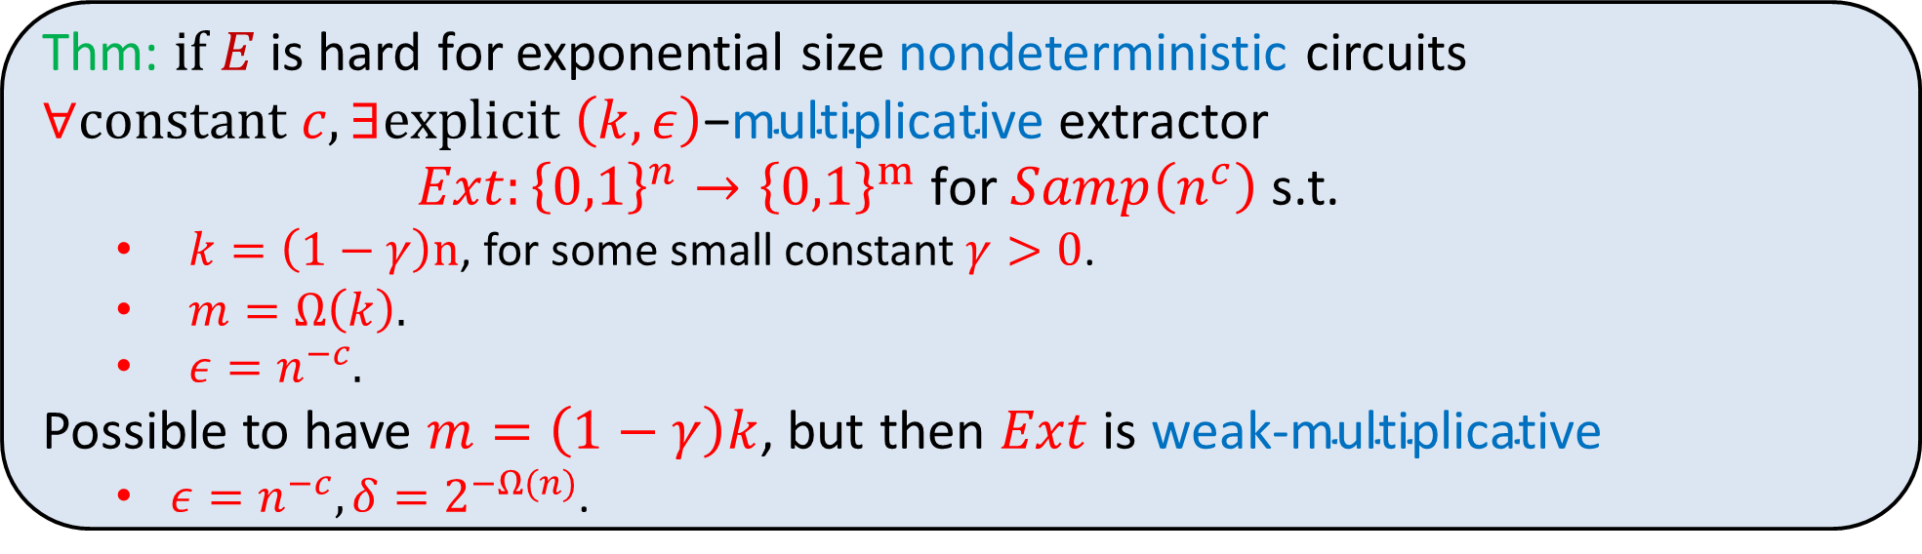

Our result: Multiplicative extractors for samplable distributions
This leads to the following definition:
weak-
Dfn [AASY15]: $Ext$ is multiplicative if output distribution $Z=Ext\left(X\right)$ satisfies: $∀A⊆{\left\{0,1\right\}}^{m}$, $\operatorname{Pr}\left[Z∈A\right]≤\left(1+ε\right)⋅\operatorname{Pr}\left[U_{m}∈A\right].$
$⇔ ∀z∈{\left\{0,1\right\}}^{m}$, $\operatorname{Pr}\left[Z=z\right]≤\left(1+ε\right)⋅2^{−m}$
$$+ δ.$$
Thm: $if E$ is hard for exponential size nondeterministic circuits $∀constant c, ∃explicit \left(k,ε\right)\text{−}\text{multiplicative} \text{extractor} Ext:{\left\{0,1\right\}}^{n}→{\left\{0,1\right\}}^{m} \text{for} Samp\left(n^{c}\right)$ s.t.
$k=\left(1−γ\right)n$, for some small constant $γ>0$.
$m=Ω\left(k\right).$
$ε=n^{−c}.$
Possible to have $m=\left(1−γ\right)k$, but then $Ext$ is $\text{weak}\text{−}\text{multiplicative}$
$ε=n^{−c}, δ=2^{−Ω(n)}$.

Slide 9
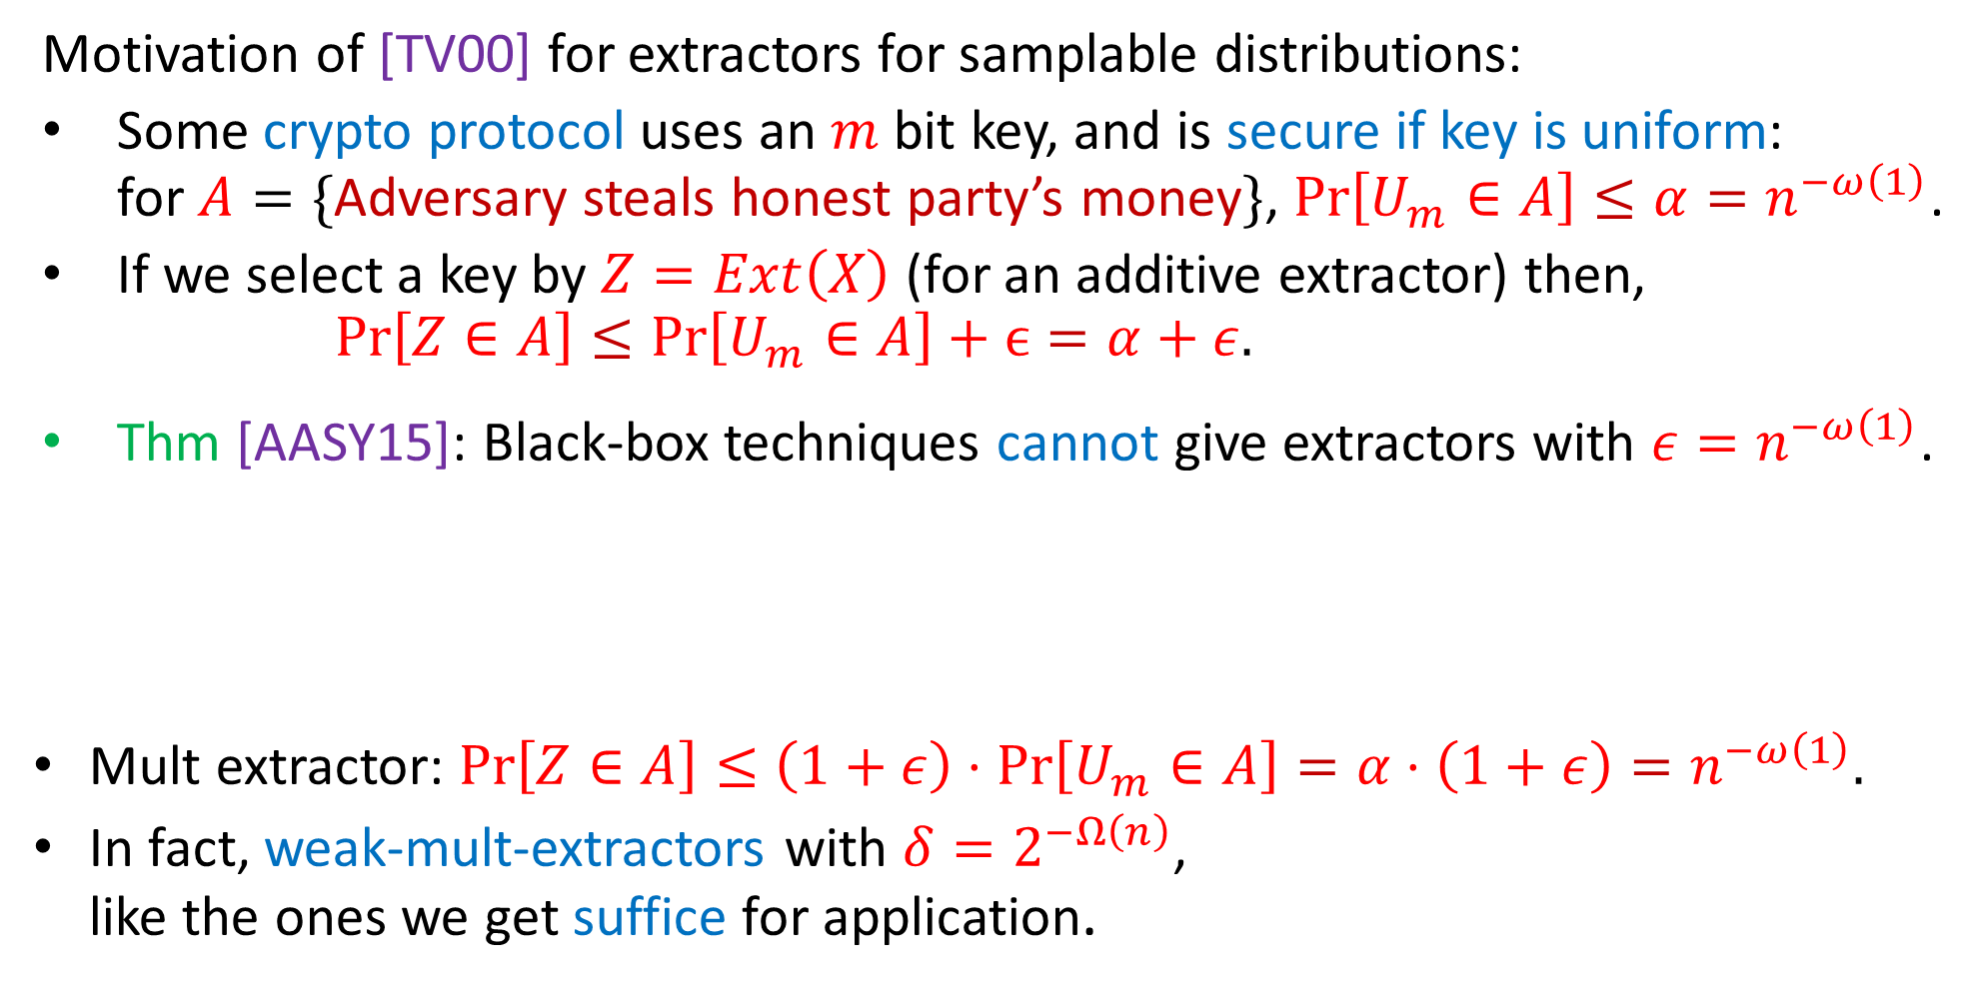
Using extractors for samplable distributions to select keys for crypto
Motivation of [TV00] for extractors for samplable distributions:
Some crypto protocol uses an $m$ bit key, and is secure if key is uniform: for $A=\{$Adversary steals honest party’s money$\}$, $\operatorname{Pr}\left[U_{m}∈A\right]≤α=n^{−ω\left(1\right)}$.
If we select a key by $Z=Ext\left(X\right)$ (for an additive extractor) then, $Pr\left[Z∈A\right]≤\operatorname{Pr}\left[U_{m}∈A\right]+ϵ=α+ε.$
Thm [AASY15]: Black-box techniques cannot give extractors with $ε=n^{−ω\left(1\right)}$.
Mult extractor: $Pr\left[Z∈A\right]≤\left(1+ε\right)⋅\operatorname{Pr}\left[U_{m}∈A\right]=α⋅\left(1+ε\right)=n^{−ω\left(1\right)}.$
In fact, weak-mult-extractors with $δ=2^{−Ω\left(n\right)}$, like the ones we get suffice for application.
not negligible. Additive extractors do not suffice for application!
Dfn : $Ext$ is multiplicative if output distribution $Z=Ext\left(X\right)$ satisfies: $∀A⊆{\left\{0,1\right\}}^{m}$, $\operatorname{Pr}\left[Z∈A\right]≤\left(1+ε\right)⋅\operatorname{Pr}\left[U_{m}∈A\right].$
Negligible! Multiplicative extractors do suffice for application!

Slide 10
High level overview
Approach of previous work [TV00,BDGM23]:
Hardness Assumption
Extractor for samplable distributions

Slide 11

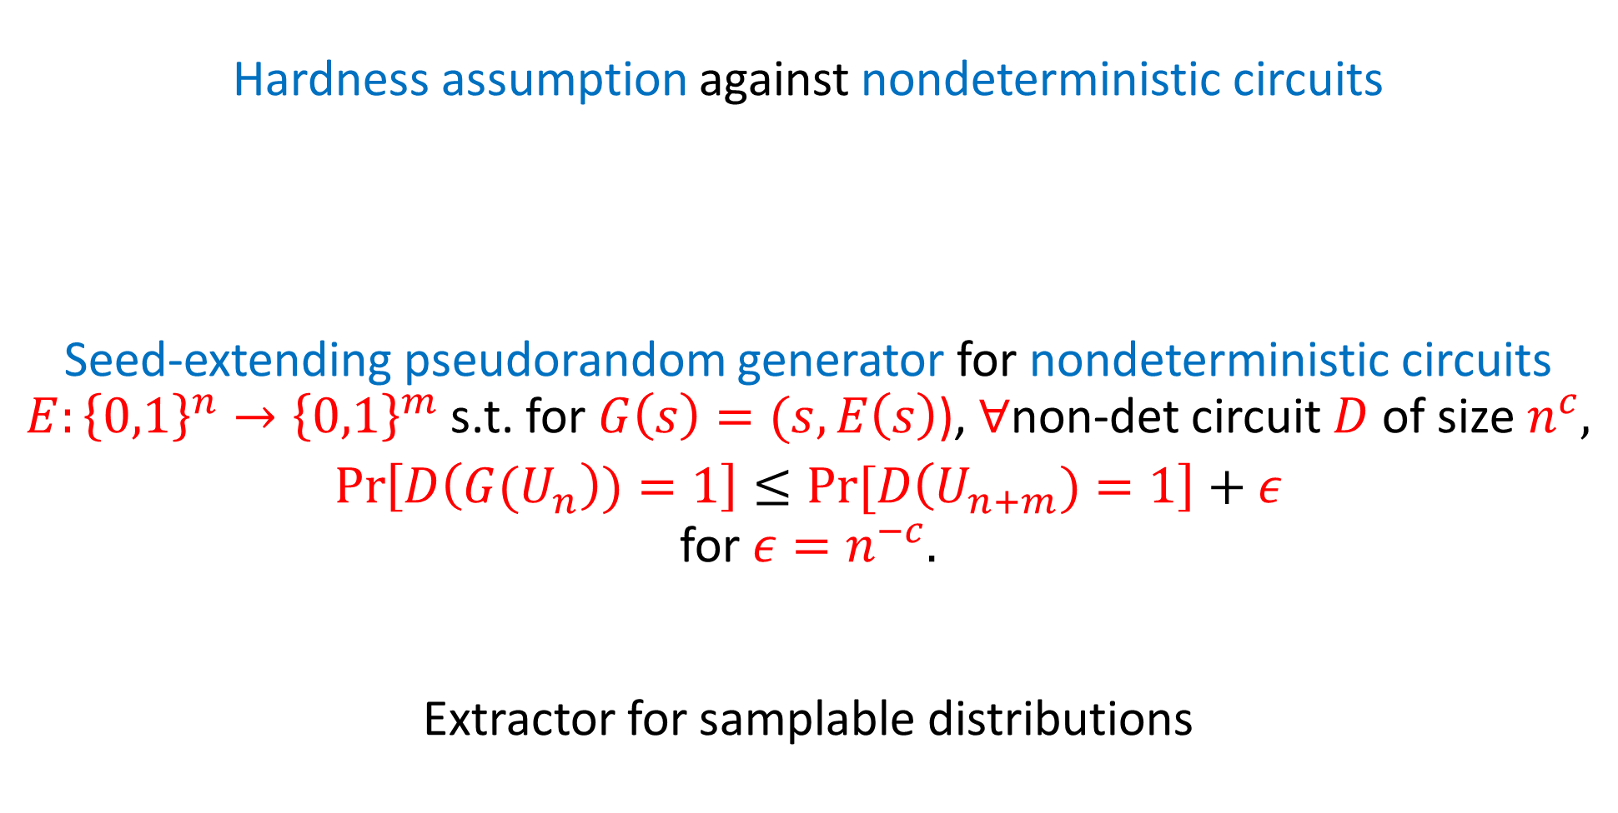
High level overview
New approach:
Hardness assumption against nondeterministic circuits
Seed-extending pseudorandom generator for nondeterministic circuits
$E:{\left\{0,1\right\}}^{n}→{\left\{0,1\right\}}^{m}$ s.t. for $G\left(s\right)=(s,E\left(s\right)$), $∀$non-det circuit $D$ of size $n^{c},$
$$\operatorname{Pr}\left[D\left({G(U}_{n}\right))=1\right]≤Pr⁡[D\left(U_{n+m})=1\right]+ε$$
for $ε=n^{−c}.$
Extractor for samplable distributions
Using the same construction as [TV00], [BDGM23].
This turns out to be much easier because we only need to analyze on the uniform distribution, rather than on any samplable source with high min-entropy.
Weak-Multiplicative
$$⋅\left(1+ε\right)+2^{−Ω\left(n\right)}$$
Very easy.
Multiplicative

Slide 12

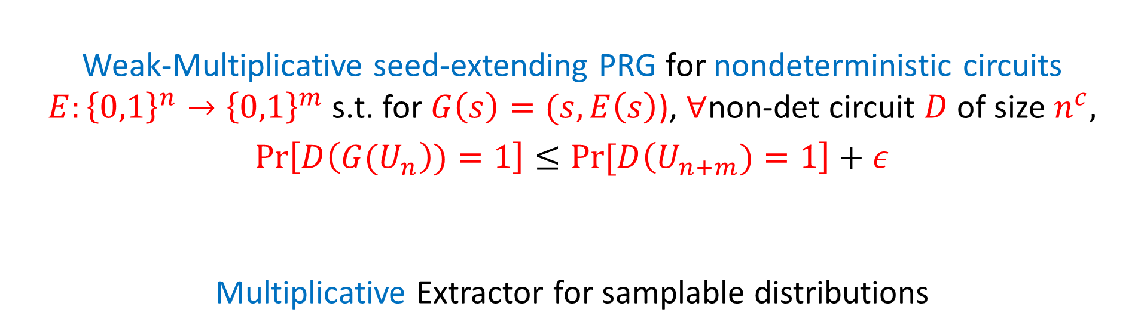

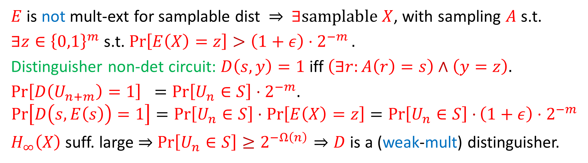
Proof of easy step
Assume for simplicity that $X$ is flat: $X$ is uniform over a subset of ${S⊆\left\{0,1\right\}}^{n}$
$E$ is not mult-ext for samplable dist $⇒$ $∃samplable X$, with sampling $A$ s.t.
$∃z∈{\left\{0,1\right\}}^{m}$ s.t. $\operatorname{Pr}\left[E\left(X\right)=z\right]>\left(1+ε\right)⋅2^{−m}.$
Distinguisher non-det circuit: $D\left(s,y\right)=1$ iff $\left(∃r:A\left(r\right)=s\right)∧\left(y=z\right).$
$\operatorname{Pr}\left[D\left(U_{n+m}\right)=1\right] =\operatorname{Pr}\left[U_{n}∈S\right]⋅2^{−m}.$
$$\operatorname{Pr}\left[D\left(s,E\left(s\right)\right)=1\right]=\operatorname{Pr}\left[U_{n}∈S\right]⋅\operatorname{Pr}\left[E\left(X\right)=z\right]=\operatorname{Pr}\left[U_{n}∈S\right]⋅\left(1+ε\right)⋅2^{−m}$$
$H_{∞}\left(X\right)$ suff. large $⇒$ $\operatorname{Pr}\left[U_{n}∈S\right]≥2^{−Ω\left(n\right)}⇒D$ is a (weak-mult) distinguisher.
Weak-Multiplicative seed-extending PRG for nondeterministic circuits
$E:{\left\{0,1\right\}}^{n}→{\left\{0,1\right\}}^{m}$ s.t. for $G\left(s\right)=(s,E\left(s\right)$), $∀$non-det circuit $D$ of size $n^{c},$
$$\operatorname{Pr}\left[D\left({G(U}_{n}\right))=1\right]≤Pr⁡[D\left(U_{n+m})=1\right]+ε$$
Multiplicative Extractor for samplable distributions
$$⋅\left(1+ε\right)+2^{−Ω\left(n\right)}$$
Very easy.

Slide 13
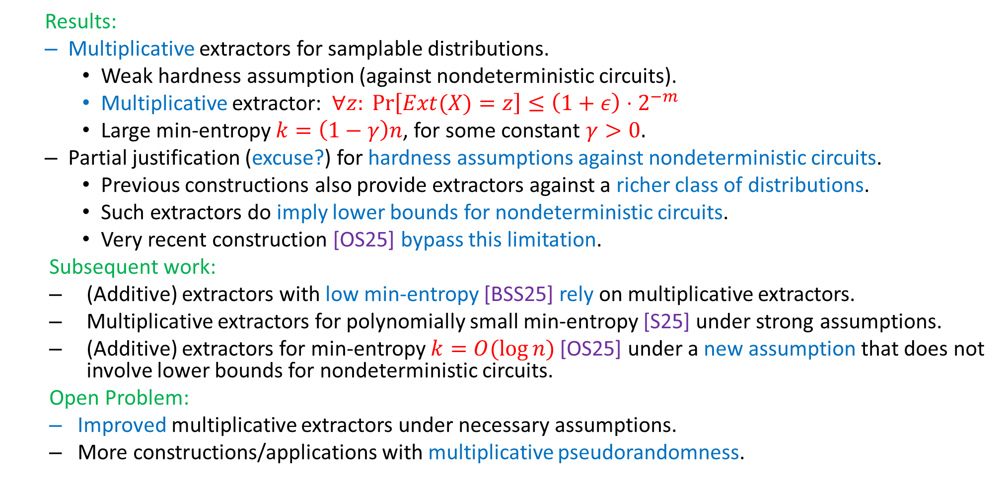
Conclusion and Open Problems
Results:
Multiplicative extractors for samplable distributions.
Weak hardness assumption (against nondeterministic circuits).
Multiplicative extractor: $∀z: \operatorname{Pr}\left[Ext(X)=z\right]≤\left(1+ε\right)⋅2^{−m}$
Large min-entropy $k=\left(1−γ\right)n$, for some constant $γ>0.$
Partial justification (excuse?) for hardness assumptions against nondeterministic circuits.
Previous constructions also provide extractors against a richer class of distributions.
Such extractors do imply lower bounds for nondeterministic circuits.
Very recent construction [OS25] bypass this limitation.
Subsequent work:
(Additive) extractors with low min-entropy [BSS25] rely on multiplicative extractors.
Multiplicative extractors for polynomially small min-entropy [S25] under strong assumptions.
(Additive) extractors for min-entropy $k=O(log⁡n)$ [OS25] under a new assumption that does not involve lower bounds for nondeterministic circuits.
Open Problem:
Improved multiplicative extractors under necessary assumptions.
More constructions/applications with multiplicative pseudorandomness.

Slide 14
That’s it…
Thank You…

