Slide 1
Õptimal Fault-Tolerant Labeling for Reachability and Approximate Distances in Directed Planar Graphs
Itai Boneh, Shiri Chechik, Shay Golan, Shay Mozes, Oren Weimann

Slide 2
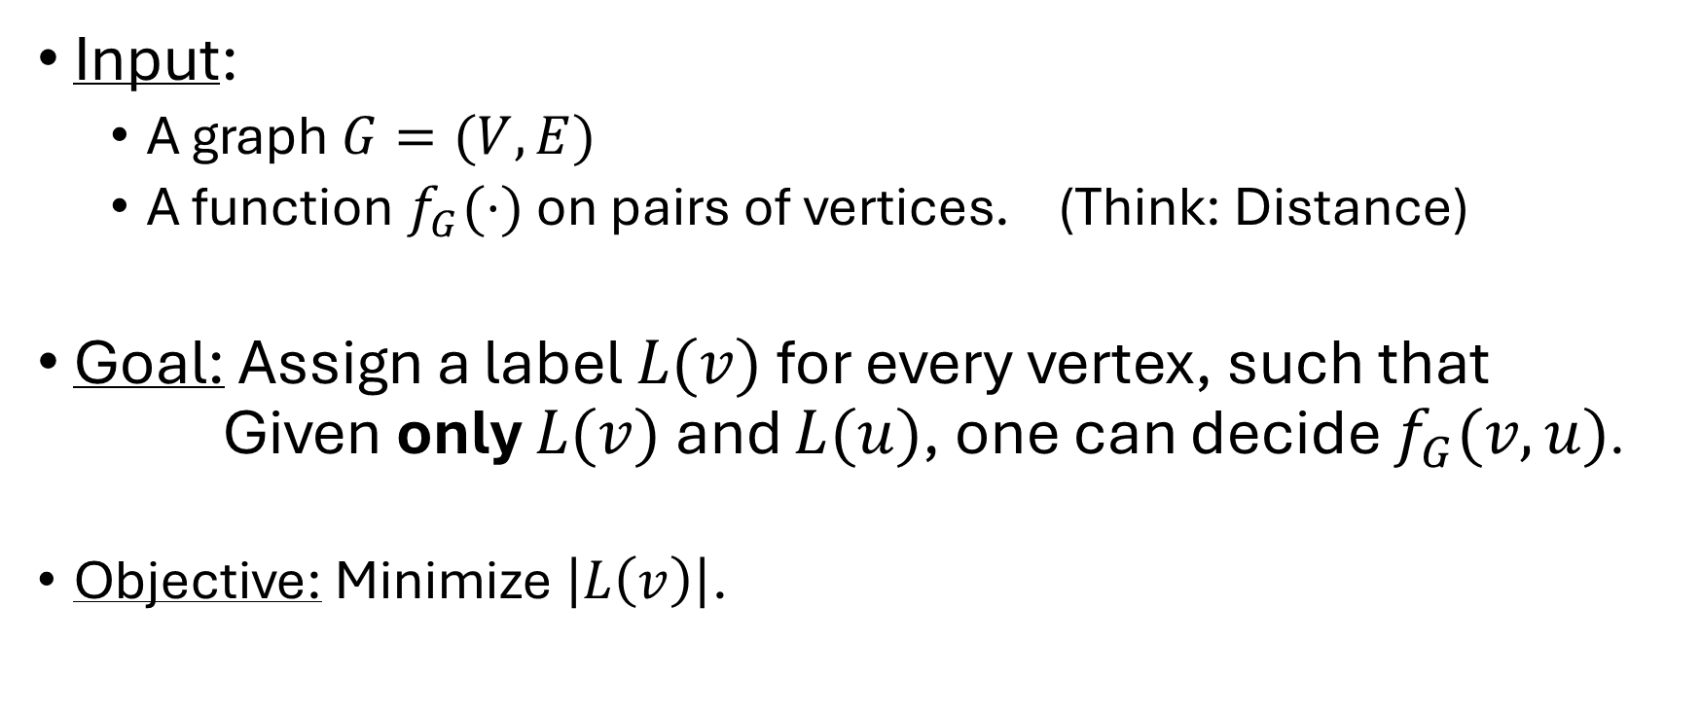
Labeling
Input:
  A graph $G=(V,E)$
  A function $f_{G}(⋅)$ on pairs of vertices. (Think: Distance)
Goal: Assign a label $L(v)$ for every vertex, such that
Given only $L(v)$ and $L(u)$, one can decide $f_{G}(v,u)$.
Objective: Minimize $\left|L\left(v\right)\right|$.
(We don’t care about computation time)

Slide 3

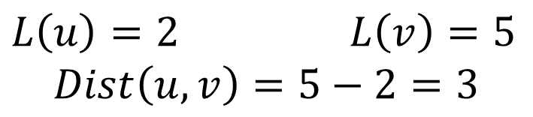









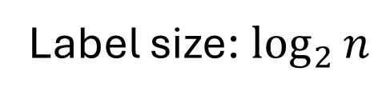
Example: Path
$$1$$
$$2$$
$$3$$
$$4$$
$$5$$
$$6$$
$$7$$
$$8$$
$$u$$
$$v$$
$L\left(u\right)=2$ $L\left(v\right)=5$
$$Dist\left(u,v\right)=5−2=3$$
Label size: $\log_{2}{n}$

Slide 4











Example: Cycle
$$1$$
$$11$$
$$2$$
$$10$$
$$3$$
$$9$$
$$4$$
$$8$$
$$5$$
$$7$$
$$6$$

Slide 5

Example: Cycle
$$1$$
$$11$$
$$2$$
$$10$$
$$3$$
$$10−2=8$$
But the distance is $3$…
$$9$$
$$4$$
$$8$$
$$5$$
$$7$$
$$6$$

Slide 6









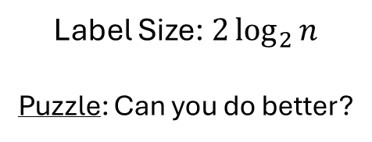



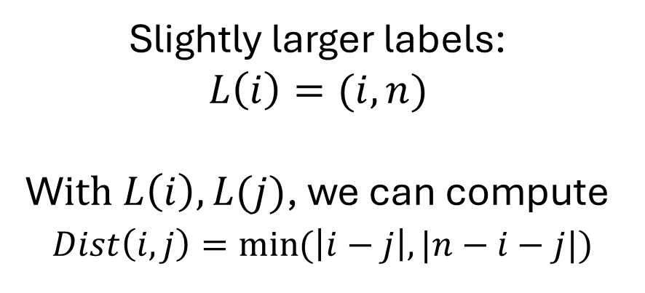
Example: Cycle
$$1$$
$$11$$
Slightly larger labels:
$$L\left(i\right)=(i,n)$$
W$ith L\left(i\right),L(j)$, we can compute
$Dist\left(i,j\right)=\min{(\left|i−j\right|, |n−i−j|)}$
$$2$$
$$10$$
$$3$$
$$10−2=8$$
But the distance is $3$…
$$9$$
$$4$$
$$8$$
Label Size: $2\log_{2}{n}$
Puzzle: Can you do better?
$$5$$
$$7$$
$$6$$

Slide 7
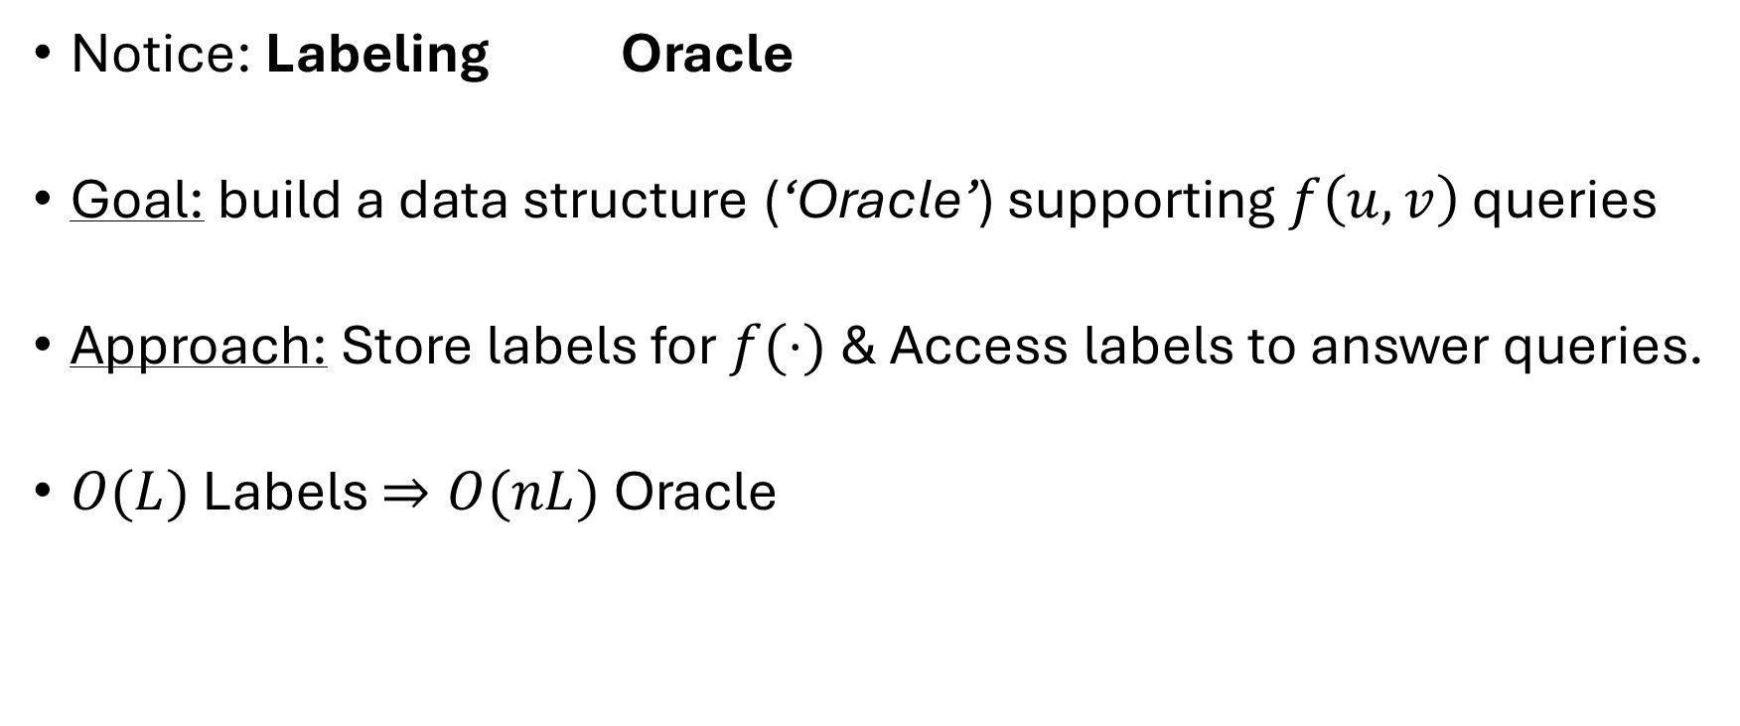
Labeling
Notice: Labeling Oracle
Goal: build a data structure (‘Oracle’) supporting $f\left(u,v\right)$ queries
Approach: Store labels for $f(⋅)$ & Access labels to answer queries.
$O(L)$ Labels $⇒O(nL)$ Oracle

Slide 8
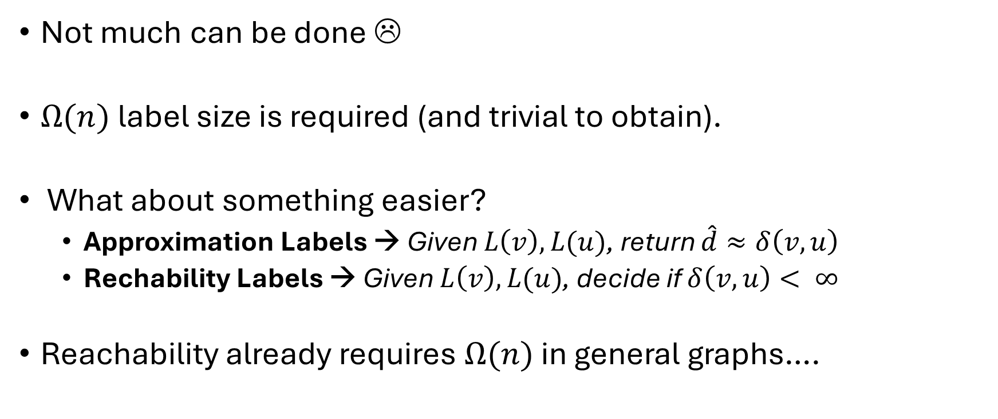
Distance Labeling – General (directed) Graphs
Not much can be done ☹
$Ω(n)$ label size is required (and trivial to obtain).
What about something easier?
  Approximation Labels → Given $L\left(v\right),L(u)$, return $\hat{d}≈δ\left(v,u\right)$
  Rechability Labels → Given $L\left(v\right),L(u)$, decide if $δ\left(v,u\right)< ∞$
Reachability already requires $Ω(n)$ in general graphs….

Slide 9
Planar Graphs
‘Graphs that can be drawn without crossing edges’

Slide 10
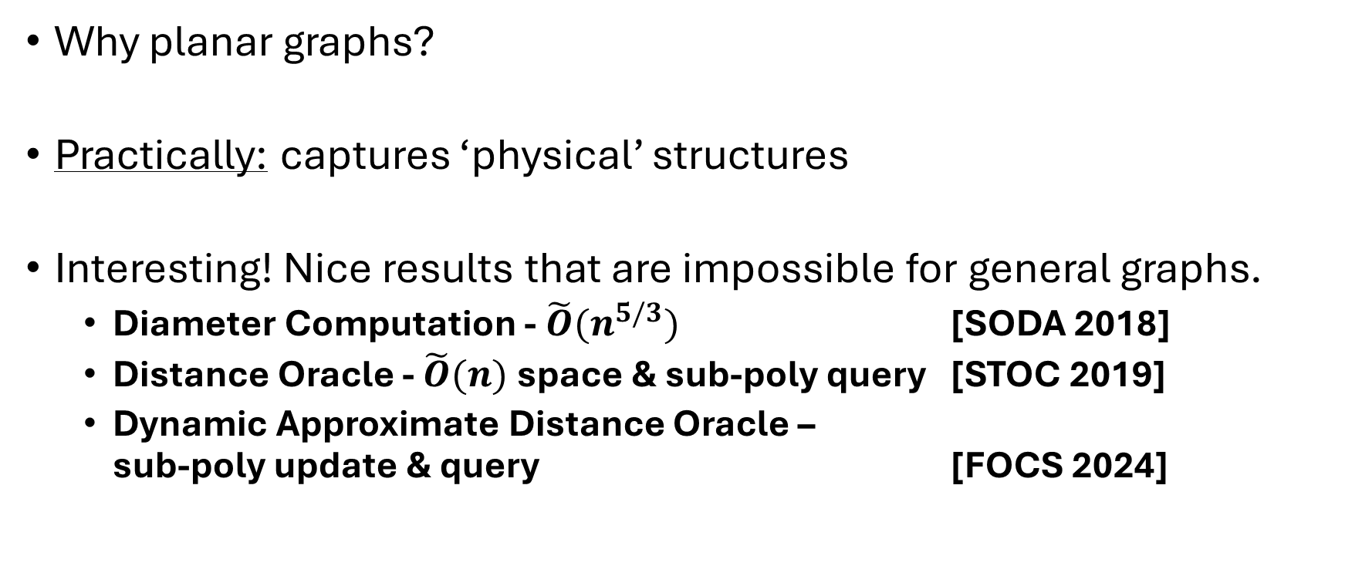
Planar Graphs
Why planar graphs?
Practically: captures ‘physical’ structures
Interesting! Nice results that are impossible for general graphs.
  Diameter Computation - $\tilde{O}(n^{5/3})$ [SODA 2018]
  Distance Oracle - $\tilde{O}(n)$ space & sub-poly query [STOC 2019]
  Dynamic Approximate Distance Oracle –
  sub-poly update & query [FOCS 2024]

Slide 11
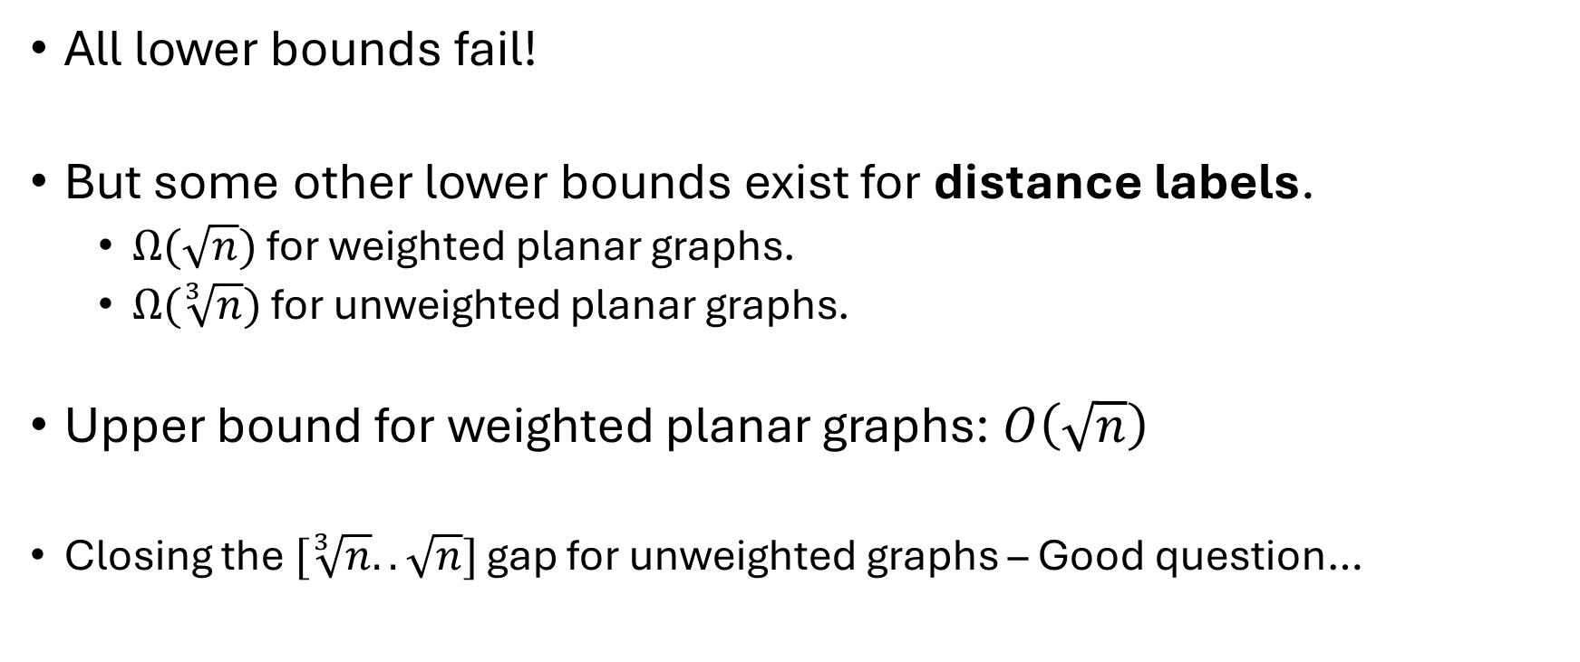
Planar Graphs-Distance Labels
All lower bounds fail!
But some other lower bounds exist for distance labels.
  $Ω(\sqrt{n})$ for weighted planar graphs.
  $Ω(\sqrt[3]{n})$ for unweighted planar graphs.
Upper bound for weighted planar graphs: $O\left(\sqrt{n}\right)$
Closing the $[\sqrt[3]{n}..\sqrt{n}]$ gap for unweighted graphs – Good question…

Slide 12

Reachability
For reachability – We can do much better!
$O(\log{n})$ labels.
(From now on – we count machine words, not bits)

Slide 13


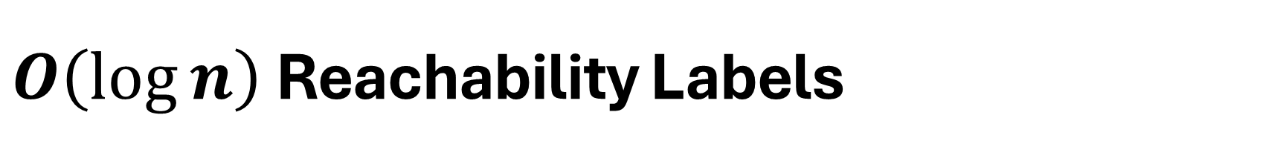



$O\left(\log{n}\right)$Reachability Labels
Planar concept: Path Separators
$$P$$
$$G$$
$$G_{2}$$
$\left|G_{1}\right|,{|G}_{2}|∈Θ(n)$
$P$ is a path.
$$G_{1}$$

Slide 14






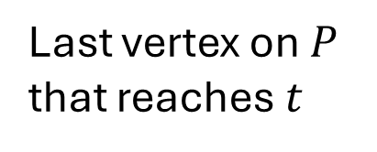
$O\left(\log{n}\right)$Reachability Labels
Planar concept: Path Separators
$$P$$
Last vertex on $P$ that reaches $t$
First vertex on $P$ reachable from $s$
$$s_{f}$$
$$s$$
$$t$$
$$t_{ℓ}$$

Slide 15





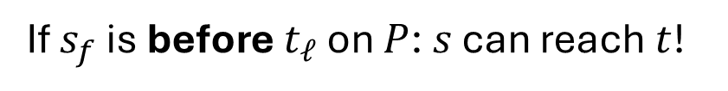
$O\left(\log{n}\right)$Reachability Labels
Planar concept: Path Separators
$$P$$
If $s_{f}$ is before $t_{ℓ}$ on $P$: $s$ can reach $t$!
$$s_{f}$$
$$s$$
$$t$$
$$t_{ℓ}$$

Slide 16


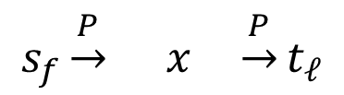

$O\left(\log{n}\right)$Reachability Labels
Planar concept: Path Separators
$$P$$
If $s$ can reach $t$: the path crosses P
$$s_{f}$$
$$s_{f}\underset{→}{P} x \underset{→}{P}t_{ℓ}$$
$$x$$
$$s$$
$$t$$
$s_{f}$ is before $t_{ℓ}$ on $P$
$$t_{ℓ}$$

Slide 17
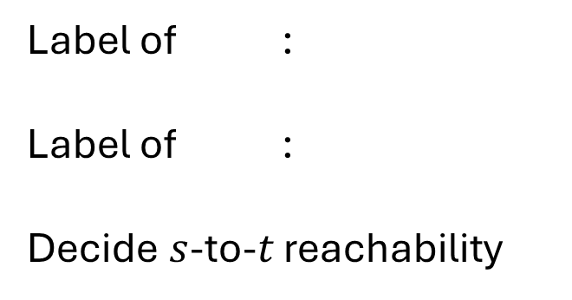




$O\left(\log{n}\right)$Reachability Labels
Planar concept: Path Separators
$$P$$
$$s$$
$$s_{f}$$
Label of :
Label of :
Decide $s$-to-$t$ reachability
$$t$$
$$t_{ℓ}$$
$$s_{f}$$
$$s$$
$$t$$
$$t_{ℓ}$$

Slide 18

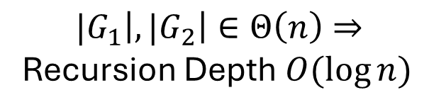



$O\left(\log{n}\right)$Reachability Labels
Planar concept: Path Separators
$$P$$
$s$ and $t$ are on the same side?
Recurse!
$$s$$
$$s_{f}$$
Label of :
Label of :
Decide $s$-to-$t$ reachability
$$t$$
$$t_{ℓ}$$
$$s$$
$${|G}_{1}\left|,{|G}_{2}\right|∈Θ\left(n\right)⇒$$
Recursion Depth $O(\log{n})$
Label Size per Recursive level: $O(1)$
$$t$$

Slide 19






Faulty Reachability
Approximate Distances:
Given $s,t,f$: return $\hat{d}$ s.t.
$$δ\left(s,t\right)≤\hat{d}≤\left(1+ε\right)δ(s,t)$$
Input: vertices $s,t$ and a ‘faulty’ vertex $f$
Output: Can $s$ reach $t$ in $G∖ f$ ?
Our result:
  $\tilde{O}(1)$ Labels
  Before: Only $\tilde{O}(n$) Oracle (centralized).
  $\tilde{O}(1)$ Labels for Approximate
  Distances.
  Before: Not Even an Oracle!
(in $G∖f$)
$$s$$
$$f$$
$$t$$

Slide 20





Reachability – The settings
Recursively separate to obtain:
Only $t$
Only $s$
$$f$$
$$s$$
$$t$$

Slide 21



Reachability – The settings
Recursively separate to obtain:
Only $t$
Only $s$
$$s$$
$$t$$
$$f$$

Slide 22








Reachability – The settings
The rest…
How can a path look like?
$$R$$
Only $t$
Only $s$
$$f$$
$$s$$
$$R_{2}$$
$$t$$
$$R_{3}$$
$$R_{1}$$
$$a$$
$$b$$
Prefix in ‘Only $s$’
Suffix in ‘Only $t$’

Slide 23
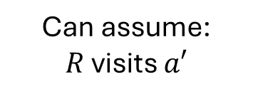
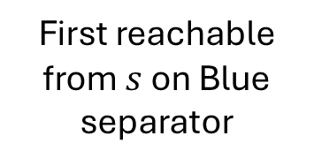

Reachability – The settings
Same Key Idea as without faults: Store ‘First’ on separators.
First reachable from $s$ on Blue separator
Only $t$
Only $s$
$$a′$$
$$f$$
$$s$$
$$t$$
$$a$$
$$b$$
Can assume:
$R$ visits $a′$

Slide 24
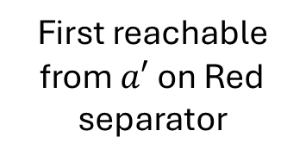

Reachability – The settings
Same Key Idea as without faults: Store ‘First’ on separators.
First reachable from $a′$ on Red separator
Only $t$
Only $s$
$$a′$$
$$b′$$
$$f$$
$$s$$
$$t$$
$$a$$
$$b$$
Can assume:
$R$ visits $a′$

Slide 25




Reachability – The settings
Same Key Idea as without faults: Store ‘First’ on separators.
$b’$is before $c’$ on $P$
Only $t$
$s$ can reach $t$
Only $s$
$$a′$$
$$b′$$
$$f$$
$$s$$
$$t$$
$$a$$
$$b$$
$$c′$$
Last that reaches $t$

Slide 26















Reachability – The settings
Reduced into subtasks:
Find
Find
Find
$$a′$$
Easy! f is not in the way
Only $t$
$$b′$$
Only $s$
$$a′$$
$$b′$$
$$f$$
$$c′$$
$$s$$
$$t$$
$$a$$
$$b$$
$b’$is before $c’$ on $P$
$$c′$$
$s$ can reach $t$

Slide 27



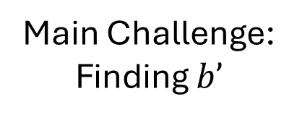

Reachability – The settings
Terminology:
‘${first}_{G}(u)$ on P’:
“The first vertex on $P$ reachable from $u$ in graph $G$”
Main Challenge:
Finding $b’$
Reduced into subtasks:
is first on $P$ via path in
‘Only $s$’
is last on $P$ via
path in ‘Only $t$’
$$a′$$
Only $t$
Only $s$
$$a′$$
$$b′$$
$$f$$
$$s$$
$$t$$
$$c′$$
$$a$$
$$b$$
$$c′$$

Slide 28






Main Challenge: Finding $b’$
P’
$$u$$
P
Find b’: The first vertex on $P$ that
is reachable from $a’$ in $G∖ f$.
Idea: Canonical Paths
Iterate $P’$ and ask each
vertex: what is your first
on $P$?
(Ignoring the fault)
$$v$$
$$f$$
$$a′$$

Slide 29


Main Challenge: Finding $b’$
P’
P
$$u$$
Idea: Canonical Paths
Iterate $P’$ and ask each
vertex: what is your first
on $P$?
Answer does not change?
Keep going.
$$v$$

Slide 30

Main Challenge: Finding $b’$
P’
P
Idea: Canonical Paths
Iterate $P’$ and ask each
vertex: what is your first
on $P$?
Answer does not change?
Keep going.
$$u$$
$$v$$

Slide 31

Main Challenge: Finding $b’$
P’
P
Idea: Canonical Paths
Iterate $P’$ and ask each
vertex: what is your first
on $P$?
Answer does not change?
Keep going.
$$v$$
$$u$$

Slide 32






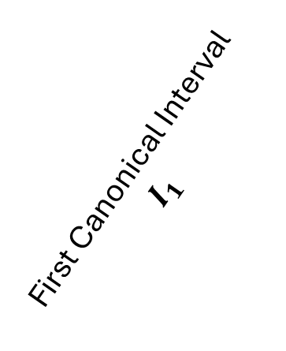
Main Challenge: Finding $b’$
P’
P
Idea: Canonical Paths
New answer:
  All vertices above $u_{1}$
  can reach $v_{1}$ (via $P’$)
  Canonical path of a
  canonical interval
The first canonical path
$$C_{1}$$
$$v_{1}$$
$$u_{1}$$
First Canonical Interval
$$I_{1}$$
$$v_{2}$$
$$u_{2}$$

Slide 33


Main Challenge: Finding $b’$
P’
P
Idea: Canonical Paths
New answer:
  All vertices above $u_{1}$
  can reach $v_{1}$ (via $P’$)
  Canonical path of a
  canonical interval
$$C_{1}$$
$$v_{1}$$
$$u_{1}$$
$$v_{2}$$
$$u_{2}$$

Slide 34



Main Challenge: Finding $b’$
P’
P
Idea: Canonical Paths
New answer:
  All vertices above $u_{1}$
  can reach $v_{1}$ (via $P’$)
  Canonical path of a
  canonical interval
$$C_{1}$$
$$v_{1}$$
$$u_{1}$$
$$C_{2}$$
$$v_{2}$$
$$u_{2}$$
$$u_{3}$$
$$v_{3}$$

Slide 35

Main Challenge: Finding $b’$
P’
P
Idea: Canonical Paths
New answer:
  All vertices above $u_{1}$
  can reach $v_{1}$ (via $P’$)
  Canonical path of a
  canonical interval
$$C_{1}$$
$$v_{1}$$
$$u_{1}$$
$$C_{2}$$
$$v_{2}$$
$$u_{2}$$
$$v_{3}$$
$$u_{3}$$

Slide 36


Main Challenge: Finding $b’$
P’
P
Idea: Canonical Paths
New answer:
  All vertices above $u_{1}$
  can reach $v_{1}$ (via $P’$)
  Canonical path of a
  canonical interval
$$C_{1}$$
$$v_{1}$$
$$u_{1}$$
$$C_{2}$$
$$v_{2}$$
$$u_{2}$$
$$C_{3}$$
$$v_{3}$$
$$u_{3}$$

Slide 37
Main Challenge: Finding $b’$
P’
P
Claim:
Canonical Path are disjoint
$$C_{1}$$
$$v_{1}$$
$$u_{1}$$
$$C_{2}$$
$$v_{2}$$
$$u_{2}$$
$$C_{3}$$
$$v_{3}$$
$$u_{3}$$

Slide 38



Main Challenge: Finding $b’$
P’
P
Claim:
Canonical Path are disjoint
$$v_{1}$$
$$u_{1}$$
$$C_{1}$$
$$x$$
$$v_{2}$$
$$u_{2}$$
$$C_{2}$$
$$C_{3}$$
$$v_{3}$$
$$u_{3}$$

Slide 39
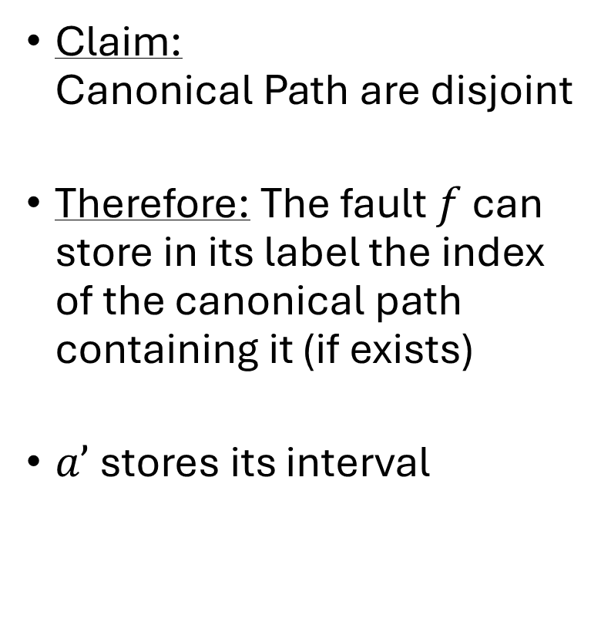

Main Challenge: Finding $b’$
P’
P
Claim:
Canonical Path are disjoint
Therefore: The fault $f$ can store in its label the index of the canonical path containing it (if exists)
$a’$ stores its interval
$$C_{1}$$
$$v_{1}$$
$$u_{1}$$
$$C_{2}$$
$$v_{2}$$
$$f$$
$$u_{2}$$
$$a′$$
$$C_{3}$$
$$v_{3}$$
$$u_{3}$$

Slide 40
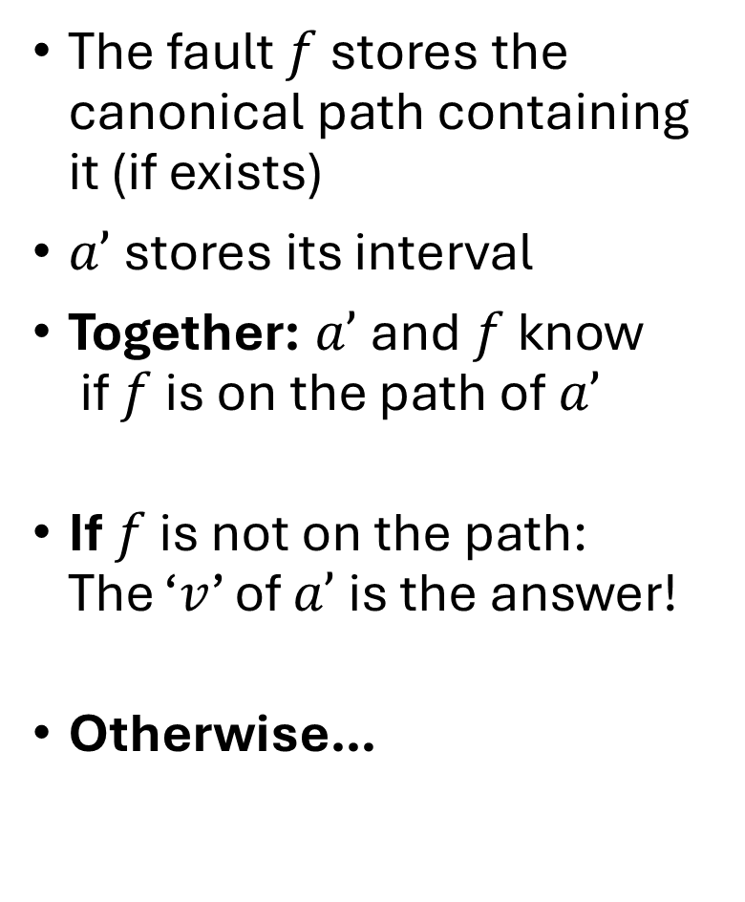

Main Challenge: Finding $b’$
P’
P
The fault $f$ stores the canonical path containing it (if exists)
$a’$ stores its interval
Together: $a’$ and $f$ know
if $f$ is on the path of $a’$
If $f$ is not on the path:
The ‘$v$’ of $a’$ is the answer!
Otherwise…
$$C_{1}$$
$$v_{1}$$
$$u_{1}$$
$$C_{2}$$
$$v_{2}$$
$$f$$
$$u_{2}$$
$$a′$$
$$v_{3}$$
$$C_{3}$$
$$b′$$
$$u_{3}$$

Slide 41

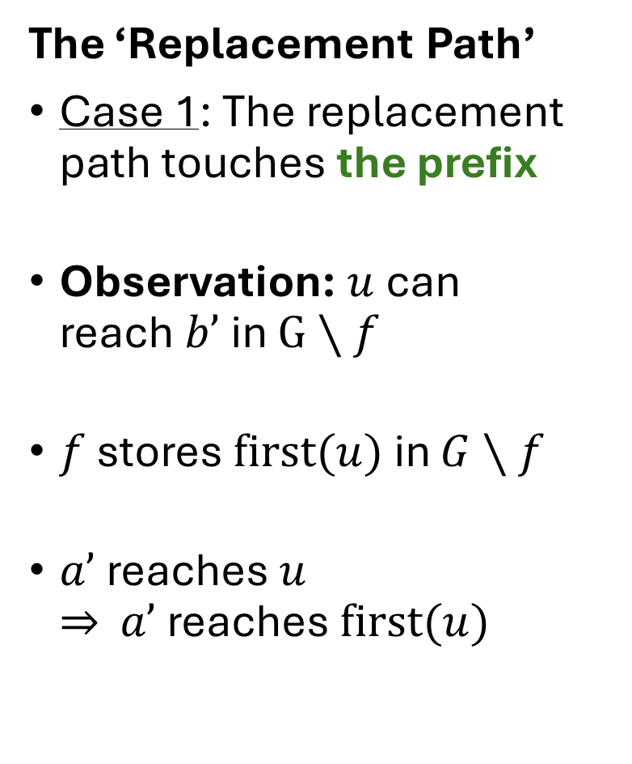




Main Challenge: Finding $b’$
P’
P
The ‘Replacement Path’
Case 1: The replacement path touches the prefix
Observation: $u$can
reach $b’$ in $G∖f$
$f$ stores $first(u)$in $G∖f$
$a’$ reaches $u$
$⇒$ $a’$ reaches $first(u)$
$$a′$$
$$v$$
$$f$$
$$u$$
$$b′$$

Slide 42

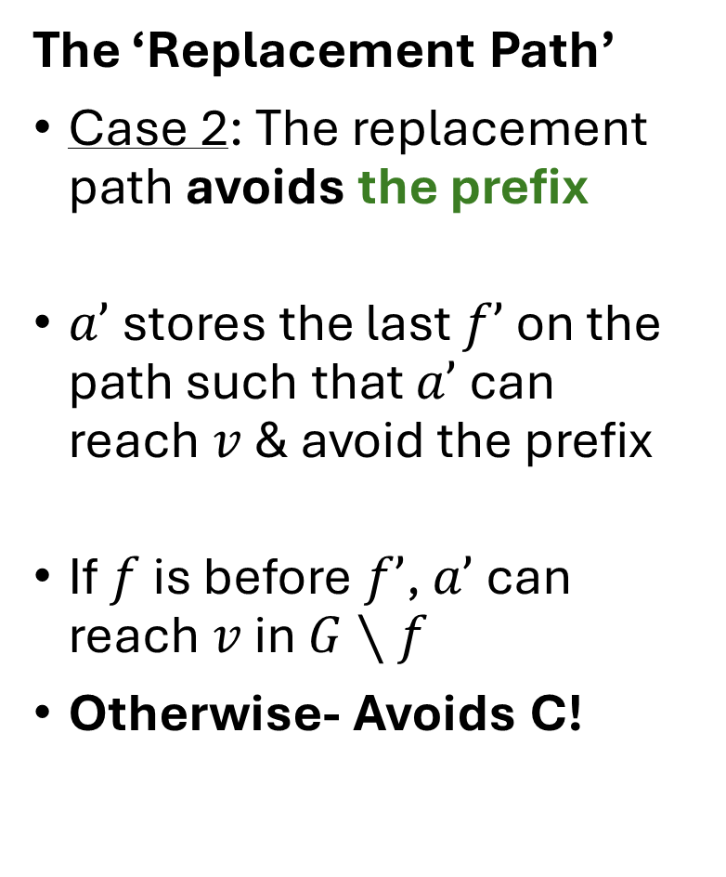

Main Challenge: Finding $b’$
P’
P
The ‘Replacement Path’
Case 2: The replacement path avoids the prefix
$a’$ stores the last $f’$ on the path such that $a’$can
reach $v$ & avoid the prefix
If $f$ is before $f’$, $a’$ can reach $v$ in $G∖f$
Otherwise- Avoids C!
$$a′$$
$$v$$
$$b′$$
$$f′$$
$$f$$
$$u$$

Slide 43


Main Challenge: Finding $b’$
P’
P
The ‘Replacement Path’
Case 2 a: The replacement path avoids C
$a’$stores $first(a’)$ in
$G∖C$
$$a′$$
$$v$$
$$f$$
$$b′$$
$$u$$

Slide 44







Main Challenge: Finding $b’$
$O(1)$label:
Done!
P’
P
Conclusion:
Path uses prefix:
$f$ stores ${first}_{G∖f}\left(u\right)$
Path avoids prefix & uses suffix:
$a’$stores last f that does not
‘block’ $v$.
Path avoids $C$completely:
$a’$ stores ${first}_{G∖C}\left(a′\right)$
$$a′$$
$$v$$
$$f′$$
$$f$$
$$v_{d}$$
$$u$$
$$v_{u}$$

Slide 45
Reachability – The settings
FOUND!
Only $t$
Only $s$
$$a′$$
$$b′$$
$$f$$
$$s$$
$$t$$
$$a$$
$$b$$
$$c′$$

Slide 46



Fault on the Path
In the previous case: we replaced b with ${first}_{G∖f}(a)$
Does not work here…
Only $t$
Only $s$
$$b’$$
$$s$$
$$t$$
$$f$$
$$a$$
$$b$$

Slide 47




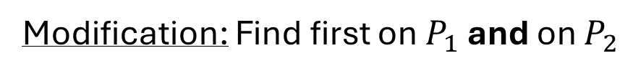
Fault on the Path
Already done!
Either it’s the first on $P$, or does not exist...
Modification: Find first on $P_{1}$ and on $P_{2}$
$$P_{1}$$
Only $t$
Only $s$
$$f$$
$$s$$
$$t$$
$$P_{2}$$
$$a$$
$$b$$

Slide 48





First step: Disjoint Path
P’
P
The path from $a’$ to $b’$ can have a weird shape.
We start by finding the first reachable
vertex via a path disjoint from P
$$f$$
$$a′$$
$$b’$$
$$b’$$

Slide 49


First step: Disjoint Path
P’
$$z$$
P
The first vertex in $P’$ can reach some
vertices of $P$ disjointly.
Observation: $a’$ can reach a
subset of these vertices.
Claim: a’ can reach an interval.
$$a′$$

Slide 50

First step: Disjoint Path
P’
$$z$$
P
Claim: a’ can reach an interval.
Consider the first&last vertices
reachable from $a′$
Consider some in-between
vertex reachable from $z$.
From Planarity: a’ reaches as well!
$$a′$$

Slide 51





First step: Disjoint Path
SUBTASK
SOLVED!
P’
$$z$$
P
$a’$stores the endpoints of its
interval on $P$
$f$ stores the vertex following it
that is reachable from $z$
If $f$ is in the interval of $a’$ –
The answer is stored in $f$
Otherwise- The answer is an
endpoint stored in $a’$ (or null)
$$f$$
$$b′$$
$$f$$
$$a′$$
$$b′$$

Slide 52




Next Step: Making progress on a path
P’
P
Reminder:
we want this
$$f$$
$$a′$$
$$b’$$
$$b$$
We are here

Slide 53





Next Step: Making progress on a path
Next subtask: given $b,f∈P_{2}$,
Compute $first_{G∖f}(b)$ on $P_{2}$.
$$c$$
$$f$$
$$b′$$
$$b$$

Slide 54
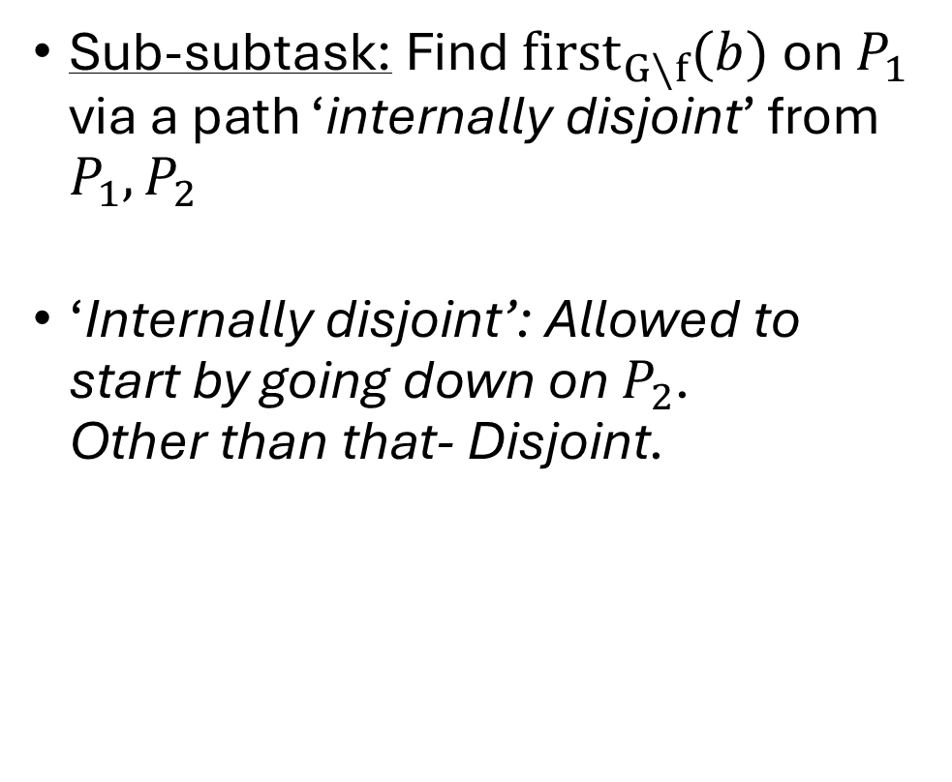
Making progress on a path
Sub-subtask: Find $first_{G∖f}(b)$ on $P_{1}$ via a path ‘internally disjoint’ from $P_{1},P_{2}$
‘Internally disjoint’: Allowed to
start by going down on $P_{2}$.
Other than that- Disjoint.
$$c$$
$$f$$
$$b$$

Slide 55
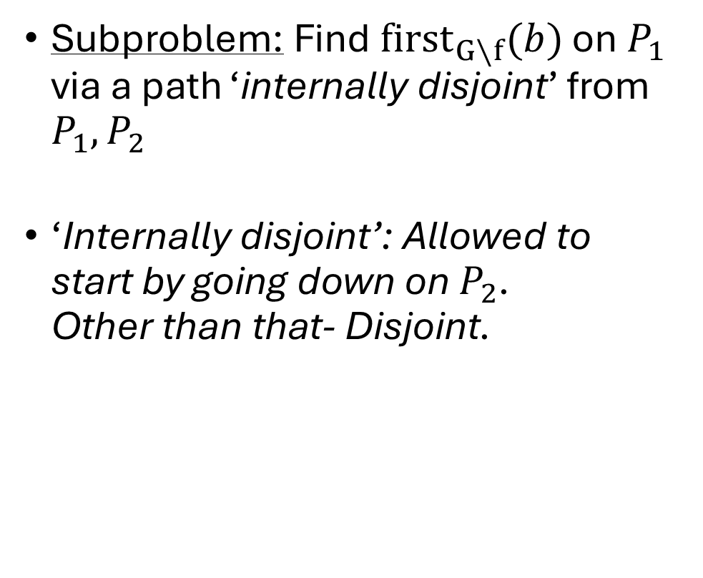

Making progress on a path
Subproblem: Find $first_{G∖f}(b)$ on $P_{1}$ via a path ‘internally disjoint’ from $P_{1},P_{2}$
‘Internally disjoint’: Allowed to
start by going down on $P_{2}$.
Other than that- Disjoint.
$$c$$
‘internally disjoint’
$$f$$
$$b$$

Slide 56

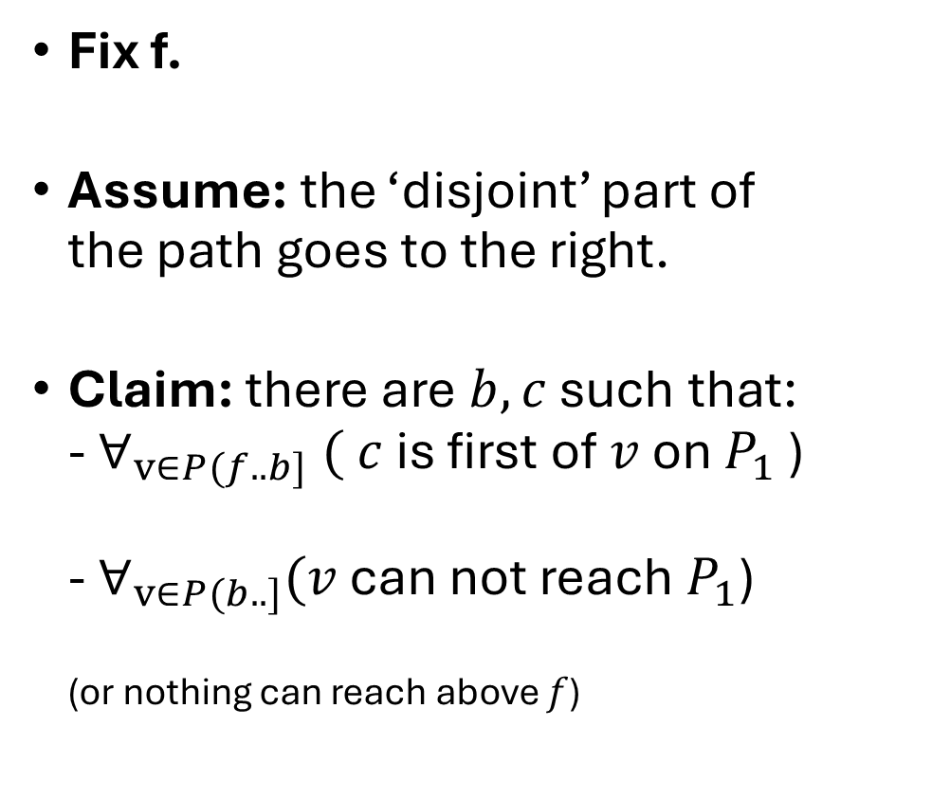



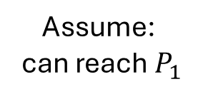
Making progress on a path
Fix f.
Assume: the ‘disjoint’ part of
the path goes to the right.
Claim: there are $b,c$ such that:
- $∀_{v∈P(f..b]} ( c$is first of $v$ on $P_{1}$ )
- $∀_{v∈P(b..]}(v$ can not reach $P_{1}$)
(or nothing can reach above $f$)
First reachable from $P_{2}$
$$c$$
$$\hat{c}$$
Can reach c:
Contradiction!
$$f$$
Last that reaches $c$
Assume:
can reach $P_{1}$
$$b$$
$$\hat{b}$$

Slide 57
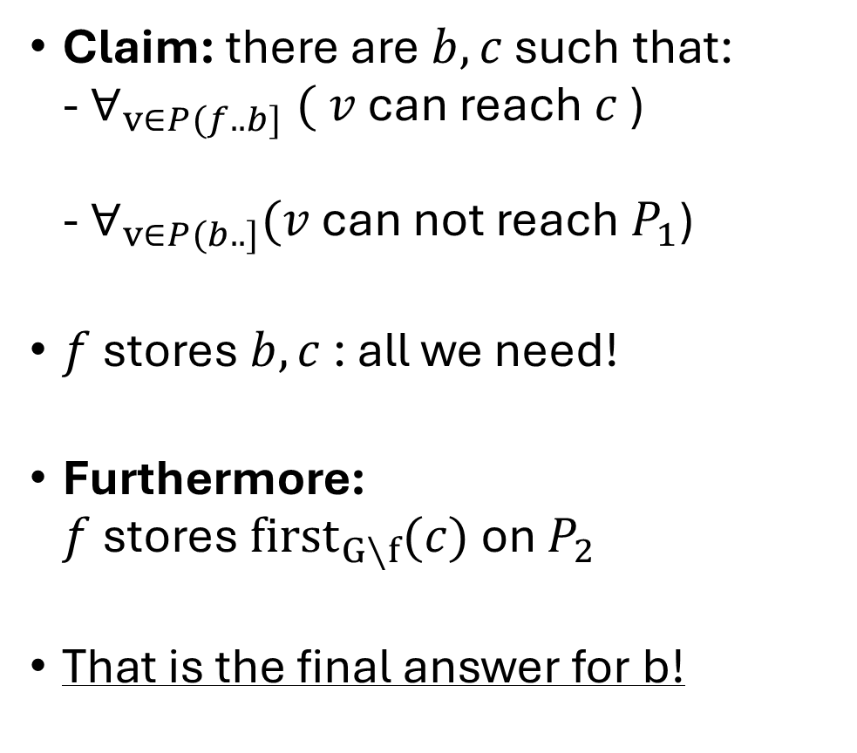

Making progress on a path
Claim: there are $b,c$ such that:
- $∀_{v∈P(f..b]} ( v$can reach $c$ )
- $∀_{v∈P(b..]}(v$ can not reach $P_{1}$)
$f$ stores $b,c$ : all we need!
Furthermore:
$f$ stores $first_{G∖f}(c)$ on $P_{2}$
That is the final answer for b!
$$c$$
$$f$$
$$b′$$
$$b$$

Slide 58




Making progress on a path
Last subproblem: Given $b,f$-
Find $first_{G∖P_{1}}\left(b\right)$ on$P_{2}$.
$$f$$
$$b′$$
$$b$$

Slide 59






Making progress on a path
Last subprbolem: Given $b,f$ - Find $first_{G∖P_{1}}\left(b\right)$ on$P_{2}$.
For every $v∈P$, define:
$b_{v}=$ the last vertex on $P$ that reaches $v$ without using $P\left(v..\right]$
This define a set of intervals $[v,b_{v}]$
$$P$$
$$b_{v}$$
$$b$$
$$v$$
$$f$$

Slide 60



Making progress on a path
Claim: The intervals do not cross
Does not use anything before $v$
(In particular, before of $x$)
$$P$$
$$b_{v}$$
$$b_{x}$$
$$v$$
$$x$$

Slide 61


Making progress on a path
Laminar Family.
$$P$$
$$b_{v}$$
$$v$$
$$b_{x}$$
$$x$$

Slide 62
Making progress on a path
Laminar Family.
$$P$$

Slide 63
Making progress on a path
Laminar Family.
$$P$$

Slide 64
Making progress on a path
Laminar Family.
$$P$$

Slide 65



Making progress on a path
Given $b,f$, find the interval $[v,b_{v}]$ that contains $b$, has $v>f$
with minimal $v$.
$$P$$
$$b_{v}$$
$$b$$
$$v$$
$$f$$

Slide 66




Making progress on a path
Guess the length of the correct interval : $\left|v−b_{v}\right|∈\left[2^{i}..2^{i+1}\right)$
$b$ stores the longest interval containing b
$f$ stores the longest ‘adjacent’ interval after $f$.
$$P$$
$$b$$
$$f$$

Slide 67

Making progress on a path
‘Adjacent Interval’:
Adjacent
Not Adjacent
$$f$$

Slide 68


Making progress on a path
$f$ stores the longest interval to its left.
$b$ stores the longest interval containing b
Why would the longest containing $b$ not be the answer? – contains $f$
But then, what is the maximal to the left of $f$?
Stored in $b$
Correct Answer
$$P$$
$$b$$
$$f$$

Slide 69
Making progress on a path
$f$ stores the longest interval to its left.
$b$ stores the longest interval containing b
Why would the longest containing $b$ not be the answer? – contains $f$
But then, what is the maximal to the left of $f$?
after correct answer? not adjacent.
$$P$$
$$b$$
$$f$$

Slide 70
Making progress on a path
$f$ stores the longest interval to its left.
$b$ stores the longest interval containing b
Why would the longest containing $b$ not be the answer? – contains $f$
But then, what is the maximal to the left of $f$?
Contains correct answer?
Contradiction to the answer
$$P$$
$$b$$
$$f$$

Slide 71




Making progress on a path
$f$ stores the longest interval to its left.
$b$ stores the longest interval containing b
Why would the longest containing $b$ not be the answer? – contains $f$
But then, what is the maximal to the left of $f$?
Before correct?
Must be disjoint, and contained within the answer of $b⇒$ not enough room
$$<2^{i+1}$$
$$2^{i}≤$$
$$≥2^{i}$$
$$P$$
$$b$$
$$f$$

Slide 72
Making progress on a path
$f$ stores the longest interval to its left.
$b$ stores the longest interval containing b
Why would the longest containing $b$ not be the answer? – contains $f$
But then, what is the maximal to the left of $f$?
Contained in correct answer?
Contradiction to maximality
$$P$$
$$b$$
$$f$$

Slide 73
Making progress on a path
Subproblem solved!
$f$ stores the longest interval to its left.
$b$ stores the longest interval containing b
Why would the longest containing $b$ not be the answer? – contains $f$
But then, what is the maximal to the left of $f$?
Must be the correct answer!
$$P$$
$$b$$
$$f$$

Slide 74



Making progress on a path-Wrap up
Case1: The path does not use $P_{1}$
Just use the subproblem!
$b’ ={first}_{G∖P_{1}}(b)$ on $P_{2}$.
$$f$$
$$b′$$
$$b$$

Slide 75




Making progress on a path-Wrap up
Case2: The path uses $P_{1}$
Start by using subproblem 2.
$\hat{b}={first}_{G∖P_{1}}(b)$ on $P_{2}$.
Use subproblem 1 to find the
‘leap’ $c$ to $P_{1}$
Subproblem 1 also gives
$b’={first}_{G∖f}(c)$ on $P_{2}$
$$c$$
$$f$$
$$b′$$
$$\hat{b}$$
$$b$$

Slide 76












Reachability Labels – Wrap up
$\tilde{O}(1)$ Faulty Reachability
Labels
Path Broken into parts, each solved with a subproblem.
In every step, find the first reachable vertex on the path – w.l.o.g, it is visited.
$$P_{1}$$
First in $G∖f$
Only $t$
Only $s$
First ‘internally disjoint’
$$f$$
$$s$$
Last in Only $t$
$$t$$
First in Only $s$
$$P_{2}$$
First Disjoint from P
First without $P_{1}$

Slide 77
Approximate Distances

Slide 78




Approximate Distances – Find the First?
First Reachable from s
$$a_{f}$$
$$s$$
$$t$$
$$a$$

Slide 79





Approximate Distances – Find the First?
Problem: Reachable, but at what cost?
Solution: Guess!
$$100$$
First reachable with cost $1$
$$1$$
$$a_{f}$$
$$s$$
$$t$$
$$1$$
$$1$$
$$a$$
Guess the length of this prefix

Slide 80



Approximate Distances – Find the First?
Problem: What about the cost of $P$?
Solution: Let’s say it is zero
$$1$$
First reachable with cost $1$
$$a_{f}$$
$$100$$
$$0$$
$$s$$
$$t$$
$$1$$
$$1$$
$$a$$

Slide 81

Approximate Distances – Find the First?
Problem: We have no idea how to compute this.
Solution: Relax
$$1$$
$$a_{f}$$
First reachable with cost $1$
$$0$$
$$s$$
$$t$$
$$1$$
$$1$$
$$a$$

Slide 82






Approximate Distances – Find the First?
Problem: We have no idea how to compute this.
Solution: Relax
Find some vertex $a’$ s.t.:
$a’$ is (weakly) before $a_{f}$
$a’$ can also be reached
with $(1+ε)$
$$1+ε$$
$$a′$$
$$1$$
$$a_{f}$$
First reachable with cost $1$
$$s$$
$$t$$
$$1$$
$$1$$
$$a$$

Slide 83


Approximate Distances – Find the First?
Problem: We have no idea how to compute this.
Solution: Relax
Find some vertex $a’$ s.t.:
$a’$ is (weakly) before $a_{f}$
$a’$ can also be reached
with $(1+ε)$
$$1+ε$$
$$a′$$
This is good enough!
And we can compute it
$$1$$
$$a_{f}$$
$$s$$
$$t$$
$$1$$
$$1$$
$$a$$

Slide 84





Reachability →Approximate Distances
Subproblem: Find $first_{G∖f}(b)$ on $P_{1}$ via a path ‘internally disjoint’ from $P_{1},P_{2}$
Approximation version:
$c$ : first reachable with budget $1$
Find some $c’$ before $c$ that is reachable with cost $1+ε$
$$c′$$
$$c$$
$$1+ε$$
$$f$$
$$1$$
$$b$$

Slide 85













Reachability →Approximate Distances
Key claim(Reachability):
‘if $b_{1}$reaches $c_{1}$and
$b_{2}$reaches $c_{2}$: $b_{2}$reaches $c_{1}$’
Would be nice (For approx. ):
‘if $b_{1}$reaches $c_{1}$with cost $≤1$
and $b_{2}$reaches $c_{2}$ with cost $≤1$: $b_{2}$reaches $c_{1}$ with cost $≤1+ε$’
False….
First reachable from $b_{1}$
$$c_{1}$$
$$0.99$$
$$c_{2}$$
First reachable from $b_{2}$
$$0.01$$
$$f$$
$$x$$
$$0.01$$
$$b_{1}$$
Unless $ε=1$
$$0.99$$
$$b_{2}$$

Slide 86




Reachability →Approximate Distances
Nice fact (For 2 approx. ):
‘if $b_{1}$reaches $c_{1}$with cost $≤1$
and $b_{2}$reaches $c_{2}$ with cost $≤1$: $b_{2}$reaches $c_{1}$ with cost $≤1+ε$’
Allows the same approach as
Reachability:
-Store the first reachable $c$ ($c_{1}$)
-Store the last $b$ that reaches
above $f$ ($b_{2}$).
$$c_{1}$$
$$c_{2}$$
$$f$$
Every vertex here:
- Can’t reach above $c_{1}$ with budget 1
-Can reach $c_{1}$with budget 2
$$≤2$$
(with budget $1$)
$$b_{1}$$
$$b_{2}$$
Vertices here can not reach above f
(with budget 1)

Slide 87

Reachability →Approximate Distances
Seems like this approach can not be used for $ε<1$.
In the worst case, it is possible
that the green path costs 2
New Tool:
Good Cross-Bad Cross
$$c_{1}$$
$$c_{2}$$
$$f$$
$$≤2$$
$$b_{1}$$
$$b_{2}$$

Slide 88









Reachability →Approximate Distances
$$c_{1}$$
Good Cross:
A cross such that the endpoints are ‘close’
Bad Cross:
Not a good cross.
$c_{1}$: be the first reachable vertex
$b_{1}$: Last good cross with $b$
Continue in the lower interval.
$$≤1+ε$$
Vertices here:
$c_{1}$is a good answer!
$$f$$
$b_{1}$and $b$ good cross
$$b$$
$$b_{1}$$
Vertices here:
Bad Cross with $b$

Slide 89







Reachability →Approximate Distances
First reachable from here
(with budget 1)
Last good cross with $b$
$$b_{2}$$
$$b$$
$$b_{1}$$
$$f$$
$$c_{2}$$
$$c_{1}$$

Slide 90
Reachability →Approximate Distances
$$b_{2}$$
$$b_{1}$$
$$f$$
$$c_{2}$$
$$c_{1}$$

Slide 91


Reachability →Approximate Distances
In every interval, the corresponding $c$ is a good answer.
We want $f$ to store all intervals – How many intervals are created?
$$b_{3}$$
$$b_{2}$$
$$b_{1}$$
$$f$$
$$c_{3}$$
$$c_{2}$$
$$c_{1}$$

Slide 92



Reachability →Approximate Distances
Claim: at most$\frac{1}{ε}$ intervals are created
(proof for $ε = 0.5$): Assume to the contrary that 3 intervals are created
Bad cross!
$$≥1.5$$
$$≤0.5$$
$$b_{3}$$
$$b_{2}$$
$$b_{1}$$
$$f$$
$$c_{3}$$
$$c_{2}$$
$$c_{1}$$

Slide 93




Reachability →Approximate Distances
Claim: at most$\frac{1}{ε}$ intervals are created
(proof for $ε = 0.5$): Assume to the contrary that 3 intervals are created
Bad cross with $b’_{2}$!
(should be far away from $c_{2}$)
$$≤1$$
$$≤0.5$$
$$b_{3}$$
$$b_{2}$$
$$b’_{2}$$
$$b_{1}$$
$$f$$
$$c_{3}$$
$$c_{2}$$
$$c_{1}$$
A path with cost $≤1.5⇒$ A contradiction

Slide 94








Reachability →Approximate Distances
Claim: at most$\frac{1}{ε}$ intervals are created
(proof for $ε$): Assume to the contrary that $1/ε+1$ intervals are created
$$+$$
$$≤2−ε$$
Bad cross with b_2!
(should be far away from $c_{2}$)
$$≥1+ε$$
$$≤1−2ε$$
$$≥1+ε$$
$$≤1−ε$$
$$b_{3}$$
$$b_{2}$$
$$b_{1}$$
$$f$$
$$c_{3}$$
$$c_{2}$$
$$c_{1}$$
Get a smaller ‘cup’, with cost $≤1−2ε⇒$
After $\frac{1}{ε}$ steps, we will get a contradiction

Slide 95



Reachability →Approximate Distances
$$c_{i}$$
F stores $O\left(1/ε\right)$ intervals.
For each $b$, the c of the interval
containing it is a good answer.
$O(1/ε)$ size label.
$$f$$
$$b$$

Slide 96

Reachability Labels – Wrap up
$\tilde{O}(1)$ Faulty approximate
Distance Labels
Guess the length of each part, and replace ‘First’ with ‘Good Enough’
Main tool for solving approx. variant of sub-problems: Good Cross-Bad Cross
$$P_{1}$$
First in $G∖f$
Only $t$
Only $s$
First ‘internally disjoint’
$$f$$
$$s$$
Last in Only $t$
$$t$$
First in Only $s$
$$P_{2}$$
First Disjoint from P
First without $P_{1}$

Slide 97
Thanks!

