Slide 1
Camera/Source Identification
By: Majd Farah & Kiran Kabaso

Slide 2
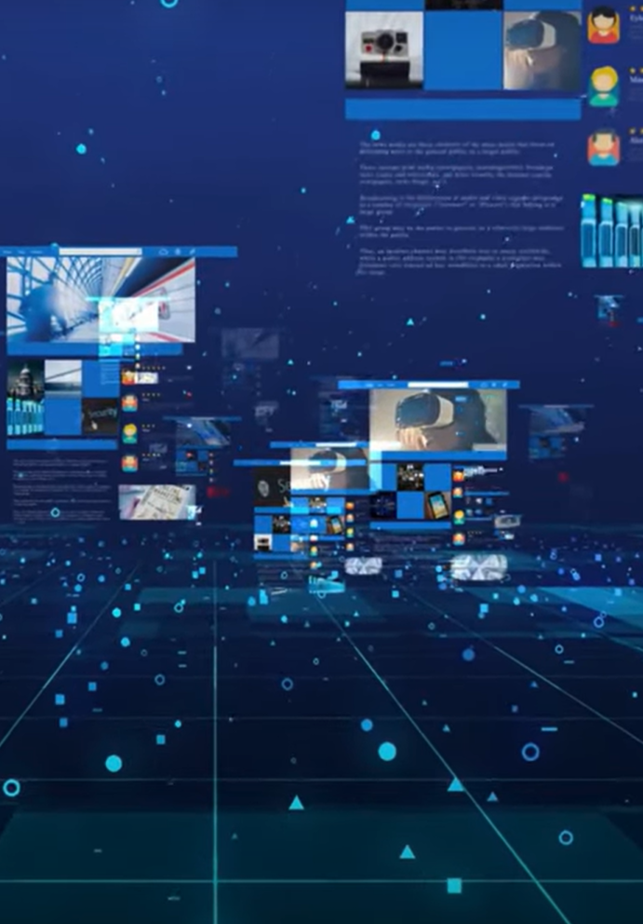
Motivation
Can we trace back the origin of an image?
Can we reveal the authors of illicit material?
Which camera acquired the image?
Notes:
אותנטיות התמונה

Slide 3
Agenda
Introduction to the Camera/Source Identification problem
Introducing two methods to solve the problem
Examining how Deep Learning method improves the process
Test results
Summary
Notes:
בדיקת ראיות.photographic evidence. פתיחת תיקים ישנים, למי יש זכויות יוצרים על התמונה?

Slide 4
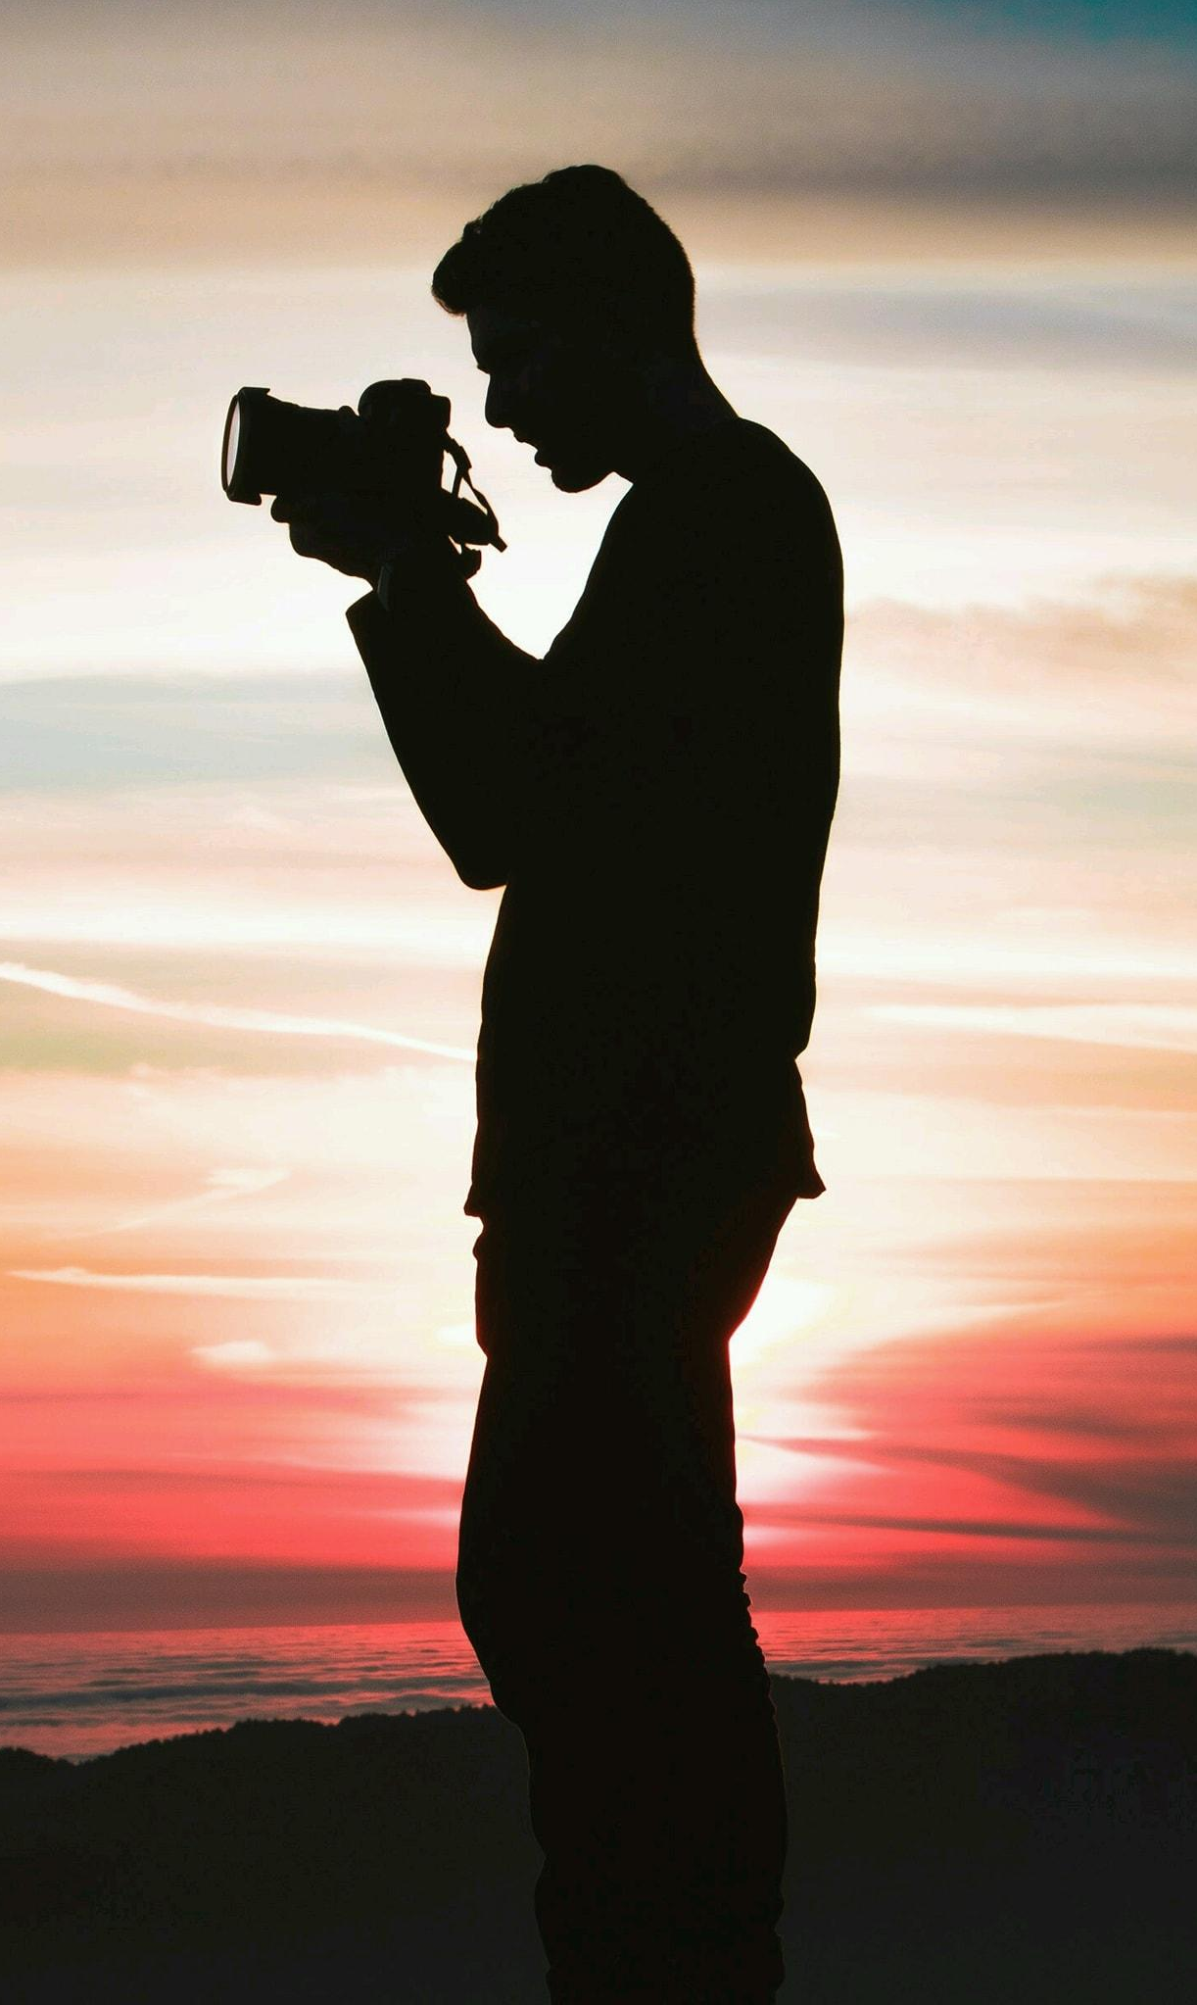
Why is it important?
Police/Law enforcement investigations
Fast growing image forgery in social media
Copyrights!
Notes:
בדיקת ראיות.photographic evidence. פתיחת תיקים ישנים, למי יש זכויות יוצרים על התמונה?

Slide 5
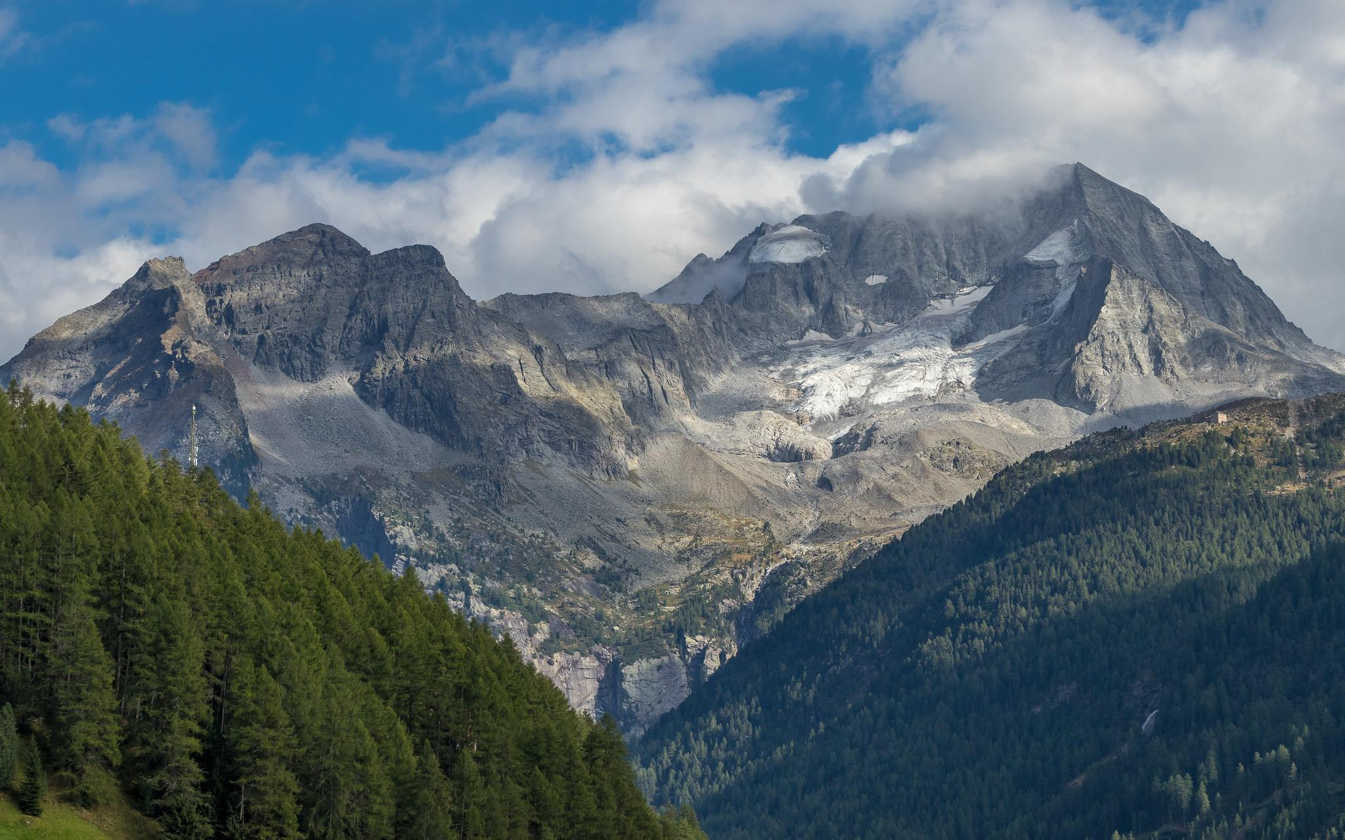
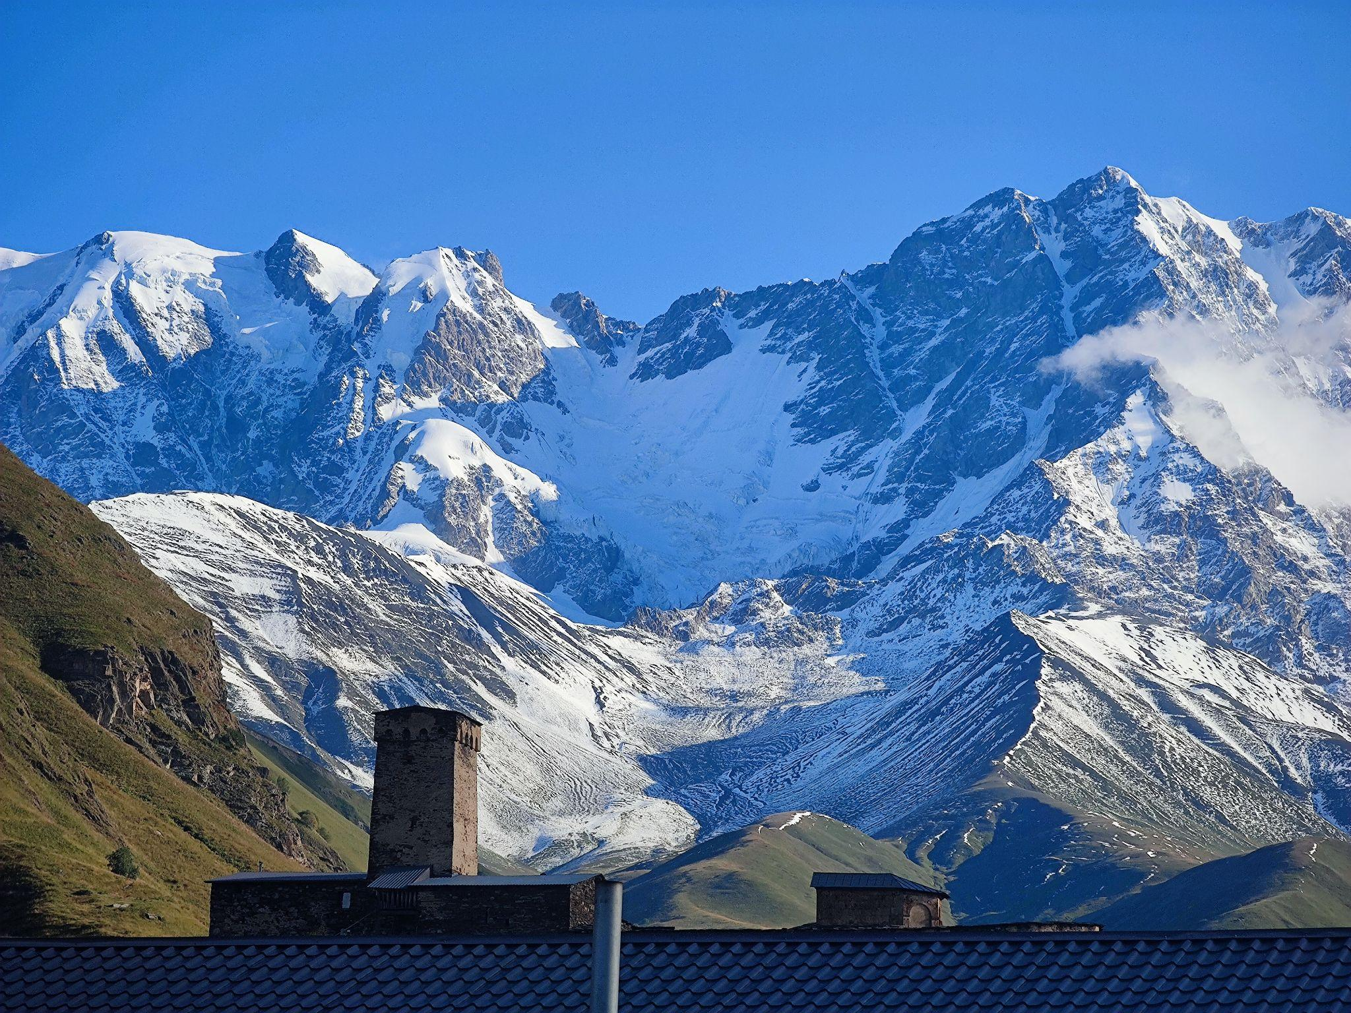
Quiz time
Digital Camera
or
Smartphone Camera

Slide 6
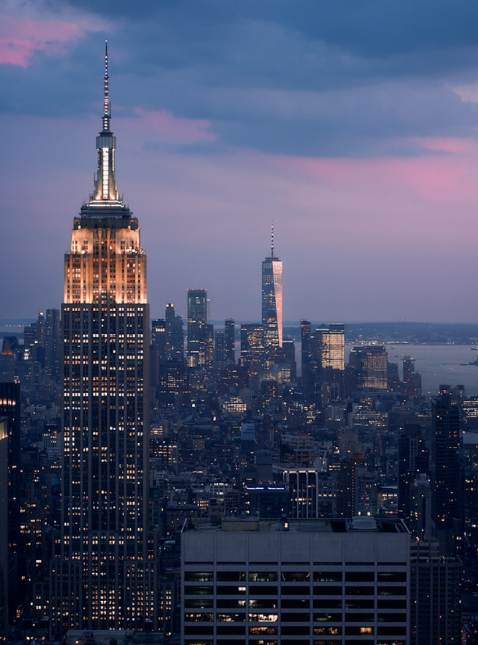
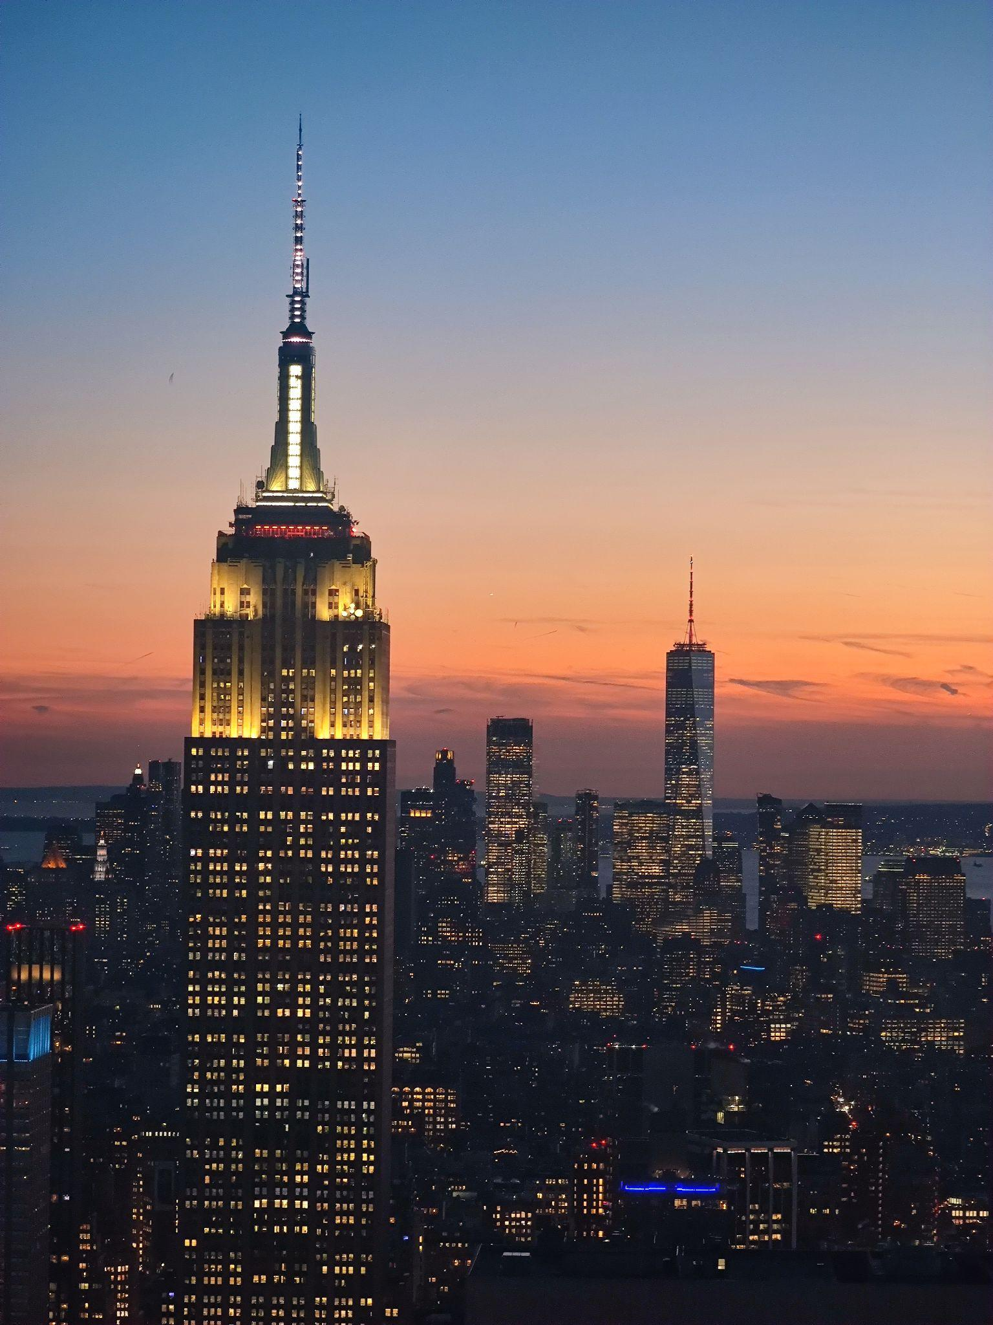

Slide 7
Xiaomi mi 11 ultra
Canon EOS 80D

Slide 8
Olympus OM-D E-M1
Xiaomi mi 11 ultra
Notes:
אם קשה לנו לזהות אפילו בין טלפון למצלמה מקצועית אז דמיינו כמה זה קשה לזהות בין כל סוגי המצלמות בעולם

Slide 9
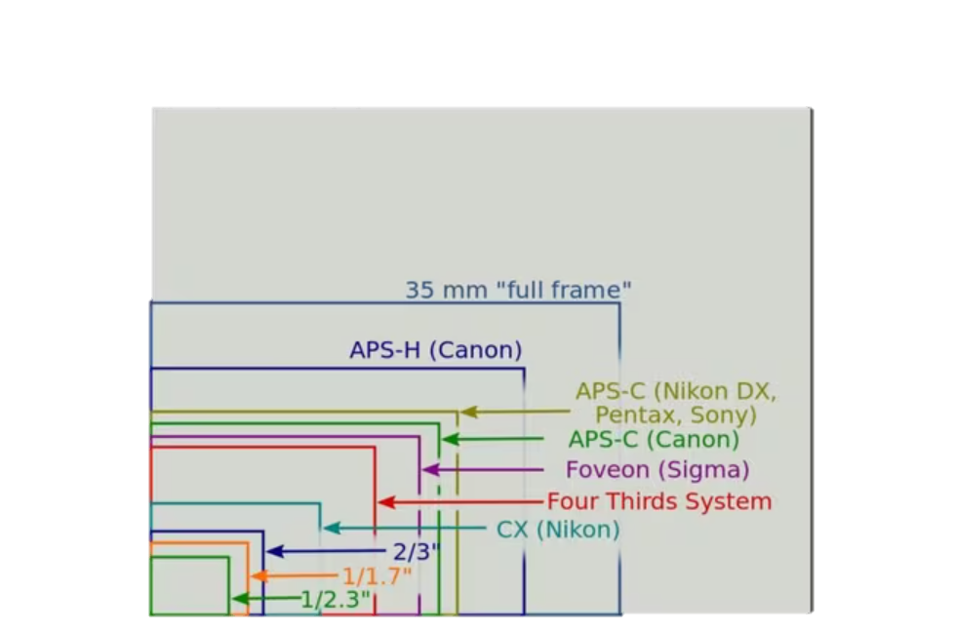
Approaches:
Camera characteristics:
Defective pixel locations
Noise level
Image format
Problem: Original acquiring camera needed.
Notes:
מאפייני המצלמה, פגמים בפיקסלים

Slide 10
Source/Camera Model Identification Using SVM Classification And Image Features

Slide 11
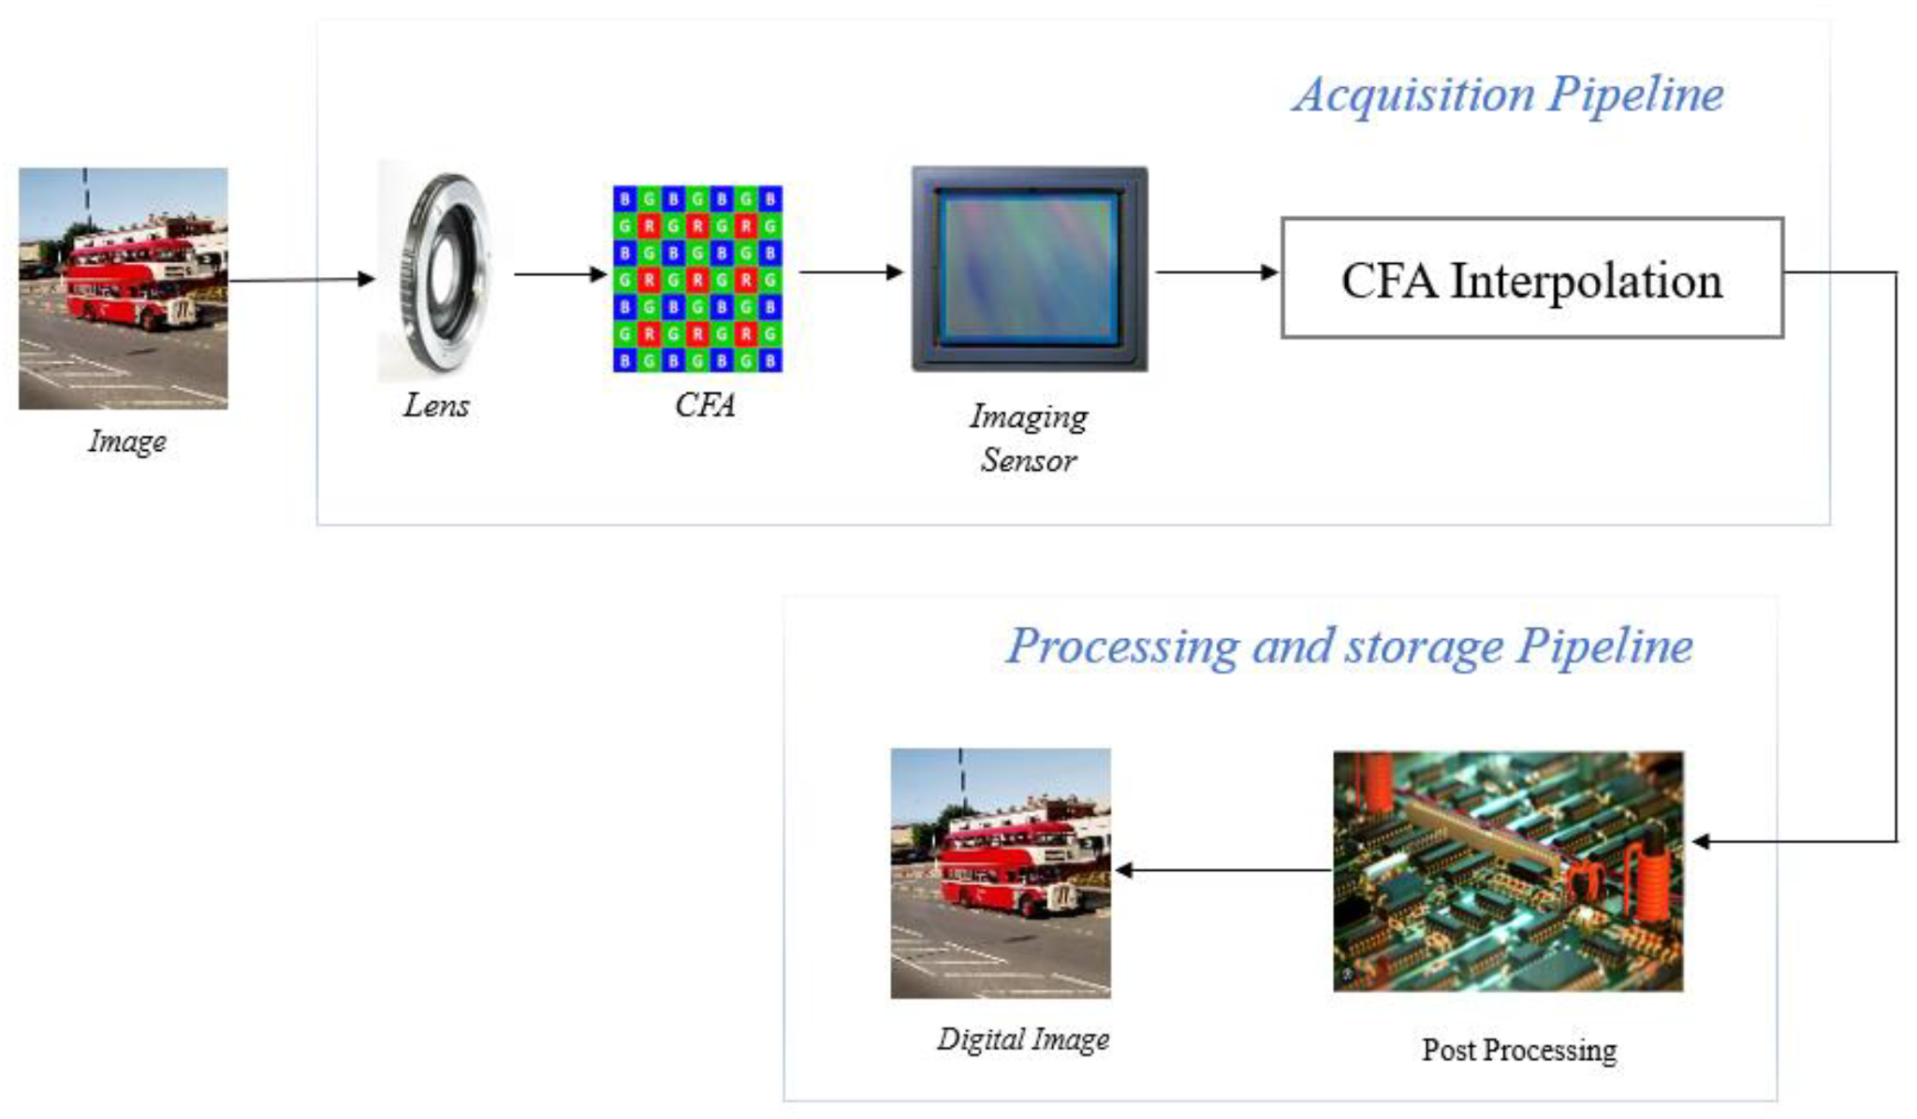
How digital cameras differ?
CFA configuration and the demosaicing algorithm
Camera’s Post Processing.
Notes:
מה ייחודי לכל מצלמה? שאלה לקהל

Slide 12
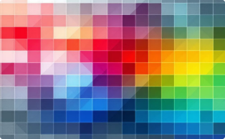
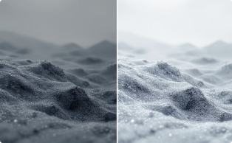
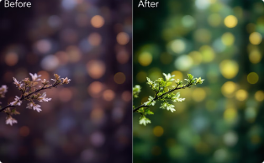
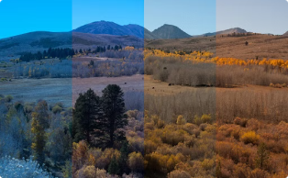
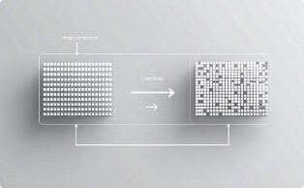
Camera Image Processing
Color Interpolation
Gamma Correction
Color Processing
White Point Correction
Compression
Notes:
Color interpolation fills in missing color intensities using neighboring pixels.
Gamma correction adjusts the brightness and contrast of the image.
Color processing makes images visually appealing.
neutralizes any color casts caused by the lighting conditions.
reduces file size while minimising information loss.

Slide 13
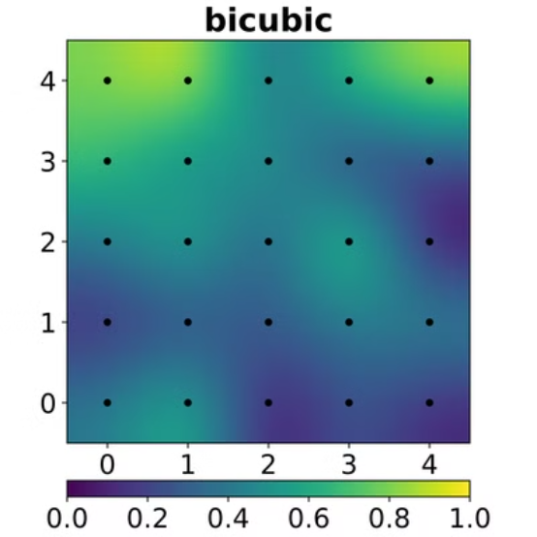
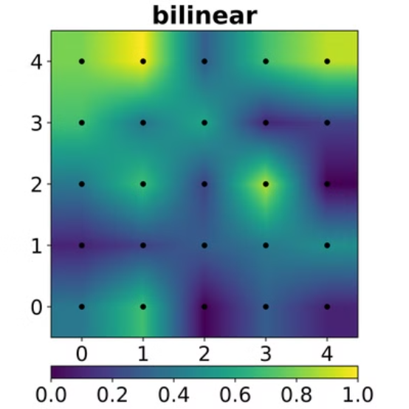
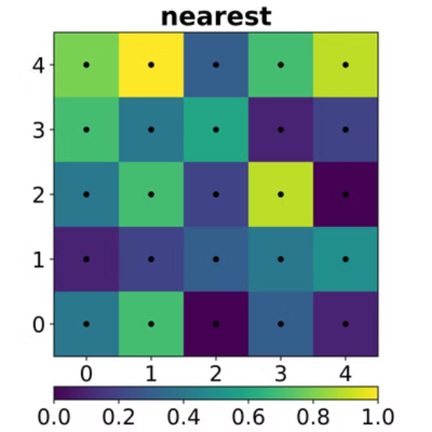
Color Interpolation
Constructs full-color image
Fills in CFA missing color values
Notes:
Color Interpolation - Fills in missing color values at each pixel in an image captured through a CFA.
Different Color Interpolation algorithms have different intensity distribution around the pixels.

Slide 14
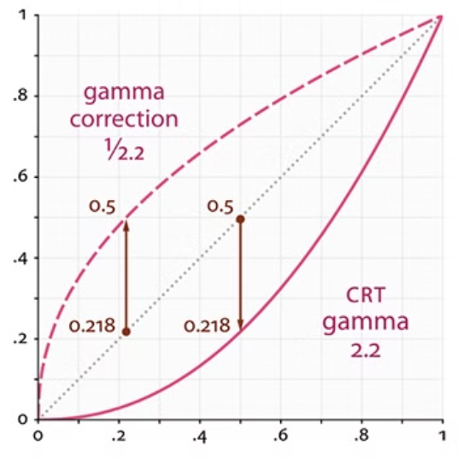
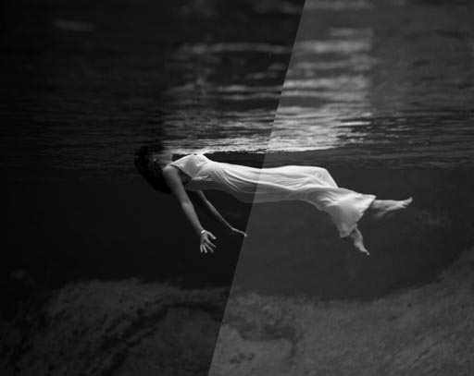
Gamma Correction
Adjusts the brightness and contrast.
Compensates for the nonlinear response of human vision to light intensity.
Notes:
Gamma Correction - Adjusts brightness and contrast to account for the nonlinear response of human vision.

Slide 15
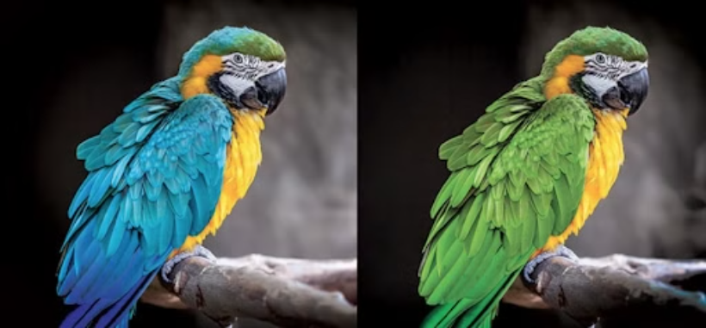
Color Processing
Modifies the appearance of an image by adjusting hue, saturation, tone, and other color properties.

Slide 16
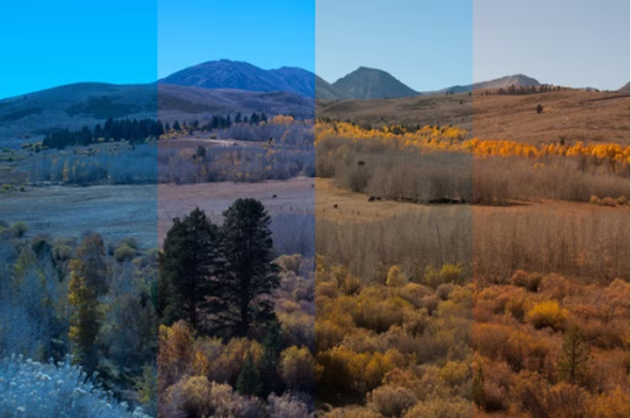
White Point Correction
Neutralizes color casts caused by different lighting conditions by scaling the RGB channels.
Ensures that objects meant to appear white look truly white in the image.

Slide 17
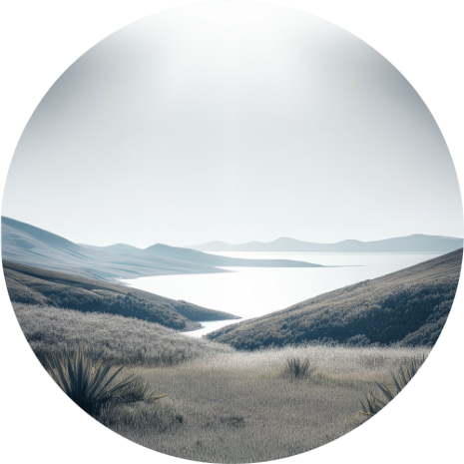
Image Compression Types
compression techniques
Uncompressed Original
Lossy Compression
Lossless Compression
containing all original data and detail.
Reduces file size by removing high frequency data.
Preserves image quality while reducing file size.

Slide 18
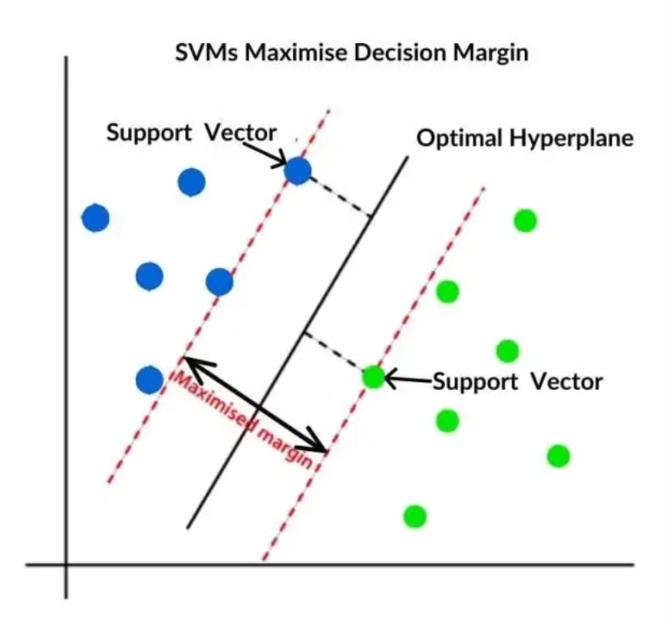
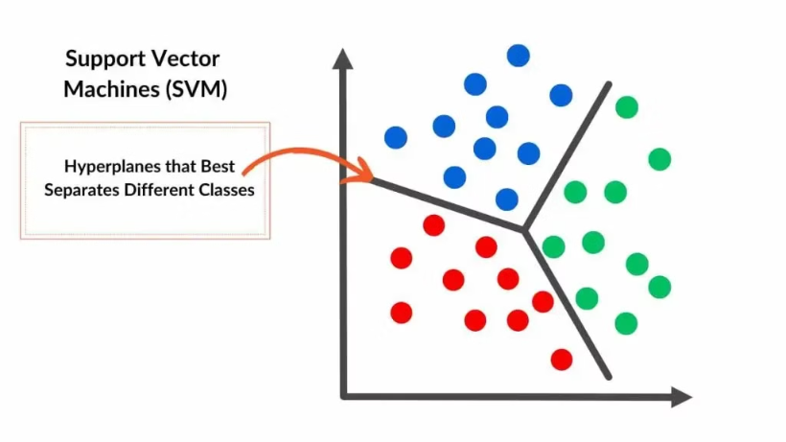
SVM Classification

Slide 19
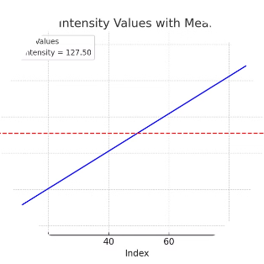
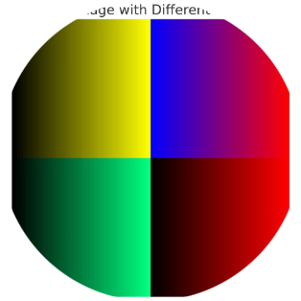
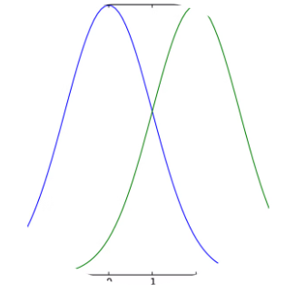
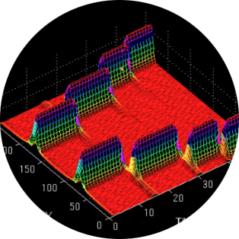
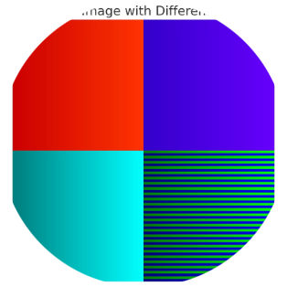
Feature Extraction for Camera Identification
Average Pixel intensity
RGB Pairs Correlation
Neighbor Distribution Center of Mass
Wavelet Domain Statistics
RGB Pairs Energy Ratio

Slide 20
Average Pixel Intensity
Measures the mean value of the three RGB channels.
If the intensities had been changed in a way that did not preserve the mean, this feature will be affected.
I_c(i) = Intensity of pixel, i in channel c (R, G, or B)
N = Total number of pixels in the image || c = Color channel

Slide 21
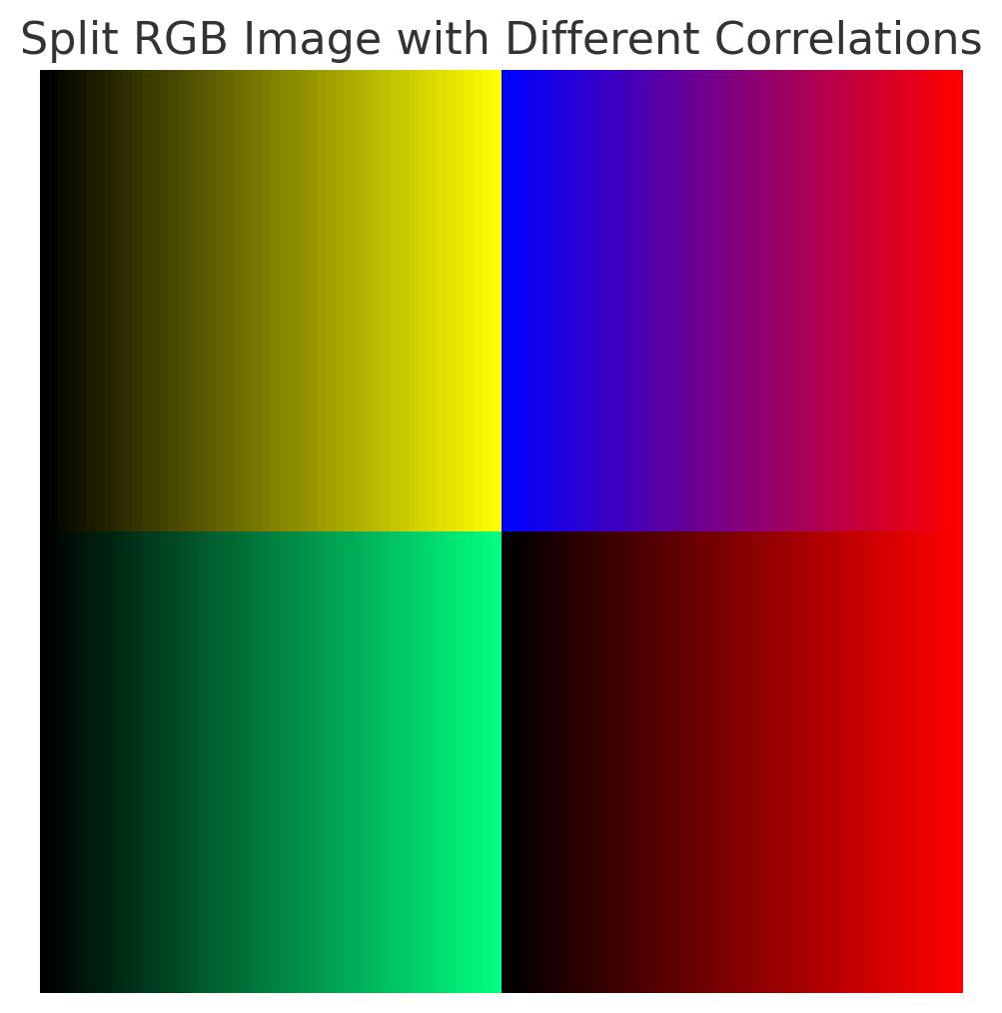
RGB Pairs Correlation
Evaluates the correlation between different color channels (RG, RB, GB).
Captures how the relationships between channels vary based on the camera’s processing pipeline.

Slide 22
Neighbor Distribution Center of Mass
sensitive to local intensity variations
sensitive to intensity scaling and shifting.
xᵢ: Intensity value.
nᵢ: Number of neighbors with intensity xᵢ.

Slide 23
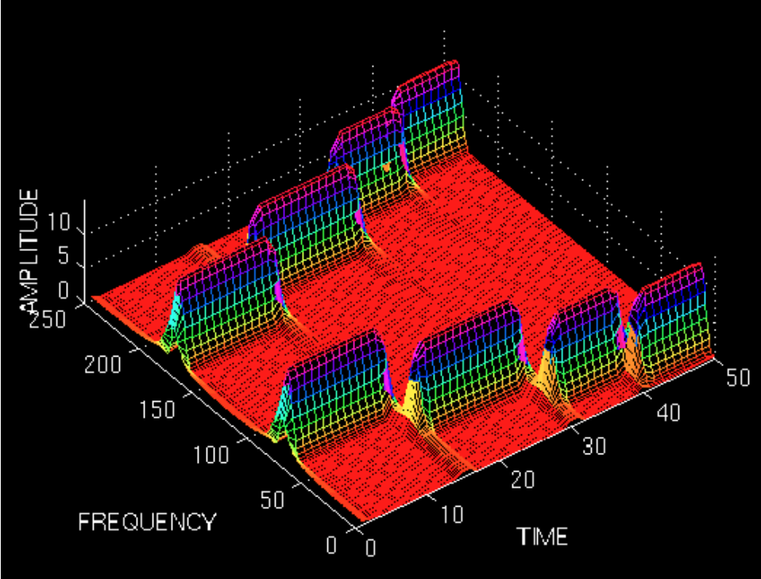
Wavelet Domain Statistics - LH,HL,HH Mean
Wavelet transforms decompose an image into different frequency bands, We then take their magnitude mean.
Measure localised intensity variations in the image.
Notes:
So basically, the Wavelet Transform (WT) does not look at the entire row when calculating frequency but instead focuses on a smaller area around the pixel we are analyzing. It calculates how close the intensity variations in the neighborhood are to a certain frequency band.
It does so by using a wavelet function on the entire row. The function ignores pixels that are not in the neighborhood and is centered on the pixel we are analyzing. The function can be stretched or compressed according to the frequency band we want to analyze. The function calculates a magnitude, which is a measure of how close the variations in the neighborhood are to the oscillation of the frequency band.
אז בעצם, ה-Wavelet Transform (WT) לא בוחן את כל השורה כאשר הוא מחשב frequency, אלא מתמקד בשכונה מסביב לפיקסל אותו אנו מנתחים. הוא מחשב עד כמה השינויים בעוצמת האור בשכונה קרובים ל-frequency band מסוים.
הוא עושה זאת על ידי שימוש ב-wavelet על כל השורה. ה-wavelet מתעלם מפיקסלים שאינם בשכונה והוא מרוכז בפיקסל אותו אנו בוחנים. ה-wavelet יכול להימתח או להתכווץ בהתאם ל-frequency band אותו אנו רוצים לנתח. ה-wavelet מחשב magnitude שהיא מדד למידת הקרבה בין השינויים בשכונה לבין התנודה של ה-frequency band המסוים.
זה נותן לנו מידע עבור כל פיקסל מה הfrequency של שינוי הבהירות בשכונה שלו

Slide 24
RGB Pairs Energy Ratio
Measures the energy distribution among the RGB channels.
Ratios include ERG=EG/ER, ERB=EB/ER, EGB=EB/EG.
Sensitive to changes from white point correction and gamma correction.
Ic​(i): Intensity of pixel iii in channel ccc.
N: Total number of pixels in the image.

Slide 25
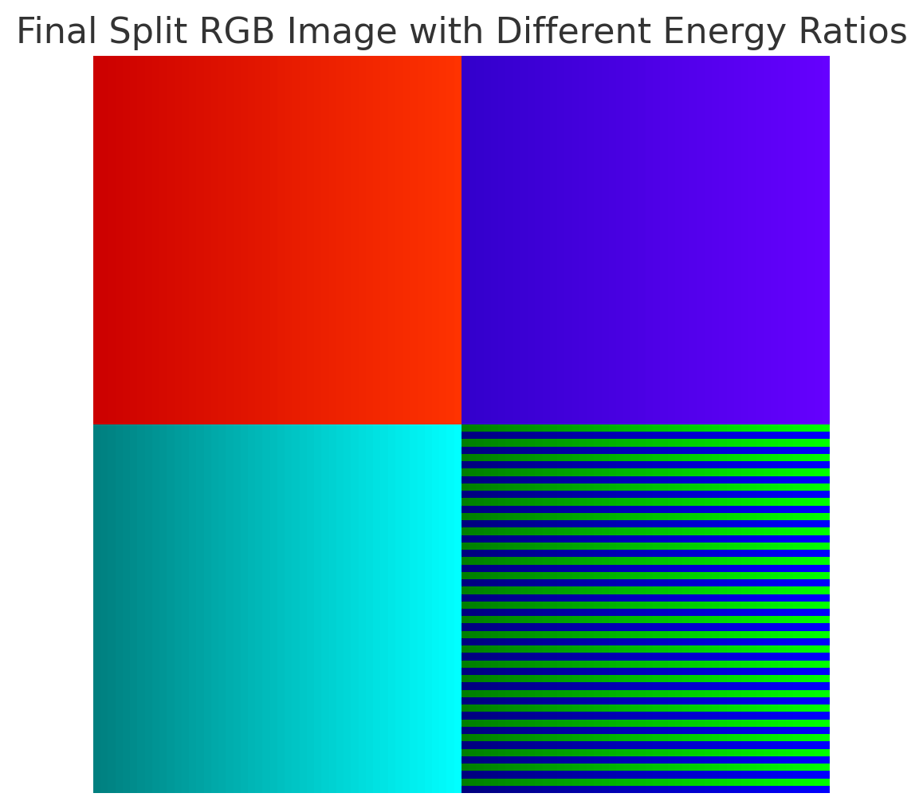

Slide 26
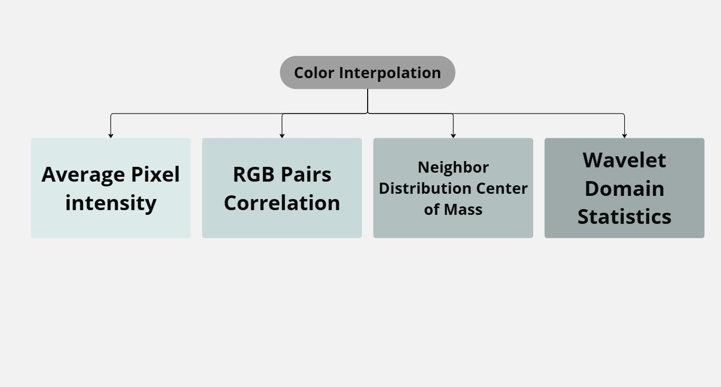
Features Related To Color Interpolation
Notes:
Average Pixel Value: CFA interpolation changes the intensity distribution of the pixels and therefore affects the Average Pixel Value.
RGB Pairs Correlation: Different interpolation algorithms (e.g., bilinear, bicubic, or gradient-based) create unique patterns in channel correlations.
Neighbor Distribution Center of Mass: This feature is sensitive to local intensity variations and will differ based on the interpolation algorithm.
Wavelet Domain Statistics: color interpolation changes the local intensity distribution which changes the rate of change of intensity in the neighborhood of each pixel.Since the Wavelet Transform (WT) focuses on these local intensity changes, this will affect the mean of the magnitude.

Slide 27
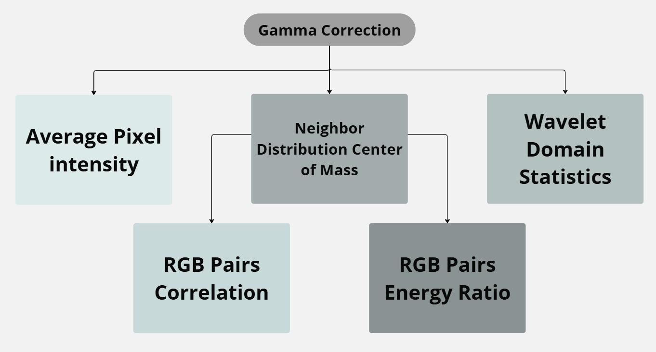
Features Related To Gamma Correction
Notes:
Average Pixel Value: Gamma correction performs over-brightening or darkening, significantly changing the average pixel value in each RGB channel.
RGB Pairs Correlation: Gamma correction adjusts brightness and contrast through a nonlinear transformation, altering the correlation between channels.
Neighbor Distribution Center of Mass: Depending on the gamma correction strength, low-intensity pixels transform more than high-intensity pixels, reducing neighbors at a ±1 intensity difference.
RGB Pairs Energy Ratio: Gamma correction scales intensities, affecting this ratio as it depends on the sum of squared intensities.
Wavelet Domain Statistics: Gamma correction affects each intensity value non-linearly, meaning the adjustment depends on the original intensity. This non-linear adjustment changes the rate of change of intensities between neighboring pixels, which in turn affects the Wavelet Transform (WT) coefficients and, consequently, the Wavelet Domain statistics.

Slide 28
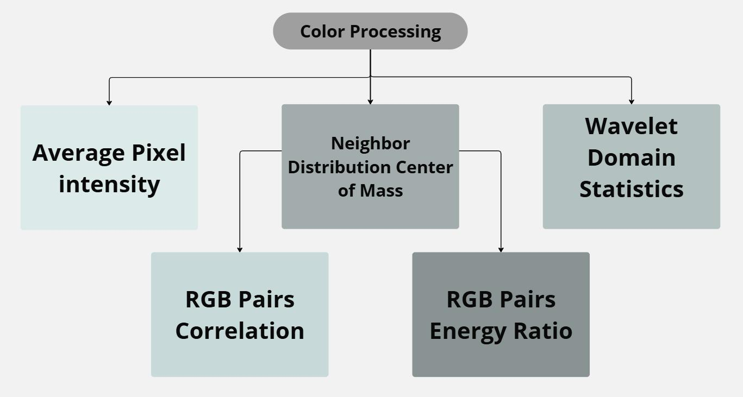
Features Related To Color Processing
Notes:
Average Pixel Value: Reflects adjustments made during color processing.
RGB Pairs Correlation: Changes in hue, saturation, tone, and other properties alter intensities differently for each channel changing channel correlations.
Neighbor Distribution Center of Mass: Local intensity adjustments affect this feature.
RGB Pairs Energy Ratio: Reflects how the RGB channels are modified relative to one another during processing.
Wavelet Domain Statistics: any color processing that affects the local intensity distribution.

Slide 29
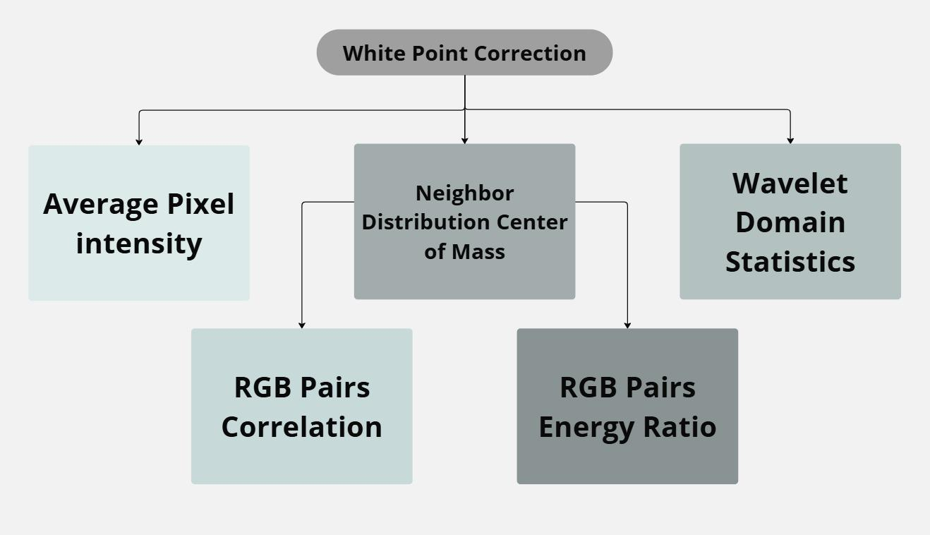
Features Related To White Point Correction
Notes:
Average Pixel Value: Scales RGB channels to neutralize color casts, directly affecting each channel's average pixel value.
RGB Pairs Correlation: Scaling RGB channels alters inter-channel correlations.
Neighbor Distribution Center of Mass: White Point Correction scales the color channels, which may cause neighbors that were ±1 intensity difference from each other to drift further, thus modifying this feature.
RGB Pairs Energy Ratio: Independent scaling of RGB channels affects this ratio.
Wavelet Domain Statistics: White Point Correction scales the color channels changing the local intensity distribution.

Slide 30
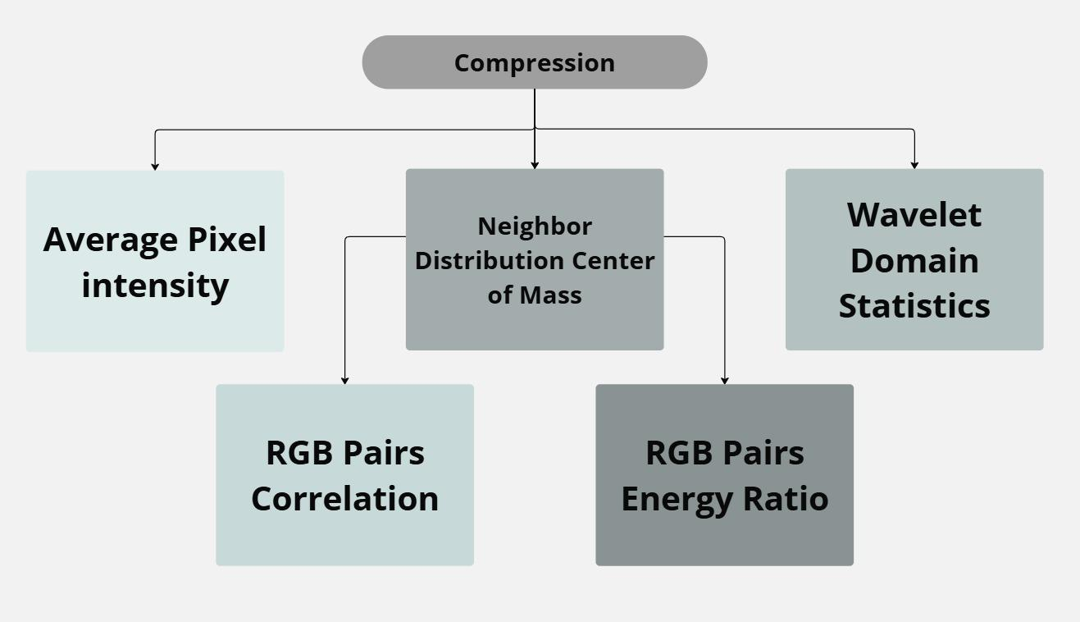
Features Related To Compression
Notes:
Average Pixel Value: Lossy compression may slightly change pixel intensities, reducing the precision of the average pixel value as a feature.
RGB Pairs Correlation: reduces details may cause the correlation to increase as sharp details usually mean less correlation between the channels
Neighbor Distribution Center of Mass: Quantization during compression reduces the number of unique intensities, making it harder for this feature to accurately capture local variations in intensity.
RGB Pairs Energy Ratio: reduces details cause slight unknown variation.
Wavelet Domain Statistics: Compression prioritize preserving low-frequency information.

Slide 31
Process of Deducing Camera Source
Analyze the image and extract key features
Classify Using a SVM classifier
1
2
3
Train a SVM classifier on a reference database.
Input the extracted features of the unknown image into the model.
The model predicts the most probable camera source based on its separating hyperplane.

Slide 32
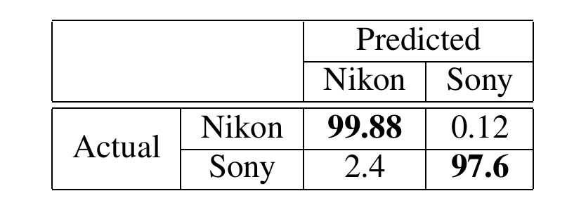
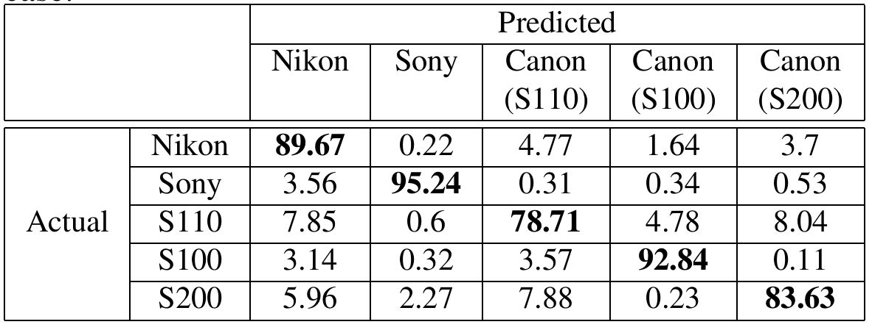
Test accuracy results
2 cameras case:
5 cameras case:

Slide 33
Limitations
Sensitive to the camera’s post processing pipeline, any change in one of the post processes can result in a misclassification.
Needs large database of images of different scenery from each camera for the training process.
Cannot detect the source device if it wasn’t
part of the training process.
We might want to search for an identification
method that does not depend on the post processes.

Slide 34
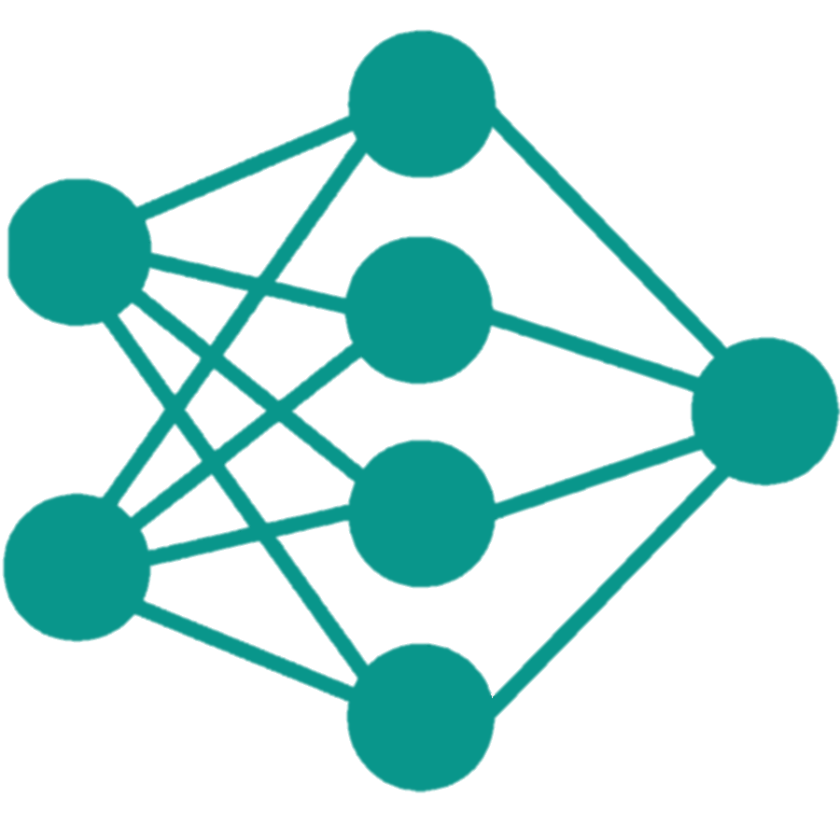
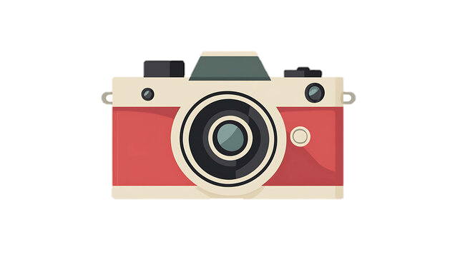
CNN-Based
Source Device Identification

Slide 35
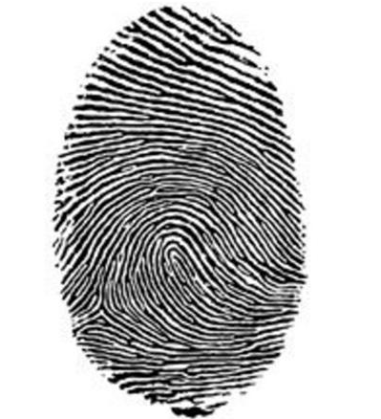
Photo Response Non-Uniformity (PRNU)
Unique pattern noise:
caused by imperfections in the sensor manufacturing process and represents a unique pattern noise associated to a certain device.
Some call it the camera’s fingerprint
Notes:
קודם כל, צריכים לדעת מה פירוש המושג PRNU

Slide 36
PRNU

Slide 37
Computing PRNU & Noise Residual
Preprocess a set of Images from the same device.
Estimate the Noise Residual W for each image:
𝑾: Noise residual
𝑰: Original image
𝑰’: Denoised image
Notes:
Preprocess: הסרת רעשים ,

Slide 38
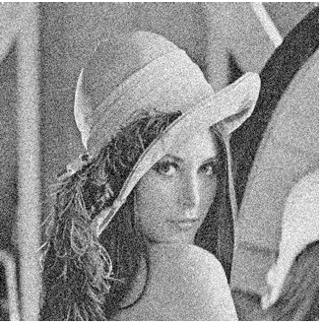
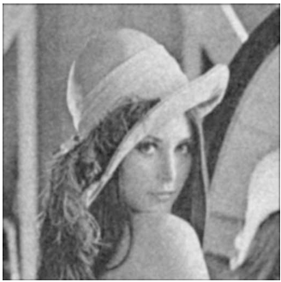
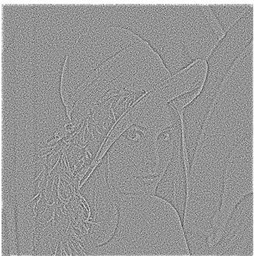
Noise Residual Example
$$I$$
$I$’
$$W$$

Slide 39
Computing PRNU & Noise Residual
III. Average the noise residuals:
K: PRNU
𝑾𝒊: Noise residual of image 𝒊
N: Total number of images.
IV. Normalize the PRNU pattern so it reflects only the pixel sensitivity variations.
Notes:
Preprocess: הסרת רעשים , noise residual שאריות הרעש, נרמול הPRNU

Slide 40
PRNU
PRNU (Photo Response Non-Uniformity ) Comparing
PRNU estimating
Denoising and PCE
Comparing
Based on set of images from the same device
Denoise the image under test and calculate the peak to correlation energy (PCE)
Compare the image PCE with the sensor fingerprint

Slide 41
PRNU Comparing

Slide 42
The problem with the approach:
Computationally expensive
With the increasing resolution of digital sensors, the search time may become prohibitive even for a moderate fingerprint database.
So, what to do?
Notes:
סיבוכיות לא יעילה בחישוב ה PCE בין רעש התמונה לבסיס התמונה , זמן חישוב ארוך

Slide 43
Leveraging Convolutional Neural Networks(CNN)
Notes:
שכבות של קונבולוציות

Slide 44
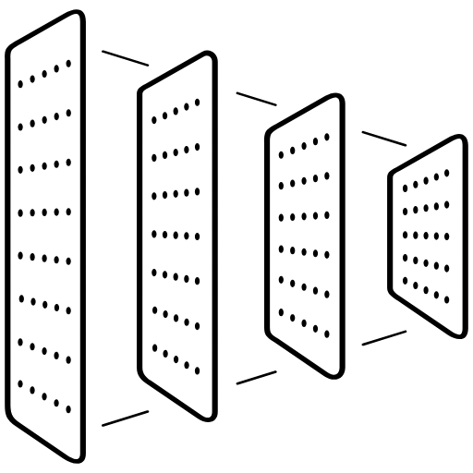
Leveraging Convolutional Neural Networks(CNN)
In short:
Replace the PCE test with CNN based method.
Consider only small patches extracted from the estimated PRNUs and the noise residual of the test image.
2 channels (2 inputs to the network),
3 convolutional layers neural network
will learn the best way to compare patches.

Slide 45
Architecture
K
W
K: Device PRNU estimation
W: Noise residual of given image
P: Size of patches of K and W
Cs: CNN based identification score
(similarity measure)
Convolutional layers
Pair-wise correlation pooling
Output:
Cs
Notes:
shallow network=fast computations

Slide 46
Pair-Wise Correlation layer
It’s the next layer after the convolutional layers.
Aggregating the inter-feature relationships across spatial dimensions (Pooling).
Computes a correlation between pairs of features.
The main motivation behind this layer is to provide fast computations.

Slide 47
Pair-Wise Correlation layer
P3: Size of features computed by previous layer.
P4: Output size of the Pair-WiseCorrPooling layer.
n: Channel index.

Slide 48
Let’s dive deeper into the method
We define:
d : The device a set of images are coming from
Kd : Device PRNU estimation
W : Noise residual of given image
Cs : CNN based identification score

Slide 49
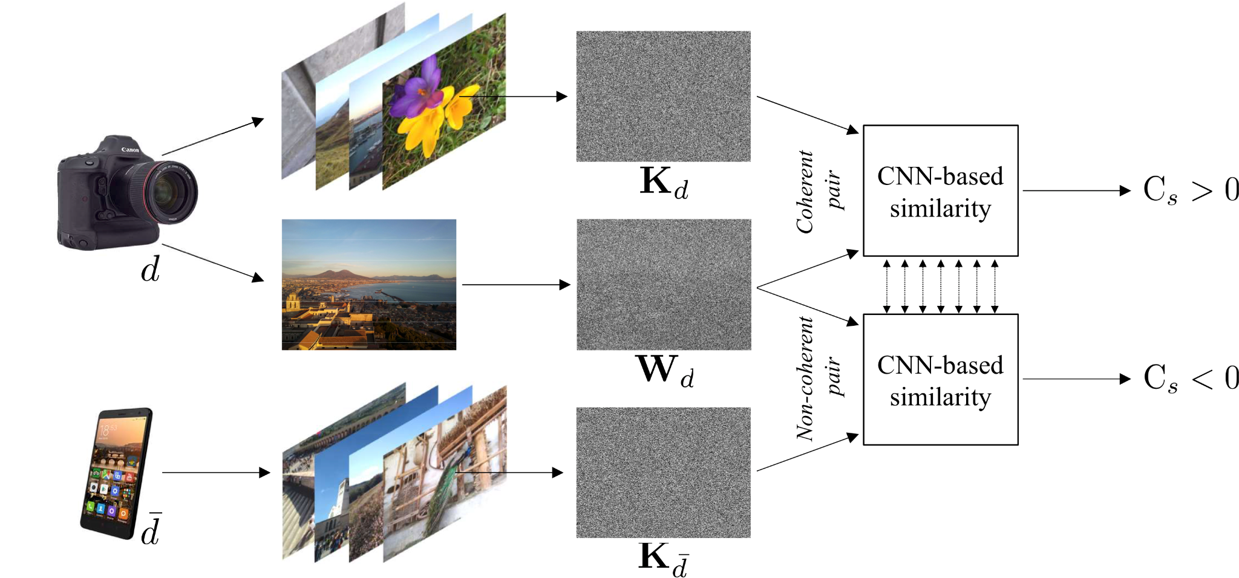
Training the network
d : The device a set of images are coming from
Kd : Device PRNU estimation
W : Noise residual of given image
Cs : CNN based identification score
Notes:
Noise residual = שאריות רעש

Slide 50
Training the network
Feed the CNN with Kd obtained from a set of images and Wd from the same device.
Do the same for PRNU (Kd) and residue (Wd) of diverse devices.
The network will learn to return high Cs for coherent pair and low for non-coherent ones.
Repeat until accuracy over validation set is maximized.
Notes:
Noise residual = שאריות רעש accuracy= אחוז של שיעור נכון

Slide 51
Deploying the network
Feed the network with pairs of PRNU and image residue
The right device will give the highest Cs (score).
Notes:
Noise residual = שאריות רעש accuracy= אחוז של שיעור נכון

Slide 52
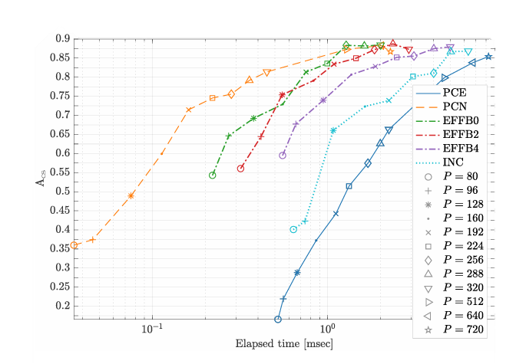
Test results
Results of testing the network using traditional PCE vs using different CNN models.
Acs: Accuracy score (the average fraction of correct predictions per device)
P: Crop size
Notes:
Noise residual = שאריות רעש accuracy= אחוז של ניחוש נכון

Slide 53
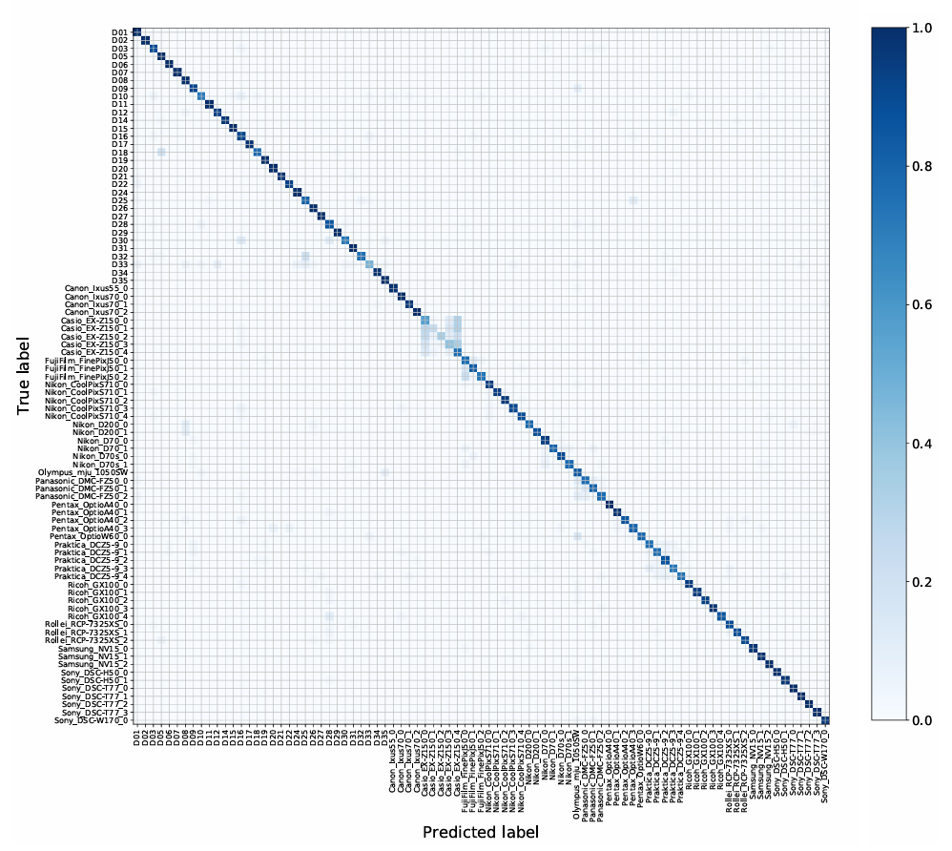
Test results
Accuracy results over different devices using CNN model EFFB4 & Crop size P = 288
Notes:
דגמים שונים של מצלמות, כמה שיותר כהה כמה שיותר מדויק

Slide 54
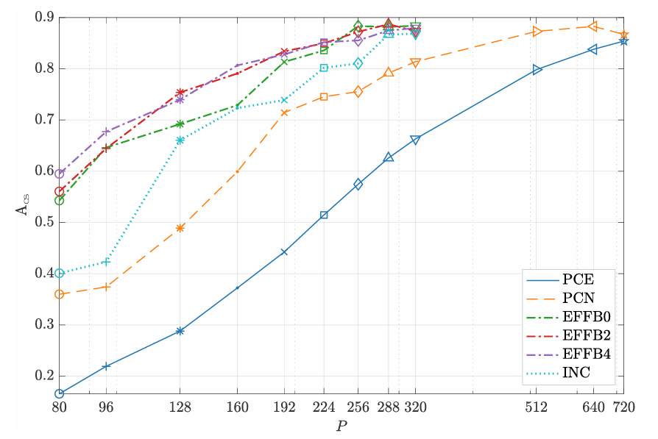
Main advantages
Faster & More Accurate than PCE

Slide 55
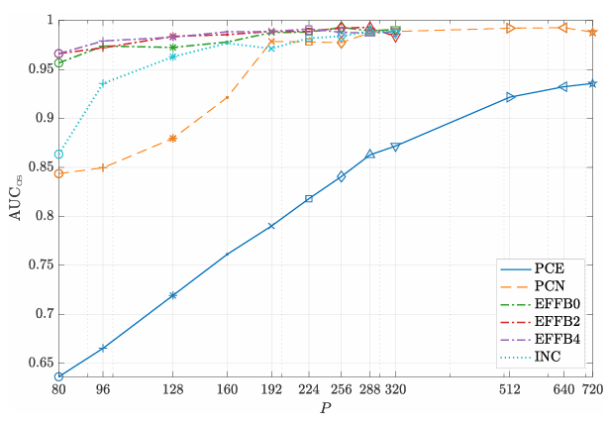
Main advantages
Can be used to compare images and devices even if the device wasn’t part of the training process
Notes:
AREA UNDER THE CURVE, A METRIC TO COMPUTE ACCURACY מדד לחישוב דיוק

Slide 56
Possible future improvements
Deeper CNNs are currently under investigation for possibly enabling to achieve even better accuracy.
But could cost with processing time.
Notes:
צריך לקחת בחשבון שזמן החישוב יכול לעלות אז צריך לחשוב על איזון בין

Slide 57
Summary
Defining the Camera/Source Identification problem and its importance in real life.
Identifying source device with SVM Classification And Image Features, while assuming camera post processing pipeline mostly doesn’t change.
Otherwise we can use CNN ->
Notes:
פונקציית דמיון, מינוף, סי אן אן המבוסס על שני ערוצים

Slide 58
Summary
Providing fast solution to the image device identification problem with Machine learning.
Leveraging CNN by using 2-channel-based CNN, able to learn the best similarity function for source device identification.
Revealing the pros of CNN
compared to other methods.
Notes:
פונקציית דמיון, מינוף, סי אן אן המבוסס על שני ערוצים

Slide 59
References and Sources
https://github.com/polimi-ispl/cnn-fast-sdi?tab=readme-ov-file
CNN-based fast source device identification
Example Applications | Neural Networks
Best Camera to Buy in 2024 - CNET
Flickr
Flickr
Fingerprint
PRNU video
Youtube
The Unknown Photographer
Adobe Stock
PNGegg
M. Kharrazi, H. T. Sencar, and N. Memon, “Blind source camera identification,” International Conference on Image Processing, pp. 709–712, 2004.
Polikar, R. (1996). The wavelet tutorial second edition part i. Fundamental Concepts & An Overview of The Wavelet Theory.‏
Nwokeji, C. E., Sheikh-Akbari, A., Gorbenko, A., & Mporas, I. (2024). Source Camera Identification Techniques: A Survey. Journal of Imaging, 10(2), 31.‏
Defective pixel
Formats
The use of residuals in denoising images
Future
Time running out
Limitations
Agenda
CNN
Diver
summary pic

