Slide 1
Lecture 2 - Statistics of natural images
Students: Ilan Vainblat, Shar-Yashuv Giat
Lecturer: Hagit Hel-Or

Slide 2
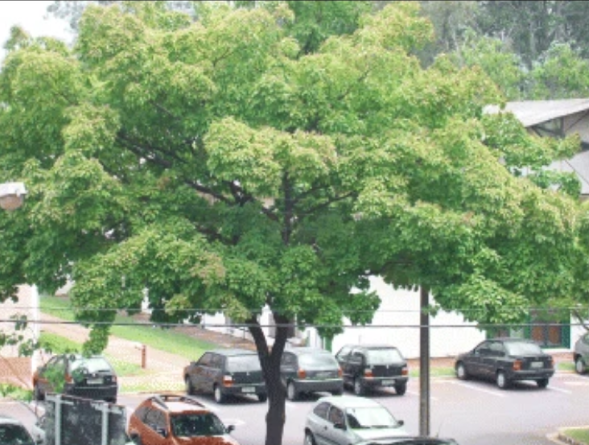
Notes:
Quiz: find the forgery. Ans: middle bright leaves are copied and rotated on the middle right

Slide 3
What we’ll see today:
Introduction to forgery technique
  COPY-MOVE
  SPLICING
Two methods for forgery detection (mainly COPY-MOVE)
  SIFT: Feature-point-based forgery detection
  DCT+SVM: block-based forgery detection
Live demonstration
Summary
Notes:
Ilan last slide

Slide 4
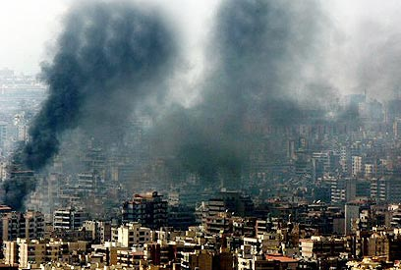
COPY-MOVE
The COPY-MOVE Image Forgery technique is a type of digital image manipulation where a portion of an image is copied and pasted into another area of the same image.
This is often done to duplicate or hide certain elements, like creating fake objects or obscuring important details.
Consistency in Source and Target Regions
Patches of pixels do not repeat themselves in real images so we can use that to detect forged images
Notes:
a lot of methods thats rely on physics won't work like light and shade from previous lecture.
Emphasize that we will look for repeating pixels.

Slide 5
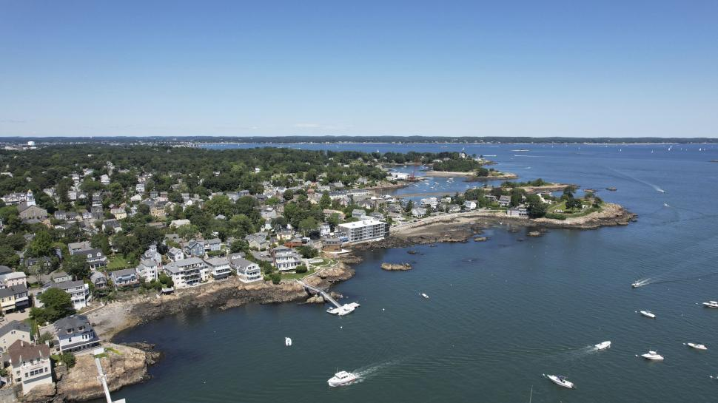


COPY-MOVE examples

Slide 6
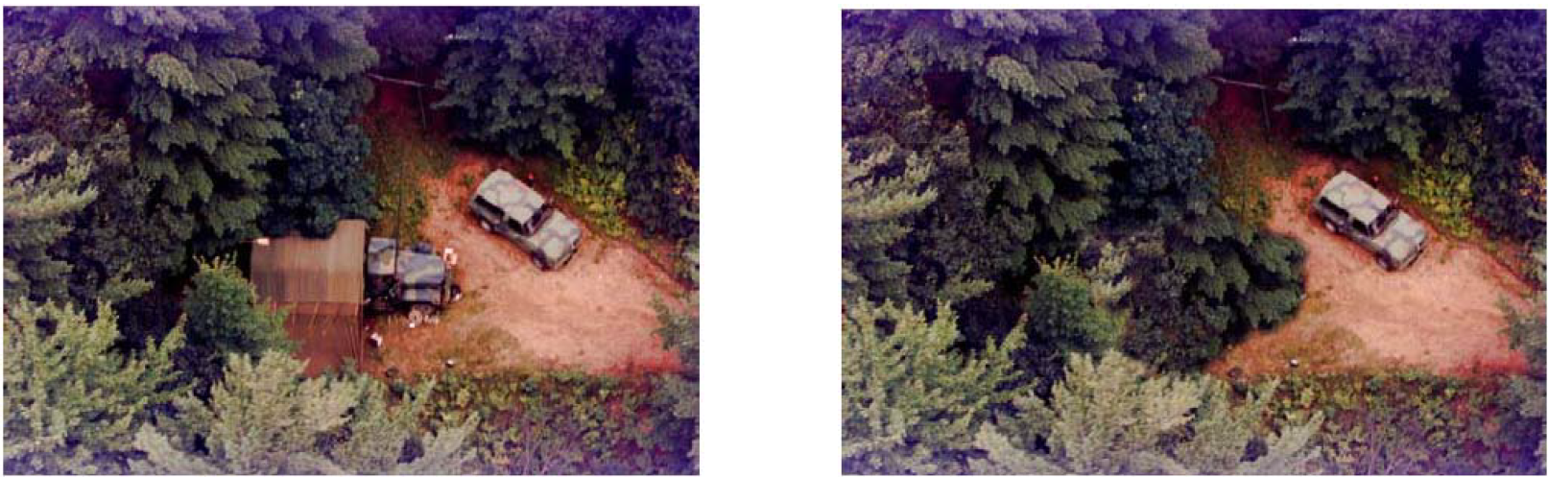
Example
Which of the following could be produced with COPY-MOVE forgery?
Notes:
answer: right one, there isn't a similar car to be copied but there are similar trees/bushes

Slide 7
SPLICING
Oxford dictionary: splice something (together) to join the ends of two pieces of film, tape, etc. by sticking them together.
In the context of images: combining several things from several images into one image.

Slide 8



SPLICING examples
Notes:
This is an extreme example, the second one is more common

Slide 9
We already saw SPLICING…
Notes:
להזכיר שראינו את זה בשבוע שעבר. שאר ישוב שקופית סוף

Slide 10
The methods we’ll show
Most methods that use statistical features are of the same form:
  Preprocess image
  Extract features
  Compare extracted features in different locations of the image
We’ll show two methods:
  One of the above form
  One that still uses statistical features but in a different way

Slide 11
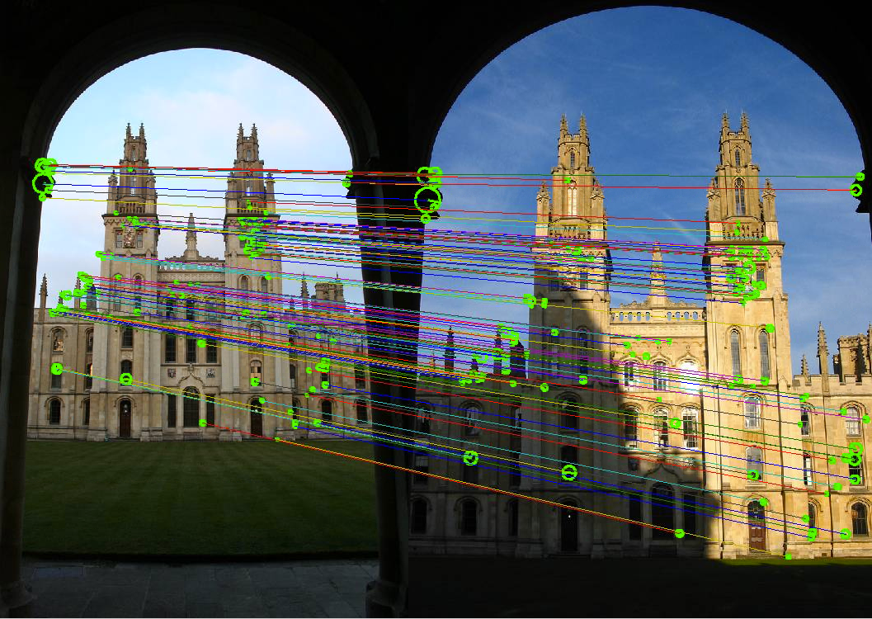
Method 1 - SIFT
Notes:
not originally designed for Forgery detection but for pattern matching and image aligning

Slide 12
Scale Invariant Feature Transform
Scale Invariant – can detect both big and small forgeries
Feature Transform – operates on keypoints, not blocks of an image (as you’ll see in DCT)
Detects COPY-MOVE forgeries
Notes:
Although not hinted by name, also rotation invaraint

Slide 13
4 steps of SIFT
Scale-space extreme detection
Keypoint localization
Orientation assignment
Keypoints descriptor
Notes:
each step could be divided into several steps, those are the classical ones

Slide 14


Scale-space extrema detection
Idea: blur the image, this will keep only the significant parts of the image

Slide 15
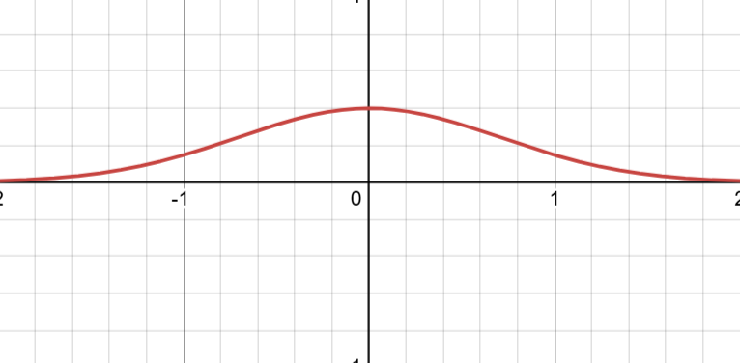
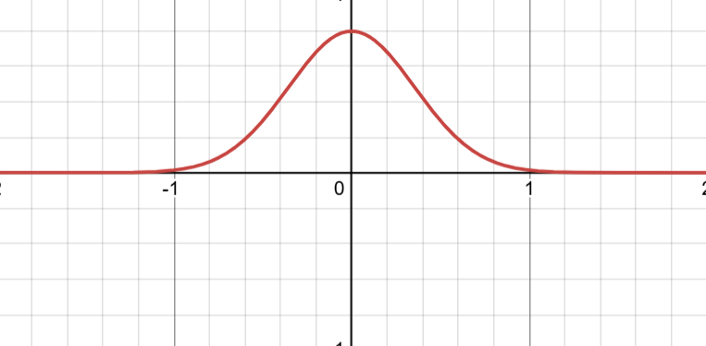

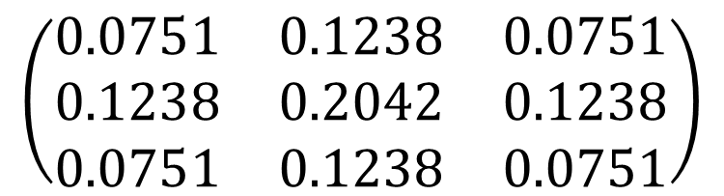
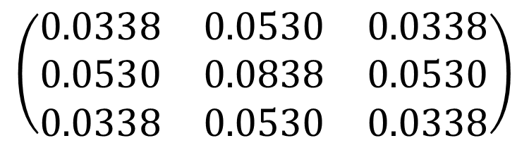
How to blur?
Standard deviation: $G\left(x, y, σ\right)=\frac{1}{2πσ^{2}}e^{−\frac{x^{2}+y^{2}}{σ^{2}}}$
Apply Kernal: $L\left(x, y, σ\right)=G\left(x, y, σ\right)∗I\left(x, y\right)$
Increasing $σ$ widens the Gaussian and intensifies the blur
$$\left(\begin{matrix}\text{0}\text{.}\text{0751} & \text{0}\text{.}\text{1238} & \text{0}\text{.}\text{0751} \\ \text{0}\text{.}\text{1238} & \text{0}\text{.}\text{2042} & \text{0}\text{.}\text{1238} \\ \text{0}\text{.}\text{0751} & \text{0}\text{.}\text{1238} & \text{0}\text{.}\text{0751}\end{matrix}\right)$$
$$\left(\begin{matrix}\text{0}\text{.}\text{0338} & \text{0}\text{.}\text{0530} & \text{0}\text{.}\text{0338} \\ \text{0}\text{.}\text{0530} & \text{0}\text{.}\text{0838} & \text{0}\text{.}\text{0530} \\ \text{0}\text{.}\text{0338} & \text{0}\text{.}\text{0530} & \text{0}\text{.}\text{0338}\end{matrix}\right)$$
Notes:
was taught in IP
more weight is given to the neighborhood when sigma increases (lower)

Slide 16
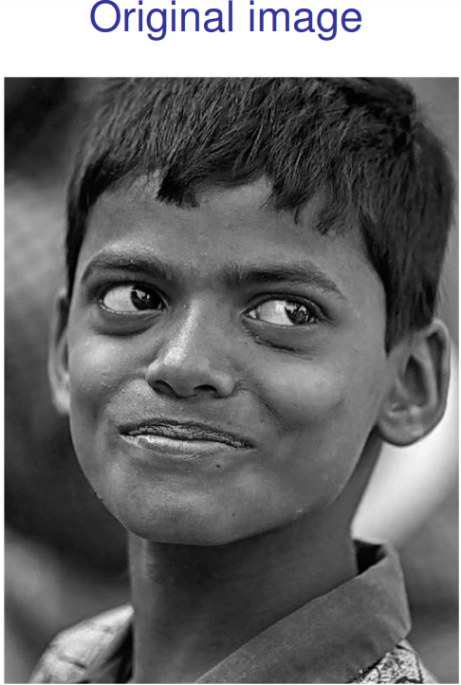
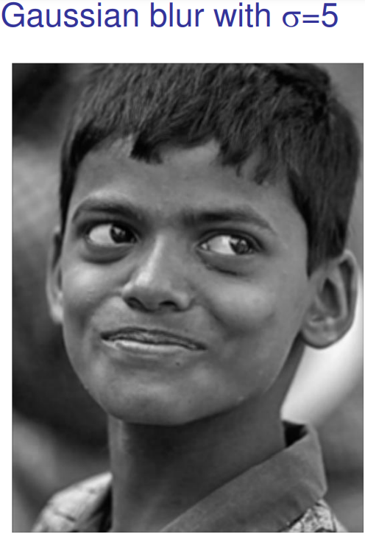
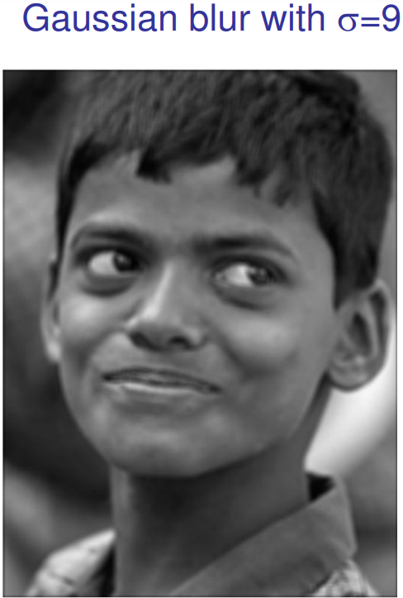
Effect of $σ$ on image blurriness

Slide 17
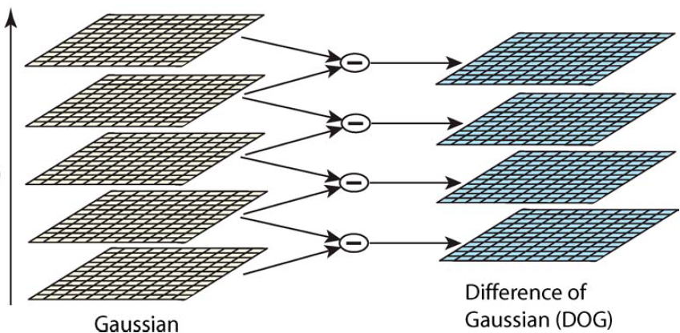

How to use the blurred images?
Difference of Gaussians (DoG): $D\left(x, y, σ\right)=$
$$\left[G\left(x, y, kσ\right)−G\left(x, y, σ\right)\right]∗I\left(x, y\right)=L\left(x, y, kσ\right)−L\left(x, y, σ\right)$$

Slide 18
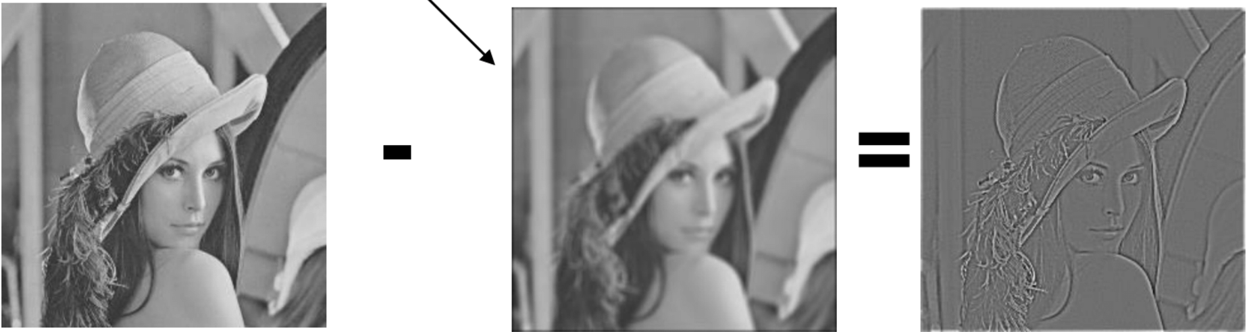
Keypoints
The keypoints are local minima or maxima of the DoG images (D) across scales
Notes:
left-original/low sigma
middle- higher sigma
right - DoG
the points that are an extrema are on lines/corners

Slide 19
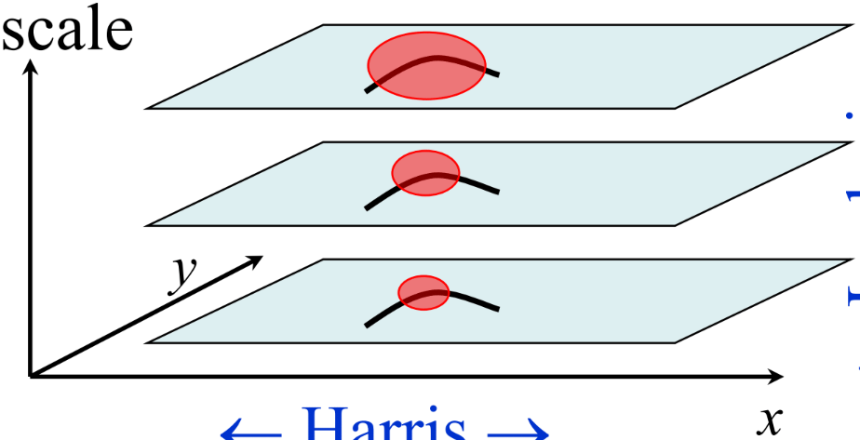
Why “across scales”
SIFT = Scale Invariant Feature transform
Notes:
and not just in the xy plane (same image)

Slide 20

Keypoint localization
Some of the points we found weren't great…
How to remove them? More complicated math of course!
which is essentially thresholds on a function of $D,(x, y, σ)$

Slide 21
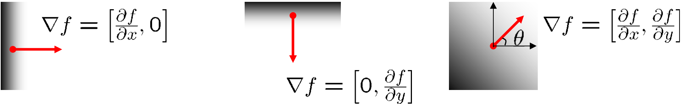
Orientation assignment
This is the step that will later help make SIFT invariant to rotation!
Assign magnitude (“significance”) and orientation (gradient direction) to each keypoint

Slide 22

How to assign magnitude and orientation
$L_{x}=L\left(x+1, y, σ\right)−L\left(x−1, y, σ\right)$
$L_{y}=L\left(x, y+1, σ\right)−L\left(x, y−1, σ\right)$
$m\left(x, y\right)=\sqrt{L_{x}^{2}+L_{y}^{2}}$
$θ\left(x, y\right)=\tan^{−1}\left(\frac{L_{y}}{L_{x}}\right)$
Notes:
gradient in x and y directions

Slide 23
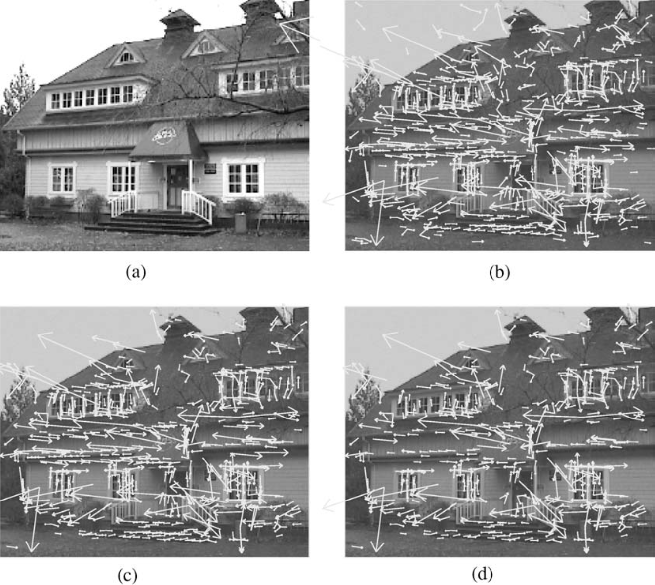
Recap
Notes:
a: original image
b: with keypoints
c: after aplying minimum threshold
d: after aplying maximum threshold

Slide 24
Keypoint descriptor
Magnitude & Orientation of keypoints is nice to have but not enough
We want to describe each keypoint with the magnitude & orientation of keypoints’ neighborhoods i.e., the general pattern around the keypoint

Slide 25
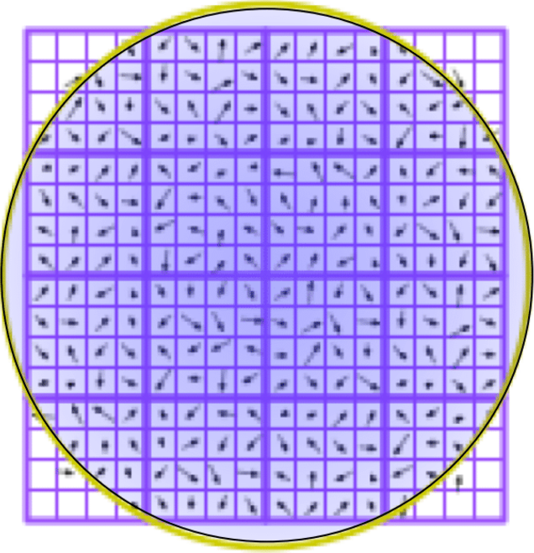

Keypoint descriptor – cont. 1
Consider the keypoint’s $16×16$ neighborhood, split it into 16 $4×4$ neighborhoods
Calculate magnitude & orientation of each pixel in the neighborhood using the same method used for keypoints

Slide 26
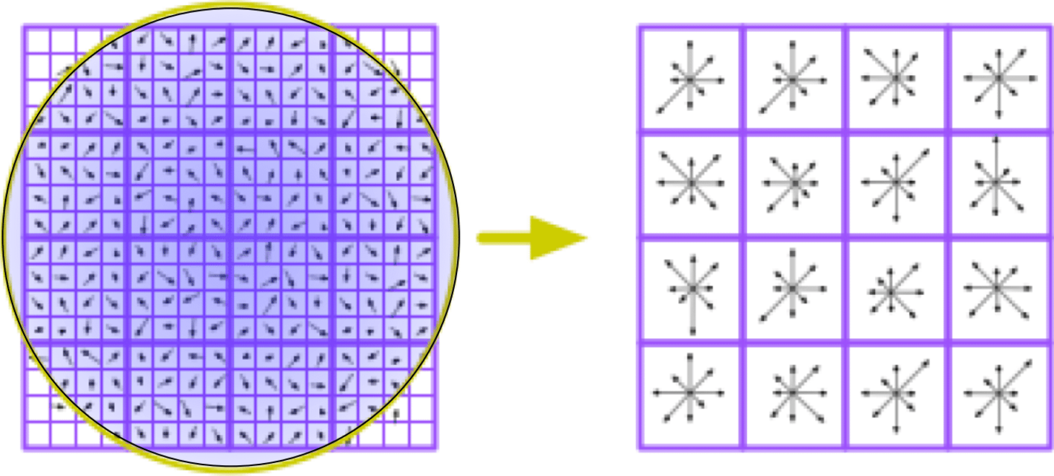
Keypoint descriptor – cont. 2
Split each orientation to 8 orientation bins (north, north-east, east, etc.)
The value of each bin is the sum of the magnitudes in the appropriate orientation and appropriate sub-neighborhood

Slide 27

Keypoint descriptor – cont. 3
To make the descriptor invariant to rotation, calculate it relative to the orientation of the appropriate keypoint
Total of 16 (amount of sub-neighborhood) $×$ 8 (amount of orientation bins per sub-neighborhood) = 128 features in a descriptor
2 | 1 | 2 | 3 | 1 | 2 | 2 | 2
2 | 3 | 1 | 2 | 2 | 2 | 2 | 1

Slide 28
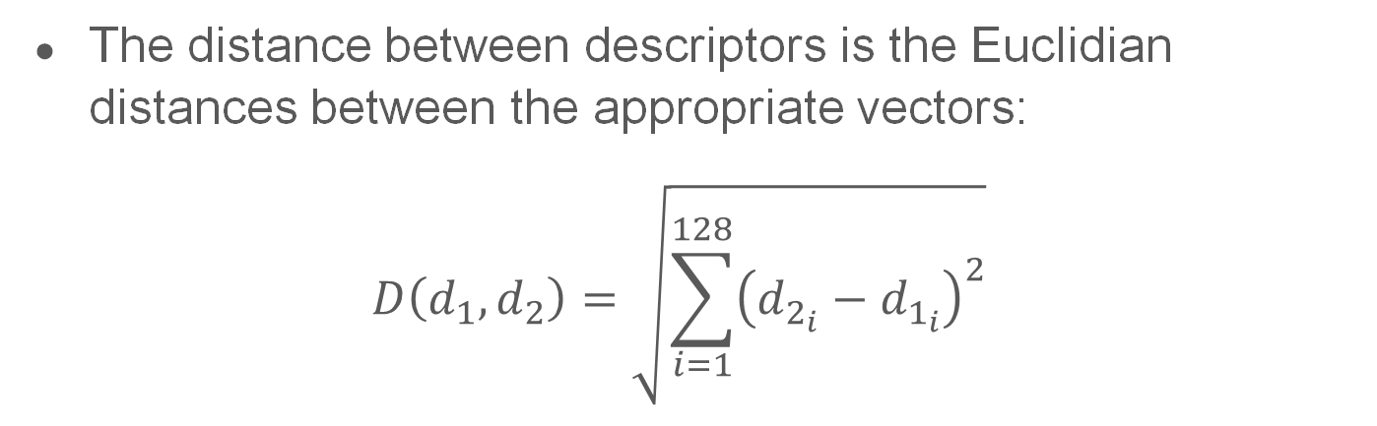
Comparing descriptors
The distance between descriptors is the Euclidian distances between the appropriate vectors:
$$D\left(d_{1}, d_{2}\right)=\sqrt{\sum_{i=1}^{128}{{\left(d_{2_{i}}−d_{1_{i}}\right)}^{2}}}$$
1 | 0.001 | 0.001 | 0.001 | …
0.127
0.98 | 0.011 | 0.0003 | 0.002 | …
3.266
1.3 | 0.24 | 0.32 | 0.278 | …

Slide 29
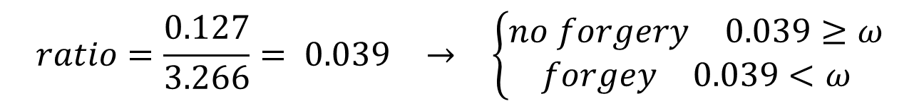

Almost done…
Two regions are decided to be a forgery iff their appropriate descriptors are very close
close enough = ratio of closest to second-closest neighbors is less than a threshold $ω$.
1 | 0.001 | 0.001 | 0.001 | …
0.127
0.98 | 0.011 | 0.0003 | 0.002 | …
3.266
1.3 | 0.24 | 0.32 | 0.278 | …
$$\begin{matrix}ratio=\frac{0.127}{3.266}= 0.039 & → & \left\{\begin{aligned}\begin{matrix}no forgery & 0.039≥ω\end{matrix} \\ \begin{matrix}forgey & 0.039<ω\end{matrix}\end{aligned}\right.\end{matrix}$$

Slide 30
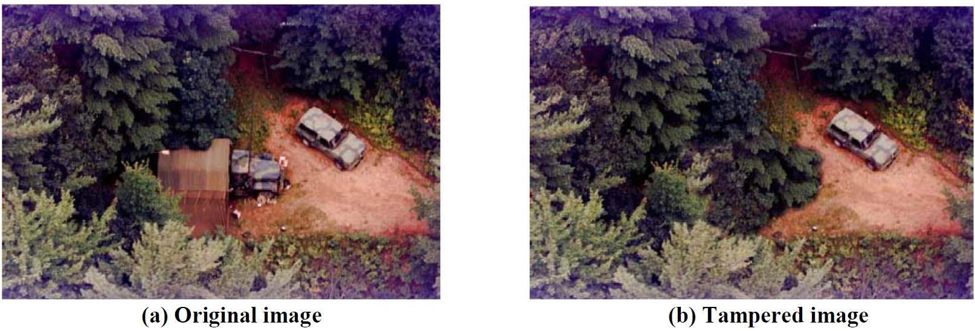
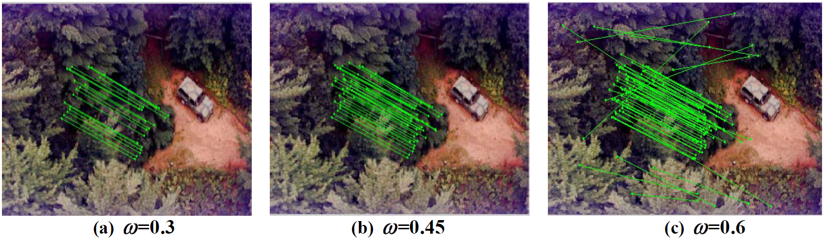
Notes:
Last slide

Slide 31
Scale Invariant Feature Transform
Scale Invariant – can detect both big and small forgeries
Feature Transform – operates on keypoints, not blocks of an image (as you’ll see in DCT)
Detects COPY-MOVE forgeries
Notes:
Ilan last slide

Slide 32
Method 2 – DCT+ SVM
Notes:
Say this method is different because there is ML

Slide 33
Motivation – why use DCT
By breaking an image into frequency components, the DCT makes it easier to identify features of the image
We hope to identify similar features in case of COPY-MOVE and disturbances in frequencies in case of SPLICING
Notes:
regarding splicing - especially on edges where the splicing occurred

Slide 34
example
Notes:
Disturbances in right bottom and middle bottom

Slide 35

4 steps of DCT
Convert $RGB$ image to $YCbCr$
Extract DCT coefficients
Extract useable data from the coefficients
Train (or use) SVM

Slide 36
YCbCr
YCbCr is a way to store color (like RGB).
It consists of 3 components:
  Y (luma) indicates the brightness (gray scale).
  Cb is the difference of the blue from the luma.
  Cr is the difference of the red from the luma.

Slide 37
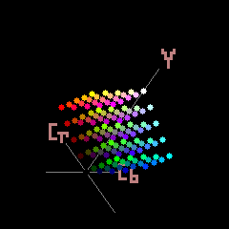
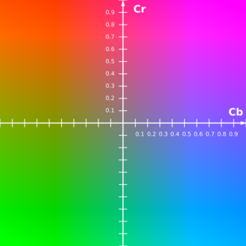
YCbCr – visual explanation
Notes:
At the left image, Y is constant across the plane
stop the gif at two separate points to show the difference, explain that Y "chooses" the color "pallet"

Slide 38
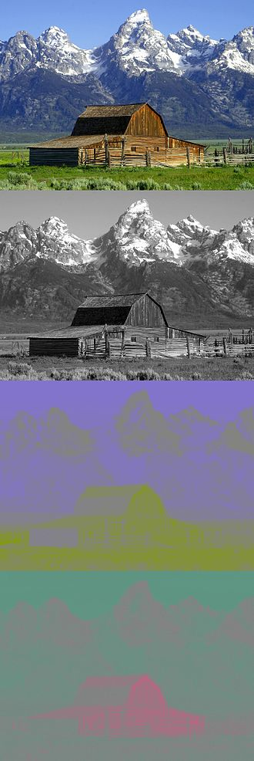
Why use it?
Humans are more sensitive to the black-and-white information
As a result, we can give more weight to the Y channel
Notes:
that's what the example to the right shows
in the classification of the SVM

Slide 39

RGB $→$ YCbCr: Informally
Use standard values: $K_{R}=0.299,K_{G}=0.587,K_{B}=0.114$
$\left[\begin{matrix}Y \\ C_{B} \\ C_{R}\end{matrix}\right]=\left[\begin{matrix}0.299⋅R+0.587⋅G+0.114⋅B \\ 128−0.169⋅R−0.331⋅G+0.500⋅B \\ 128+0.500⋅R−0.419⋅G−0.081B\end{matrix}\right]$
Notes:
This is just one standard, there are others
Y-> the more color the brighter
Cb-> the bluer the bigger, the redder/greener the smaller, add 128 to shift to [0,255]
Cr->similar to the above

Slide 40
Discrete Cosine Transform (DCT)
Used to transform data from the spatial domain into the frequency domain (like DFT/FFT)
Uses only cosine functions
Notes:
which means it decomposes a periodic function to periodic even-symmetry functions which result in only real coefficients opposed to DFT which uses real and complex coefficients.

Slide 41
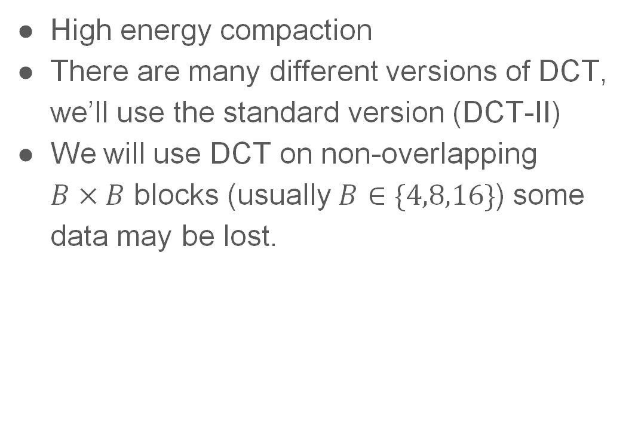
DCT - cont.
High energy compaction
There are many different versions of DCT, we’ll use the standard version (DCT-II)
We will use DCT on non-overlapping
$B×B$ blocks (usually $B∈\{4,8,16\}$) some data may be lost.
Notes:
which means most of the visual part of the image gets stored in a few coefficients (see image)
quiz of how many blocks there are? answer: (height/8)*(width/8)

Slide 42
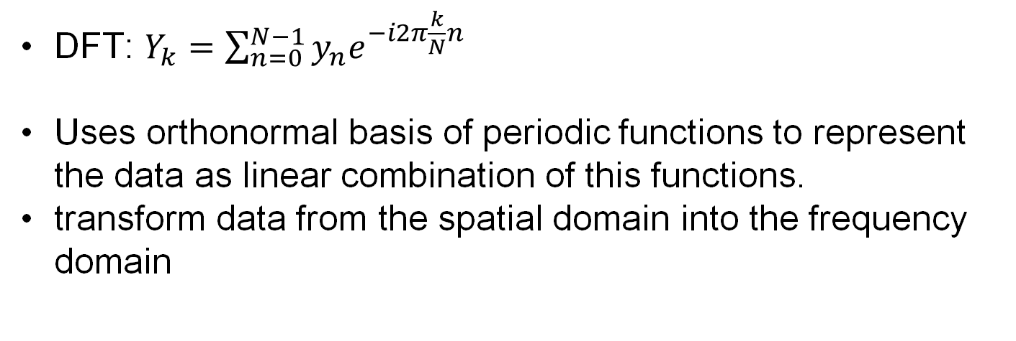
Let’s remember DFT
DFT: $Y_{k}=\sum_{n=0}^{N−1}{y_{n}e^{−i2π\frac{k}{N}n}}$
Uses orthonormal basis of periodic functions to represent the data as linear combination of this functions.
transform data from the spatial domain into the frequency domain

Slide 43
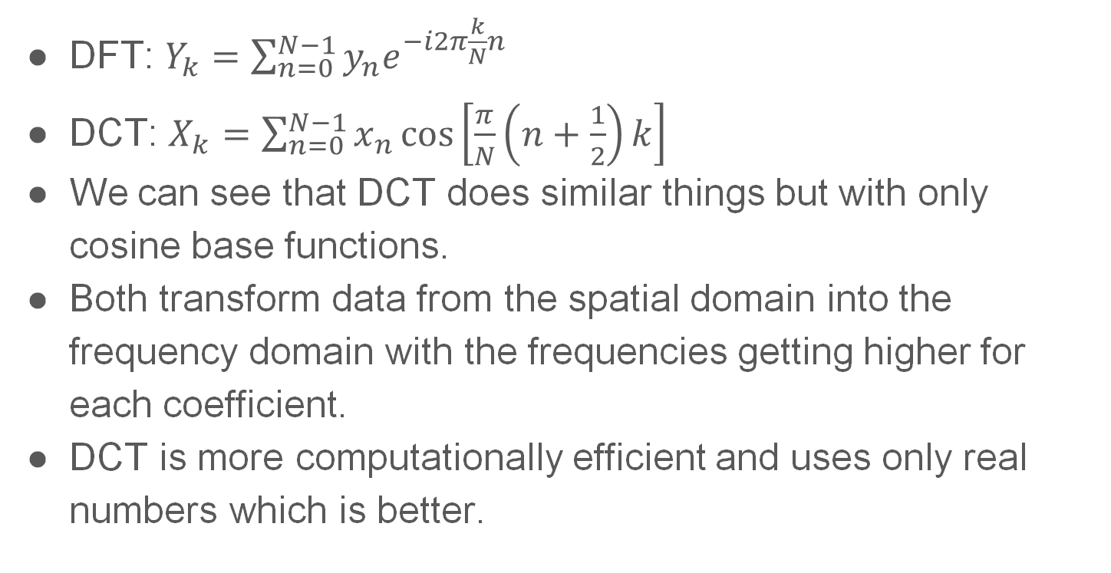
DCT V.S. DFT
DFT: $Y_{k}=\sum_{n=0}^{N−1}{y_{n}e^{−i2π\frac{k}{N}n}}$
DCT: $X_{k}=\sum_{n=0}^{N−1}{x_{n}\cos\left[\frac{π}{N}\left(n+\frac{1}{2}\right)k\right]}$
We can see that DCT does similar things but with only cosine base functions.
Both transform data from the spatial domain into the frequency domain with the frequencies getting higher for each coefficient.
DCT is more computationally efficient and uses only real numbers which is better.
Notes:
Say it looks scary but just highlight the even symmetry. Even indices are 0 and odd ones are the DCT input
up to a scale of 2
optimization: divide 𝑋_0 by √𝑛 and all the other coefficients by 2/√𝑛 and then the coefficients matrix become orthogonal which makes our lives easier.

Slide 44

But we’re working in 2d…
Generalize to 2d: product of the vertical and horizontal frequencies:
$$X_{k_{1},k_{2}}=\sum_{n_{1}=0}^{N−1}{\sum_{n2=0}^{N−1}{x_{n_{1},n_{2}}}}\cos\left[\frac{π}{N}\left(n_{1}+\frac{1}{2}\right)k_{1}\right]\cos\left[\frac{π}{N}\left(n_{2}+\frac{1}{2}\right)k_{2}\right]$$

Slide 45
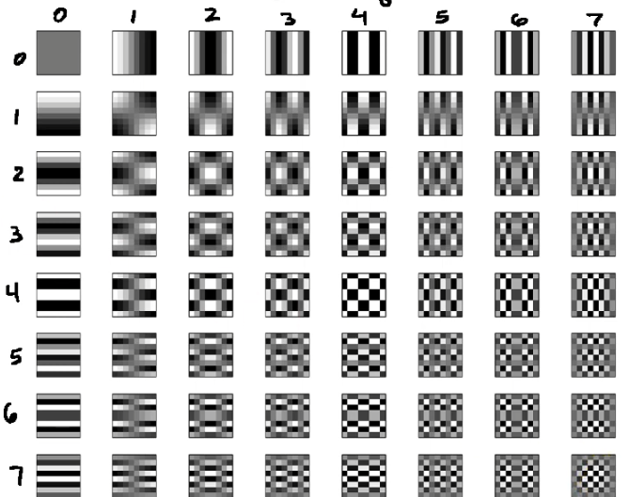
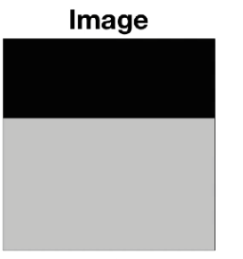
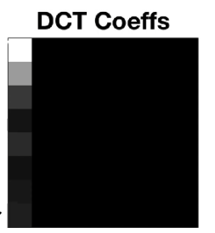
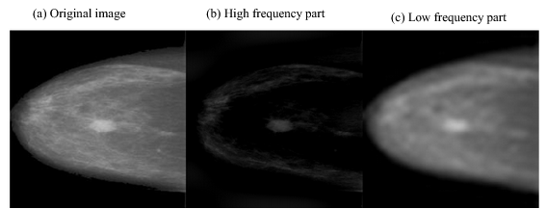
visualization
Notes:
The table in (I,j) describes what elements of the image does this frequency filter.
The “high frequency” is around 80% of the coefficients.

Slide 46
Extract useable data for the SVM
Each coefficient represents a frequency
Each block has its own 64 coefficients, one for each frequency
For each frequency we’ll look across blocks and consider for each block the matching coefficient of this frequency:
  The data we’ll use to classify is the standard deviation of these coefficients, and the number of positive coefficients
We’ll repeat the data extraction for a cropped image.
Notes:
for better results we'll ignore the first frequency also called DC coefficient.
the same frequencies are used across all blocks
Cropped = without first 4 rows and columns.

Slide 47
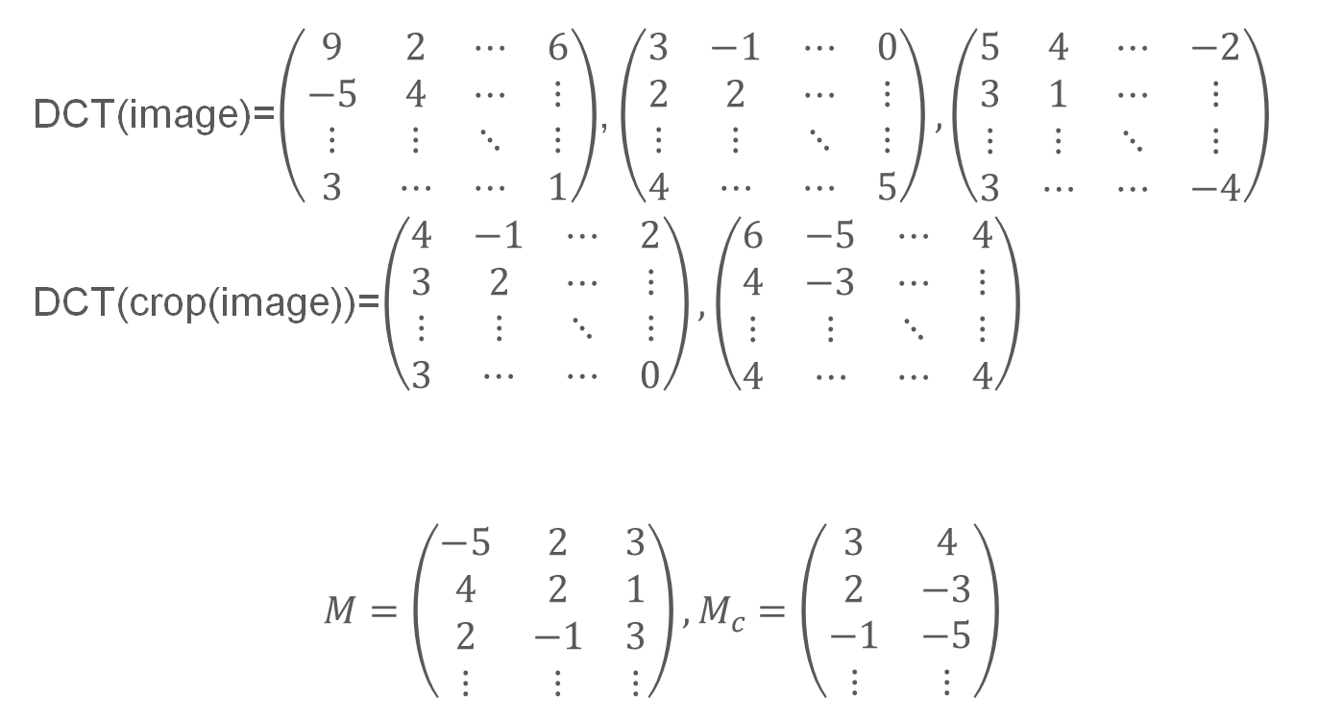
Example:
DCT(image)=$\left(\begin{matrix}9 & 2 & ⋯ & 6 \\ −5 & 4 & ⋯ & ⋮ \\ ⋮ & ⋮ & ⋱ & ⋮ \\ 3 & ⋯ & ⋯ & 1\end{matrix}\right)$, $\left(\begin{matrix}3 & −1 & ⋯ & 0 \\ 2 & 2 & ⋯ & ⋮ \\ ⋮ & ⋮ & ⋱ & ⋮ \\ 4 & ⋯ & ⋯ & 5\end{matrix}\right),\left(\begin{matrix}5 & 4 & ⋯ & −2 \\ 3 & 1 & ⋯ & ⋮ \\ ⋮ & ⋮ & ⋱ & ⋮ \\ 3 & ⋯ & ⋯ & −4\end{matrix}\right)$
DCT(crop(image))=$\left(\begin{matrix}4 & −1 & ⋯ & 2 \\ 3 & 2 & ⋯ & ⋮ \\ ⋮ & ⋮ & ⋱ & ⋮ \\ 3 & ⋯ & ⋯ & 0\end{matrix}\right),\left(\begin{matrix}6 & −5 & ⋯ & 4 \\ 4 & −3 & ⋯ & ⋮ \\ ⋮ & ⋮ & ⋱ & ⋮ \\ 4 & ⋯ & ⋯ & 4\end{matrix}\right)$
$$M=\left(\begin{matrix}−5 & 2 & 3 \\ 4 & 2 & 1 \\ 2 & −1 & 3 \\ ⋮ & ⋮ & ⋮\end{matrix}\right),M_{c}=\left(\begin{matrix}3 & 4 \\ 2 & −3 \\ −1 & −5 \\ ⋮ & ⋮\end{matrix}\right)$$
Notes:
Assume we have 12x16 image:
We’ll extract the coefficients for each block:
M ignores the first coefficient.

Slide 48
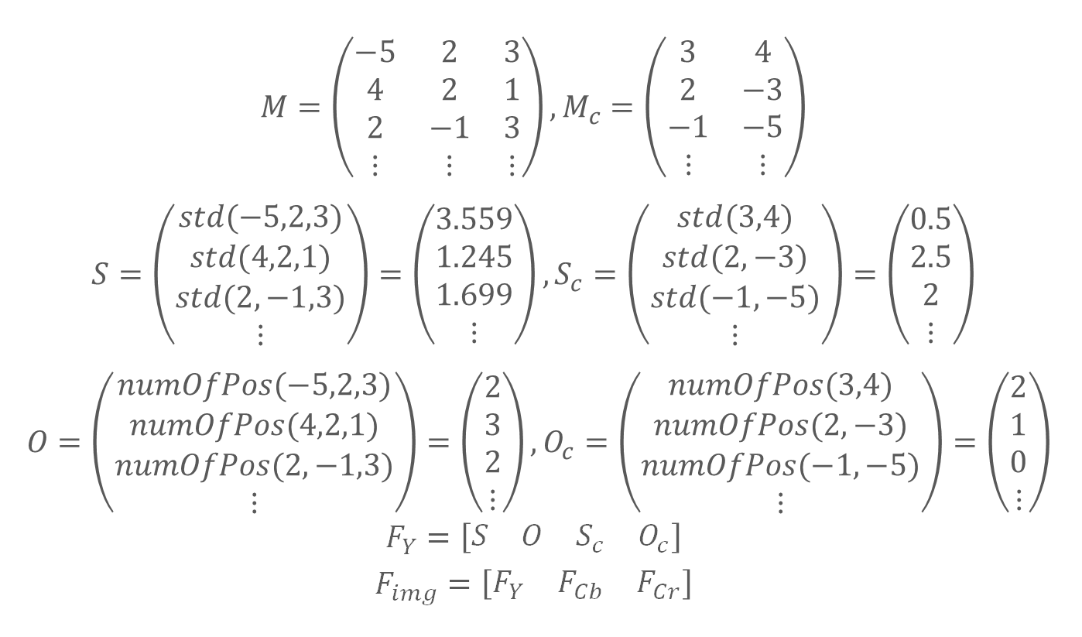
Example:
$$M=\left(\begin{matrix}−5 & 2 & 3 \\ 4 & 2 & 1 \\ 2 & −1 & 3 \\ ⋮ & ⋮ & ⋮\end{matrix}\right),M_{c}=\left(\begin{matrix}3 & 4 \\ 2 & −3 \\ −1 & −5 \\ ⋮ & ⋮\end{matrix}\right)$$
$$S=\left(\begin{matrix}std(−5,2,3) \\ std(4,2,1) \\ std(2,−1,3) \\ ⋮\end{matrix}\right)=\left(\begin{matrix}3.559 \\ 1.245 \\ 1.699 \\ ⋮\end{matrix}\right),S_{c}=\left(\begin{matrix}std(3,4) \\ std(2,−3) \\ std(−1,−5) \\ ⋮\end{matrix}\right)=\left(\begin{matrix}0.5 \\ 2.5 \\ 2 \\ ⋮\end{matrix}\right)$$
$$O=\left(\begin{matrix}numOfPos(−5,2,3) \\ numOfPos(4,2,1) \\ numOfPos(2,−1,3) \\ ⋮\end{matrix}\right)=\left(\begin{matrix}2 \\ 3 \\ 2 \\ ⋮\end{matrix}\right),O_{c}=\left(\begin{matrix}numOfPos(3,4) \\ numOfPos(2,−3) \\ numOfPos(−1,−5) \\ ⋮\end{matrix}\right)=\left(\begin{matrix}2 \\ 1 \\ 0 \\ ⋮\end{matrix}\right)$$
$$F_{Y}=\left[\begin{matrix}S & O & S_{c} & O_{c}\end{matrix}\right]$$
$$F_{img}=\left[\begin{matrix}F_{Y} & F_{Cb} & F_{Cr}\end{matrix}\right]$$
Notes:
Assume we have 8x16 image:
We’ll extract the coefficients for each block:
M ignores the first coefficient.

Slide 49

3 steps of DCT (no SVM yet)
Convert $RGB$ image to $YCbCr$
Extract DCT coefficients
Extract useable data from the coefficients
Notes:
Summarize everything

Slide 50
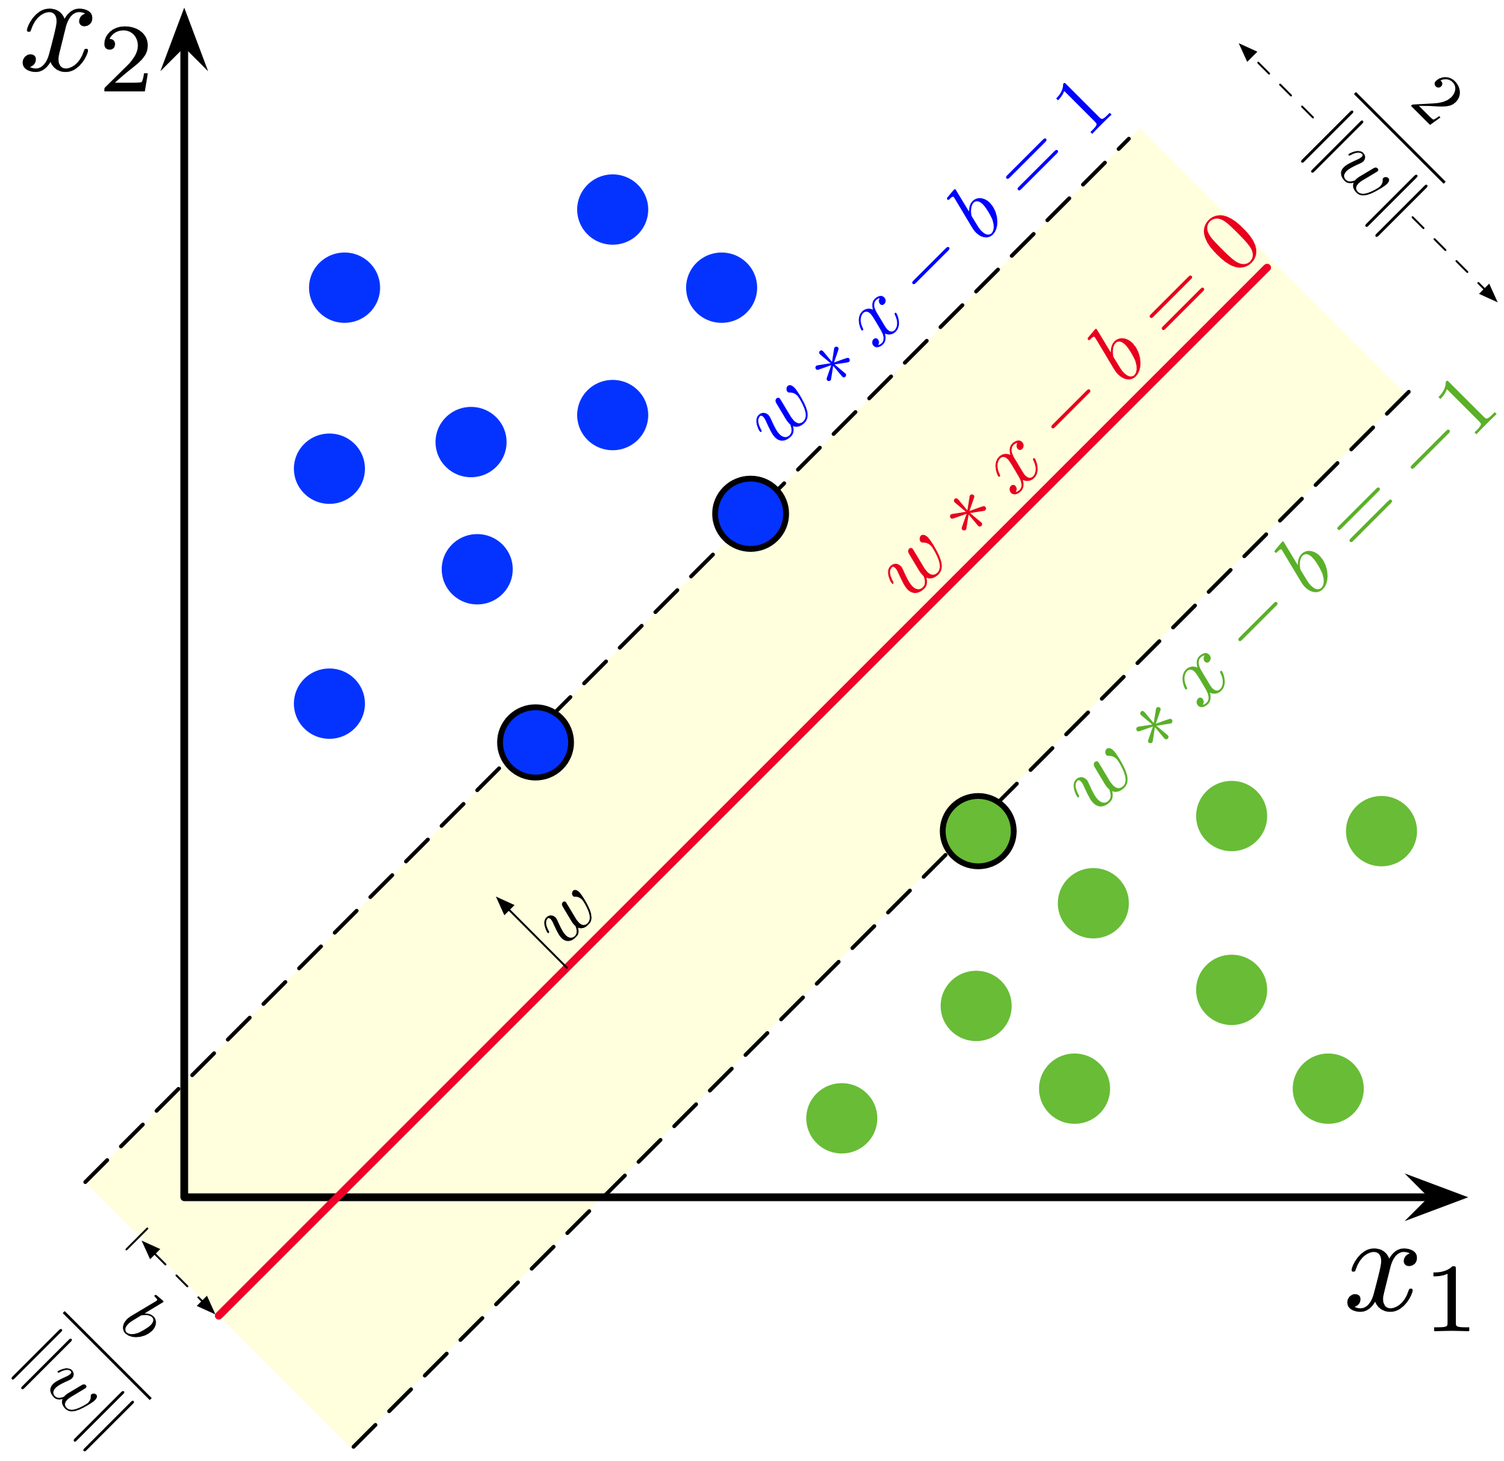
SVM - general
Finds a “good enough” separating hyperplane.
Our case has 2 classes: tampered, untampered
There isn’t anything special about SVM
Notes:
why "good enough"? because our case isn't linearly separable
i.e., other methods may be used, it's just a tool that works well (according to trial and error)

Slide 51
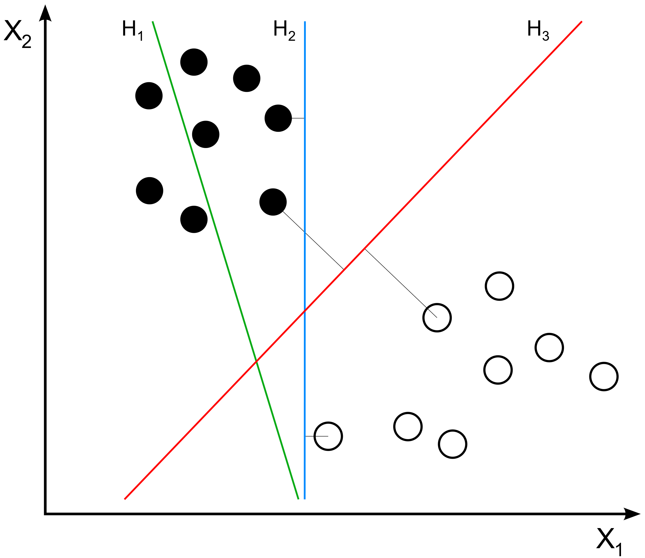
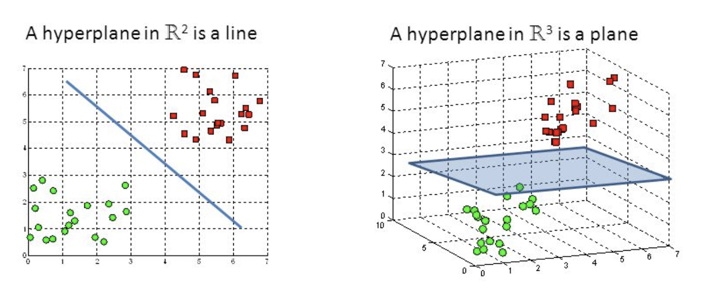
SVM examples
Notes:
explain that although blue and red work, red is better

Slide 52
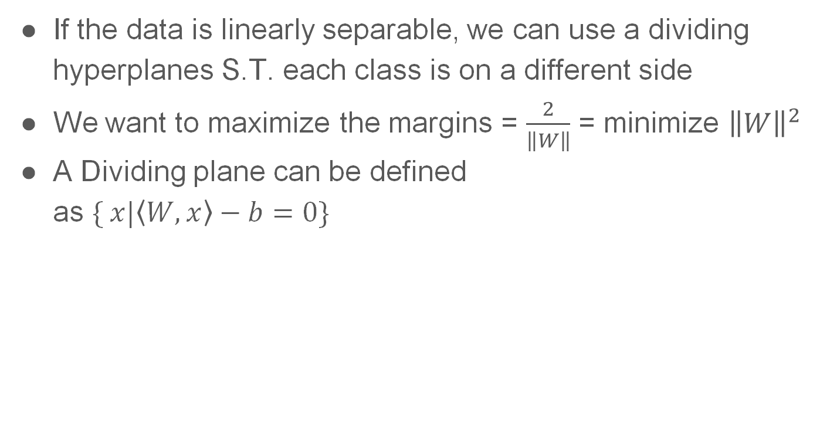
SVM-how it works
If the data is linearly separable, we can use a dividing hyperplanes S.T. each class is on a different side
We want to maximize the margins = $\frac{2}{\left\|W\right\|}$ = minimize ${\left\|W\right\|}^{2}$
A Dividing plane can be defined
as $\{ x|\left\langle W, x\right\rangle −b=0\}$

Slide 53

SVM-how it works
Minimze $\left\|W\right\|$ constrained on
$\left\{\begin{aligned}\left\langle w, x_{i}\right\rangle −b>1 if y_{i}=1 \\ \left\langle w, x_{i}\right\rangle −b<−1 if y_{i}=−1\end{aligned} \right.⇒y_{i}\left(\left\langle w, x\right\rangle −b\right)>1$
How it’s done:
  In each iteration go over all data points
  For every currently misclassified point, move the hyperplane in the appropriate direction
  Repeat until “good enough”
Notes:
Can talk about hard VS soft margins

Slide 54


Slide 55
Recap + How SVM is used in our case
Convert image to YCbCr
On each channel we’ll compute DCT coefficients on each 8x8 block of the image
We’ll look at each frequency and take the matching coefficients from all blocks and extract some data
Merge all the information into one long vector and feed it to the SVM
The SVM is trained on an open-source dataset called casia which is on GitHub
Notes:
We do this again on the same image but we removed the first 4 lines and rows because from experiments it gives better results.
quiz:
how many elements are in each vector thats get feed to the SVM.
and what is the field that the elements are one.
ans:
63*4*3 and alternating between R and N

Slide 56
(Very) pseudo code.py
def get_matrix(channel):
matrix = [[] for _ in range(63)]
for block in get_blocks(channnel):
for i, coef in enumerate(get_coeficents(block)[1:63]):
matrix[i].append(coef)
return matrix
def get_channel_data(channel):
data = []
for row in get_matrix(channel):
data.append([get_std(row), gut_num_positive(row)])
return data

Slide 57
(Very) pseudo code.py – Cont.
def get_img_data(img):
data = []
for _img in [img, cropped(img)]:
for channel in get_channels(_img):
data.append(get_channel_data(channel))
return data
def is_forgery(img):
return svm.clasiffy(get_img_data(img))
def train_svm(imgs, forgeries):
all_data = [get_img_data(img) for img in imgs]
svm.train(all_data, forgeries)

Slide 58
Miscellaneous - DCT
PCA
Compare based methods
Notes:
for extra efficiency
comparing features using lexical sorting or nearest neighbor.
Shaar yeshuv last slide

Slide 59
Miscellaneous - SIFT
More than two copies
SPLICING
Notes:
fails because ratio becomes 1
doesn't work...

Slide 60
Miscellaneous – Live demonstration
SIFT: andreacos/SIFT-based-copy-move-forgery-detection: SIFT based copy move forgery detection and localisation
DCT: dipshikha461/Image-Forgery-Detection-Using-DCT: Detects areas of copy-move forgery in images using the concept of Discrete Cosine Transforms (didn’t have time in the lecture)
Or just search Github…
Notes:
the dct uses compressions and not svm

Slide 61

Results from live demonstration – original image

Slide 62

Results from live demonstration – tampered image

Slide 63

Results from live demonstration – masked image

Slide 64

Summery – today we saw:
COPY-MOVE
SPLICING
SIFT
  Scale-space extreme detection
  Keypoint localization
  Orientation assignment
  Keypoints descriptor
DCT
  Convert $RGB$ image to $YCbCr$
  Extract DCT coefficients
  Extract useable data from the coefficients
  Train (or use) SVM

Slide 65
Sources
https://en.wikipedia.org/wiki/YCbCr
Discrete cosine transform - Wikipedia
Christlein, Vincent & Riess, Christian & Angelopoulou, Elli. (2010). A Study on Features for the Detection of Copy-Move Forgeries.. 105-116.
I. Amerini, L. Ballan, R. Caldelli, A. Del Bimbo and G. Serra, "A SIFT-Based Forensic Method for Copy–Move Attack Detection and Transformation Recovery," in IEEE Transactions on Information Forensics and Security, vol. 6, no. 3, pp. 1099-1110, Sept. 2011, doi: 10.1109/TIFS.2011.2129512.
Gray scale: Mushtaq, Saba & Mir, Ajaz. (2014). Forgery detection using statistical features. 92-97. 10.1109/CIPECH.2014.7019062.
Redi, Judith & Taktak, Wiem & Dugelay, Jean-Luc. (2011). Digital image forensics: A booklet for beginners. Multimedia Tools Appl.. 51. 133-162. 10.1007/s11042-010-0620-1.
Lowe, D.G. Distinctive Image Features from Scale-Invariant Keypoints. International Journal of Computer Vision 60, 91–110 (2004). https://doi.org/10.1023/B:VISI.0000029664.99615.94
H. Huang, W. Guo and Y. Zhang, "Detection of Copy-Move Forgery in Digital Images Using SIFT Algorithm," 2008 IEEE Pacific-Asia Workshop on Computational Intelligence and Industrial Application, Wuhan, China, 2008, pp. 272-276, doi: 10.1109/PACIIA.2008.240
Shilpa Dua, Jyotsna Singh, Harish Parthasarathy, Image forgery detection based on statistical features of block DCT coefficients, Procedia Computer Science, Volume 171, 2020, Pages 369-378, ISSN 1877-0509, https://doi.org/10.1016/j.procs.2020.04.038.
Shin, Y., & Cho, Y. (2019). Fast Detection of Forgery Image using Discrete Cosine Transform Four Step Search Algorithm. Journal of Korea Multimedia Society, 22, 527-534.
N. Kanagavalli and L. Latha, "A survey of copy-move image forgery detection techniques," 2017 International Conference on Inventive Systems and Control (ICISC), Coimbatore, India, 2017, pp. 1-6, doi: 10.1109/ICISC.2017.8068703.
Wang, Yiming & Qi, Yunliang & Xu, Chunbo & Lou, Meng & ma, Yide. (2022). Learning multi-frequency features in convolutional network for mammography classification. Medical & Biological Engineering & Computing. 10.1007/s11517-022-02582-4.
some images are from slides by Hagit Hel-Or
https://jivp-eurasipjournals.springeropen.com/articles/10.1186/s13640-019-0469-9
https://dev.to/gallettilance/support-vector-machines-from-scratch-4h7

