Slide 1
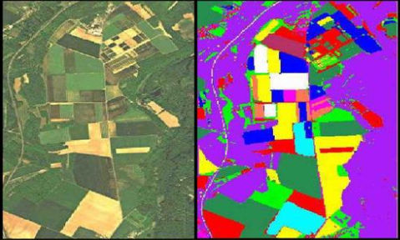
Hyperspectral Image Segmentation
Adam Rayan Adan Hammoud
Notes:
שלום לכולם היום נציג בפניכם את נושא סיגמנטציה של תמונות היבירספיקטראליות

Slide 2
Agenda
FCN
Introduction
Summarize
Segmentation using Minimum spanning forest
Watershed segmentation
Notes:
אז הסדר יהיה כזה כודם כל יהי מבוא קצר , בו נסביר מה זה סיגמנטציה איך זה יכול להיות שימושי ,
אחר כך שלושה שיטות של סיגמנטציה ובסוף השוואה קטנה שתסכם את הכל

Slide 3
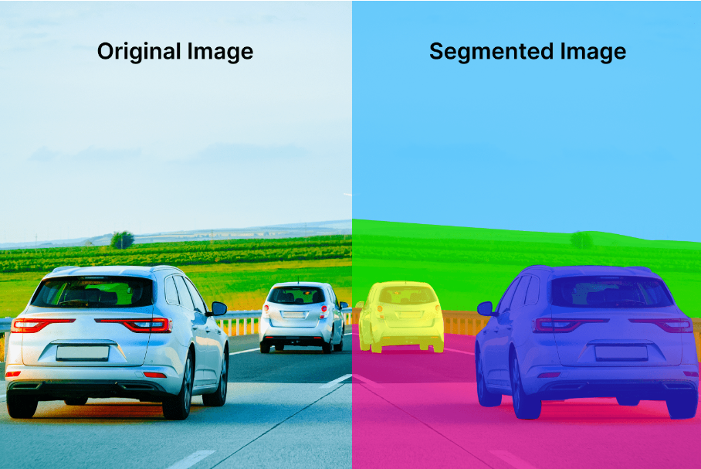
Intro
The purpose of image segmentation is to partition an image into meaningful regions with respect to a particular application.
The segmentation is based on measurements taken from the image and might be greylevel ,color ,texture ,depth or motion.
Notes:
סיגמנטציה זה לחלק את התמונה לסגמנטים שכל סגמנט יכול להיות פעל משמעות מסויימת
אופו הסגמנטציה רחב , יכול להיות על פני צבע , דרגת אפור , מציאותו של רכיב /אלמנט מסויים או חוסרו

Slide 4
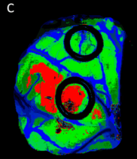
Why segmentation?
Medical Imaging :Differentiating between healthy and diseased tissues
Agriculture: Assessing plant health, and detecting diseases and pests.
Remote Sensing: Study the effects of climate change, etc…
Notes:
מפני שגמנטציה עוסקת בחלוקת תמונה למקטעים נפרדים,
סגמנטציה של עצמים מעניינים בתמונה מקלה במידה רבה על ניתוח נוסף של העצמים הללו. מה שמאפשר לנו לנתח כל מקטע בנפרד ולהפיק תובנות חשובות.
בסביבה הרפואית, סגמנטציה משומשת להבחין בין רקמות בריאות לרקמות חולות. זהו כלי חיוני באבחון מחלות, בתכנון טיפולים ובהערכת התקדמות מחלות.
בחקלאות, סגמנטציה עוזרת להעריך את בריאות הצמחים ולזהות מחלות. היא מאפשרת לנו להבחין בין צמחים בריאים לצמחים נגועים ובכך נשפר ונהפחית הפסדים.

Slide 5
Classification vs Segmentation!
Classification refers to the process of assigning each pixel in the image to a particular class or category based on its spectral signature.
Notes:
סיווג מתייחס לתהליך של שיוך כל פיקסל בתמונה לקטגוריה או מחלקה מסוימת על סמך החתימה הספקטרלית שלו.

Slide 6
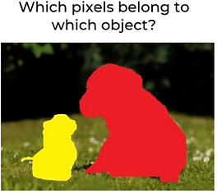
Classification vs Segmentation!
The primary focus of segmentation is identifying the boundaries of objects within the image. based on specific criteria, such as spectral similarity.
Notes:
המוקד העיקרי של סגמנטציה הוא זיהוי גבולות האובייקטים בתוך התמונה על בסיס קריטריונים ספציפיים,

Slide 7
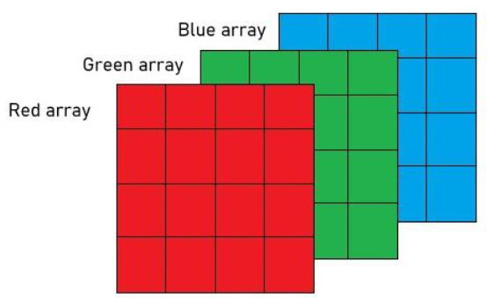
Hyperspectral image
Every pixel contains a detailed spectrum (>100 spectral bands)
More information per pixel
Dimensionality increases
Advanced algorithms are required!
Notes:
כל פיקסל בתמונה מכיל ספקטרום מפורט עם יותר מ-100 ערוצים ספקטרליים.
כל ערוץ מייצג טווח צר של אורכי גל, מה שמספק מידע עשיר על התכונות הכימיות והפיזיקליות של החומר המצולם,וזה דבר טוב , אבל יוצר בעיה
כאשר יש לנו יותר ערוצים ספקטרליים, הממדיות של הנתונים עולה באופן משמעותי.
זה יוצר אתגר בניתוח הנתונים, שכן המידע הוא רב ומורכב יותר לעיבוד.

Slide 8
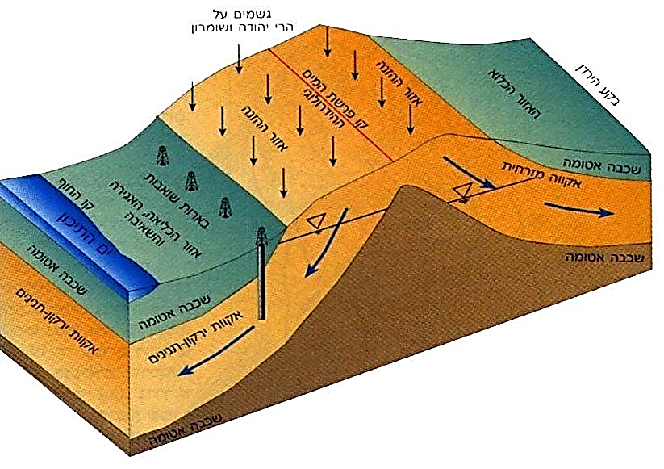
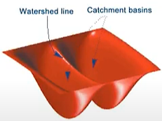
Watershed Segmentation
A drainage basin or watershed is an extent or an area of land where surface water from rain melting snow or ice converges to a single point at a lower elevation

Slide 9
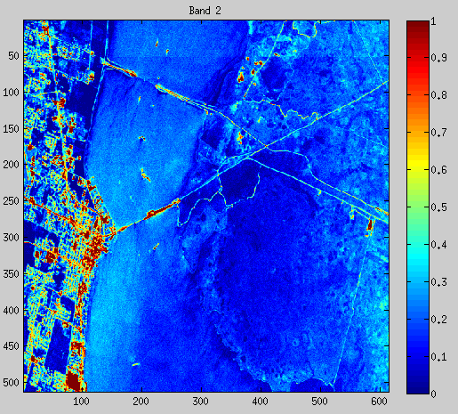
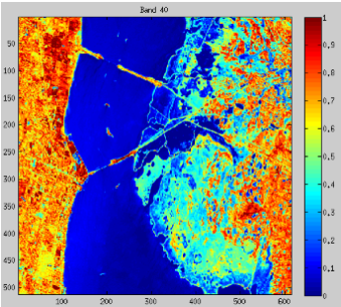
Watershed Segmentation
Steps:
Input Image :
Step: Start with a B-band hyperspectral (HS) image.
2. Gradient Image Calculation:
Calculate a one-band gradient image to highlight edges.
If a single band with good distinguishing capability is available, compute the gradient directly.
Band 40
Notes:
היא תמונה היפרספקטרלית עם מספר ערוצים ספקטרליים B ספציפיים.

Slide 10
Watershed Segmentation
2. Gradient Image Calculation:
If the image remains multi-band, choose between:
Compute gradients for each spectral band and combine them using the supremum or sum operator.

Slide 11
Watershed Segmentation
2. Gradient Image Calculation:
If the image remains multi-band, choose between:
Vector Methods: Compute vectorial gradients based on defined distances between pixel vectors.
This approach considers the spectral vectors in their entirety rather than treating each band separately.

Slide 12
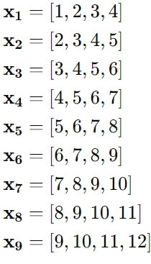
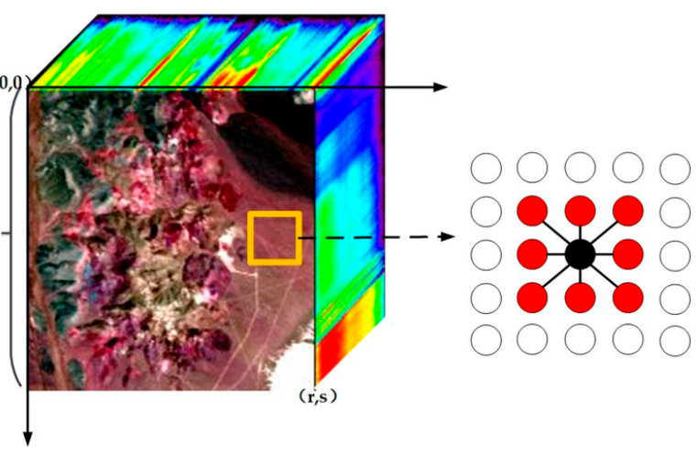
Compute Vectorial Gradient:
Select Structuring Element E
Each pixel Xp own’s his E
Define Distance Metric , Euclidean , Manhattan distance …
Calculate the pairwise distances between all vectors in E
Xp’s gradient value equals to maximum distance

Slide 13
Compute Vectorial Gradient:
In other words :
be a set of e vectors contained within a structuring element E

Slide 14
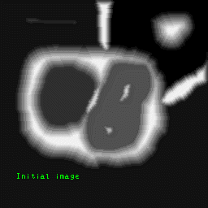
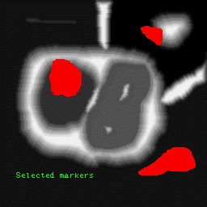
Flooding Process
Each marker is assigned a unique label, and all other pixels are initially unlabeled.
Use a priority queue (or sorted list) sorted based on the gradient values to manage the flooding process.

Slide 15
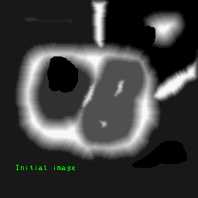
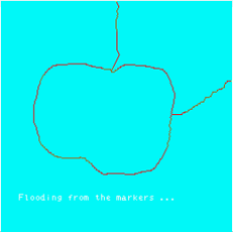
Flooding Process
Start the flooding process from all markers simultaneously. Each time a pixel is added to a basin, its neighbors are examined.
If a neighbor is unlabeled, it is added to the priority. If a neighbor is already labeled but belongs to a different marker, a watershed line is created
1
2

Slide 16
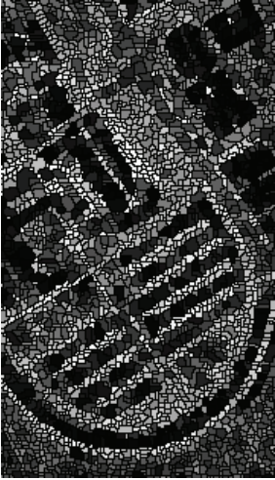
Results

Slide 17
GUESS THE ZOOMED !

Slide 18
(EASY)

Slide 19
(EASY)-pencil

Slide 20
(MED)

Slide 21
(MED)-CD

Slide 22
(HARD)

Slide 23
(HARD)-Watch

Slide 24
(BOSS LEVEL!!)

Slide 25
Fully Convolutional Network (FCN)
1. Convolution 2. Max pooling 3. Deconvolution 4. Skip Connection

Slide 26
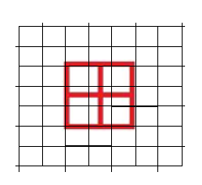
Convolutional Layers
These layers apply filters to the input data to extract features such as edges, textures, and patterns.
Convolution
Convolution
Convolution
Convolution
Convolution
Convolution

Slide 27
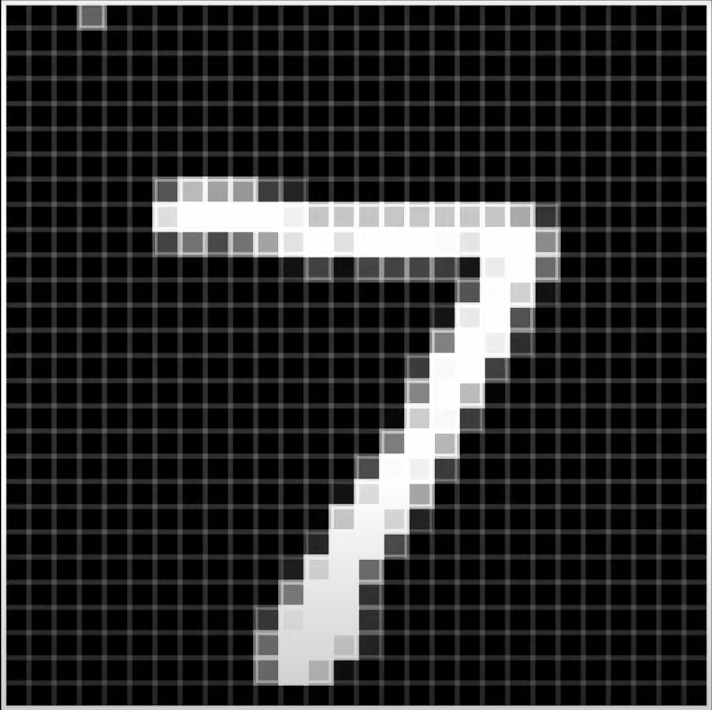
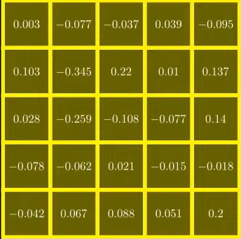
Convolutional Layers
These layers apply filters to the input data to extract features such as edges, textures, and patterns.

Slide 28
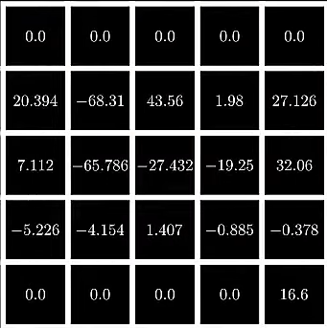
Convolutional Layers
These layers apply filters to the input data to extract features such as edges, textures, and patterns.

Slide 29
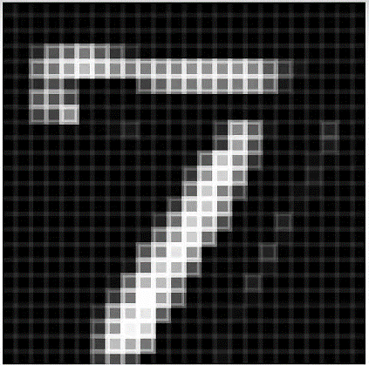
Convolutional Layers
These layers apply filters to the input data to extract features such as edges, textures, and patterns.

Slide 30
Convolutional Layers
Formal Expression:
I is the input image (or feature map).
K is the filter (or kernel) sliding over the input image.

Slide 31
Convolutional Layers
Formal Expression:
I is the input image (or feature map).
K is the filter (or kernel) sliding over the input image.
where 𝑀 and 𝑁 are the dimensions of the filter.

Slide 32
Pooling Layers
Pooling layers reduce the spatial dimensions of the data, making the network more computationally efficient and invariant to small translations.
Max Pooling: Selects the maximum value from a small region of the feature map.

Slide 33
Pooling Layers
Pool size =(2X2)

Slide 34
Pooling Layers
Formal Expression:
For Feature map Ι ,max pooling with a window size of 2×2, the operation is:

Slide 35
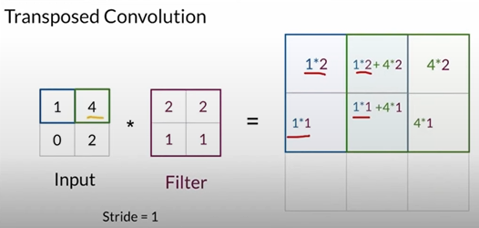
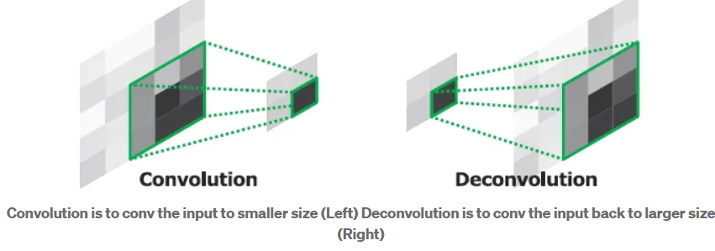
Fully Convolutional Network

Slide 36
Skip connections ; Unpooling

Slide 39
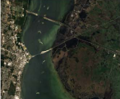
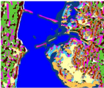
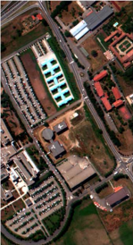
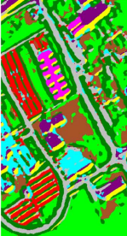
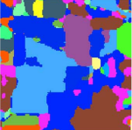

Slide 40
MSF Segmentation
Minimum Spanning Tree

Slide 41
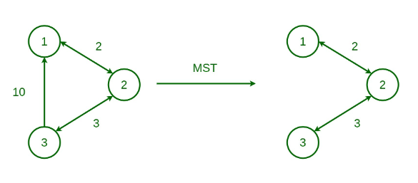
Terms
Minimum Spanning Tree:
Spanning Tree: A tree-like subgraph of a connected, undirected graph that includes all vertices and a subset of the edges forming a tree.
Minimum Spanning Tree (MST): A spanning tree with the minimum possible total edge weight.

Slide 42
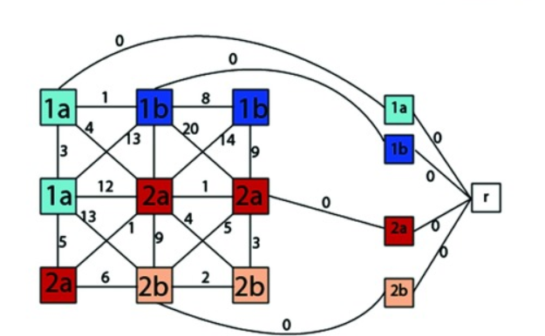
Terms
Given a graph G=(V,E,W), the MSF is a spanning forest F∗=(V,EF∗​) rooted on a set of m distinct vertices }t1​,…,tm​}.
Each tree in F∗ grows from a root 𝑡𝑖, and the sum of the edge weights in F∗ is minimal.
𝑆𝐹 represents the set of all spanning forests of 𝐺 rooted on {𝑡1,…,𝑡𝑚}.

Slide 43
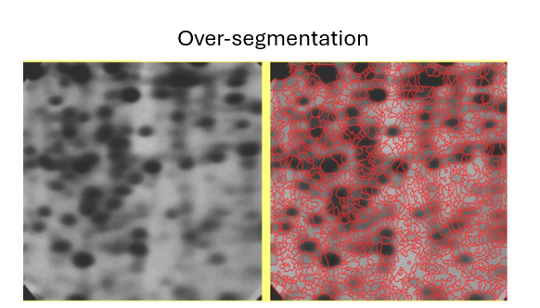
Terms
Over-segmentation: One region is detected as several ones of the image.
Under-segmentation: Several regions are detected as one.

Slide 44
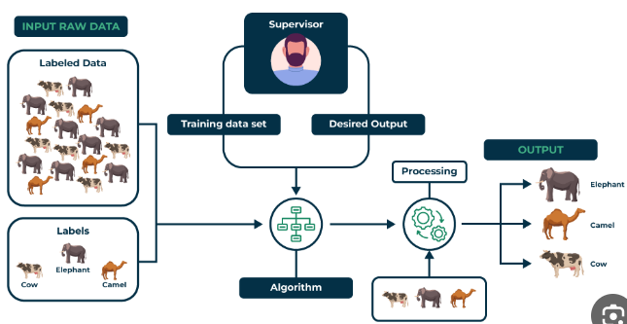
Terms
Supervised:
The training dataset consists of input-output pairs, where each input is associated with the correct output (label).

Slide 45
Support Vector Machine (SVM):
is a supervised machine learning algorithm used for classification.
The main objective of the SVM algorithm is to find the optimal hyperplane in an N-dimensional space that can separate the data points in different classes in the feature space.
The hyperplane tries that the margin between the closest points of different classes should be as maximum as possible.

Slide 46
What is the method?
The method is based on the construction of an MSF, rooted on the markers selected by using pixelwise classification results.

Slide 47
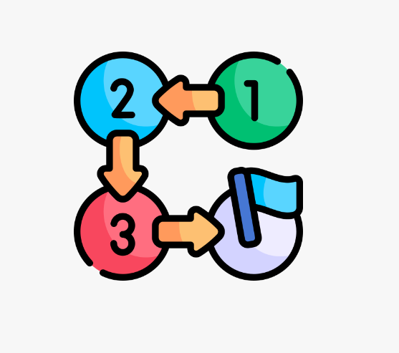
The steps
There are 4 steps:
Pixelwise classification.
Selection of the most Reliable classified Pixels.
Construction of an MSF.
Majority Voting Within Connected Components.

Slide 48
Step 1: Pairwise Classification
The first step consists in performing a probabilistic pixelwise classification of the hyperspectral image. Support Vector Machine (SVM) classifier is used.

Slide 49
Step 1: Pairwise Classification
The output of this step is classification map, containing class labels for each pixel.

Slide 50
Step 1: Pairwise Classification
For each pixel x, a probability distribution P is defined giving the probability of x belonging to each of the K classes
k: number of classes.
x: a pixel.
y: the pixel label.
p = {$p_{k}=p\left(y=k | x\right), k=1,..,K\}.$

Slide 51
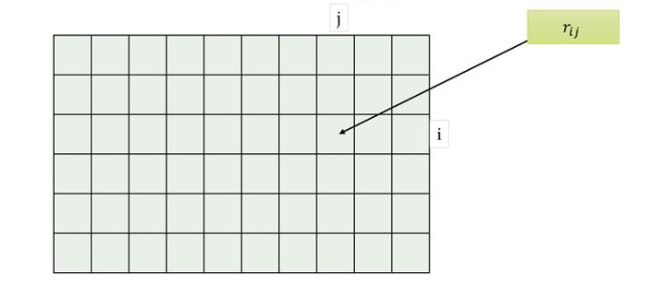
Step 1: Pairwise Classification
For this purpose:
𝑟𝑖𝑗 ​: The probability that a pixel belong to class y=i given 𝑦 is either 𝑖 or 𝑗.
A and B: Parameters estimated by minimizing the negative loglikelihood using: - Training Data: Feature vectors 𝑥 and true labels 𝑦.
- Decision Values: Raw SVM output scores $\hat{f.}$

Slide 52
Step 1: Pairwise Classification
Furthermore, the probabilities p = {$p_{k}=p\left(y=k | x\right), k=1,..,K\}$ are computed by solving the following optimization problem:

Slide 53
Step 1: Pairwise Classification
Finally, a probability map is constructed by assigning to each pixel the maximum probability estimate max($p_{k}$), k = 1,.., K.

Slide 54
Step 2: Selection Of The Most Reliable Classified Pixels
The aim of this step is to choose the most reliable classified pixels in order to define suitable markers.

Slide 55
Step 2: Selection Of The Most Reliable Classified Pixels
A simple way of marker selection consists in thresholding the probability map.
In other words, if the probability of the considered pixel belonging to the assigned class k is higher than a given threshold, this pixel is selected to join the markers.

Slide 56
Advantages and disadvantages
Advantages:
Simplicity
Disadvantages:
Each marker results in one region, so the number of markers must match the desired regions.
Spectrally similar classes 𝑘𝑖 and 𝑘𝑗 can lead to nearly equal probabilities for pixels, risking the loss of regions and causing undersegmentation.

Slide 57
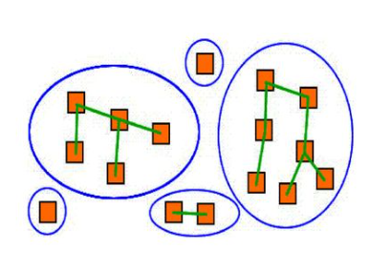
Solution
To mitigate this problem, we propose the following method of marker selection:
Perform a connected-component labeling of the pixelwise classification map. For this purpose, a classical connected component algorithm using the union-find data structure.

Slide 58
Solution
Analyze each connected region as follows:
If a region is large enough, it should contain a marker, which is determined as P% of the pixels within the connected component with the highest probability estimates.
If a region is small, it should lead to a marker only if it is very reliable; a potential marker is formed by pixels with probability estimates higher than a defined threshold.

Slide 59
Step 3: Construction of an MSF
MSF : minimum spanning forest.
The previous two steps result in a map of markers defining regions of interest in the image.
The next step consists in the grouping of all the image pixels into an MSF , where each tree is rooted on a classification-derived marker.

Slide 60
Step 3: Construction of an MSF
Each pixel is a vertex 𝑣∈𝑉 in an undirected graph 𝐺=(𝑉,𝐸,𝑊), where 𝑉 and 𝐸 are sets of vertices and edges, and 𝑊 maps edges 𝐸 to positive real numbers 𝑅+.
Each edge 𝑒(𝑖,𝑗)∈𝐸 connects neighboring pixels i and j with a weight 𝑤(𝑖,𝑗) indicating their dissimilarity.
Dissimilarity measures for edge weights include vector norms, Spectral Angle Mapper (SAM).

Slide 61
Different dissimilarity measure
The L1 vector norm between two pixel vectors $x_{i}$ = ${(x_{i1}\text{ ,}\text{…}\text{, }x_{B1})}^{T}$ and
$x_{j}$ =${{\text{(}x_{j1}\text{ , .. }\text{,}x}_{jB})}^{T}$ is given as:

Slide 62
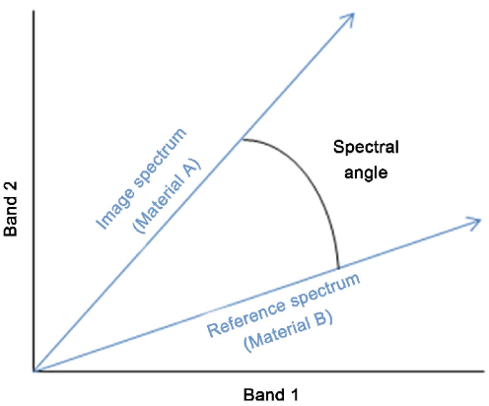
Different dissimilarity measure
The SAM distance between $x_{i}$ and $x_{j}$determines the spectral similarity between two vectors by computing the angle between them.
It is defined as:

Slide 63
Example:
1
0
1
8
0
2
14
5
8
15
5
9
0
4
0
16
0
11
12
14
12
11
3
10
0
8
0
5
2

Slide 64
Example:
0
0
1
0
1
8
0
14
$$t_{1}$$
2
0
5
8
15
5
9
r
0
4
0
16
0
$$t_{2}$$
0
11
12
14
12
3
10
11
0
18
0
5
2
0

Slide 65
Example:
0
0
1
0
1
8
0
14
$$t_{1}$$
2
0
5
8
15
5
9
r
0
4
1
16
0
$$t_{2}$$
0
11
12
14
12
3
10
11
0
8
0
5
2
0

Slide 66
Example:
0
0
1
0
1
8
0
14
$$t_{1}$$
2
0
5
8
15
5
9
r
1
4
1
16
0
$$t_{2}$$
0
11
12
14
12
3
10
11
0
8
0
5
2
0

Slide 67
Example:
0
0
1
0
1
8
1
14
$$t_{1}$$
2
0
5
8
15
5
9
r
1
4
1
16
0
$$t_{2}$$
0
11
12
14
12
3
10
11
0
8
0
5
2
0

Slide 68
Example:
0
0
1
0
1
8
1
14
$$t_{1}$$
2
0
5
8
15
5
9
r
1
4
1
16
2
$$t_{2}$$
0
11
12
14
12
3
10
11
0
8
0
5
2
0

Slide 69
Example:
0
0
1
0
1
8
1
14
$$t_{1}$$
2
0
5
8
15
5
9
r
1
4
1
16
2
$$t_{2}$$
0
11
12
14
12
3
10
11
0
8
2
5
2
0

Slide 70
Example:
0
0
1
0
1
8
1
14
$$t_{1}$$
2
0
5
8
15
5
9
r
1
4
1
16
2
$$t_{2}$$
0
11
12
14
12
3
10
11
2
8
2
5
2
0

Slide 71
Example:
0
0
1
1
8
1
$$t_{1}$$
2
0
r
1
4
1
2
$$t_{2}$$
0
3
2
8
2
5
2
0

Slide 72
Step 4: Majority Voting Within Connected Components
Although the most reliable classified pixels are selected as markers, it may happen that a marker is classified to the wrong class.
In this case, all the pixels within the region grown from this marker risk to be wrongly classified.

Slide 73
Step 4: Majority Voting Within Connected Components
Postprocess the classification map using majority voting on connected components. Assign each pixel in a connected component to the most frequent class within that region.

Slide 74
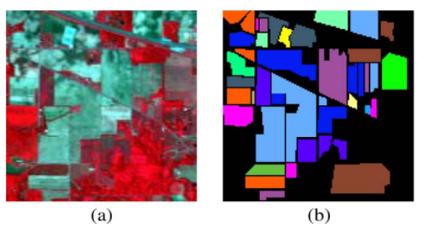
The three-band color composite (837, 636, and 537 nm) paints a vivid picture by blending wavelengths for enhanced visual appeal.
Reference data.

Slide 75
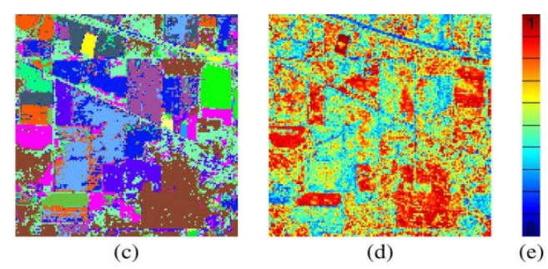
(c) Assigns class labels to each pixel.
(d) Probability map: Estimates pixel class probabilities.
(e) Color scale: 0-100% probability.

Slide 76
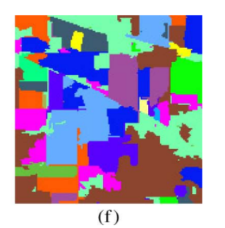
(f) Classification map: SAM measure + majority voting refine.

Slide 77
Comparison
FCN | MSF | Watershed
Efficient speed | Accepted speed | Not efficient speed | Speed
Minimal oversegmentation | Almost no oversegmentation | the image might oversegment | Over Segmentation
Very accurate segment borders | Accurate segment borders | Segment borders not accurate | Borders

Slide 78
THE END!

Slide 79
References :
SEGMENTATION AND CLASSIFICATION OF HYPERSPECTRAL DATA USING WATERSHED. Yuliya Tarabalka1,2, Jocelyn Chanussot1, Jon Atli Benediktsson2, Jesus Angulo3, and Mathieu Fauvel1,2
Deep Feature Extraction and Classification of Hyperspectral Images Based on Convolutional Neural Networks. Yushi Chen, Member, IEEE, Hanlu Jiang, Chunyang Li, Xiuping Jia, Senior Member, IEEE, and Pedram Ghamisi, Member, IEEE
Convolutional Neural Networks Deep Learning. University of Chicago course by Shubhendu Trivedi & Risi Kondor and Andrew Ng lectures
Segmentation and Classiﬁcation of Hyperspectral Images Using Minimum Spanning Forest Grown From Automatically Selected Markers Yuliya Tarabalka, Jocelyn Chanussot, and Jón Atli Benediktsson IEEE Transactions on System Man and Cybernetics, Vol 40(5), 2010
Object Segmentation in Hyperspectral Images Susi Huaman De la Vega, Dr. Vidya Manian

