Slide 1
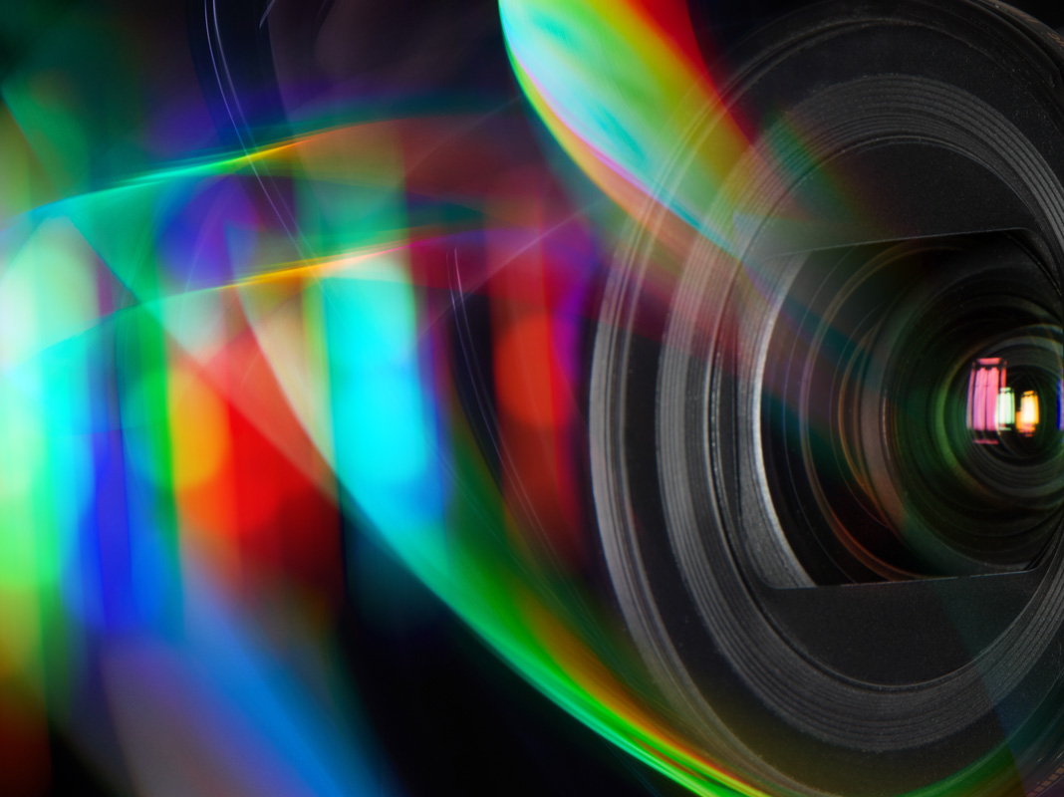
Hyperspectral Image Processing Classification and Detection
By Wesal Amasha and Jan Salama

Slide 2
Illusion

Slide 3
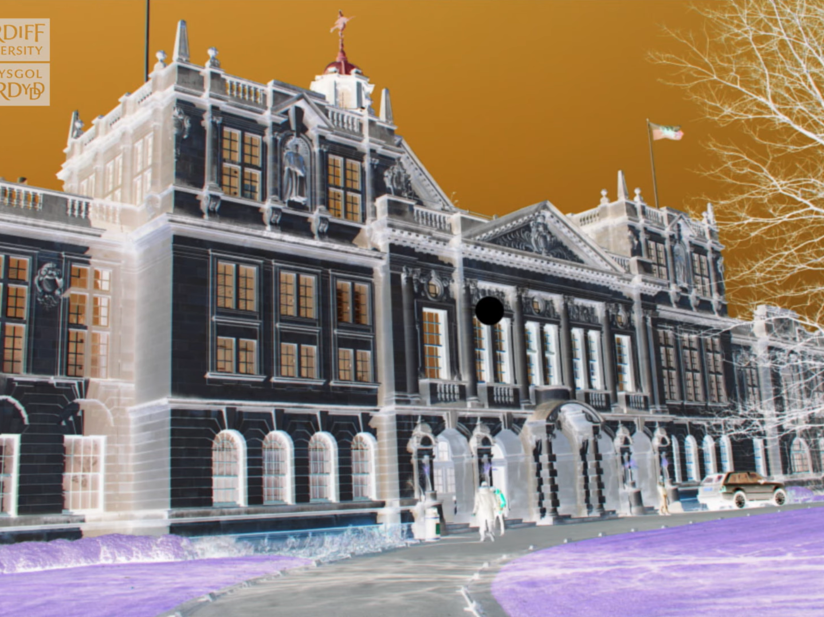

Slide 4
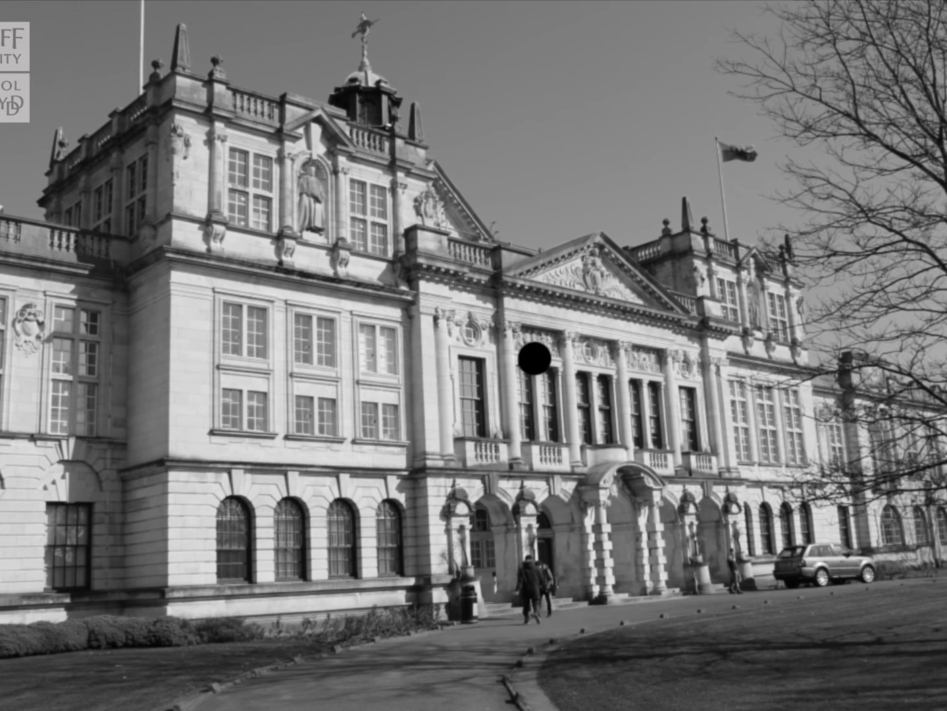

Slide 5
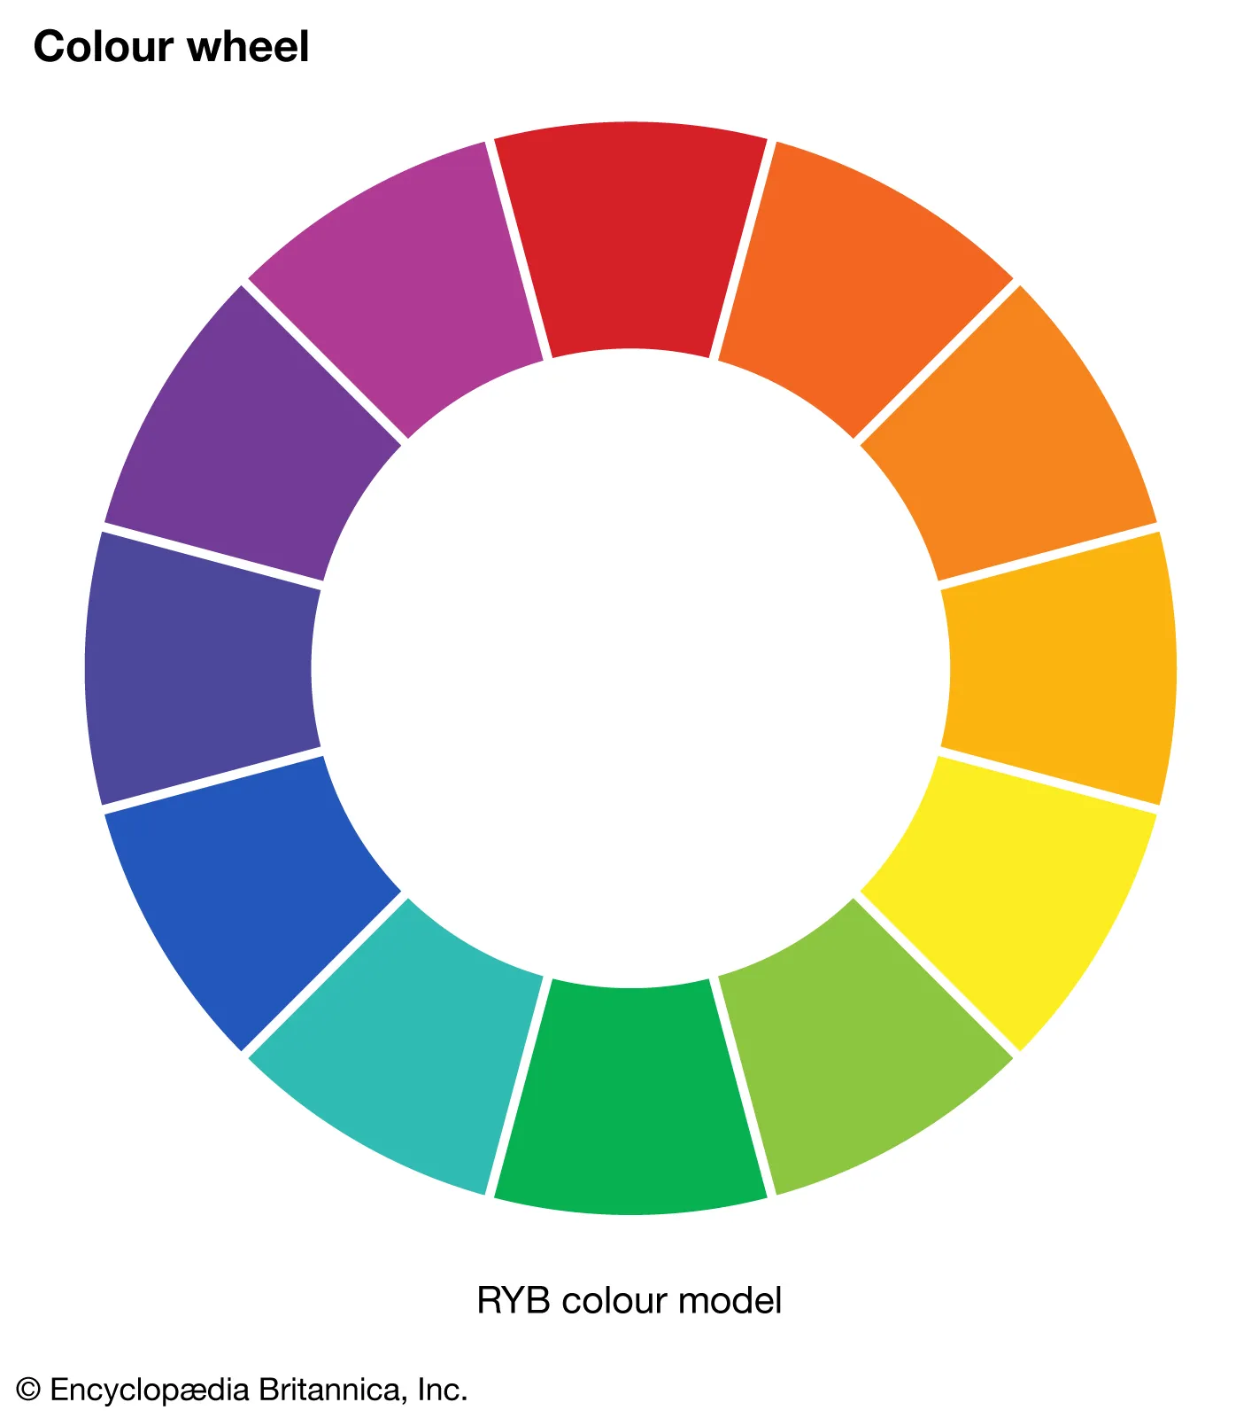
Illusion explanation

Slide 6
Lecture Topics Outline
What is hyperspectral imaging (review)
Problems
Spectral Variability Models
unmixing
Full-Pixel Targets detection
Sub-Pixel Targets detection

Slide 7
Hyperspectral Imaging (review)
Hyperspectral imaging measures the spatial and spectral characteristics of an object by imaging it at different wavelengths.

Slide 8
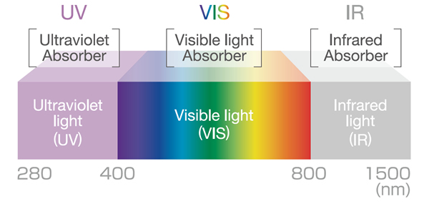
The wavelength range extends beyond the visible spectrum and covers from ultraviolet to longwave infrared wavelengths

Slide 9
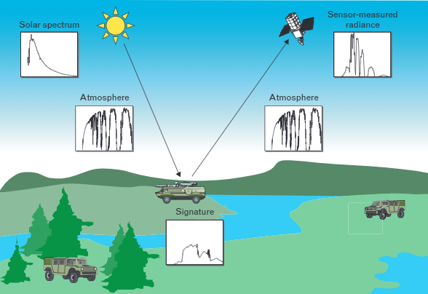
Remote Sensing System
$$\text{R}\text{eflectance} \text{spectrum}\text{(}\text{λ}\text{)}=\frac{\text{R}\text{eflected} \text{radiation} \text{at} \text{band}\text{(}\text{λ}\text{) }}{\text{I}\text{ncident} \text{radiation} \text{at} \text{band}\text{(}\text{λ}\text{)}}$$

Slide 10
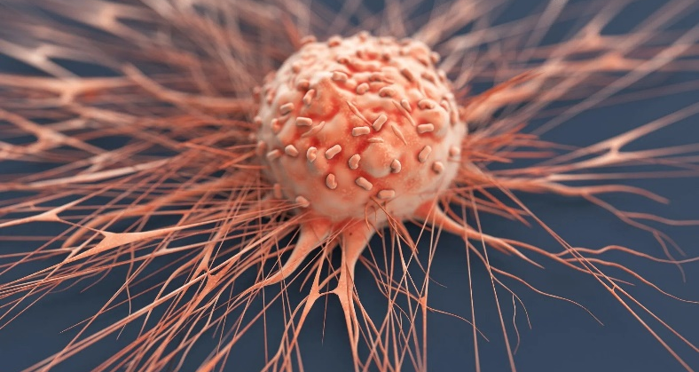
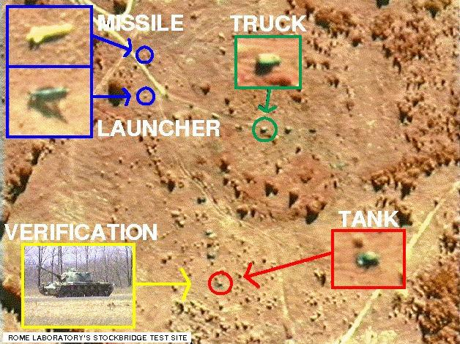
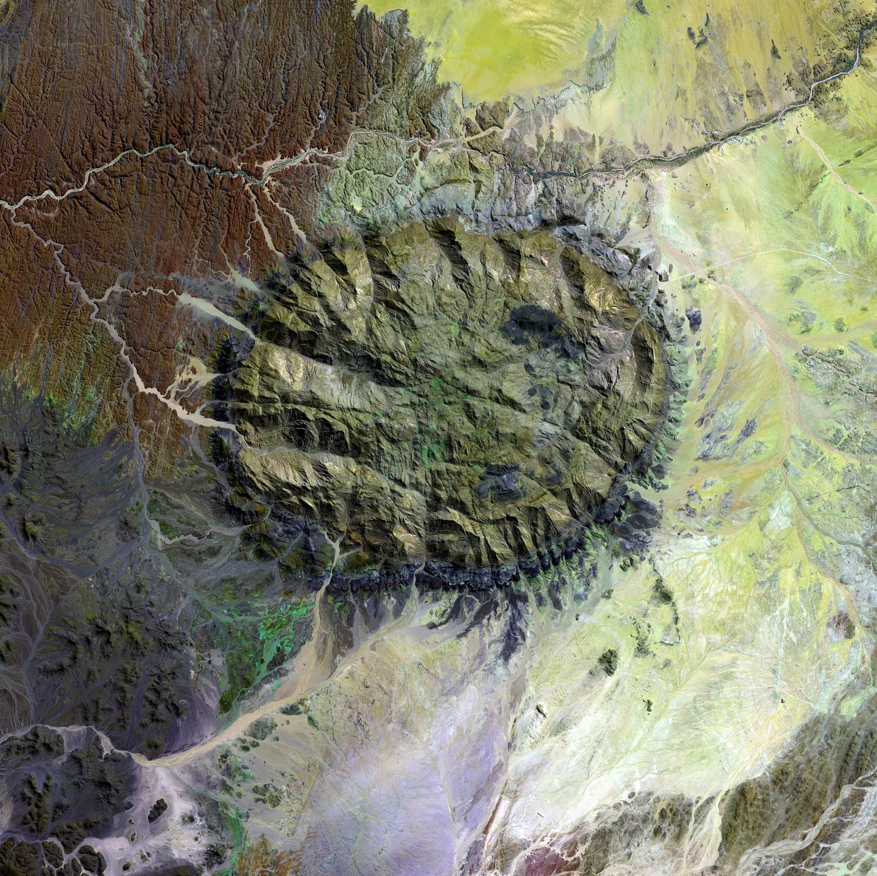
Various natural materials of interest do not have predefined shapes.
Mineral exploration.
Tumor detection.
Identifying targets of a hidden or mistaken nature. (Military use)
Why Spectral Processing?

Slide 11
How?

Slide 12
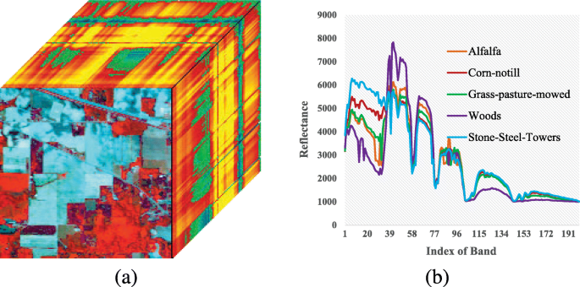
Classification

Slide 13
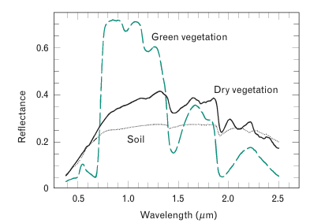
Different materials produce different electromagnetic radiation spectra

Slide 14
Questions that we need to ask ourselves:
does a spectrum uniquely specify a material?
are the spectra of any material the same when observed at different times?
What is the relation between the spectrum observed by the sensor and the spectrum of a ground material?
How do we decide if two spectra are the same?

Slide 15
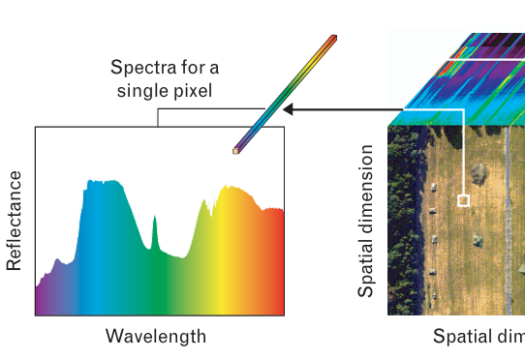
The “What if ?”s:
If each material is characterized by a unique deterministic spectrum :
We could just take the spectrum vector $x=[x_{1},…,x_{k}$] and calculate the Euclidean distance or a Spectral Angle Map to measure similarity.
Suppose x and y are the spectrum vectors of 2 materials:
Euclidian:
SAM:
$$\left\|x−y\right\|={\sqrt{\sum_{k=1}^{K}{{( x}_{k}}}−y_{k} )}^{2}$$
$$∡\left(x,y\right)=\arccos{\frac{x^{T}y}{\left\|x\right\|\left\|y\right\|}}$$

Slide 16
The “What if?”s:
If every material had a unique fixed accurate spectrum :
then we could discriminate between different materials by comparing their spectra.
(spectral signature of the material.)

Slide 17
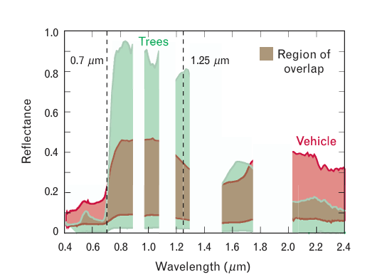
But..
We can’t compare these materials using any one band alone. they overlap completely

Slide 18
Spectra of material at different wavelengths are correlated
Fortunately

Slide 19
New idea detected!
Instead of measuring similarity over a single band.
We can exploit spectral correlation by using more than one band at the same time.
The more bands be used, the more accuracy improves

Slide 20
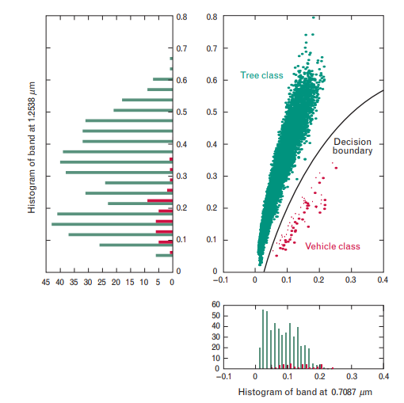
Example: exploitation of 2-bands

Slide 21
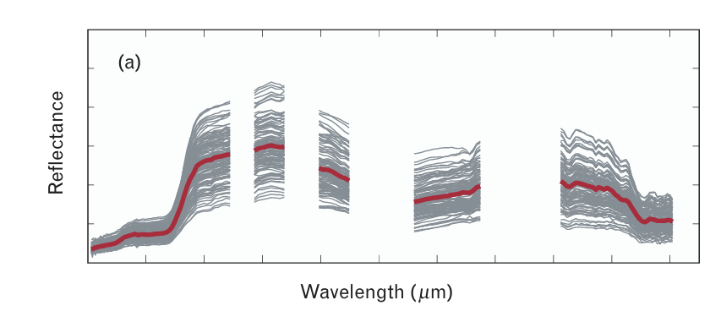
Oops..
Even in a laboratory setting, spectrums of the same material are never consistent!
Due to:
atmospheric conditions, surrounding materials, etc..
This problem will be defined as :
Spectral Variability

Slide 22
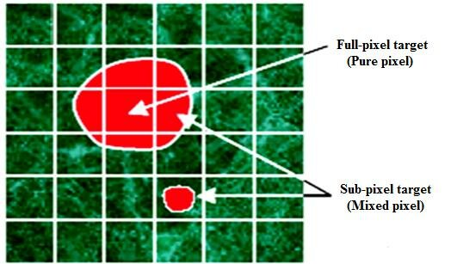
Another problem
full-pixel
target
The same pixel can have more than a single material This problem will be defined as Mixed-Pixel Interference
Mixed-pixel
target

Slide 23
Our goal
to determine for every pixel what material it is

Slide 24
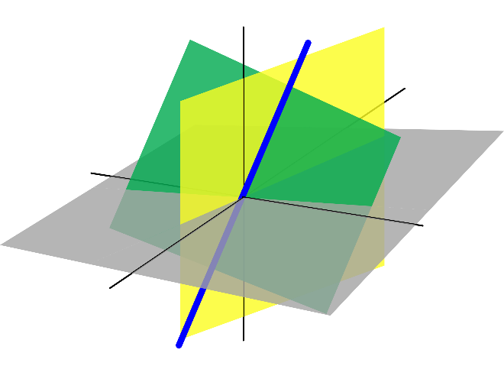
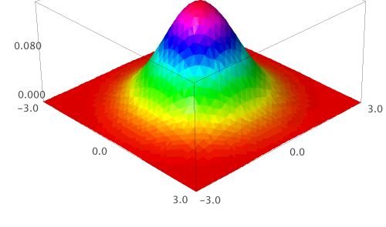
Spectral Variability Models:
1. Probability Density Models
2. Subspace Models
3. Linear Spectral Mixing Models

Slide 25
Probability Density Models
Find the distribution of each class and for each pixel figure out the most likely class it belongs to.

Slide 26
Probability Density Models:
$M$ - No. of classes
$x$ - observed spectrum
$π_{k}$ - the probability of spectral class 𝑘. $\sum_{k=1}^{M}{a_{k}=1}$
$θ_{k}$ - ${(μ}_{k}$, $Γ_{k})$
$Γ_{k}$- covariance matrix of class $k$
${(μ}_{k}$– mean of class $k$
$f\left(x\right)$ - the probability for observing x.
$f_{k}\left(x;θ_{k}\right)$- the probability observing x given a class k. usually chosen as Normal Distribution
$x \sim N\left(μ,Γ\right)$.

Slide 27
Where $f\left(x\right)$ and $f\left(x;θ_{k}\right)$ are given by:
$$f\left(x\right)=\sum_{k=1}^{M}{π_{k}f\left(x{;θ}_{k}\right)}$$
$f\left(x;θ_{k}\right)=\frac{1}{\left({(2π)}^{K/2} {\left|Γ\right|}^{1/2}\right)}ⅇ^{−\frac{1}{2}{\left(x−μ\right)}^{T}Γ^{−1}\left(x−μ\right)}$
One way to decide the class of x is to select the class k that maximize $f\left(x;θ_{k}\right).$
$Δ^{2}={\left(x−μ\right)}^{T}Γ^{−1}$ $\left(x−μ\right)$
This is known as the: Mahalanobis distance
plays a major role in the design and evaluation of target detection algorithms.

Slide 28
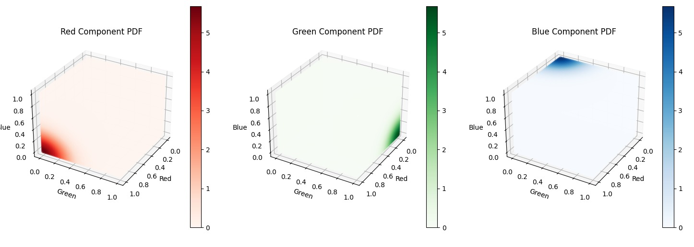
Example:
We set $π_{red}=0.3, π_{green}=0.4,π_{blue}=0.3$
And each of their resp covariance matrices to 0.05*$I$

Slide 29
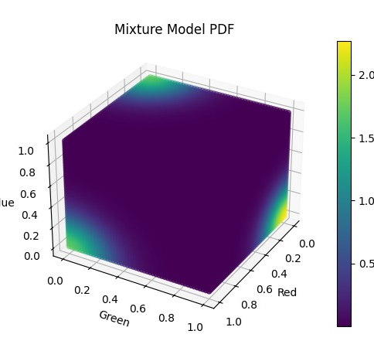
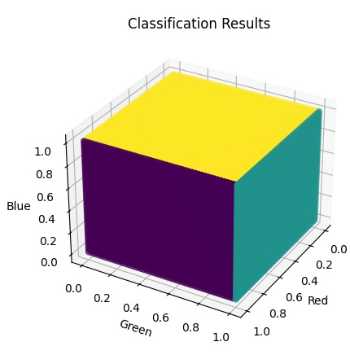

Slide 30
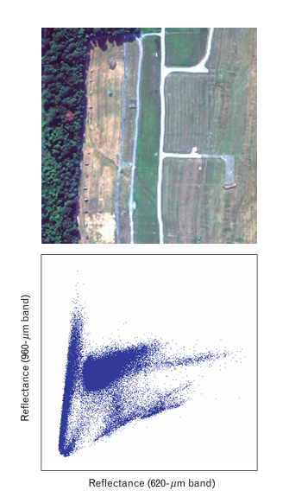
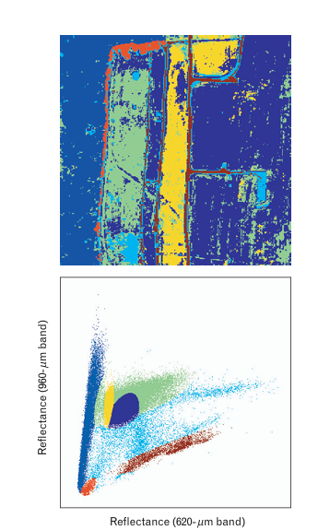
Real world example
Color coded spectral classes obtained by
K-mean
Ground image and a scatter plot of reflectance at two bands

Slide 31
Subspace Models
Project a pixel’s spectrum onto a subspace and find the closest class in the subspace.

Slide 32
Subspace Models
A subspace model essentially lowers the dimension of the data.(not all dimensions of the band space are equally important for describing variability in the data.)
K - the number of bands in the spectral data represent $x$.
M < K – the number of bands represents the subspace.
$s_{1},{…,s}_{k}$- are the basis for this space
$a_{1},{…,a}_{k}$- are how much each basis contributes to the final spectrum of the pixel .
$$x=\sum_{k=1}^{M}{a_{k}s_{k}}=Sa$$

Slide 33
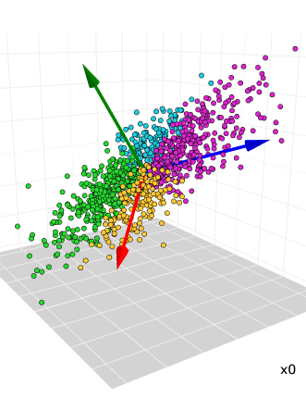
Subspace Models Implementations
Very popular way of implementing this model is :
Principal Component Analysis (PCA), we collect the data, compute the covariance matrix, perform find eigenvectors and eigenvalues, and use only the largest ones.

Slide 34
Linear Spectral Mixing
Find the coefficients for each endmember and classify the pixel appropriately.

Slide 35
Linear Spectral Mixing Models
The most popular model!
Spectrum of each pixel made up of several deterministic spectral signatures. called Endmembers.
$a_{1},{..,a}_{M}$ contribution of each endmember to the final spectrum of the pixel
𝒂_𝟏,〖..,𝒂〗_𝑴 contribution of each endmember to the final spectrum of the pixel
This model assumes that a pixel is a linear combination of $M$ endmembers $s_{1},{..,s}_{M}$.
This model assumes that a pixel is a linear combination of 𝑀 endmembers 𝒔_𝟏,〖..,𝒔〗_𝑴.
$$\sum_{k=1}^{M}{a_{k}=1} \left(additivity constraint\right)$$
$a_{k}≥0 (positivity constraint)$
$$x=\sum_{k=1}^{M}{a_{k}s_{k}}$$

Slide 36
The goal
To select the appropriate endmembers, and to solve for the coefficients $a_{k}$, this would lead us to understanding the composition of each pixel

Slide 37
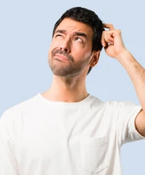
So… What just happened?
We saw three different models that should help us classify materials in a hyperspectral image.
In short how do they work?
Probabilistic Density – Find the distribution of each class and for each pixel figure out the most likely class it belongs to.
Subspace – Project a pixel’s spectrum onto a subspace, and find the closest class in the subspace.
Linear Spectral Mixing – Find the coefficients for each endmember and classify the pixel appropriately.

Slide 38
But..How?

Slide 39
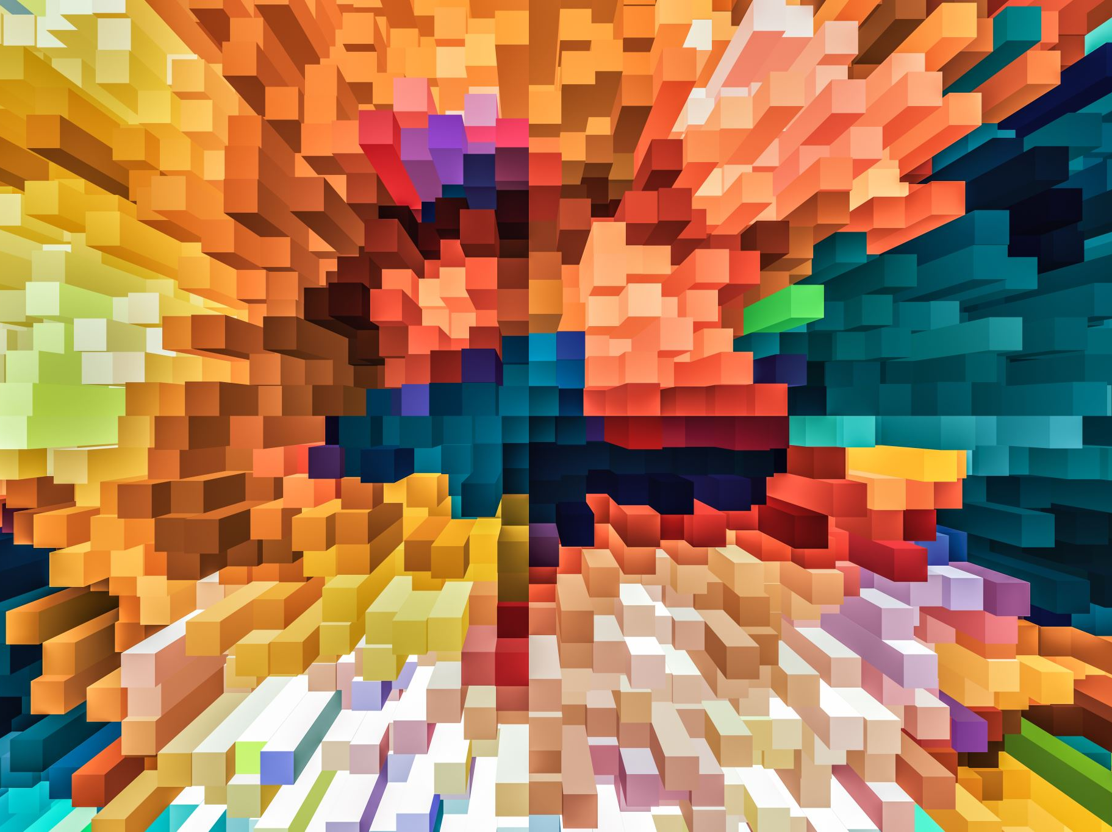
Unmixing
Unmixing is the process of finding out the abundance of each endmember in a pixel.

Slide 40
Unmixing
In some cases, we will know the endmembers in advance.
If not, there are several methods for choosing our endmembers ranging from manual selection to very complex methods.
After choosing the endmembers, we arrive at the main bulk of the action which is finding their abundances.
The most straightforward method is solving the linear equation
$$\min_{a}\left\|Sa −X\right\|$$

Slide 41
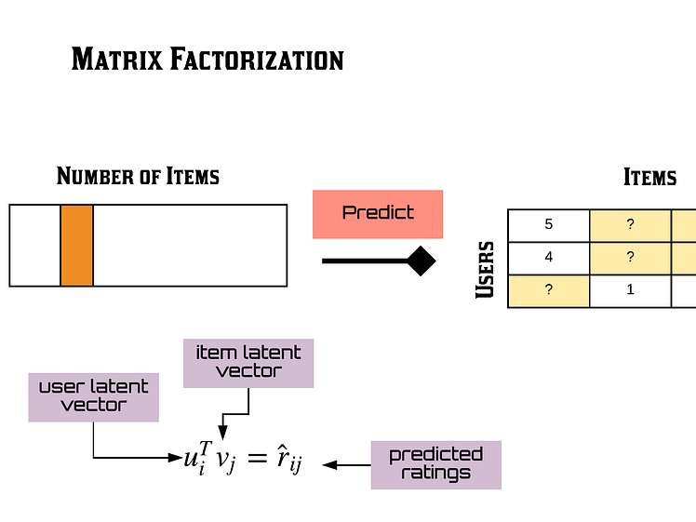
Factorizing the matrix is essentially attempting to minimize the difference between the original matrix and the matrix obtained by the product of the two assumed endmember and abundance matrices.

Slide 42
Unsupervised Unmixing - Matrices
Constrained Positive Matrix Factorization (CPMF) –
Unsupervised – this means that we don’t know the labels (or in our case the endmembers) in advance.
Constrained Positive – enforcing non-negativity on S and a.
The CPMF algorithm starts with random endmember and abundance matrices and uses iterative optimization to inch closer and closer to the original matrix.

Slide 43
Unsupervised Unmixing CPMF Example
$$X=\left(\begin{matrix}0.5 & 0.4 & 0.1 \\ 0.6 & 0.3 & 0.1 \\ 0.7 & 0.2 & 0.1\end{matrix}\right)$$
$$S=\left(\begin{matrix}\text{0}\text{.}\text{2876} & \text{0}\text{.}\text{1512} \\ \text{0}\text{.}\text{3013} & \text{0}\text{.}\text{2157} \\ 0.3150 & 0.2802\end{matrix}\right) , A=\left(\begin{matrix}\text{1}\text{.}\text{7322 } & \text{0}\text{.}\text{9219} & \text{0}\text{.}\text{1116} \\ 0.0940 & 0.0678 & 0.0416\end{matrix}\right)$$
$$S⋅A∼\left(\begin{matrix}0.51 & 0.27 & 0.04 \\ 0.54 & 0.29 & 0.04 \\ 0.57 & 0.31 & 0.05\end{matrix}\right)$$

Slide 44
Detection

Slide 45
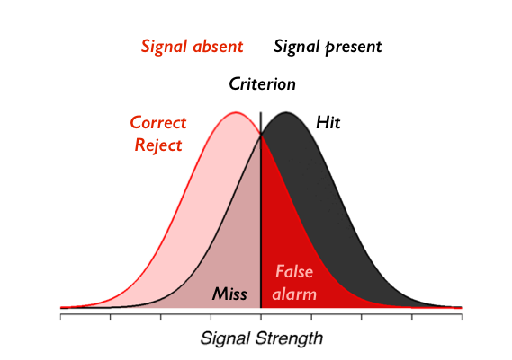
How?

Slide 46
Full-Pixel Detectors
Since we are trying to detect a specific material.
We will separate the image into 2 distinct classes:
1. The material we are trying to detect, or the Target.
2. And everything else that isn’t the material, which we will refer to as the Background.

Slide 47
Full-Pixel Detectors
Let’s begin by first assuming we know the statistics of targets and backgrounds
Consider a detection problem where the target and background both follow a normal distribution.
$$H_{0}:x\sim N\left(μ_{0},Γ_{0}\right) (target absent)$$
$H_{1}:x\sim N\left(μ_{1},Γ_{1}\right)$ $(target present)$
$∗∗where μ is the mean and Γ is the cov matrix∗∗$

Slide 48
Neyman-Pearson detector.
The detector makes a decision based on the Mahalanobis distance (from earlier) of x’s spectrum from each of the classes.
$$y=D\left(x\right)={\left(x−μ_{0}\right)}^{T}{Γ_{0}}^{−1}\left(x−μ_{0}\right)$$
$$−{\left(x−μ_{1}\right)}^{T}{Γ_{1}}^{−1}\left(x−μ_{1}\right).$$

Slide 49
If both classes have the same covariance matrix, the equation becomes simpler:
$$y=D\left(x\right)=C_{MF}^{T}x ,$$
$$c_{MF}=kΓ^{−1}(μ_{1}−μ_{0})$$
MF is an abbreviation of a common term in this space – Matched Filter.
k is just a scaling constant used for normalization, does not effect decision and often omitted.

Slide 50
$$c_{MF}=Γ^{−1}(μ_{1}−μ_{0})$$
Intuitively:
$μ_{1}−μ_{0}$ - represents the direction of maximum difference between the mean of the target and the mean of the background.
$Γ^{−1}$ accounts for noise and variation, ensuring reliability in distinguishing between the classes.

Slide 51
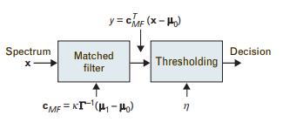
Matched Filter based detector
Centering
$$P_{FA}=\int_{η}^{∞}{p\left(\left.y\right|H_{0}\right)ⅆy}=α$$

Slide 52
Example Lets take this hypothetical 3d hyperspectral image, and choose a pixel x (in red).
$$\left(\begin{matrix}\left[\begin{matrix}2 \\ 3 \\ 4\end{matrix}\right] & \left[\begin{matrix}5 \\ 5 \\ 5\end{matrix}\right] & \left[\begin{matrix}3 \\ 3 \\ 3\end{matrix}\right] \\ \left[\begin{matrix}2 \\ 3 \\ 4\end{matrix}\right] & \left[\begin{matrix}2 \\ 3 \\ 4\end{matrix}\right] & \left[\begin{matrix}5 \\ 5 \\ 5\end{matrix}\right] \\ \left[\begin{matrix}3 \\ 3 \\ 3\end{matrix}\right] & \left[\begin{matrix}5 \\ 5 \\ 5\end{matrix}\right] & \left[\begin{matrix}2 \\ 3 \\ 4\end{matrix}\right]\end{matrix}\right)$$

Slide 53
Assume the following Target and Background means, and a mutual covariance matrix
$$μ_{0}= \left[\begin{matrix}2 \\ 3 \\ 4\end{matrix}\right], μ_{1}=\left[\begin{matrix}5 \\ 5 \\ 5\end{matrix}\right],Γ=\left(\begin{matrix}1 & 0.5 & 0.3 \\ 0.5 & 1 & 0.4 \\ 0.3 & 0.4 & 1\end{matrix}\right)$$
$$μ_{1}−μ_{0}=\left[\begin{matrix}5 \\ 5 \\ 5\end{matrix}\right]−\left[\begin{matrix}2 \\ 3 \\ 4\end{matrix}\right]=\left[\begin{matrix}3 \\ 2 \\ 1\end{matrix}\right]$$
$$Γ^{−1}≈\left(\begin{matrix}1.25 & −0.5 & −0.25 \\ −0.5 & 1.25 & −0.5 \\ −0.25 & −0.5 & 1.25\end{matrix}\right)$$
$${c_{MF}=Γ}^{−1}\left(μ_{1}−μ_{0}\right)=\left(\begin{matrix}1.25 & −0.5 & −0.25 \\ −0.5 & 1.25 & −0.5 \\ −0.25 & −0.5 & 1.25\end{matrix}\right)\left[\begin{matrix}3 \\ 2 \\ 1\end{matrix}\right]=\left[\begin{matrix}2 \\ −2 \\ 1\end{matrix}\right]$$

Slide 54
$$x=\left[\begin{matrix}3 \\ 3 \\ 3\end{matrix}\right], x_{centered}=x −μ_{0}=\left[\begin{matrix}3 \\ 3 \\ 3\end{matrix}\right]−\left[\begin{matrix}2 \\ 3 \\ 4\end{matrix}\right]=\left[\begin{matrix}1 \\ 0 \\ −1\end{matrix}\right]$$
$${y= c}_{MF}^{T}\left(x −μ_{0}\right)=\left[\begin{matrix}2 & −2 & 1\end{matrix}\right]\left[\begin{matrix}1 \\ 0 \\ −1\end{matrix}\right]=1$$
Assuming 1 is above our threshold, we would say that this pixel contains the target, and as background otherwise.
We proceed the same way for the rest of the matrix, hypothetically (with threshold 1.5):
$$\left(\begin{matrix}0 & 1 & 0 \\ 0 & 0 & 1 \\ 0 & 1 & 0\end{matrix}\right)$$

Slide 55
Anomaly Detection
In many situations we don’t have the statistics of the target class.
We need a solution only based on the background class.
We only consider the simplified case where both classes share the covariance matrix.

Slide 56
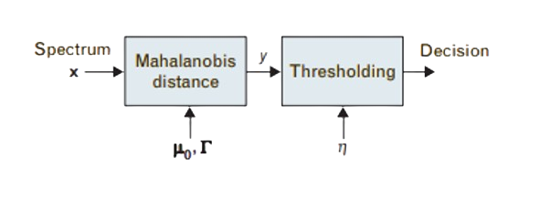
We’ll just take the Mahalanobis distance from the background class that is greater than a predetermined threshold.

Slide 57
Adaptive Detection
In practice, we are not just given the statistics on a silver plate, we need to infer them from the date in the hyperspectral image.
In such a case we try to pick an area of interest that we can infer the distribution from.
As the quality of the area chosen improves, so does the performance of our detectors.
Ideally the distributions of the target and background class are indeed normal

Slide 58
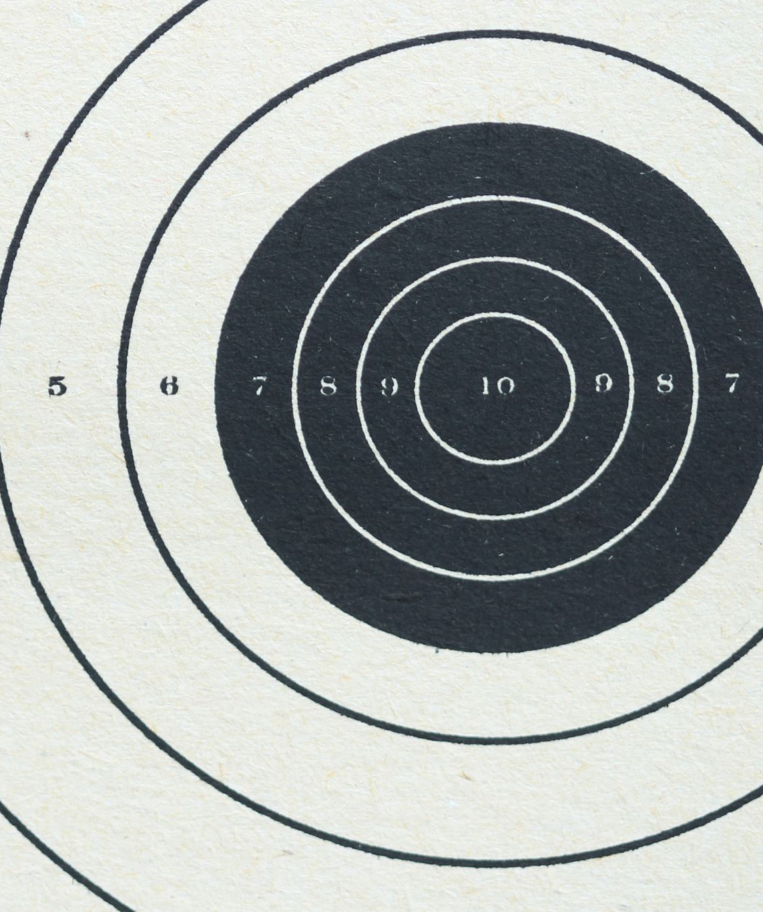
Sub-Pixel Targets
In this section we will separate the pixel itself into two the classes discussed previously:
Target Class – The material we are trying to detect.
Background Class – Everything else in the pixel.

Slide 59
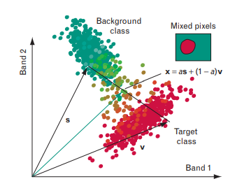
The spectrum of mixed pixels can usually be represented easily as a linear combination of the spectra of the target class and the background class, since it lies on the line that connects the two components.

Slide 60
Target Class Variability
The target class variability is always described using a subspace model Sa as previously described.
$$x=\sum_{k=1}^{M}{a_{k}s_{k}}=Sa$$
But what is Sa? What is this expression doing here?

Slide 61
Unstructured Background Models
The variability of the background is called “Unstructured” if it is described by a statistical distribution.
In our case we will assume that the background is modeled by a Normal Distribution
$v \sim N\left(μ,Γ\right)$

Slide 62
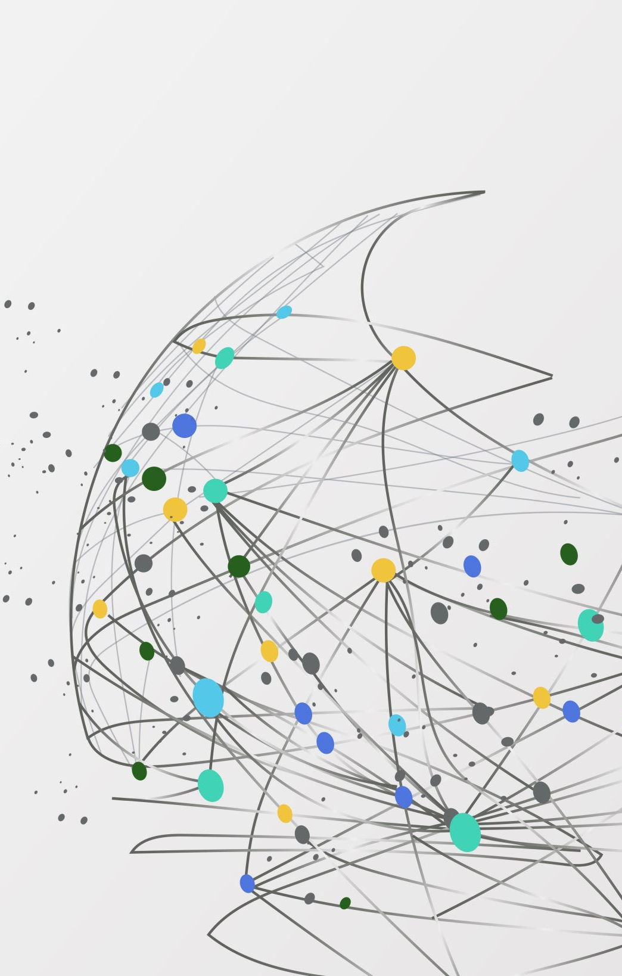
$$H_{0}: x=v (target absent)$$
$H_{1}:x=Sa+v$ $(target present)$
In addition, we assume we have a training set of i.i.d pixels to train our model.

Slide 63
Adaptive Coherence Estimator Detection (ACE detection)
$$D_{ACE}\left(x\right)=$$
$$\frac{x^{T}{\hat{Γ}}^{−1}S{(S^{T}{\hat{Γ}}^{−1}S)}^{−1}S^{T}{\hat{Γ}}^{−1}x}{x^{T}{\hat{Γ}}^{−1}x} \begin{matrix}H_{1} \\ ≷ \\ H_{0}\end{matrix}η_{ACE}$$
The Numerator calculates how much of x aligns with S after accounting for background noise (in the form of the cov matrix).
The Denominator normalizes the expression by a noise-normalized x.

Slide 64
Structural Background Models
$H_{0}: x=Ba_{b,0}+w (target absent)$
$$H_{1}: x=Sa+Ba_{b,1}+w (target present)$$
$Matrix S$represents the Target’s subspace.
$Matrix B$represents the Background’s subspace.
$p_{A}^{⊥}$ - this expression means projecting onto the orthogonal compliment of a matrix A.

Slide 65
Detector
$$y=D_{SB}\left(x\right)=\frac{x^{T}p_{B}^{⊥}x−x^{T}p_{SB}^{⊥}x}{x^{T}p_{SB}^{⊥}x}$$
We take the projection matrix into the column space of the matrix defined in the subscript.
SB is the matrix obtained by combining the target and background subspaces.

Slide 66
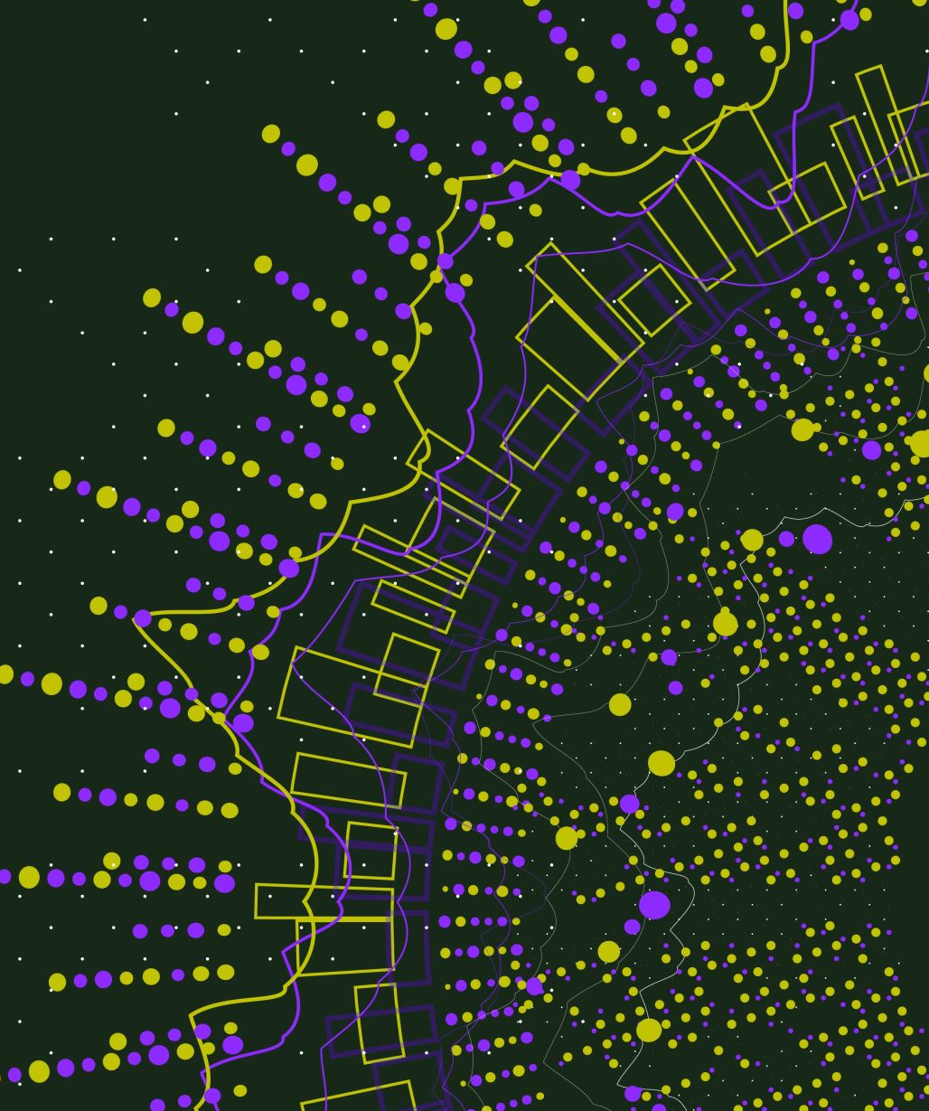
Detector – Cont’
$$y=D_{SB}\left(x\right)=\frac{x^{T}p_{B}^{⊥}x−x^{T}p_{SB}^{⊥}x}{x^{T}p_{SB}^{⊥}x}\begin{matrix}H_{1} \\ ≷ \\ H_{0}\end{matrix}η_{SB}$$
$x^{T}p_{B}^{⊥}x$ Measures how much x is orthogonal to the background subspace.
$x^{T}p_{SB}^{⊥}x$ Measures how much x is orthogonal to the target and background subspace.
The difference isolates the part of x that aligns with the target subspace.
The denominator normalizes the expression.

Slide 67
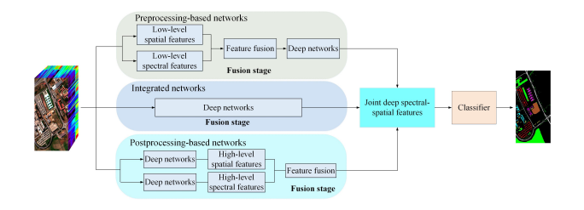
Modern Solutions – Deep Learning

Slide 68
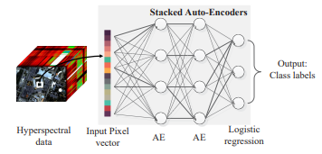
Modern Solutions – Deep Learning

Slide 69
What did we learn?
1. We learned about the different problems in classifying data.
2. We learned about models to address data variability.
3. We learned some basic unmixing approaches.
4. We saw some detection algorithms
4.1. For Full-Pixels
4.2. For Sub-Pixels
5. We got a glimpse into what modern approaches entail.

Slide 70
References:
https://courses.cs.washington.edu/courses/cse591n/07sp/papers/14_1hyperspectralprocessing.pdf
https://www.uprm.edu/cise/wp-content/uploads/sites/171/2018/12/masalmahcise.pdf
https://ww3.math.ucla.edu/camreport/cam09-30.pdf
https://arxiv.org/pdf/1910.12861

Slide 71
Thank you !

