Slide 1
Super-Resolution
A presentation by: TeamAmir & friends
A guide to SR different approaches

Slide 2
Introduction
What is super-resolution?(SR)
SR is the process of inducing more information
out of a set of image (or a single one) onto a high resolution image.
Why do we need it?
SR provides a very helpful tool for image processing of a scene and lets us improve existing data.

Slide 3
basics
In theory, as suggested by M. Irani in her 1991 masterpiece, more details can be extracted from a set of images using the next concept:
Suppose we find an area of the image (patch) that is similar to another patch, we can use that pair for inferring more data.

Slide 4
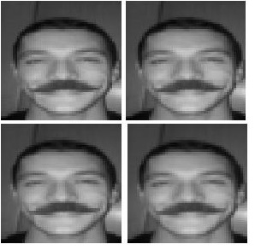
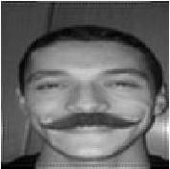

Examples
Super Resolution result
Original high-res image
Generated dataset

Slide 5
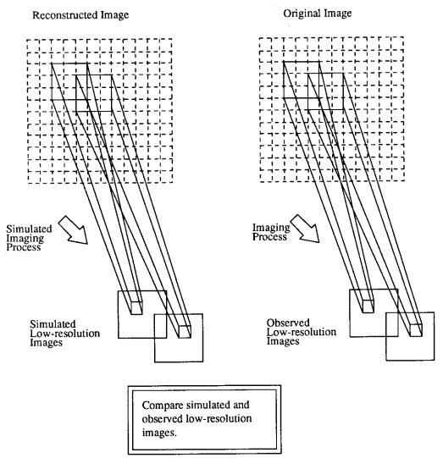
basics
When we take an image
we sample the world.
Our sampling is in lower res
than the real image.
We can use the overlapping
patches in the generated
images to recover some of the details.

Slide 6
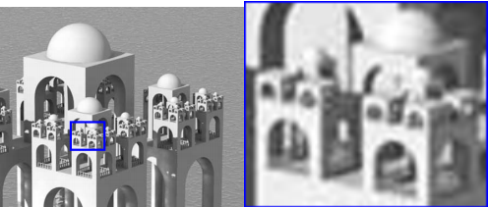
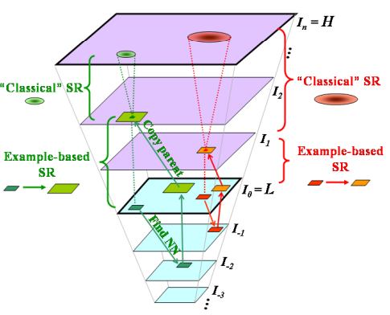
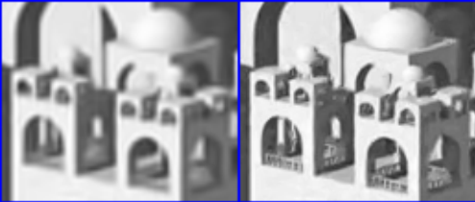
Example – from single image

Slide 7
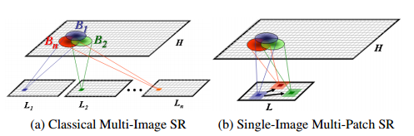
The mathematical concept

Slide 8
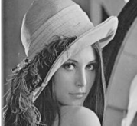
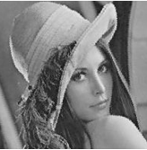





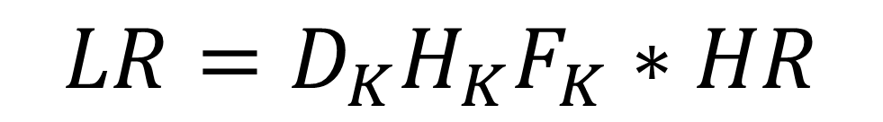

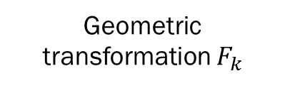

The first lady of the internet
Geometric transformation $F_{k}$
Sampling $D_{k}$
Noise $LR$
Scene $HR$
Optical blur $H_{k}$
$$LR=D_{K}H_{K}F_{K}∗HR$$

Slide 9

The first lady of the internet
Geometric transformation $F_{k}$
Sampling $D_{k}$
Noise $LR$
Scene $HR$
Optical blur $H_{k}$
$$LR=D_{K}H_{K}F_{K}∗HR$$
$$LR=DHF_{K}∗HR$$

Slide 10
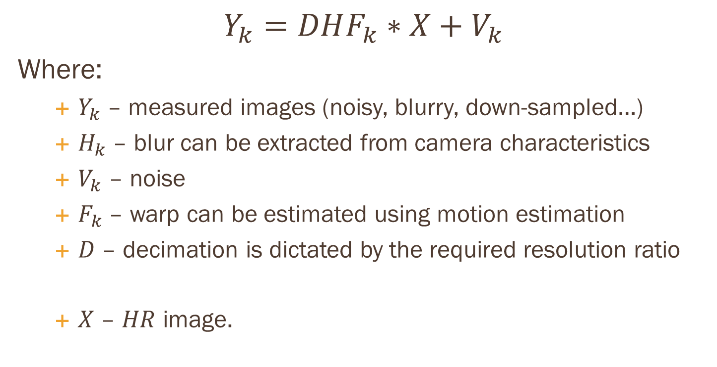
The sr problem
$$Y_{k}=DHF_{k}∗X+V_{k}$$
Where:
  $Y_{k}$ – measured images (noisy, blurry, down-sampled…)
  $H_{k}$– blur can be extracted from camera characteristics
  $V_{k}$ – noise
  $F_{k}$ – warp can be estimated using motion estimation
  $D$ – decimation is dictated by the required resolution ratio
  $X$ – $HR$ image.

Slide 11
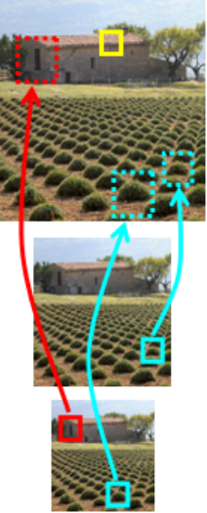
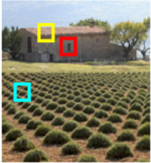
example
Patch recurrence in different scales within same image

Slide 12
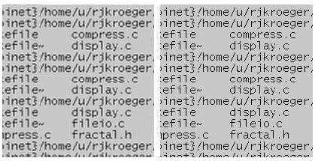
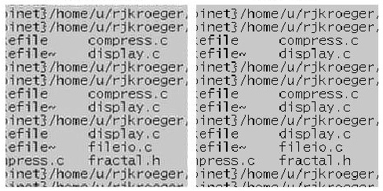
Preliminary results
SR result,
dataset size 2
Original
SR result,
dataset size 5

Slide 13
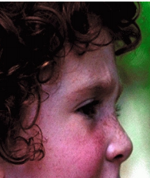
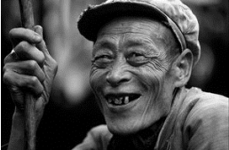


Example based – another approach
We have seen one way of looking at the SR problem.
A different way is to use a “learning” algorithm.
Suppose we have a dataset of patch pairs: one is a small patch, and the other is its larger representation.
For Example. . .

Slide 14
Example based (CONT.)
Given this dataset, we can run searches for similar patches, and find their larger counterparts.
No equation solving!
No registration!
No iterations!
Much simpler, is it not?

Slide 15
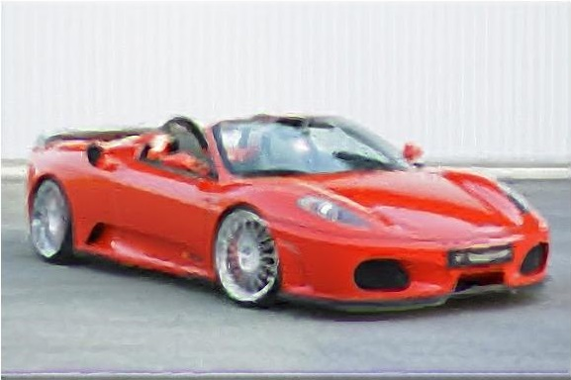

Preliminary results
This time we see the results of our algorithm based on example learning. We chose our dataset to be a collection of images of red ferraris, in order to assure better results
Result
Input

Slide 16
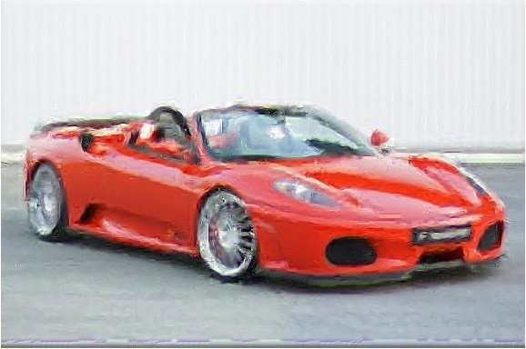
Preliminary results
Here we see the results generated from a random collection of images(of the same size):

Slide 17
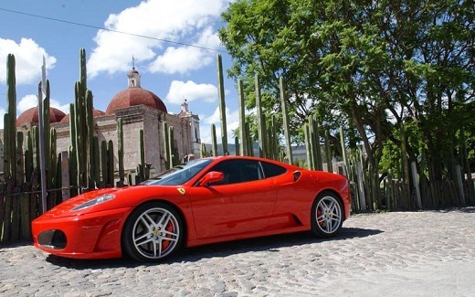

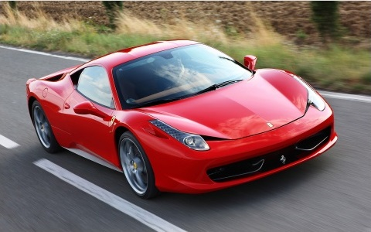
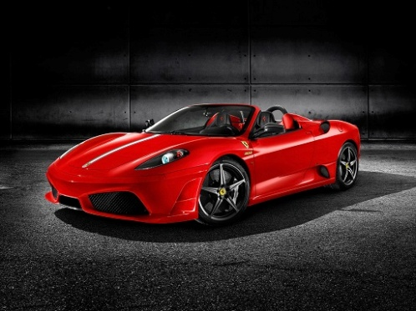

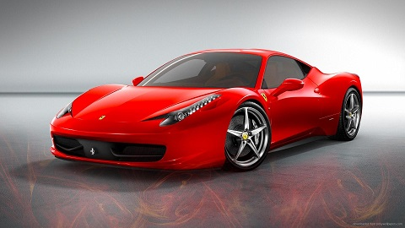
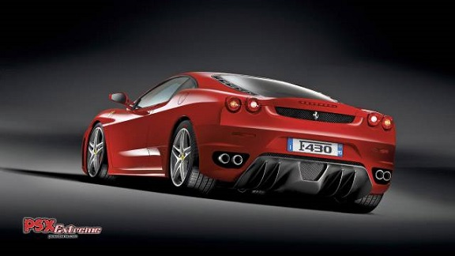
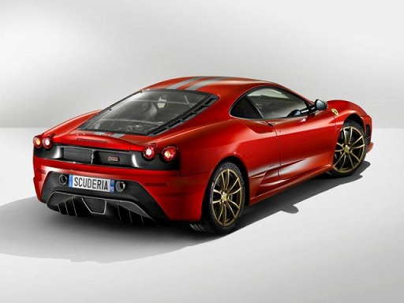
Datasets:

Slide 18
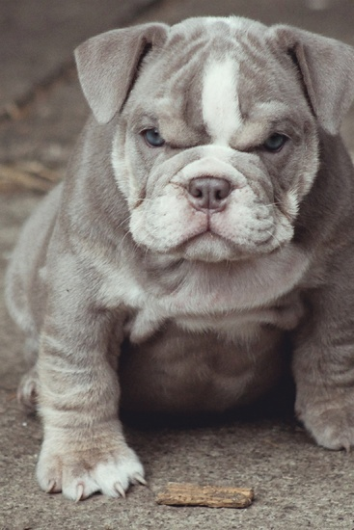



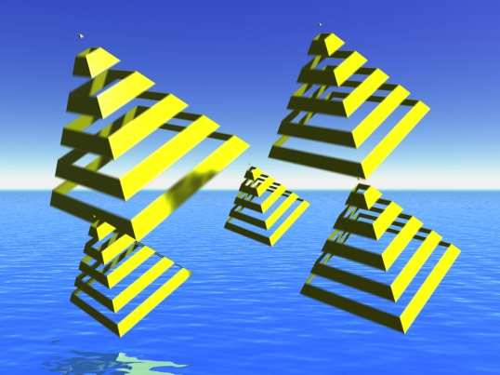
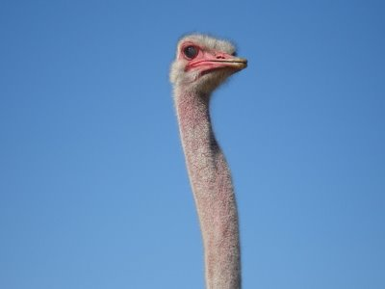

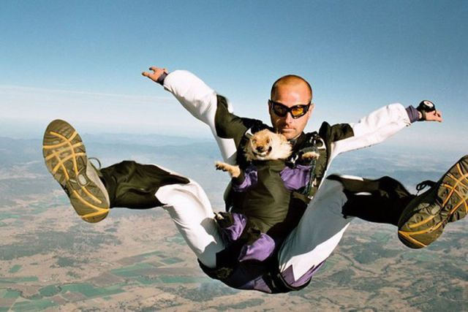

Datasets:

