Slide 1
Vision & Language
By: Guy Hamburger

Slide 2
Our topic today
Combining natural language and computer vision.
Advancing to new fields and subjects in CV and deep learning.

Slide 3
1’st article
Deep Visual-Semantic Alignments for Generating Image Descriptions
By Andrej Karpathy & Li Fei-Fei. 2015

Slide 4
Subject Example

Slide 5
The Model
Data preparation – Data alignment(contains 2 parts)
Generating descriptions

Slide 6
Data preparation – Data alignment

Slide 7
Data-alignment: Representing Image
Using RCNN to get the top 19 places in the picture
Each bounding box is $I_{b}$
$v$is bounding box representor at h-dimensional vector

Slide 8
Data-alignment: Representing sentences
Using BRNN to create words as other words function
Indexing the words
$I_{t}$ is indicator vector(1 at t 0 at others)
$W_{w}$ is weight matrix from word2vec initialized with weights to words
h’s are the hidden layers and St is the last result

Slide 9
Data-alignment: Object alignment
$S_{kl}$is the valuation of image to sentence which is used it to evaluate our results and to emulate each word to a region in the image
$v_{i}$ and St are do products which gives a result (number) that
describes the similarity between each word and its sentence.
$S_{kl}$ is the score of Image-Sentence

Slide 10
Data-alignment: Rank the assignment
Ranking the assignment while encouraging the correct assignment to have higher score
Getting REAL 2 pairs of Image-Sentence have higher score by margin

Slide 11
Short review

Slide 12
Data-alignment: Text segments alignments to images
Achieving natural language - each description as a long sentence and not as a single word (if the score allows)
Each alignment is $a_{j}${1…M} for j= 1….N (M bounding boxes ,N words) While trying to minimize the total energy in the formula using dynamic programing

Slide 13
Generating descriptions: The RNN
Why RNN? Need a NN that can learn from past decisions and infer it to a current state, as known RNN does it the best.
I is image region,($x_{1}$…$x_{T}$) words input. And ($h_{1}$ …$h_{t}$ ) hidden layers and output ($y_{1}$,…. $y_{T}$) t=1 to T
$y_{t}$ hold the log probabilities of words in the dictionary
$b_{v}$ is the bias which we give on the first iteration only

Slide 14
Generating descriptions: RNN training
$$h_{0}=\vec{0}$$
$$y_{1}=first word$$
$$Repeat. until{ x}_{T}represnt$$
$$the last word$$
$$x_{1}=START$$
$$predict{ y}_{2}(next word)$$
$$x_{2}=first word$$
$$y_{T}represent END$$

Slide 15
Generating descriptions: RNN testing
$$h_{0}=\vec{0}$$
Compute $y_{1}$
$$x_{1}=START$$
$$x_{2}=y_{1}$$
$$Repeat, until we get END token$$
$$get b_{v} from image$$

Slide 16
Generating descriptions: Review

Slide 17
Experiments
Using Flicker8K,Flicker30K and MSCOCO which have 8K,31K,123K images and each has 5 sentences with Amazon Mechanical Turk , in order to experiment the results from the model.
Each sentence converted to lower-case ,removed non-alphanumeric characters.

Slide 18
Experiments: Image-sentence Alignment evaluation
Using the image-sentence score $S_{kl}$ for evaluation of the image-sentence alignments we.
Using median rank to get the fraction of times of a correct result was found among the K results.

Slide 19
Experiments: Generated description - Full frame
Evaluating the results from the RNN- the description of each image region (full image).
First the result of the entire image were tested to check that the entire image is rich enough to distribute it to small sentences.
Several methods were used to check how much a sentence is matched to 5 sentence on that image written by 5 different people.

Slide 20
Experiments: Generated description-Full frame cont.

Slide 21
Experiments: Generated description-Region
Testing the results of regions found and corresponded text snippets in the image and sentence.
Creating a new dataset using AMT and MSCOCO, and creating 9,000 text snippets for 200 images .

Slide 22
Experiments: Generated description - Comparison
Region evaluation brings better results.
Why? - The comparison method itself uses BLUE ranking and Full frame has much longer sentence therefore it more likely to have lower rank.

Slide 23
Results

Slide 24
Conclusions
Introducing into a model that generates a natural language descriptions of image regions based on a dataset of images and sentence with few assumptions .
Demonstrating the feasibility of connecting image and natural language using a common multi model embedding.
This approach features a novel ranking model that aligns part of visual and language through a common multi-model embedding.

Slide 25
2’nd article
VQA: Visual Question Answering by Aishwarya Agrawal∗ , Jiasen Lu∗ , Stanislaw Antol∗ , Margaret Mitchell, C. Lawrence Zitnick, Dhruv Batra, Devi Parikh . 2015

Slide 26
Topics
What is VQA?
Task goal and why?
Dataset collection
Dataset analysis
Conclusion
Actual results(not in the paper)

Slide 27
VQA
VQA – Visual Question Answering . A natural language questions and answers to be given to a set of images and their captions.
VQA targets different areas of an image including background and underlying context

Slide 28
Task goal – and why?
free-form open-ended Visual Questions Answering that given image natural language answer.
In order to push forward the AI problems forward:
There is a need to involve more subject than a particular filed such as CV or NLP while combining and having a well defined quantitative evaluation metric

Slide 29
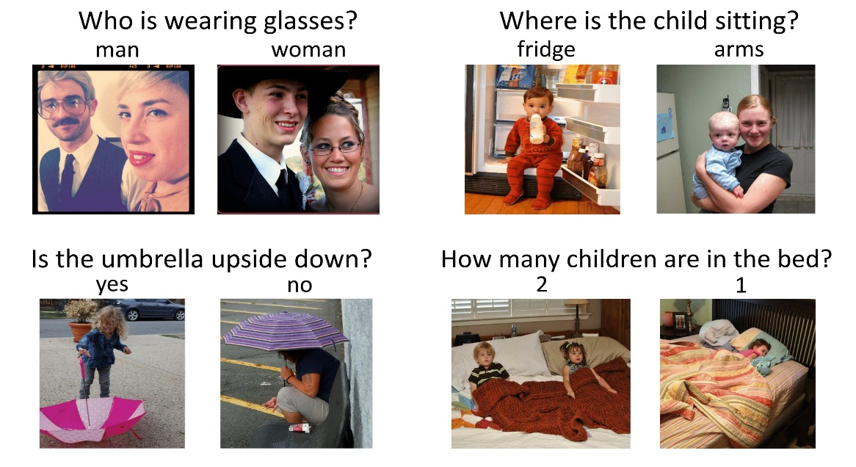
How VQA and the goal connect?
Open ended question require vast set of AI capabilities to answer such as: recognition, object detection ,activity recognition commonsense reason etc.
VQA has automatic quantitative evaluation making it possible to effectively track progress on this task

Slide 30
Dataset Collection
Creating 2 kinds of dataset: Real Images & Abstract Images
Real Images used MS COCO dataset which has a rich contextual information and multiple object in it which is very well suited for VQA.
Abstract Images VQA requires a high and complex reasoning and in order to attract researchers which want to be more focused on that and less on the low level vision task this added to the dataset.

Slide 31
Data Collection - Example

Slide 32
Questions
There is a need for interesting diverse and well posed questions. Many questions require low level CV, some require common sense Knowledge. ALSO the questions should require the image to correctly answer and not be answerable using just commonsense while having variety of questions difficulty.

Slide 33
Questions – cont.
gathering the questions?
First study: each subject was asked to create a question that a “toddler/alien/smart robot” would have trouble answering(each question had to be image-independent).
In total for each image/scene there are 3 questions (subjects were shown the previous questions already asked for that image )
In overall ~0.76M questions

Slide 34
Answers
The answers should be open-ended with diverse set of possible answers. Although many questions are a simple “yes/no” other need short phrase.
Noted many questions can be answered by multiple correct answers furthermore many subjects might disagree on the correct answer.
10 answer were gathered for each question from unique subject while ensuring the answer given is not by the asker.
Each subject was instructed to give a short phrase answer And also if they are sure they answer the question correctly

Slide 35
Testing Answer-question evaluation
There are 2 kinds of answers – open answer and multiple-choice
Open-answer: valuating the accuracy of the answer using this formula-
$\min\left(\frac{\#humans that provided that answer}{3} ,1\right)$.
Multiple-choice: 18 candidate answers are created for each question ,creating a set of correct and incorrect answer (top 10 answers).
For Plausible(incorrect) picking the answers that can be given without looking at the image (also help to ensure the need of the image not only common sense) also to generate total of 18 answers we added random answers from the data set
~10M answers(including the answers without looking at the image)

Slide 36
Dataset Analysis
In order to understand the type of questions asked and the answers provided.
Gathering 614k questions and 8M answers for 204K real images and 1.9 M answers and 150K questions for abstract scenes.

Slide 37
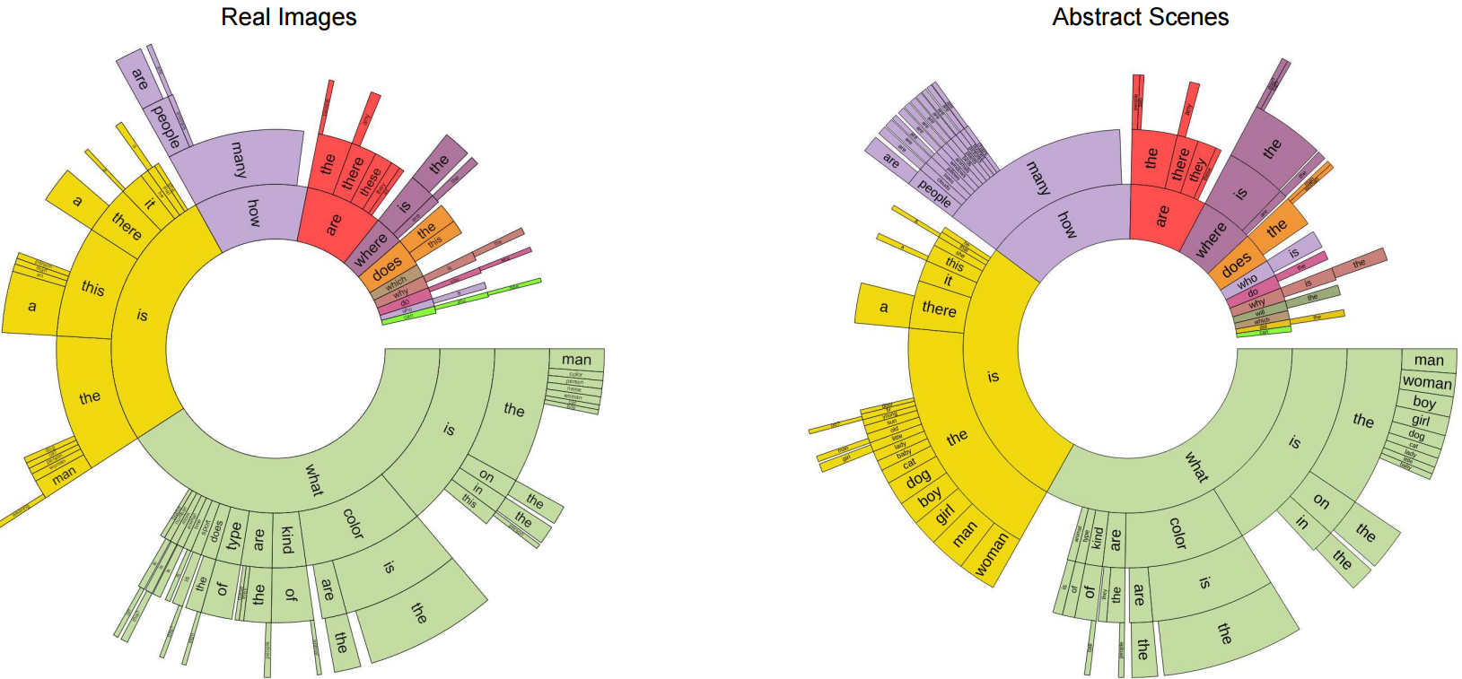
Dataset analysis- typical questions

Slide 38
Dataset analysis- questions lengths

Slide 39
Dataset analysis – typical answers
Answers length are mostly a single word
The distribution of answer with one word.
two and three words as follow:
89.32%,6.91% and 2.74% for real images
And 90.51% ,5.89% and 2.49% for abstract

Slide 40
Dataset analysis – ‘yes/no’/’number’
Many of the questions are answered with “yes”/”no” 38.37% and 40.66% of the questions on real image and abstract while there is a bias towards “yes” 58.83% for real and 55.86% in yes/no questions.
Questions type as “How many..” are answered using number 12.31% and 14.48% of the questions on real image and abstract while “2” is the most popular answer among number questions

Slide 41
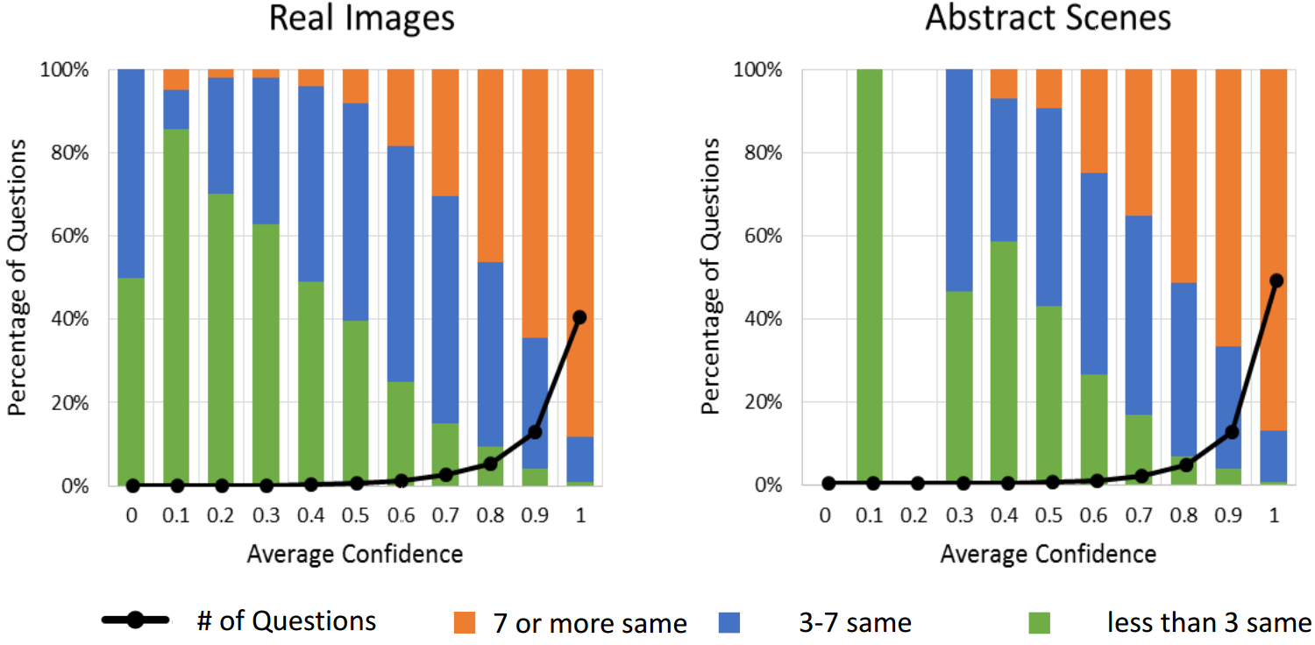
Dataset analysis- Subject Confidence & Agreement
Each answer the subject gave, he was asked to rank his confidence in his answer
The influence of person confidence in his answer and the human agreement upon their answers was checked
as expected the agreement
between subjects
increase with confidence

Slide 42
Dataset analysis - Commonsense Knowledge
Avoiding a question that is given, won’t be answered using only commonsense whether by looking at the image.
Asking each subject to answer the question without looking at the image.
From the table it is clear that the need of image is critical for VQA and information and commonsense are not enough

Slide 43
Dataset analysis- Captions
In order to emphases the importance of image for answering correctly a VQA , question and their answer using only a caption( description of the image) were tested.
The deeper image understanding is needed to answer question whether just normal description of an image.

Slide 44
Dataset analysis – dataset difficulty
Checking the difficulty of the dataset that provided.
First checking the results of randomly choosing an answer from the top 1K answers gets accuracy of 0.12%.
Unless picking always the word “yes” gets accuracy of 29.72%. While picking the most popular answer per question type provide 36.18 % accuracy and a nearest- neighbor provides 40.61%.
The results were tested also with LSTM model with softmax layer to generate answer.

Slide 45
Dataset analysis – dataset difficulty cont.
Questions: choosing the 1000 words in the questions as bag-of-words repressions
Caption: using the 1000 most popular words in the captions as bag-of-words
Image: using VGGNet last hidden layer as feature(4096-dim)
As expected multiple-choice gives
better results than open-answer
(all give worse results than human)

Slide 46
LSTM: Long-Short term memory
LTSM is an improved RNN with Long memory ability
LSTM answers a need of remembering information from a very long distance time spaces – problem of the vanishing gradients that RNN has
LSTM vs RNN – instead of just connecting the hidden layer to the next input we connect it to a LSTM unit which determine what to do with it a protect the error in the LSTM unit

Slide 47
LSTM: Long-Short term memory cont.
The sigmoid function squashed in time happens in backpropagation
Cell unit is used to Write , Read and save data( contains 3 gates)
Input – determine whether to use new input
Forget – determine Whether to forget the current data in the cell
Output – determine Whether let the output effect the NN itself

Slide 48
Results

Slide 49
Conclusions
Challenging a new task of VQA given an image and an open-ended natural language question about an image and provide an natural language answer.
Providing a variety of question and answers in dataset as well as the diverse set of AI capabilities in CV, NLP and commonsense reasoning required to answer these questions correctly.

