Slide 1
Hybrid Classiﬁers for Object Classiﬁcation
with a Rich Background
M. Osadchy, D. Keren, and B. Fadida-Specktor, ECCV 2012
ECCV paper (PDF)
Computer Vision and Video Analysis
An international workshop in honor of
Prof. Shmuel Peleg
The Hebrew University of Jerusalem
October 21, 2012

Slide 2
In a nutshell…
One-against-all classification.
Positive class = cars, negative class = all non-cars (= background).
SVM etc. requires samples from both classes (and one-class SVM is too simple to work here).
Hard to sample from the (huge) background.
Proposed solution:
Represent background by a distribution.
Construct a “hybrid” classifier, separating positive samples from background distribution.

Slide 3
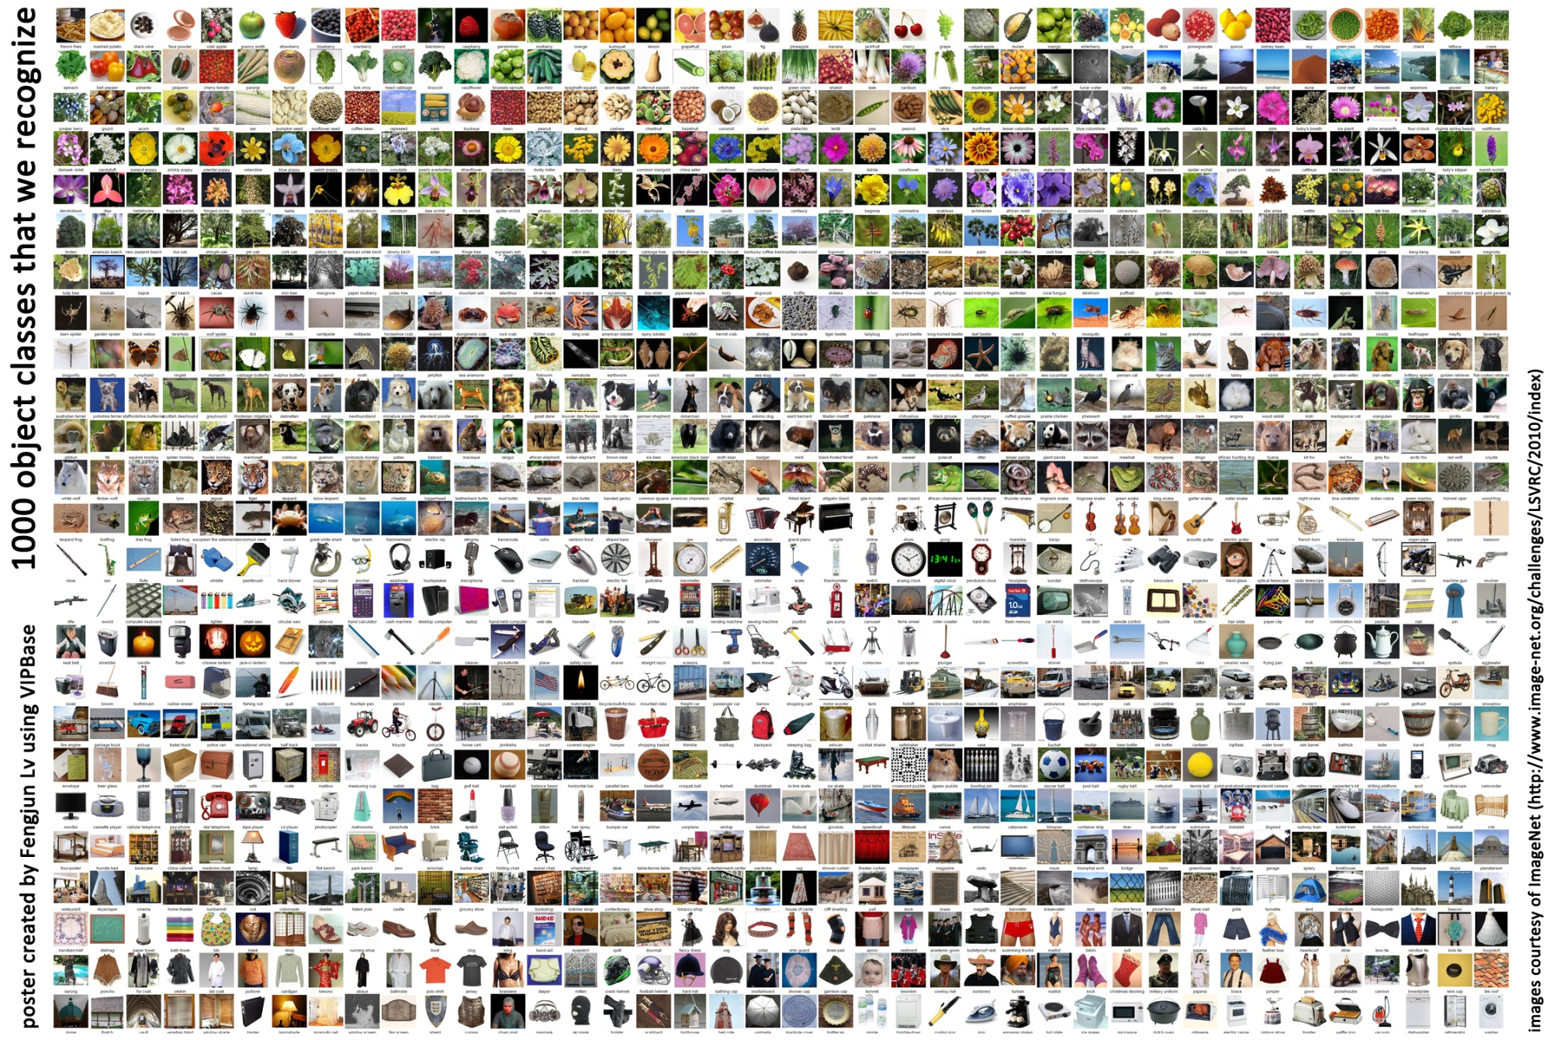
Classes Diversity in Natural Images

Slide 4
Previous Work
Cost sensitive methods (e.g. Weighted SVM).
Undersampling the majority class.
Oversampling the minority class.
…
Alas, these methods do not solve the complexity issue.
Linear SVM (Joachims, 2006)
PEGASOS (Shalev-Shwartz et al, 2007)
Kernel Matrix approximation (Keerthi et al ,2006; Joachims et al, 2009)
Special kernel forms: (Maji et al, 2008; Perronnin et al 2010)
Discriminative Decorrelation for Clustering and Classification (Hariharan et al, 2012).

Slide 5
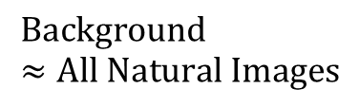
M. Osadchy & D. Keren (CVPR 2006)
Object class
Instead of minimizing the number of background samples: minimize the overall probability volume of the background prior in the acceptance region.
$$Background ≈All Natural Images$$
No negative samples!
Less constraints in the optimization
No negative SVs
Background is modeled just once, very useful if you want many one-against-all classifiers.

Slide 6
M.Osadchy & D. Keren (CVPR 2006) , cont.
“Hybrid SVM”: positive samples, negative prior.

Slide 7
M.Osadchy & D. Keren (CVPR 2006) , cont.
Problem formulation
“Boltzmann” prior: characterizes grey level features. Gaussian smoothness-based probability.
ONE constraint on the probability, instead of many constraints on negative samples.
Expression for the probability that
for a natural image x , vector w, and scalar b.

Slide 8
Contributions of Current Work
Work with SIFT.
Kernelize.
Kernel hybrid classifier, which is more efficient than kernel SVM, without compromising accuracy.

Slide 9
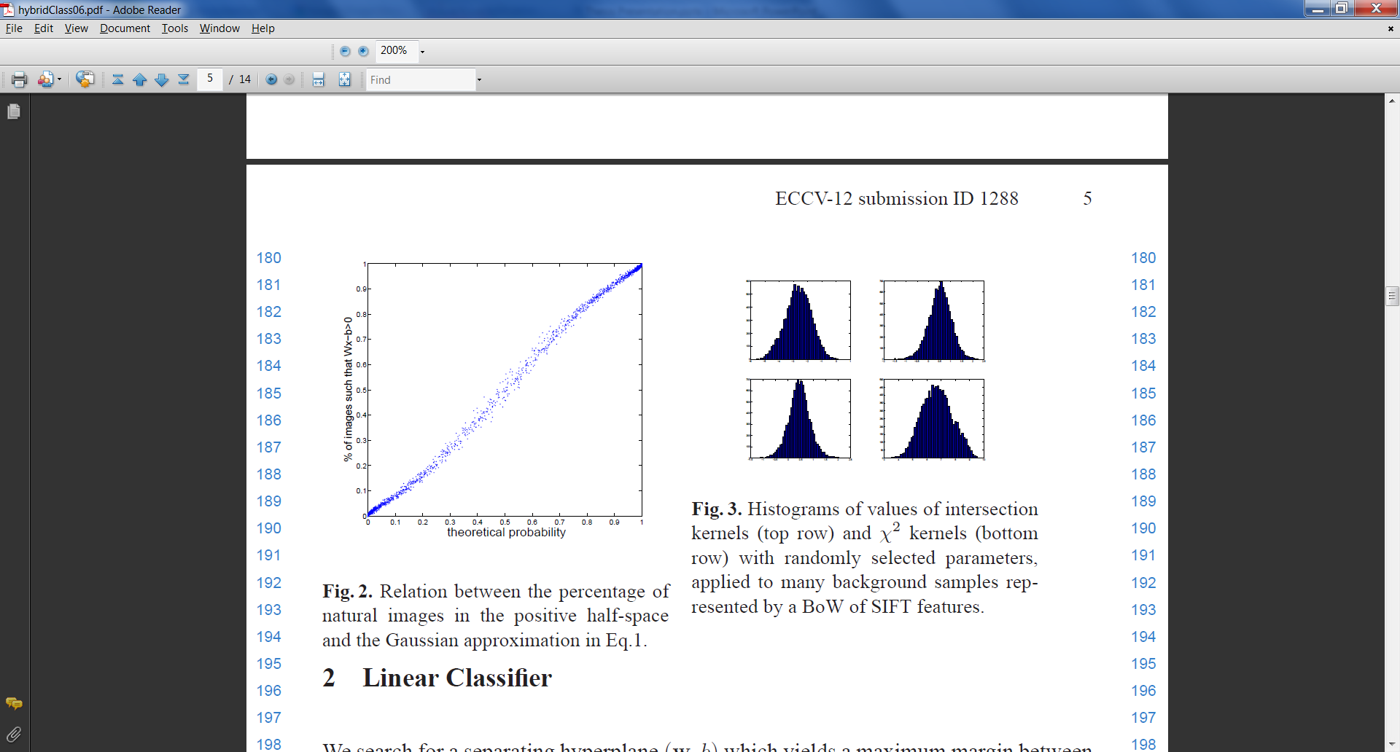
How do projections of natural images look like?
To separate the positive samples from the background, we must first model the background.
Problem – background distribution is known to be extremely complicated.
BUT – classification is done post-projection!
Under certain independence conditions, low dimensional projections of high-dimensional data are close to Gaussian.
Experiments show that SIFT BOW projections are Gaussian-like:
Histogram Intersection kernel of Sift Bow Projections

Slide 10
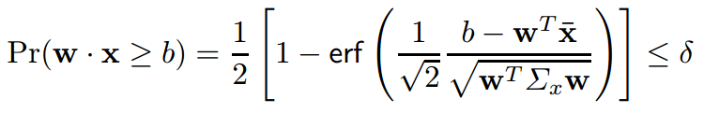
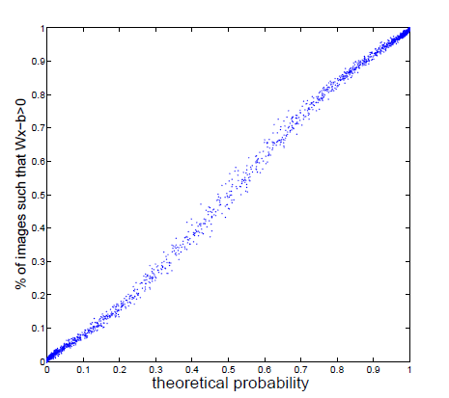

Linear Classifier - Probability Constraint
Using the Gaussian approximation, we obtain the following, for a natural image x, vector w, and scalar b:
Where $\overline{x}$ is the mean and $Σ_{x}$
the covariance matrix of
the background, and a small
constant.
constraint
shows a good correspondence with reality.

Slide 11
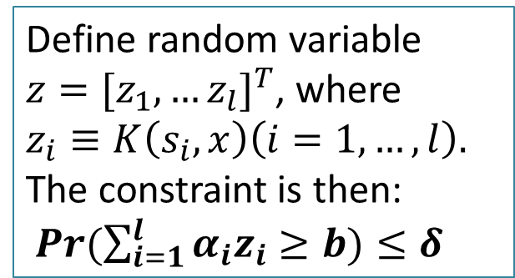
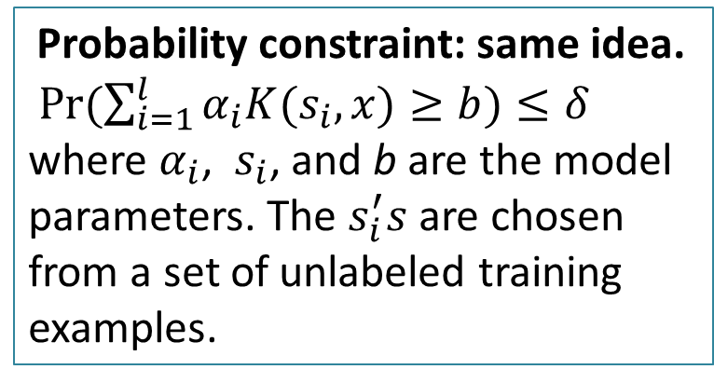
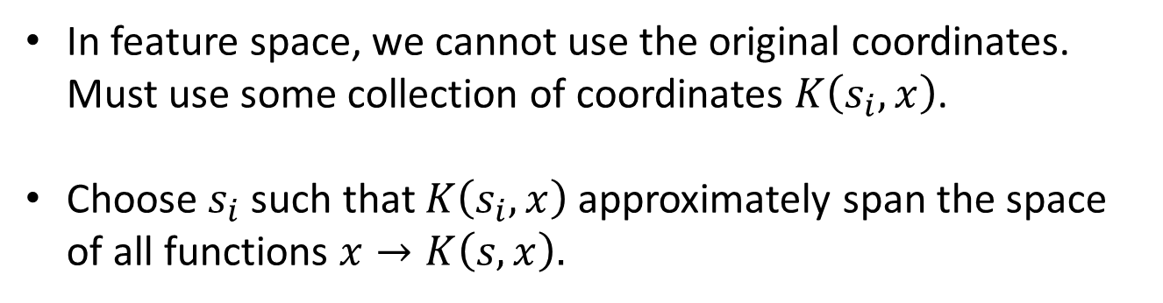
Hybrid Kernel Classifier
Probability constraint: same idea.
$Pr⁡(\sum_{i=1}^{l}{α_{i}K(s_{i},x)≥b)≤δ}$
where $α_{i}$, ${ s}_{i}$, and b are the model parameters. The $s_{i}^{′}s$ are chosen from a set of unlabeled training examples.
Define random variable $z={[z_{1},…z_{l}]}^{T}$, where $z_{i}≡K\left(s_{i},x\right)\left(i=1,…,l\right).$ The constraint is then:
$Pr⁡(\sum_{i=1}^{l}{α_{i}z_{i}≥b)≤δ}$
In feature space, we cannot use the original coordinates. Must use some collection of coordinates $K\left(s_{i},x\right)$.
Choose $s_{i}$ such that $K\left(s_{i},x\right)$ approximately span the space of all functions $x→K\left(s,x\right).$

Slide 12
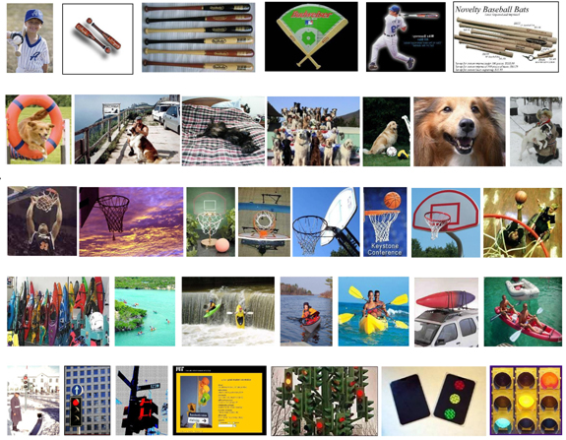
Experiments
Predict absence/presence of a specific class in the test image.
Caltech256 dataset
SIFT BoW with 1000 , SPM kernel.
Performance of linear and kernel Hybrid Classifiers was compared to linear and kernel SVMs and their weighted versions
30 positive samples, 1280 samples for Covariance matrix + mean estimation. In SVM: 7650 samples
EER for binary classification was computed with 25 samples from each class.

Slide 13
Results
 | SVM | Weighted SVM | Hybrid
Linear | 71% | 73.9% | 73.8%
Kernel | 83.4% | 83.6% | 84%
 | Weighted SVM | Hybrid
Number of kernel evaluations | 600-1000 | 230
Number of parameters in optimization | 7680 | 230
Number of constraints in optimization | 7680 | 31
Memory usage | 450M | 4.5M

