Slide 1
Feedback-directed Source 2 Source Optimization Tool Projects proposal
Dr. Gadi Haber

Slide 2
What is the proposed source 2 source optimizations area?
The proposed area does not come to serve as an alternative to the existing compilers
Instead, its focus is to provide an interactive interfacing with the developer while relying on profile information gathered on a typical execution
Such an interfacing opens up a new area for aggressive optimizations which affect program semantics and therefore, require user intervention

Slide 3
What type of optimizations will be applied?
Optimizations which require user knowledge in order to be aggressive
reuse of temporary computations
class/structure splitting
object Inlining
function specialization
feedback directed data reordering
feedback directed software caching
parallelization of frequently executed loops
feedback directed data allocation
and others..
Each optimization is a different project

Slide 4
How does it work?
Each optimization is accompanied by an appropriate GUI which:
displays the relevant source code area to be optimized such as:
frequently executed loops
frequently accessed fields of classes/structures
etc.
lists the optimization options and parameters to choose from
lists the criteria needed for applying the optimization:
“variable must not be modified outside the scope of the loop”
for the optimization of reusing temporary computations
“there should be no references to a field element outside the module”
for class splitting optimization
etc
transforms the code under user authorization
The optimized source code can be revisited by the user, i.e.:
the transformed code includes proper documentation
the user has the option to accept or reject the transformed code based on the provided criteria list

Slide 5
Can source 2 source optimizations help Java programs?
The optimizations in Java are performed at run-time by the JIT compiler
JIT works under severe constrains of producing low overhead at run-time
As a result, Java applications can benefit from aggressive optimizations which require heavy analysis at source level without affecting their portability
For Java applications this technology can also help users tune their applications by:
trying out various optimization combinations, e.g.:
check which unrolling factors work best for the program at hand
select different functions for inlining
applying iterative tuning tools which make use of automatic search algorithms to detect optimial set of options

Slide 6
C example of parallelizing a loop
Highlighted loop does not contain dependencies across iterations and has the potential to run in parallel

Slide 7
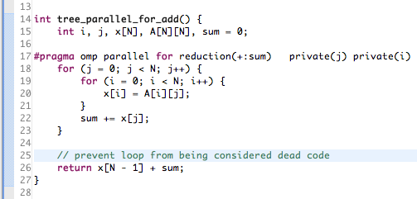
Parallelizable loop – recommended transformed code
Recommended parallelized loop version using the OPenMP pragma

Slide 8
Related work
Lawrence Livermore National Laboratory, a Department Of Energy (DOE) project ROSE - a source to source infrastructure for large-scale scientific applications
Berkley CCured - a source-to-source translator for C. Analyzes C programs to determine the smallest number of run-time checks that must be inserted in the program to prevent all memory safety violations.
Stanford Univeristy SUIF - an Infrastructure for Research on Parallelizing and Optimizing Compilers
Initial work on Eclipse JDT Code Advisor plugin user guide: http://jdt-comments.appspot.com/UserGuide.pdf
Initial work done on Eclipse CDT Code Advisor plugin https://sites.google.com/site/codeadvisorproject

