Slide 1
Computational Modeling of Cognitive Activity
Prof. Larry M. Manevitz
Course Slides: 2012

Slide 2
Aim of Course: To view some of the methods and results of Cognitive and Brain Modeling
What is it good for?
What does it replace?
Aim of Course: To understand how machine learning methods could help understand cognition and Brain Function

Slide 3
Some Cognitive Tasks
Memory
Declarative
Procedural
Associative
Decision Making
Pattern Identification
Language
Speech
Reading
…

Slide 4
What is the brain?
What is cognition?
We can think of brain activity as a computation.
Can we do “reverse engineering”?
Can we explain activity?
Many approaches
Physiological Explanations
Computational Explanations
Cognitive Explanations

Slide 5
Related Fields, Related Methods?
Neurophysiology
Cell Structure
System Biology
Cognitive Psychology
Psychophysical Experiments
Important Tools
fMRI
EEG
Others …

Slide 6
We have several tools from CS that can help us
Successfully model cognitive activity
Successfully explore activity in vivo (i.e. in a person…)

Slide 7
What tools are appropriate?

Slide 8
Basic Structure of Neural System
From work of Cajal (as opposed to Golgi), the neural system is separated into discrete cells.
So we need to understand at least
Computational aspect of separate cells
Computational aspect of network of cells

Slide 9
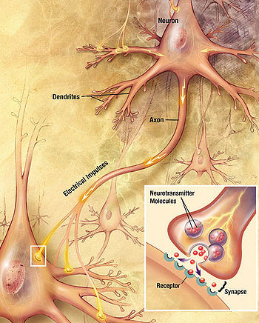
Let’s start with the simplest model.
The neural system is known to be cellular.
That means there is not continuous connections (like an electric wire) but discrete elements.

Slide 11
Examples of Neurons

Slide 13
Neuron Stains

Slide 15
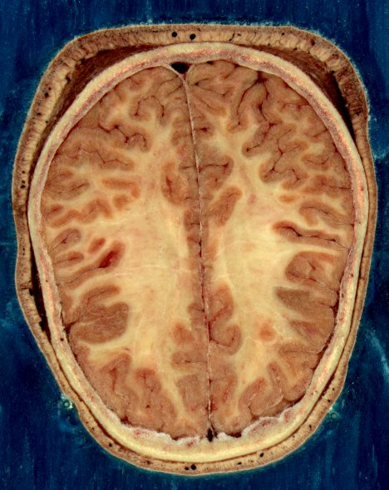

Slide 16
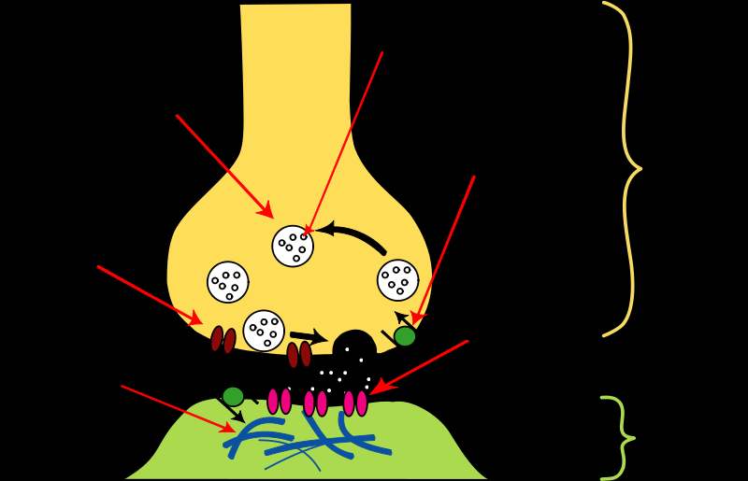
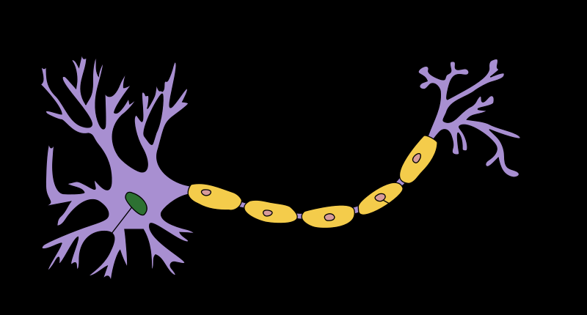

Slide 19
Let’s start in 1948. McCullough Pitts. Want to understand how the brain works.
Their view: all there is, is Boolean functions.
Note: Same view as logicians as old as Boole (1898)

Slide 20
Definitions and History
McCullough –Pitts Neuron
Perceptron
Adaline
Linear Separability
Multi-Level Neurons
Neurons with Loops

Slide 21
Natural versus Artificial Neuron
Natural Neuron McCullough Pitts Neuron

Slide 22
Sample Feed forward Network (No loops)
Weights
Output
Weights
Weights
Input
Wji
Vik
F(Σ wji xj

