Slide 1
Establishing the Existence of a Secondary Adult Human Declarative Memory System via Machine Learning on fMRI Data
Larry Manevitz
Neurocomputation Laboratory
Caesarea Rothschild Institute (CRI)
University of Haifa
Joint with:
Asaf Gilboa, Rotman Institute (U. Toronto), Hananel Hazan (U. Haifa), Ester Koilis (U. Haifa), Tali Sharon (U. Haifa)

Slide 2
Some Human Memory Types
Memory
Declarative
Episodic
Semantic
Non- declarative
Skills & Habits
Priming
Conditioning

Slide 3
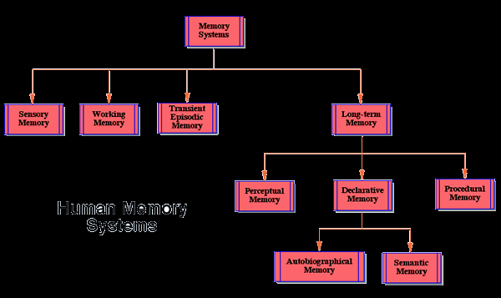
Human Memory Systems

Slide 4


Memory Types
Unconscious
procedures
Procedural
Memory
Declarative
Conscious recollection of facts and events

Slide 5
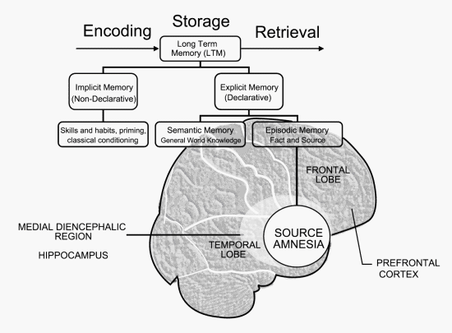
Human Memory Systems …

Slide 6
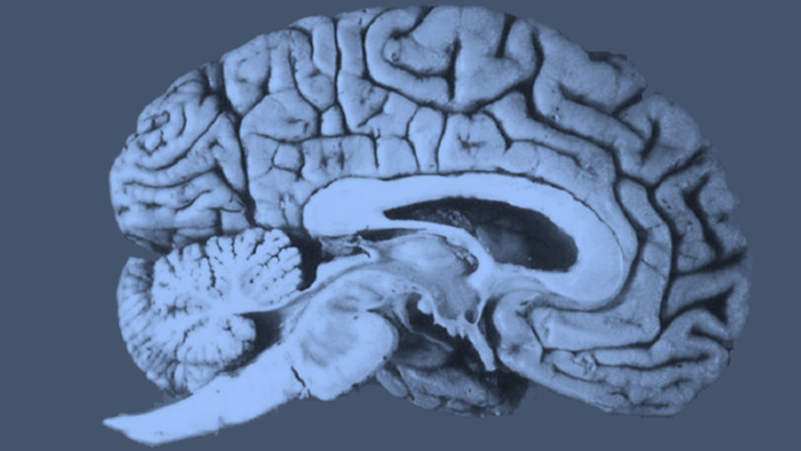
… and Brain Correlates?
Hippocampus
  Usually thought of as related to Declarative Memory
  “Standard Theory” of Memory Consolidation relates Hippocampus to Cortex

Slide 7
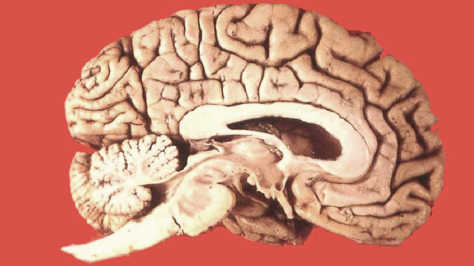

Slide 8
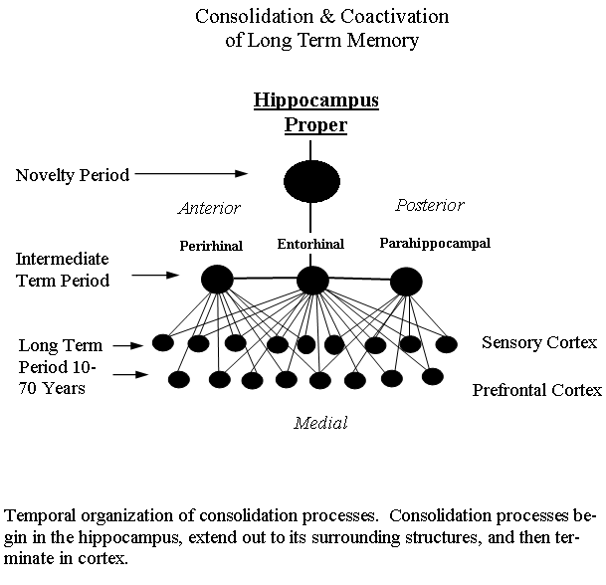
“Standard Theory of Consolidation
http://www.nature-nurture.org/wp-content/uploads/consolidationCoactivationLongTermMemorySmall.gif

Slide 9
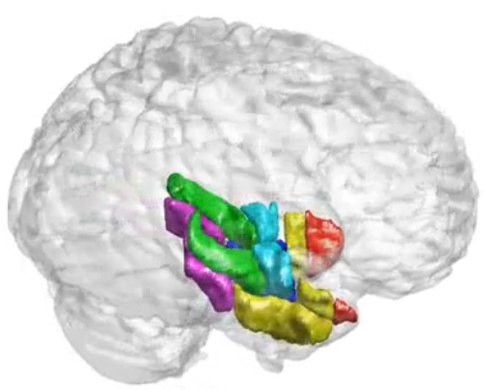
Declarative Memory Acquisition
EXPLICIT ENCODING
MTL
(including
hippocampus)
consolidation
It takes days to months
to consolidate new information
in the neurocortex
Neurocortex
(Long-Term Memory)

Slide 10
Explicit Encoding and Fast Mapping
Young children have an apparently additional declarative memory system. This way, they remember things after one exposure.
Not much was known about such an ability for adults
Motivation: TBI and Stroke patients with brain damage (e.g. on hippocampus) that limits ability to remember new things. (H.M. was the most famous example.) If secondary system exists, perhaps such patients are treatable using this bypass system.

Slide 11

Declarative Memory Acquisition
Mom: Look at this yellow
butterfly!
yellow
FAST MAPPING
Neurocortex
(Long-Term Memory)
What about adults?
Gilboa, Moscovitch, Sharon, 2011 – adults with hippocampal lesions are able
to learn new facts with Fast Mapping

Slide 12
Psycho-Physical Experiment
Performed by Gilboa and Sharon
Designed to force subjects to use one or the other system.
Done in fMRI, so brain scans available as subjects learned memory
Tested on success of retrieval afterwards

Slide 13
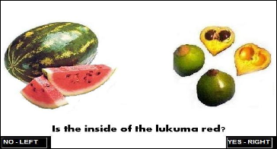
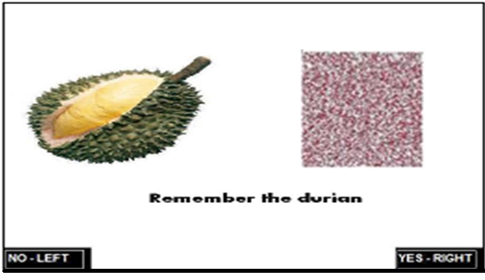
Psycho-Physical Experiment (Gilboa, Sharon,2010)
fMRI data of 24 healthy participants, 12 of them performing FM tasks, other performing EE tasks
  FM task – “Is the inside of the lukuma red?”
  EE task – “Remember the durion”
Post-recollection success test is performed

Slide 14




Experiment : Brain Decoding
3 different contrasts were defined:
Contrast 1.
Explicit Encoding Task - “recollection
success” vs. “recollection failure”
conditions.
Contrast 2.
Fast Mapping Task - “recollection
success” vs. “recollection failure”
conditions.
Contrast 3.
Fast Mapping vs. Explicit Encoding
Tasks

Slide 15
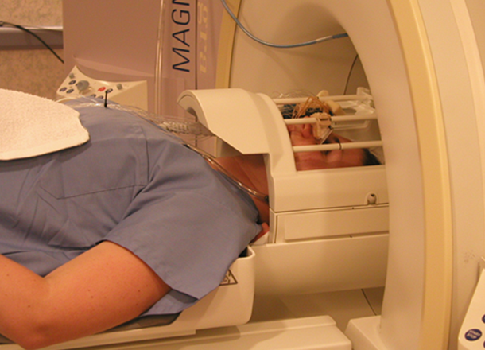


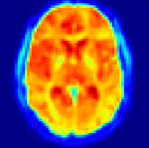
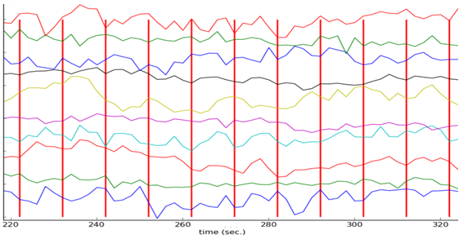
fMRI – functional Magnetic Resonance Imaging
fMRI Machine
A sequence of stimuli
Registered brain activity
(over time)
…
time
Blood Oxygen Level-Dependent (BOLD) signal (oxygen hemodynamic response) is a measurement of the brain activity
BOLD signal is recorded for each voxel inside the brain image
BOLD
v₁(t) Voxel 1
v₂(t) Voxel 2
.
.
.
v_{N}(t) Voxel N

Slide 16
fMRI – functional Magnetic Resonance Imaging
fMRI Machine
A sequence of stimuli
Registered brain activity
(over time)
…
time
Blood Oxygen Level-Dependent (BOLD) signal (oxygen hemodynamic response) is a measurement of the brain activity
BOLD signal is recorded for each voxel inside the brain image
BOLD
v₁(t) Voxel 1
v₂(t) Voxel 2
.
.
.
v_{N}(t) Voxel N

Slide 17
Machine Learning
Classifying cognitive activity via ML from brain scan data has had success in recent years –
  Cox and Savoy, …
  Mitchell, Just et al, …
  Hardoon, Manevitz et al, …
  Mourao-Miranda et al, …
  Many others
However, in this case we have a rather complex cognitive task; involving recognition and memory storage, type of memory system

Slide 18
Classification Questions (to be answered by ML from Brain Scans)
Can we tell in the case of EE experiment (from the scan at the time of exposure to memory), whether the subject will remember or not?
Can we tell in the case of FM experiment (from the scan at the time of exposure to memory) whether the subject will remember or not?
Given a scan where the subject successfully recalled, can we tell if it was EE or FM?

Slide 19
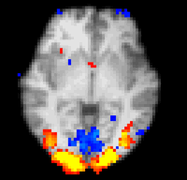
Analysis of fMRI Data
Brain decoding
  Prediction of the cognitive state given the brain activity
Brain mapping
  Highlighting areas of brain maximally related to some specific cognitive or perceptual task
time
predict
time
generate
+

Slide 20
Machine Learning - Classification
ML Classifier – stimulus prediction according to the brain image
High classification accuracy is an indicator of information existence inside the data
Predicted
Sample
Classifier
Sample 1
Sample 2
Classifier
…
Sample n
Classifier

Slide 21

Classification Methods
Multivariate classification, based on linear Support Vector Machine classifier:
Classification accuracy as a measurement for the amount of relevant information
Predicted
class
label
Given
class
label
Classifier
EE
FM
n=517000

Slide 22
Machine Learning - Classification
ML Classifier – stimulus prediction according to the brain image
High classification accuracy is an indicator of information existence inside the data
Predicted
Sample
Classifier
Sample 1
Sample 2
Classifier
…
Sample n
Classifier

Slide 23
Classification Methods
Multivariate classification, based on linear Support Vector Machine classifier:
Classification accuracy as a measurement for the amount of relevant information
Predicted
class
label
Given
class
label
Classifier
EE
FM
n=517000

Slide 24

Feature Selection
Dimensionality reduction –the most important features participate in the classification process
1000 top features were selected for all contrasts
Feature Selector

Slide 25
Feature Selection
(1)
Three methods were explored:
  Activity – the most active voxels are selected
  Accuracy – voxels producing the most accurate predictions when used for classification
  SVM-RFE (recursive-feature-elimination)
Classifier
Predicted
class
label
v_{i}
Prediction
accuracy?
EE
FM

Slide 26
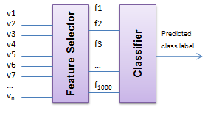
Final Architecture
Multivariate classification, based on linear Support Vector Machine classifier, with feature selection:
EE
FM

Slide 27
Classification Accuracy – Contrast 1 EE
Analysis Type | Feature Selection Method | Prediction Accuracy | SD
Within-Subject | Accuracy | 0.66 | 0.044
 | Activity | 0.68 | 0.040
 | SVM-RFE | 0.78 | 0.0237
Cross-Subject | Accuracy | 0.61 | 0.0496
 | Activity | 0.60 | 0.0452
 | SVM-RFE | 0.73 | 0.0619

Slide 28
Classification Accuracy – Contrast 2 FM
Analysis Type | Ranking Metric | Prediction Accuracy | SD
Within-Subject | Accuracy | 0.73 | 0.0504
 | Activity | 0.71 | 0.0393
 | SVM-RFE | 0.81 | 0.0390
Cross-Subject | Accuracy | 0.66 | 0.0609
 | Activity | 0.65 | 0.0368
 | SVM-RFE | 0.76 | 0.0307

Slide 29
Classification Accuracy – Contrast 3 FM vs. EE
Ranking Metric | Prediction Accuracy | SD
Accuracy | 0.80 | 0.0364
Activity | 0.60 | 0.0324
SVM-RFE | 0.89 | 0.0564

Slide 30
Classification Questions (to be answered by ML from Brain Scans)
Can we tell in the case of EE experiment (from the scan at the time of exposure to memory), whether the subject will remember or not?
Can we tell in the case of FM experiment (from the scan at the time of exposure to memory) whether the subject will remember or not?
Given a scan where the subject successfully recalled, can we tell if it was EE or FM?

Slide 31
Brain Mapping
Find the important areas for each of EE and FM
Find the important areas that distinguish between EE and FM

Slide 32
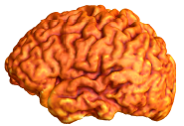
Experiment 2: Brain Mapping
Aim: to highlight the areas relevant for the required contrast, Contrast 1 FM or Contrast 2 EE
Method: “searchlight” algorithm (Kriegeskorte, 2006)
r=4

Slide 33
Experiment 2: Brain Mapping
Experiment 2: Brain Mapping
Aim: to highlight the areas relevant for the required contrast, Contrast 1 FM or Contrast 2 EE
Method: “searchlight” algorithm (Kriegeskorte, 2006)
r=4

Slide 34
“Searchlight” Method
Training classifiers on many small voxel sets which, put together, include the entire brain
The search area includes voxel’s spherical neighborhood in radius r (r=4 voxels in this study)
SVM (Support Vector Machines) was used as the underlying classifier
The accuracies of a classifier are used for highlighting the map voxels
Search done separately for EE and FM

Slide 35
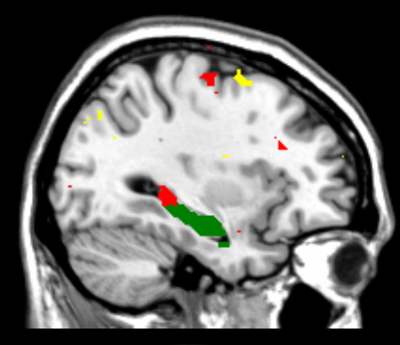

Anecdotal Slide – one individual
Larry: WOW!!
EE
FM
Hippocampus

Slide 36
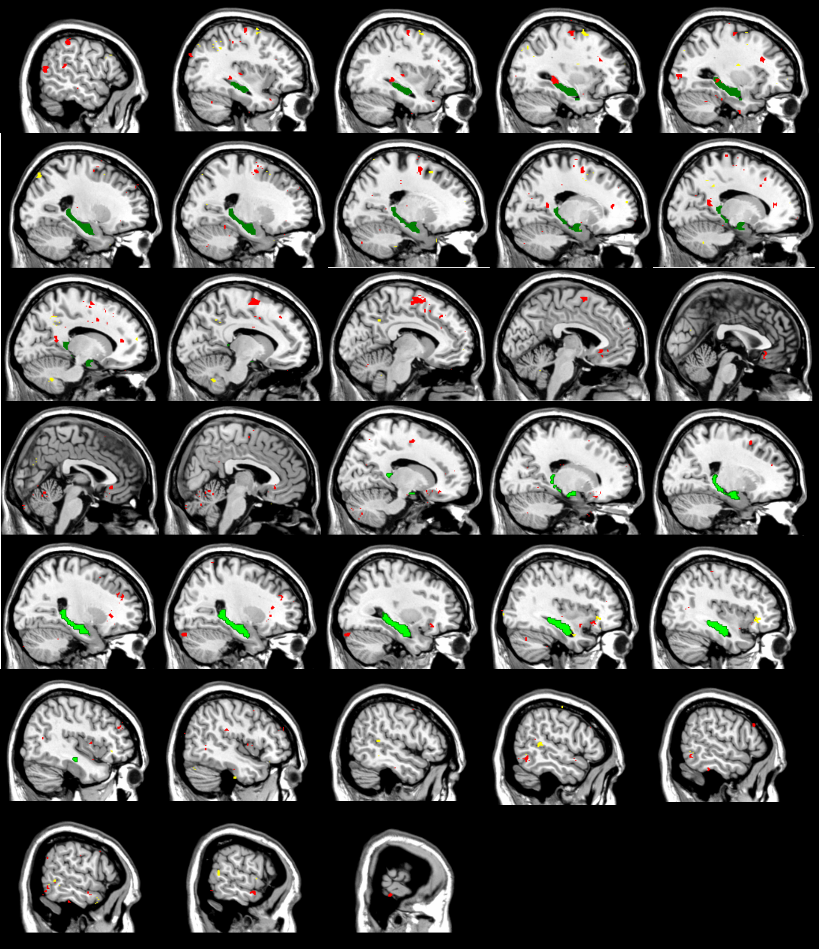
One individual

Slide 37
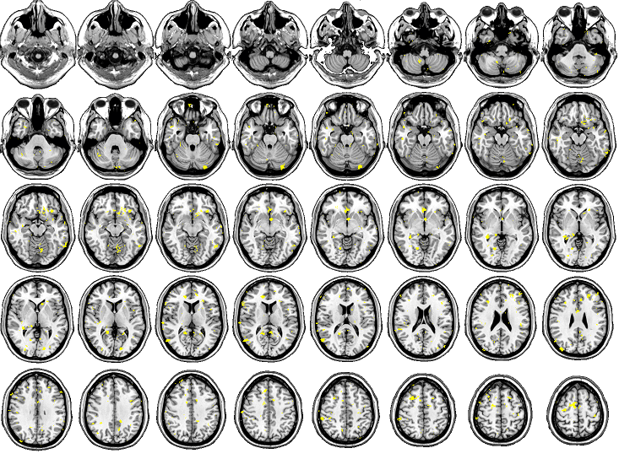
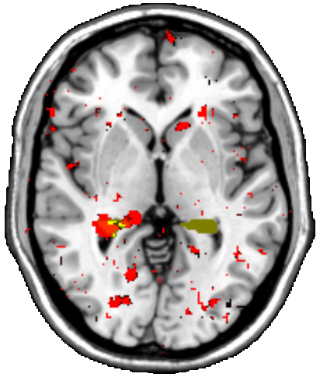
Results – All Subjects EE
Hippocampus

Slide 38
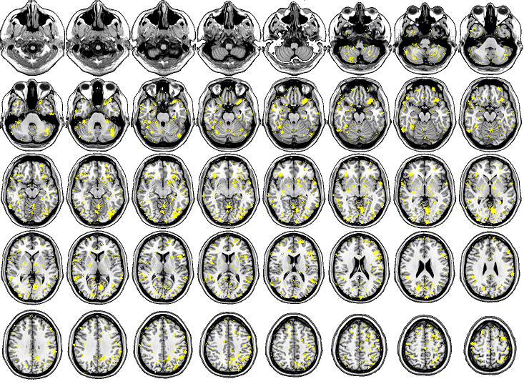
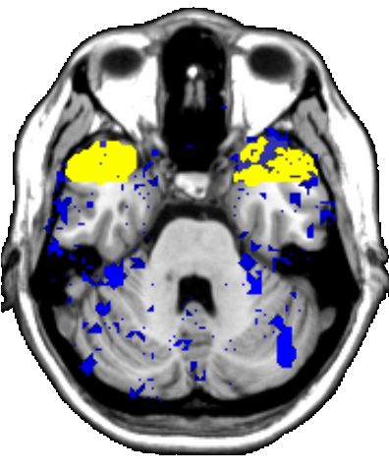
Results – All Subjects FM
Temporal Pole

Slide 39
Brain Mapping
Chose Best “contrast” predictors
  Used “searchlight algorithm”
  Took …. Best voxels based on classification ability

Slide 40
Experiment 2: Brain Mapping
Aim: to highlight the areas relevant for the required contrast, Contrast 1 FM or Contrast 2 EE
Method: “searchlight” algorithm (Kriegeskorte, 2006)
r=4

Slide 41
“Searchlight” Method
Training classifiers on many small voxel sets which, put together, include the entire brain
The search area includes voxel’s spherical neighborhood in radius r (r=4 in this study)
SVM (Support Vector Machines) was used as the underlying classifier
The accuracies of a classifier are used for highlighting the map voxels

Slide 42
Hippocampus vs. Temporal Pole
In this experiment, the classification was based on different brain areas
EE FM
Area | Prediction Accuracy
 | Within-Subject | Cross-Subject
All | 0.778 | 0.732
Hippocampus Only | 0.733 | 0.697
Temporal Pole Only | 0.701 | 0.663
All w/o Hippo. | 0.777 | 0.735
All w/o TP | 0.777 | 0.734
Putamen Only | 0.579 | 0.592
Area | Prediction Accuracy
 | Within-Subject | Cross-Subject
All | 0.807 | 0.761
Hippocampus Only | 0.723 | 0.686
Temporal Pole Only | 0.756 | 0.713
All w/o Hippocampus | 0.807 | 0.765
All w/o Temporal Pole | 0.808 | 0.760
Putamen Only | 0.567 | 0.557

Slide 43
Reverse pattern of FM and EE
The same pattern of activity was detected in patients

Slide 44
Reverse pattern of FM and EE
The same pattern of activity was detected in patients

Slide 45
Conclusions
Using the multivariate methods for feature selection and classification purposes brought substantial increase to the classification performance
Two different memory acquisition mechanism, FM and EE, were explored
Fast Mapping network includes regions positioned more lateral in the temporal neocortex, and specifically in polar area, as opposed to medial temporal regions critical for the explicit encoding memory system

Slide 46
Summary
One can tell from brain scans whether a subject is successfully storing a memory with EE declarative system
One can tell from brain scans whether a subject is successfully storing a memory with FM declarative system
Using a “searchlight” algorithm based on classification, one sees different parts of the brain as crucial for one method or the other
Thus we have physical corroboration of two declarative memory systems
  Hopefully this system can be trained and used by therapists for individuals with damaged MTL EE systems

Slide 47

My Collaborators
Psychologists
  Asaf Gilboa, Rotman Institute, Toronto
  Tali Sharon, U. Haifa (Asaf’s Student)
Computer Scientists (My students)
  Hananel Hazan
  Ester Koilis (Ran most of the experiments)
      Thanks to Caesarea Research Institute

Slide 48
SECOND TALK FOLLOWS

Slide 49




Learning BOLD Response in fMRI by Reservoir Computing
Paolo Avesani¹², Hananel Hazan³, Ester Koilis³,
Larry Manevitz³, and Diego Sona¹²
1 NeuroInformatics Laboratory (NILab), Fondazione Bruno Kessler, Trento, Italy
2 Interdipartimental Mind/Brain Center (CIMeC), Università di Trento, Italy
3 Department of Computer Science, University of Haifa, Israel

Slide 50
fMRI – functional Magnetic Resonance Imaging
fMRI Machine
A sequence of stimuli
Registered brain activity
(over time)
…
time
Blood Oxygen Level-Dependent (BOLD) signal (oxygen hemodynamic response) is a measurement of the brain activity
BOLD signal is recorded for each voxel inside the brain image
BOLD
v₁(t) Voxel 1
v₂(t) Voxel 2
.
.
.
v_{N}(t) Voxel N

Slide 51
Analysis of fMRI Data – Brain Mapping
Highlighting areas of brain maximally relevant for a given cognitive or perceptual task
Brain Map
BOLD
v₁(t) Voxel 1
v₂(t) Voxel 2
.
.
.
v_{N}(t) Voxel N
Relevant voxels are highlighted

Slide 52


GLM (General Linear Model) Method
BOLD signal is reconstructed as a linear combination of input stimuli convolved with the expected ideal BOLD hemodynamic function (obtained theoretically).
⊗
Predicted BOLD
signal
Stimuli
sequence
Expected
ideal
BOLD
Predictor
Convolved
stimuli
sequence
⊗
GLM

Slide 53
Brain Mapping – GLM Method
Predicted BOLD
Brain Map
Compare
Relevant
voxels
Original BOLD
Good prediction accuracy indicates the relevance of the voxel for a given perceptual/cognitive task

Slide 54
GLM Approach Drawbacks
Prior assumption is made on the expected ideal BOLD hemodynamic response
  The ideal BOLD haemodynamics may vary for different reasons
May lead to incorrect brain maps!!!
⊗
Expected Response
Real Responses

Slide 55
The Schema
A predictor is trained to produce the BOLD voxel-wise given the sequence of stimuli based on a real training data
Training data set
A
B
A
B
B
A
train
time
Predictor

Slide 56
The Schema
?
Testing data set
Predicted BOLD
B
A
A
B
B
predict
Brain Map
Predictor
Compare
Relevant
voxels
Original BOLD
A predictor is trained to produce the BOLD voxel-wise given the sequence of stimuli based on a real data
Good prediction accuracy indicates the relevance of the voxel for a given perceptual/cognitive task

Slide 57
Generating BOLD signal
Each voxel activity is described by an unknown function encoding the dependency of voxel from the entire stimuli sequence
This process may be defined as:
where h and g_{i} are the transition and the output functions parameterized on Λ and Θ_{i}
the internal state
the voxel behavior

Slide 58
Reservoir Computing Model
Computational paradigm based on the recurrent networks of spiking neurons
  The recurrent nature of the connections project the time-varying stimuli into a reverberating pattern of activations, which is then read out by any learner (decoder) to generate the required BOLD signal
Implementation details:
  A Reservoir – an LSM network based on LIF neurons with fixed weights
  Decoders – voxel-wise MLP trained with the resilient back-propagation algorithm
h_{Λ}
g_{Θi}
S(t)
X(t)
Input
Voxel-wise
decoders
Reservoir

Slide 59
Experimental Material
Synthetic datasets
  Generated with a standard hemodynamic Balloon model plus autoregressive white noise + some parameters adjustments
  Both voxels related and not related to the stimuli were generated
3 different experiment designs:
  Block, Event-Related, Fast Event-Related
a. Block design
c. Fast event related
0
sec
b. Slow event related
0
sec
0
sec

Slide 60
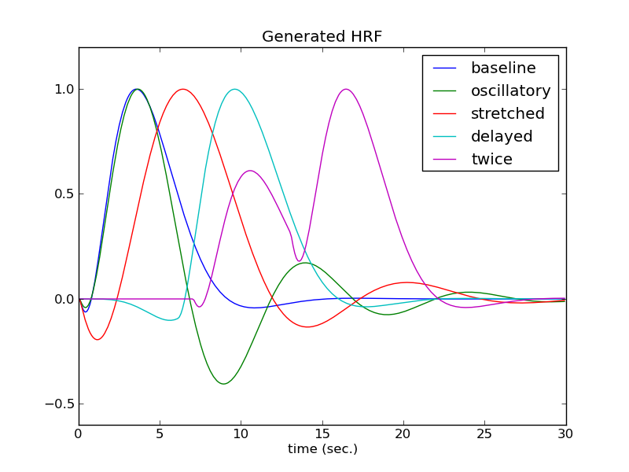
Experimental Material
5 different HRF shapes:
  Baseline
  Oscillatory
  Stretched
  Delayed
  Twice

Slide 61
Experimental Material
Real datasets
  Datasets collected on a real healthy subject performing a known cognitive task (faces vs. scrambled faces).
  A standard GLM approach was used to evaluate the relevance of the selected voxels to a given task
Evaluation
  4-fold cross-validation for each voxel
  The prediction accuracy measured as a Pearson correlation between the original and the reproduced BOLD signals averaged over all 4 folds
  RMSD values are calculated

Slide 62
Synthetic Datasets - Results
Event Related Design
Metrics | Voxels Related to Stimuli | Noise Level (σ)
 |  | σ = 0.1 | σ = 0.2 | σ = 0.3 | σ = 0.4 | σ = 0.5
r (SD) | Yes | 0.707 (0.042) | 0.533 (0.043) | 0.468 (0.057) | 0.350 (0.055) | 0.292 (0.044)
 | No | 0.072 (0.046) | 0.082 (0.051) | 0.078 (0.038) | 0.064 (0.048) | 0.085 (0.058)
RMSD(SD) | Yes | 0.641 (0.091) | 0.964 (0.073) | 1.001 (0.064) | 1.030 (0.063) | 1.139 (0.037)
 | No | 1.413 (0.060) | 1.374 (0.055) | 1.389 (0.041) | 1.438 (0.043) | 1.388 (0.051)

Slide 63
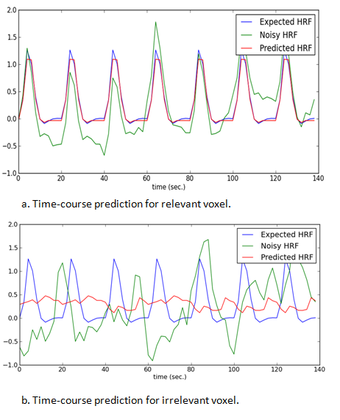
Synthetic Datasets - Results
Event Related Design

Slide 64
Synthetic Datasets - Results
Fast Event Related Design
Block Design
Metrics | Voxels Related to Stimuli | Noise Level (σ)
 |  | σ = 0.1 | σ = 0.2 | σ = 0.3 | σ = 0.4 | σ = 0.5
r (SD) | Yes | 0.423 (0.065) | 0.288 (0.076) | 0.277 (0.062) | 0.208 (0.055) | 0.170 (0.042)
 | No | 0.085 (0.032) | 0.078 (0.018) | 0.076 (0.026) | 0.113 (0.041) | 0.119 (0.049)
Metrics | Voxels Related to Stimuli | Noise Level (σ)
 |  | σ = 0.1 | σ = 0.2 | σ = 0.3 | σ = 0.4 | σ = 0.5
r (SD) | Yes | 0.724 (0.043) | 0.643 (0.046) | 0.599 (0.065) | 0.405 (0.054) | 0.377 (0.050)
 | No | 0.045 (0.017) | 0.090 (0.041) | 0.062 (0.040) | 0.066 (0.031) | 0.057 (0.034)

Slide 65
Synthetic Datasets (HRF Variation) - Results
Metric | HRF Type
 | Baseline | Oscillatory | Stretched | Delayed | Two Picks
r_{min} - r_{max} | 0.838-0.949 | 0.810 – 0.927 | 0.850 – 0.967 | 0.799 – 0.959 | 0.779 – 0.961
For all tested HRF functions, for all noise levels, the correlation values between the original and the reproduced signals are above 0.75, all signals are reconstructed properly
For dataset including voxels unrelated to the stimuli, average correlation value of 0.014 was obtained

Slide 66
Real Datasets - Results
Design | Voxels Related to Stimuli | r | SD
Block | Yes | 0.568 | 0.062
 | No | 0.094 | 0.044
Event Related | Yes | 0.348 | 0.053
 | No | 0.056 | 0.042
Fast Event Related | Yes | 0.278 | 0.041
 | No | 0.102 | 0.040

Slide 67
Real Datasets - Results
Relevant voxel
Block
LSM
Predicted
Real
Real
Irrelevant voxel
Block
Predicted
Real

Slide 68
Summary
Dataset Type | Protocol | Accuracy by Voxel Type
 |  | Related to Stimuli | Unrelated to Stimuli | Both Related & Unrelated to Stimuli
Synthetic Datasets | Block | 100% | 100% | 100%
 | Slow ER | 100% | 100% | 100%
 | Fast ER | 100% | 100% | 100%
 | Oscillatory HRF | 100% | 100% | 100%
 | Stretched HRF | 100% | 100% | 100%
 | Delayed HRF | 100% | 100% | 100%
 | Twice-Pick HRF | 100% | 100% | 100%
 | Total Synthetic | 100% | 100% | 100%
Real Datasets | Block | 100% | 92% | 96%
 | Slow ER | 96% | 99% | 98%
 | Fast ER | 86% | 88% | 87%
 | Total Real | 93% | 94% | 94%
All | Total for All Sets | 96.5% | 97% | 97%
Percentage of correctly identified voxels based on calculated correlation values (r>0.15 – voxels related to the stimuli, otherwise – not related to the stimuli)

Slide 69
Next Steps
Improve the analysis techniques for super fast event related design by introducing the reservoir computer training phase
Include the entire brain into the analysis
Use reservoir computing for tracing signal history length

Slide 70

Identifying Human Memory Encoding Mechanisms from Physiological fMRI data via Machine Learning Techniques
Asaf Gilboa¹², Hananel Hazan³, Ester Koilis³,
Larry Manevitz³, and Tali Sharon²
_{1 Rotman Research Institute,} _{Toronto, Canada}
2 Department of Psychology, University of Haifa, Israel
3 Department of Computer Science, University of Haifa, Israel

Slide 71
fMRI – functional Magnetic Resonance Imaging
fMRI Machine
A sequence of stimuli
Registered brain activity
(over time)
…
time
Blood Oxygen Level-Dependent (BOLD) signal (oxygen hemodynamic response) is a measurement of the brain activity
BOLD signal is recorded for each voxel inside the brain image
BOLD
v₁(t) Voxel 1
v₂(t) Voxel 2
.
.
.
v_{N}(t) Voxel N

Slide 72
Analysis of fMRI Data
Brain decoding
  Prediction of the cognitive state given the brain activity
Brain mapping
  Highlighting areas of brain maximally related to some specific cognitive or perceptual task
time
predict
time
generate
+

Slide 73

Areas of Research
Processing of senses: vision, hearing, perception
Physiology of cognitive functions: memory, decision making, induction/deduction, categorization
Higher cognitive processes: executive attention, meta-information processing

Slide 74
Declarative Memory Acquisition
EXPLICIT ENCODING
MTL
(including
hippocampus)
consolidation
It takes days to months
to consolidate new information
in the neurocortex
Neurocortex
(Long-Term Memory)

Slide 75
Declarative Memory Acquisition
Mom: Look at this yellow
butterfly!
yellow
FAST MAPPING
Neurocortex
(Long-Term Memory)
What about adults?
Tali Sharon, 2010 – adults with hippocampal lesions are able
to learn new facts with Fast Mapping

Slide 76
Declarative Memory Acquisition (Sharon,2010) – Fast Mapping

Slide 77
Current Study
Explore the neural correlates related to the FM (Fast Mapping) mechanism
Compare the neurophysiological (fMRI) data collected from healthy adults performing FM (Fast Mapping) and EE (Explicit Encoding) tasks:
  Is FM a complimentary mechanism for EE?
  Does FM exist in healthy individuals?

Slide 78
Current Study – Materials (Sharon,2010)
fMRI data of 24 healthy participants, 12 of them performing FM tasks, other performing EE tasks
  FM task – “Is the inside of the lukuma red?”
  EE task – “Remember the durion”
Post-recollection success test is performed

Slide 79
Experiment 1: Brain Decoding
3 different contrasts were defined:
Contrast 1.
Explicit Encoding Task - “recollection
success” vs. “recollection failure”
conditions.
Contrast 2.
Fast Mapping Task - “recollection
success” vs. “recollection failure”
conditions.
Contrast 3.
Fast Mapping vs. Explicit Encoding
Tasks

Slide 80
Machine Learning - Classification
ML Classifier – stimulus prediction according to the brain image
High classification accuracy is an indicator of information existence inside the data
Predicted
Sample
Classifier
Sample 1
Sample 2
Classifier
…
Sample n
Classifier

Slide 81
Classification Methods
Multivariate classification, based on linear Support Vector Machine classifier:
Classification accuracy as a measurement for the amount of relevant information
Predicted
class
label
Given
class
label
Classifier
EE
FM
n=517000

Slide 82
Feature Selection
Dimensionality reduction –the most important features participate in the classification process
1000 top features were selected for all contrasts
Feature Selector

Slide 83
Feature Selection
(1)
Three methods were explored:
  Activity – the most active voxels are selected
  Accuracy – voxels producing the most accurate predictions when used for classification
  SVM-RFE (recursive-feature-elimination)
Classifier
Predicted
class
label
v_{i}
Prediction
accuracy?
FM
EE

Slide 84
Final Architecture
Multivariate classification, based on linear Support Vector Machine classifier, with feature selection:
FM
EE

Slide 85
Classification Accuracy – Contrast 1 EE
Analysis Type | Feature Selection Method | Prediction Accuracy | SD
Within-Subject | Accuracy | 0.66 | 0.044
 | Activity | 0.68 | 0.040
 | SVM-RFE | 0.78 | 0.0237
Cross-Subject | Accuracy | 0.61 | 0.0496
 | Activity | 0.60 | 0.0452
 | SVM-RFE | 0.73 | 0.0619

Slide 86
Classification Accuracy – Contrast 2 FM
Analysis Type | Ranking Metric | Prediction Accuracy | SD
Within-Subject | Accuracy | 0.73 | 0.0504
 | Activity | 0.71 | 0.0393
 | SVM-RFE | 0.81 | 0.0390
Cross-Subject | Accuracy | 0.66 | 0.0609
 | Activity | 0.65 | 0.0368
 | SVM-RFE | 0.76 | 0.0307

Slide 87
Classification Accuracy – Contrast 3 FM vs. EE
Ranking Metric | Prediction Accuracy | SD
Accuracy | 0.80 | 0.0364
Activity | 0.60 | 0.0324
SVM-RFE | 0.89 | 0.0564

Slide 88
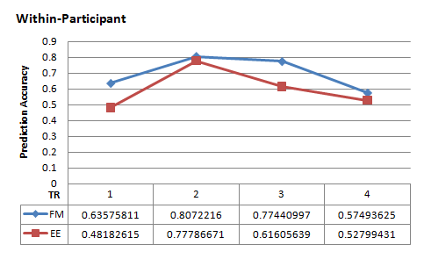
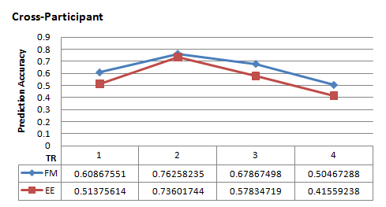
Prediction accuracy as a function of time

Slide 89
Experiment 2: Brain Mapping
Aim: to highlight the areas relevant for the required contrast, Contrast 1 FM or Contrast 2 EE
Method: “searchlight” algorithm (Kriegeskorte, 2006)
r=4

Slide 90
“Searchlight” Method
Training classifiers on many small voxel sets which, put together, include the entire brain
The search area includes voxel’s spherical neighborhood in radius r (r=4 in this study)
SVM (Support Vector Machines) was used as the underlying classifier
The accuracies of a classifier are used for highlighting the map voxels

Slide 91
Results – Contrast 1 EE
Hippocampus

Slide 92
Results – Contrast 2 FM
Temporal Pole

Slide 93
Experiment 3: Hippocampus vs. TP
In this experiment, the classification was based on different brain areas
EE FM
Area | Prediction Accuracy
 | Within-Subject | Cross-Subject
All | 0.778 | 0.732
Hippocampus Only | 0.733 | 0.697
Temporal Pole Only | 0.701 | 0.663
All w/o Hippo. | 0.777 | 0.735
All w/o TP | 0.777 | 0.734
Putamen Only | 0.579 | 0.592
Area | Prediction Accuracy
 | Within-Subject | Cross-Subject
All | 0.807 | 0.761
Hippocampus Only | 0.723 | 0.686
Temporal Pole Only | 0.756 | 0.713
All w/o Hippocampus | 0.807 | 0.765
All w/o Temporal Pole | 0.808 | 0.760
Putamen Only | 0.567 | 0.557

Slide 94
Reverse pattern of FM and EE
The same pattern of activity was detected in patients

Slide 95
Conclusions
Using the multivariate methods for feature selection and classification purposes brought substantial increase to the classification performance
Two different memory acquisition mechanism, FM and EE, are explored
Fast Mapping network includes regions positioned more lateral in the temporal neocortex, and specifically in polar area, as opposed to medial temporal regions critical for episodic memory

